Slide 1
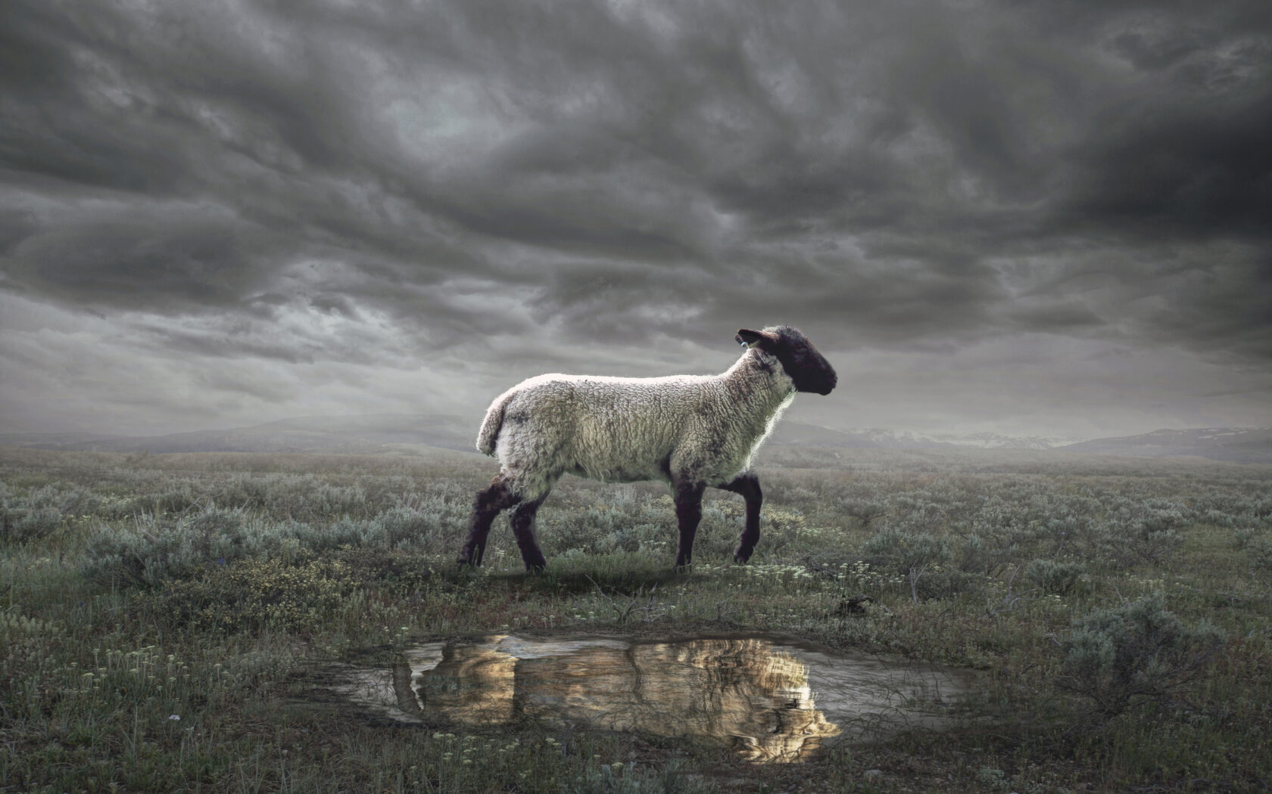
The Revelation
8. I saw a Lamb, standing as slain
chapters 4-5

Slide 2
Review Quiz
What are some of the ways that Revelation (so far, ch.1-4) has ”pulled back the curtain” for the Christians in 1st century Romans Asia?
Discuss together in small groups
Share out your answers

Slide 3
Structure of Revelation
Letters to the Churches (1-3)
The Throne of God & the Lamb (4-5)
Seven Seals (6-8)
Seven Trumpets (8-11)
Seven Signs (12-14)
Seven Bowls (15-16)
Fall of Babylon (17-19)
Final Battle (19-20)
New Heavens & New Earth (21-22)

Slide 4
Revelation 4-5
Hear & see (imagine) what John is describing.
What is the drama (story) playing out in these two chapters?

Slide 5
Revelation 5:1-14
The sealed scroll points us back to Daniel 12:4, 8-9 – God’s plan for history
defeating beasts + rescuing saints
no one worthy – all have rebelled
Jesus is worthy. Plan fulfilled in Him.
Lion: conquers + establishes kingdom
Lamb: conquers through sacrifice
The Lamb is worshipped by the living creatures and elders, like God in ch.4

Slide 6
Revelation 5:1-14
“sang a new song” – the progress of God’s work toward it’s culmination
ransomed a people for God
made them a kingdom and priests
they shall reign on the earth
Hears millions of angels worshipping
worthy to receive [seven things]
All creation now joins in praise of the one who sits on the throne and the Lamb

Slide 7
Revelation 4-5
What does this vision mean for the Christians in Roman Asia?
What does it mean for us?
Worship?
Conquering?

Slide 8
The Revelation
For Wednesday (4/5)
9. The Lamb opened the seals…

