Slide 1
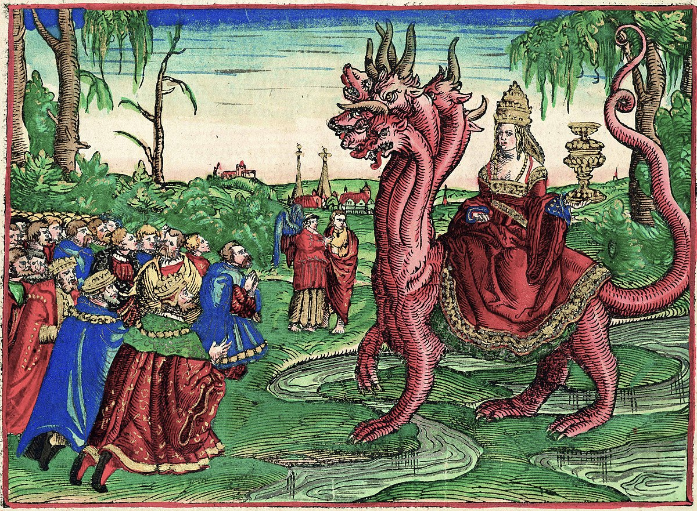
The Revelation
20. Judgment of the prostitute
chapter 17

Slide 2
Revelation Review
What all do you remember about the beast in ch.13? (aims, tactics, characteristics, significance, etc.)

Slide 3
Revelation 17
Read (listen to) the judgment.
What is the significance of describing ”Babylon” as a “the great prostitute”?

Slide 4
Making sense of Revelation 17
Patterns in Scripture – Prostitute as a picture of unfaithful Israel (Hosea, Ez.16)
In Context – Another angle on the war with the beast (13) & victory of saints (14)
Key Points – Seductive and oppressive enemy conquered by the King/saints
Original Readers – Easy to see Rome, but the ‘spirit of Babylon’ is alive and well

Slide 5
Revelation 17: Closer Look
“Mother of Prostitutes” (1-6)
Babylon (5) – archetypal city of pride, opulence, rebellion, cruelty (Gen. 11, Is. 13-14, Dan. 4:30)
I marveled (6) – she seduces and charms with impressive beauty and rich adornment
Golden cup (2,4) – the seduced kings and earth-dwellers must drink the filth of her cup
On the beast (3) – she uses the might of empire to spread her immorality to the nations
Blood of the martyrs (6) – she (and the beast) demand loyalty, so the saints are targeted

Slide 6
Revelation 17: Closer Look
“the Lamb will conquer them” (7-18)
Was, is not, is to come (8) – the beast suffered apparent defeat, but “will rise again” (see 13:3)
Seven mountains (9) – Rome, ‘city of seven hills’
Seven kings (10-11) – Seven Roman emperors?
… or 1) counterfeit perfection, + 2) storied history, hope of revival, but ultimate futility
One mind (12-14) – Ten more kings, all working for the beast to rebel against the Lamb
Beast v. prostitute (16-17) – city & empire self- destruct, devour themselves, as God planned

Slide 7
Reflections on Revelation 17
What is the warning for us?
What is the comfort for us?

Slide 8
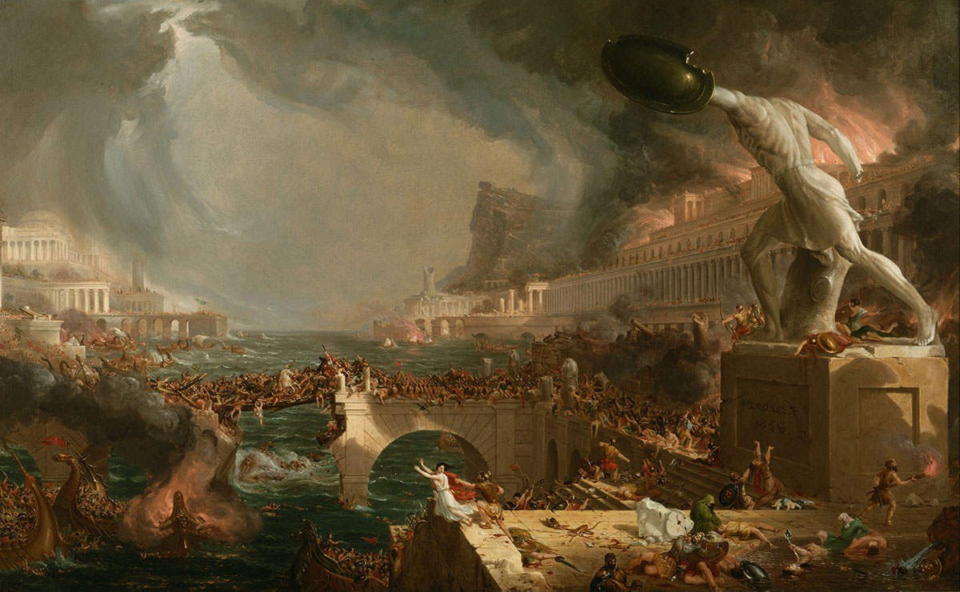
The Revelation
For Wednesday (5/17)
20. Fallen is Babylon (ch.18)

