Slide 1
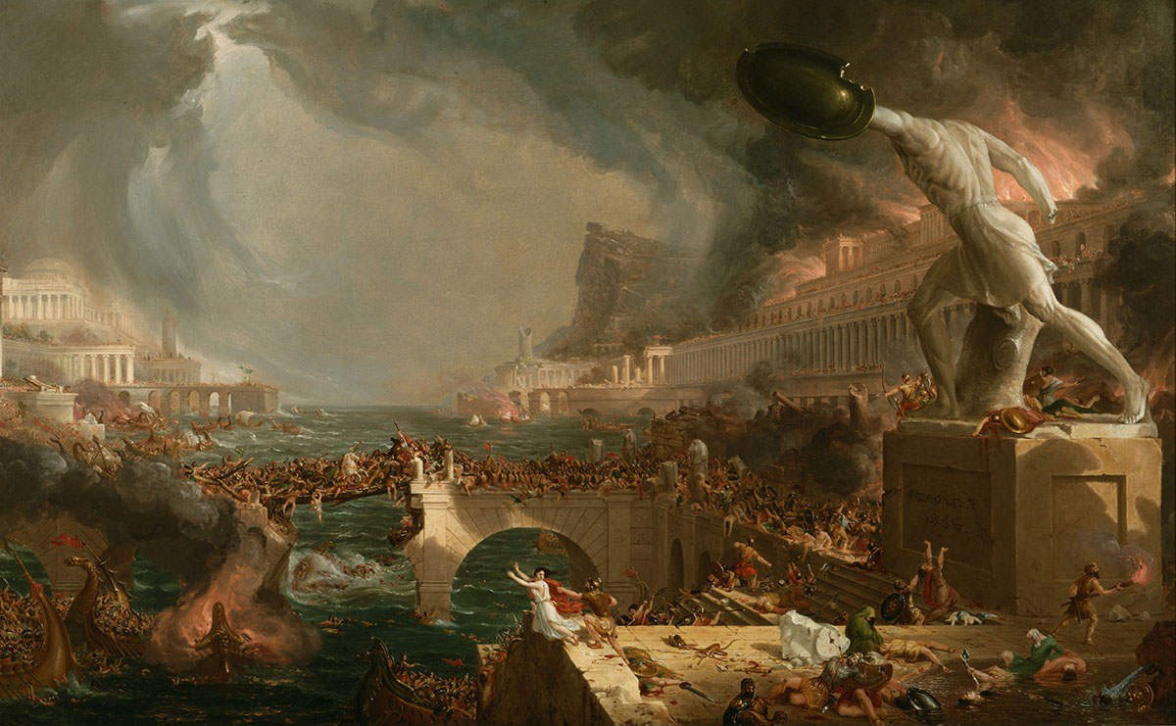
The Revelation
21. Fallen, fallen is Babylon
chapter 18

Slide 2
Revelation Review
Why is Babylon described as a harlot in chapter 17?

Slide 3
Revelation 18
Read (listen to) the chapter.
What are the sins for which Babylon is being judged?

Slide 4
Making sense of Revelation 18
Key Points – God’s judgment for arrogance, trust in wealth, oppression
In Context – further description of the “mother of prostitutes” from ch.17
Patterns in Scripture – cf. judgments on Babylon (Is.21, 47, Jer.51) & Tyre (Ez.27)
Original Readers – Rome’s pride and luxurious wealth easily identifiable

Slide 5
Revelation 18: Closer Look
Call from Heaven (1-8)
“dwelling place for demons” (2) – see Is. 34:8-15; civilization reverts back to chaos
“immorality with her” (3) – she has seduced the world into join her sins
God’s people called to “come out” (4)
She has brought judgment on herself through her arrogance / tormenting (5-8)
“in a single hour” (8) - cf. Daniel 5:30

Slide 6
Revelation 18: Closer Look
Cries from Earth (9-20)
Kings who benefitted from her luxury stunned with fear-–they could be next (9-10)
Merchants enriched by her now mourn (11-17)
luxuries, gained by oppression? (12-13)
pinnacle of exploitation: slavery (13)
“for which your soul longed” (14)
merchants also fear her torment (15)
Sea-farers marvel at sudden reversal (17-19)
“God has judged your judgment on her” (20)

Slide 7
Revelation 18: Closer Look
Pronouncement from Angel (21-24)
“great millstone” (21) – like Jeremiah’s symbol of Babylon’s fall (51:63) and like Jesus’ condemnation on those who cause little ones to stumble (Mark 9:24)
The great city left in total silence (“a haunt,” v.2) after its devastation (21-23)
Deception, oppression, violence (23-24)

Slide 8
Reflections on Revelation 18
What does it mean / look like for us to obey the command of 18:4, “Come out of Babylon”?

Slide 9
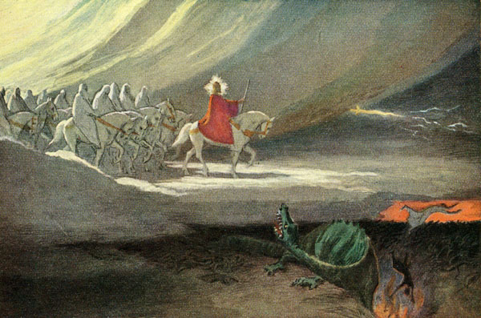
The Revelation
For Sunday (5/21)
22. Winepress of fury (ch.19)

