Slide 1
The Gospel according to Mark
Bellaire Auditorium Class
Wednesday Nights
September to November 2023

Slide 2
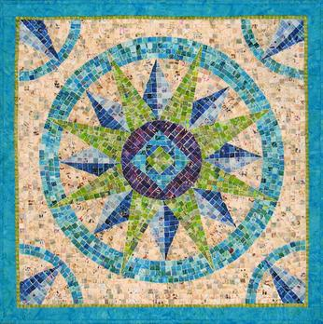

Slide 3
Using the Booklet
Read the text
List each ‘episode’ in the text
Look for ‘stitches’ that connect ‘episodes’
Use those connections to identify lessons

Slide 4
Mark Chapter 1
Episodes:
Introduction/Title? (1)
John on the scene (2-8)
Jesus baptized (9-11)
Jesus into the wilderness (12-13)
Jesus preaches gospel (14-15)
Jesus calls disciples (16-20)
Jesus in the synagogue (21-28)
Jesus heals Peter’s mom-in-law (29-31)
Jesus heals many sick (32-34)
Jesus rises early to pray (35-39)
Jesus heals a leper (40-45)

Slide 5
Mark Chapter 1
Work with people around you to look for ‘stitches’: words, details, ideas, or features in the text that connect stories together.
Example: “wilderness” / “desolate place”
v. 3 - voice in the wilderness
v.4 - John in the wilderness
v.12,13 - Jesus to the wilderness
v.35 - Jesus to a desolate place
v.45 - Jesus confined to desolate places
Take 7-8 minutes to work in groups

Slide 6
Stitches in Mark 1
What did you find?
Gospel (1,7*,14,15,38*)
Repentance (4,15)
Spirit (8,10,12)
Isaiah (2-3,11,14-15,32*)
Authority (17*,20*,22,27,34*)
Everyone coming (5,28,32-34,37,39,45)
Healing (26,29-31,32-34,40-42)
How do these ‘threads’ help us to understand the message about Jesus?

Slide 7
Gospel & Kingdom in Mark 1
“The beginning of the gospel of Jesus Christ, the son of God.” ~ Mark 1:1
Kind of statement made of Caesar and the beginning of Caesar’s life/reign
“Gospel” in Is.40:9 – “Behold, your God!”
“Gospel” in Is. 52:7 – “Your God reigns”
Christ = Messiah (Davidic King, 2Sam. 7)
Son of God = King (Ps. 2:7, Mark 1:11)

Slide 8
Gospel & Kingdom in Mark 1
“The beginning of the gospel of Jesus Christ, the son of God.” ~ Mark 1:1
“… preaching the gospel of God, and saying, ‘The time is fulfilled, and the kingdom of God is at hand; repent and believe in the gospel.” ~ Mark 1:14-15
The good news is that God’s kingdom (reign) has come in the person of Jesus Christ
Response to that proclamation is repentance and allegiance (trust)

Slide 9
Gospel & Kingdom in Mark 1
“I am not fit to stoop down and untie the strap of his sandals.’”~ Mark 1:7
John announcing One coming with great power/authority (i.e. God Himself, 1:3)
Response is repentance! (Mark 1:4)

Slide 10
Gospel & Kingdom in Mark 1
“I am not fit to stoop down and untie the strap of his sandals.” ~ Mark 1:7
“…He was teaching them as one having authority… ‘What is this?’ A new teaching with authority!’” ~ Mark 1:22, 27
People astonished/amazed at Jesus’ authority
What does Jesus do with His authority?
Calls disciples – and they follow (1:14-20)
Casts out demons (1:23-27, 32-34, 39)
Heals the sick (1:29-31, 32-34, 40-45)

Slide 11
Gospel & Kingdom in Mark 1
What do we learn about Jesus?
… about following Jesus?
Jesus is King. In establishing God’s kingdom, He drives out Satan’s power, heals humanity, and redeems creation.
We follow Him. Leaving everything, we go where He goes and do what He says, because only in Him are we made whole.

Slide 12
The Gospel according to Mark
Next Wednesday (September 13)
Mark 2-3

