Slide 1
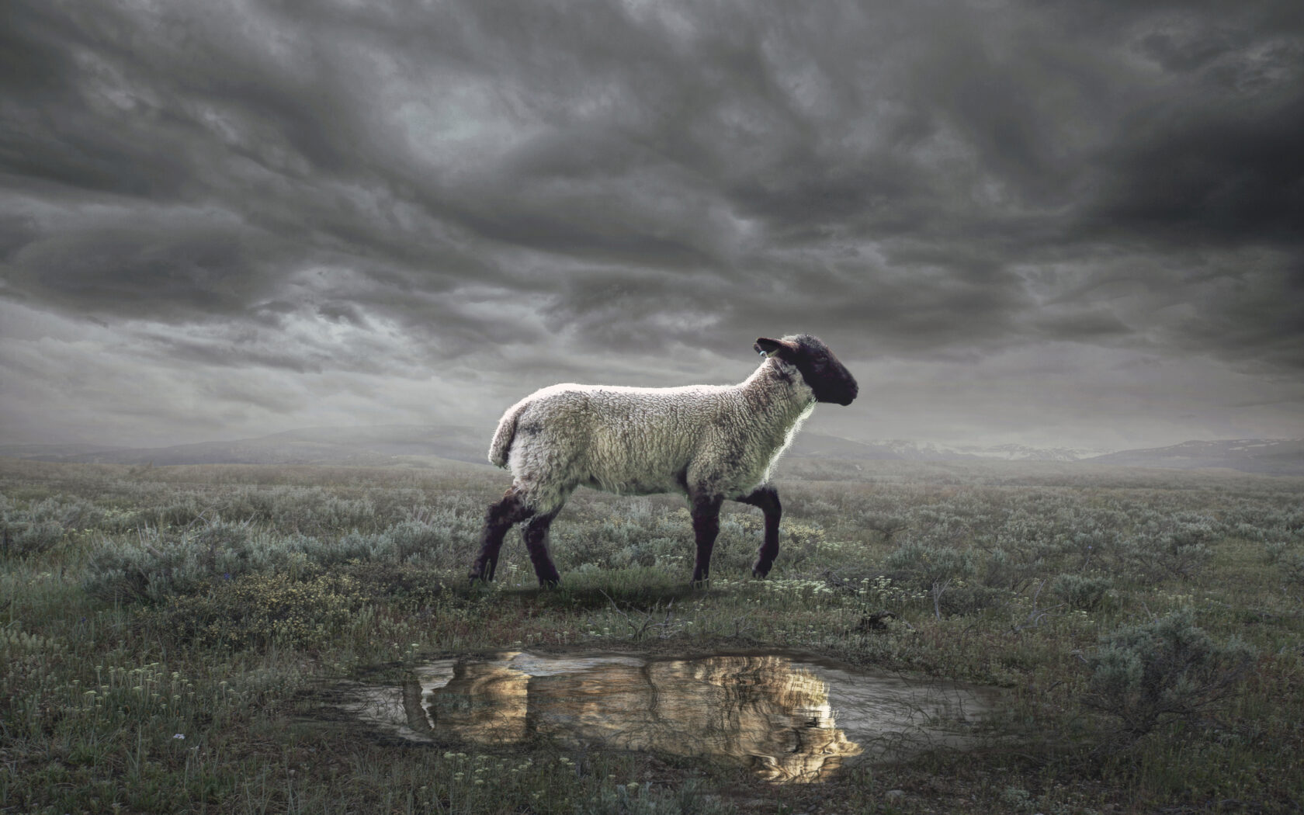
The Revelation
Wednesday Nights
Winter 2023-24

Slide 2
Review Quiz
What is the genre of the Book of Revelation?
Apocalyptic Literature
Prophecy
Letter
All of the Above

Slide 3
Review Quiz
In the Bible, what is an apocalypse?
The end of the world
An unveiling of reality
Zombies, definitely zombies

Slide 4
Review Quiz
Which O.T. book contains the most apocalyptic writing?
Genesis
Psalms
Isaiah
Daniel

Slide 5
Review Quiz
Which of the following are characteristics of apocalyptic?
Brings comfort during crisis
Contains an angelic guide
Secret code to fool enemies
Flashes of disjointed images
Shows a transcendent reality

Slide 6
What are we reading?
Apocalyptic Literature is “a story, written in a time of crisis and distress, that is given by otherworldly beings explaining how God will reverse everything so the righteous will triumph.”
- Mark Roberts

Slide 7
What are we reading?
¹ The Revelation of Jesus Christ, which God gave Him to show to His bond-servants, the things which must soon take place; and He sent and communicated it by His angel to His bond-servant John, ² who testified to the word of God and to the testimony of Jesus Christ, even to all that he saw. ³ Blessed is he who reads and those who hear the words of the prophecy, and heed the things which are written in it; for the time is near.
⁴ John to the seven churches that are in Asia:

Slide 8
What is Prophecy?
In the Bible, prophecy does NOT mean fortune-telling or predicting the future.
It means a word from God, delivered by a man or woman of God (prophet).
The Hebrew prophets did the following:
Interpret History
Enforce Covenants
Describe Future Events

Slide 9
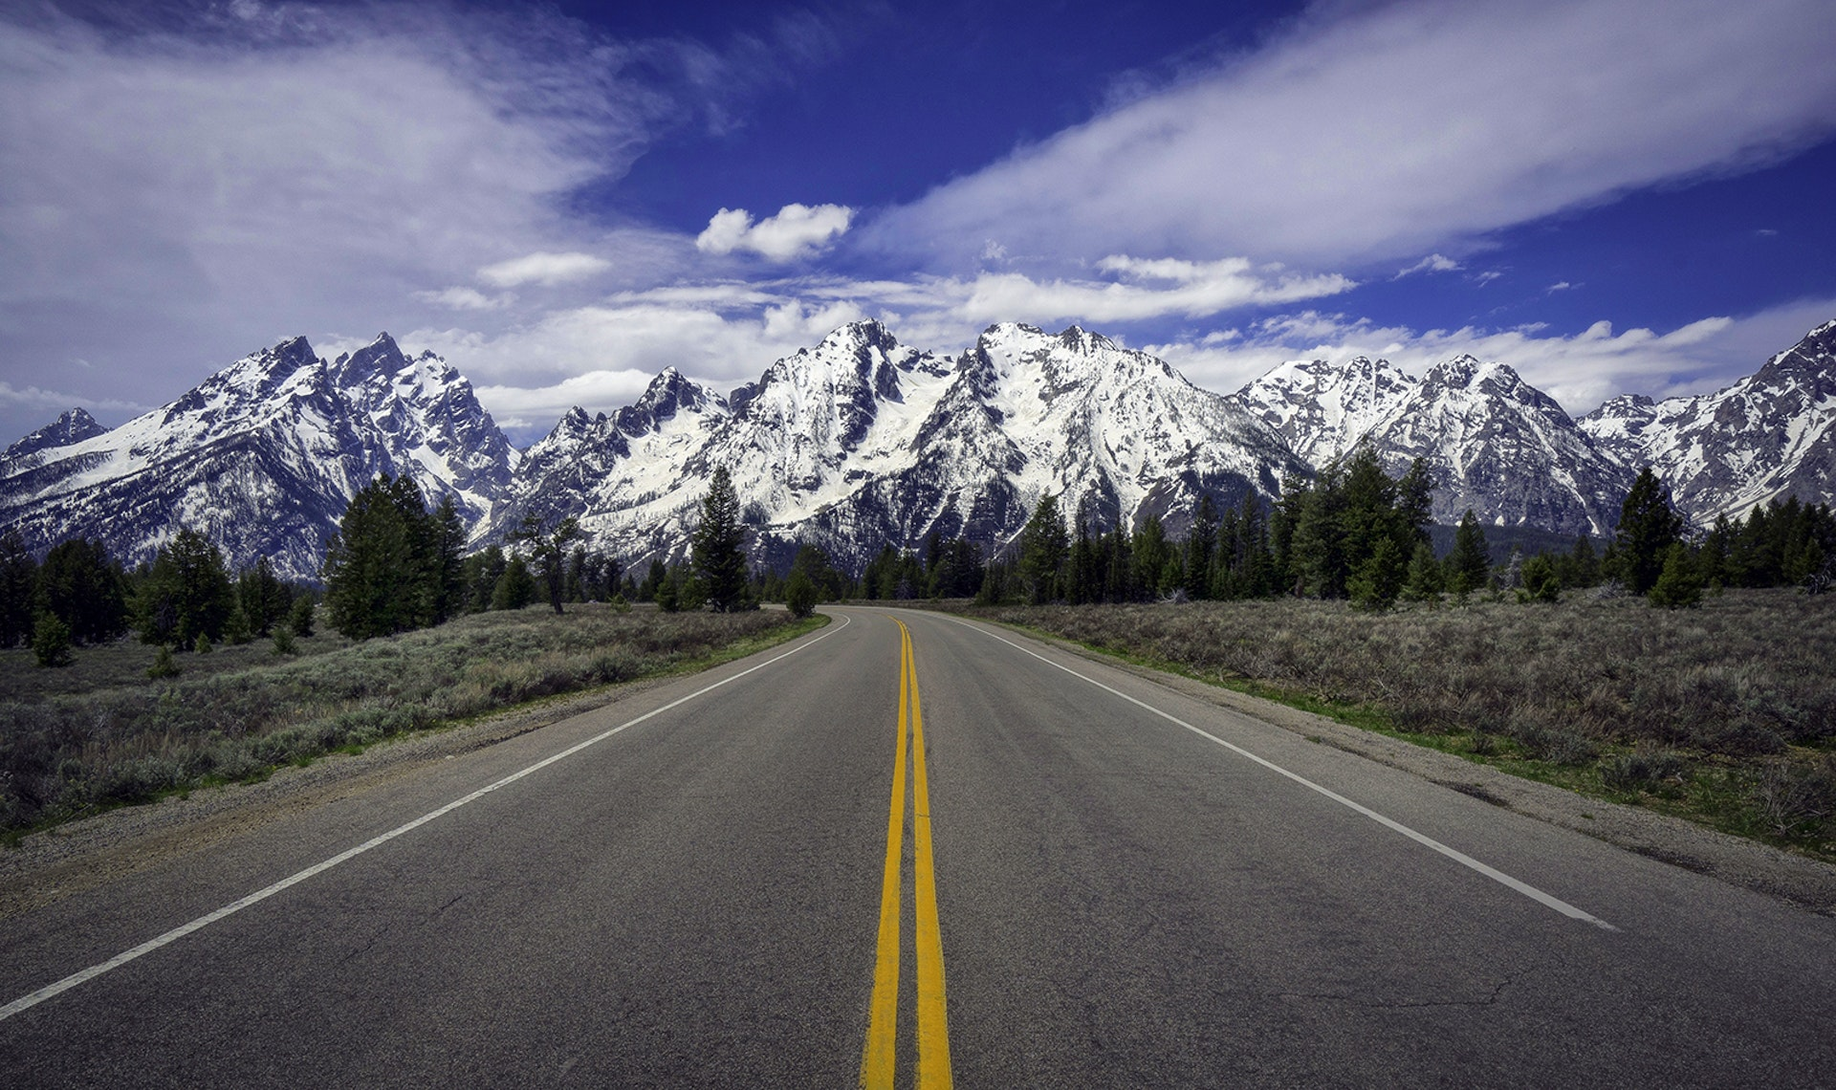
Prophetic View of Time

Slide 10
To when is Ezekiel referring?
^{36:33} Thus says the Lord God, “On the day that I cleanse you from all your iniquities, I will cause the cities to be inhabited, and the waste places will be rebuilt. ³⁴ The desolate land will be cultivated instead of being a desolation in the sight of everyone who passes by. ³⁵ They will say, ‘This desolate land has become like the garden of Eden; and the waste, desolate and ruined cities are fortified and inhabited.’ ³⁶ Then the nations that are left round about you will know that I, the Lord, have rebuilt the ruined places and planted that which was desolate; I, the Lord, have spoken and will do it.”

Slide 11
Apocalyptic View of Time
A common feature in apocalyptic literature is the division of time into periods, with the current moment placed toward the end.
Not as a precise chronology or timeline
Shows God has ordered history/is in control
Encourages reader to hang on a bit longer
Example: 70 Weeks prophecy (Daniel 9)
Response to “Act and don’t delay!” (9:19)
Numbers are symbolic, not literal
The critical moment is the last “week”

Slide 12
“For the time is near”
Revelation says the events of the book will happen “soon.” (1:1; 22:6)
“Soon” in the Bible isn’t always soon
Deut 32:35 - “near” = 800 years
Rom 16:20 - God will “soon” crush Satan
Think of time in Revelation:
Prophetically (layers of fulfillment)
Apocalyptically (hold on a little longer)
Don’t forget the original readers!

Slide 13
What are we reading?
¹ The Revelation of Jesus Christ, which God gave Him to show to His bond-servants, the things which must soon take place; and He sent and communicated it by His angel to His bond-servant John, ² who testified to the word of God and to the testimony of Jesus Christ, even to all that he saw. ³ Blessed is he who reads and those who hear the words of the prophecy, and heed the things which are written in it; for the time is near.
⁴ John to the seven churches that are in Asia:

Slide 14
Reading Other People’s Mail
The letters of the New Testament are for us, but they were not written to us.
First: What did it mean to them?
Then: What does it mean for us?
Understanding the situation of the original readers is critical.
External evidence can help us here
But there is internal evidence as well

Slide 15
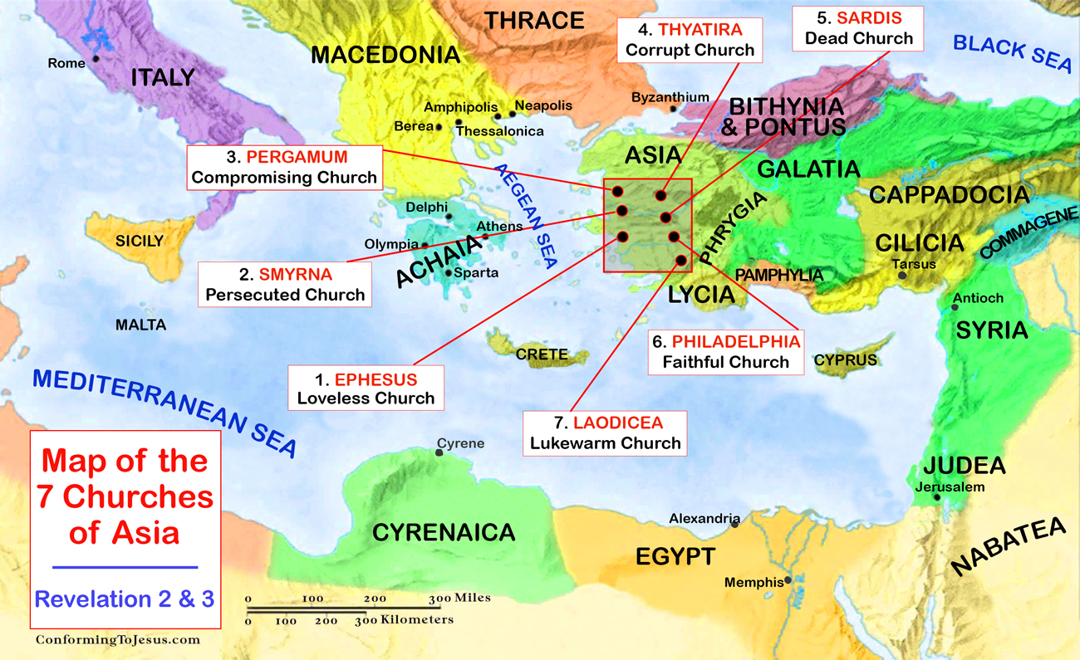

Slide 16
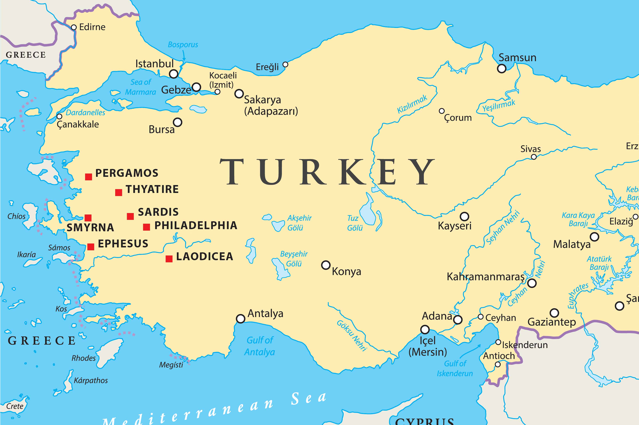

Slide 17
1st Century Roman Asia
One of the wealthiest provinces in the Roman Empire at this time.
Epicenter of the imperial cult (worship of the emperor as a god)
Refusal to participate in emperor worship had its consequences:
Economic (exclusion from work)
Social (ostracized in community)
Legal (imprisonment or death)

Slide 18
Christians in Roman Asia
External Pressures
Persecution (1:9; 2:9; 2:13; 3:9)
Prosperity (3:2; 3:17)
Spiritual Dangers:
Compromise (2:6,14-15; 2:20)
Apathy (2:4; 3:1; 3:16)

Slide 19
Situation of the Readers
Them
Us
Decades removed from Christ
Enjoyed material prosperity
Pressure to worship to the emperor
Choosing between faithfulness & comfort
Faced false teaching of compromise
Centuries removed from Christ
Enjoy (even more) material prosperity
Pressure to bow to the state / zeitgeist
Choosing between faithfulness & comfort
Face false teaching of compromise

Slide 20
Converting the Imagination
The visions of Revelation do not work through rational logic but imagination.
God is equipping us with us images with which to see and understand the world.
Revelation combines images and a narrative to shape our reality.
But the symbolic world is no less real than the world we see. Maybe more real.

Slide 21
Tips for Reading Revelation
Read aloud or listen.
Read long, continuous chunks.
Visualize what is being described.
Feel the emotions being evoked.
Keep the big picture in view.
Find the comfort or challenge.

Slide 22
The Revelation
Next Week (12/20)
3. Revelation 1-3: The Churches

