Slide 1
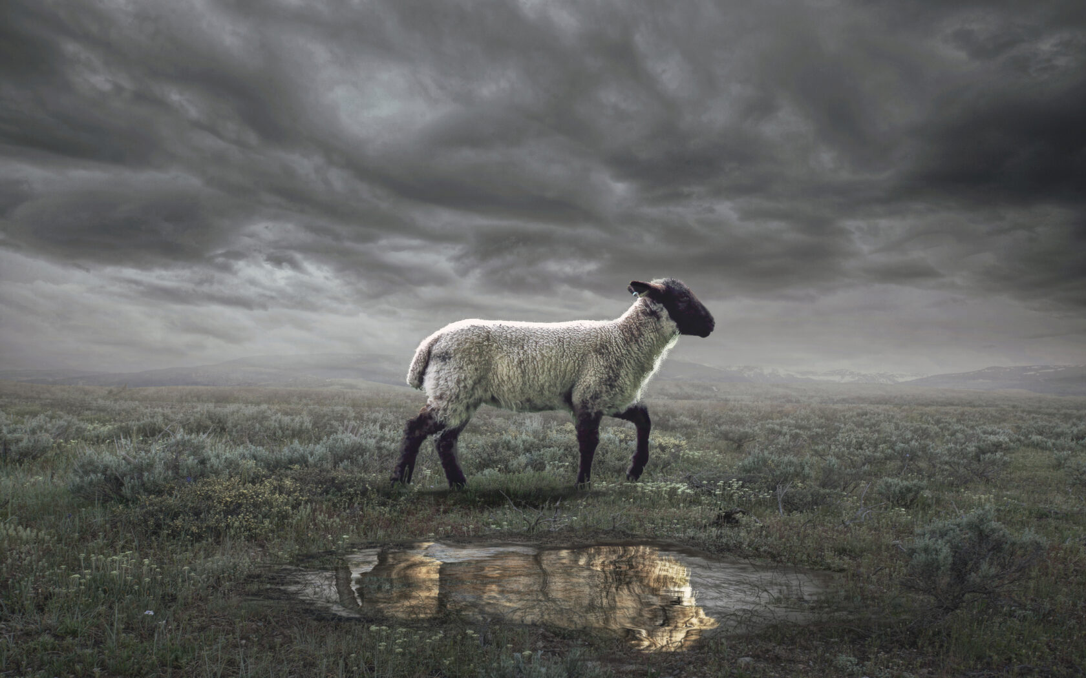
The Revelation
Wednesday Nights
Winter 2023-24

Slide 2
Review Quiz
What is the genre of the Book of Revelation?
_________
_________
_________

Slide 3
What are we reading?
¹ The Revelation of Jesus Christ, which God gave Him to show to His bond-servants, the things which must soon take place; and He sent and communicated it by His angel to His bond-servant John, ² who testified to the word of God and to the testimony of Jesus Christ, even to all that he saw. ³ Blessed is he who reads and those who hear the words of the prophecy, and heed the things which are written in it; for the time is near.
⁴ John to the seven churches that are in Asia:

Slide 4
Review Quiz
What are some characteristics of apocalyptic literature?

Slide 5
Review Quiz
What were the external pressures facing the Christians in Asia?
___________
___________
What were the spiritual dangers?
___________
___________

Slide 6
Christians in Roman Asia
External Pressures
Persecution (1:9; 2:9; 2:13; 3:9)
Prosperity (3:2; 3:17)
Spiritual Dangers:
Compromise (2:6,14-15; 2:20)
Apathy (2:4; 3:1; 3:16)

Slide 7
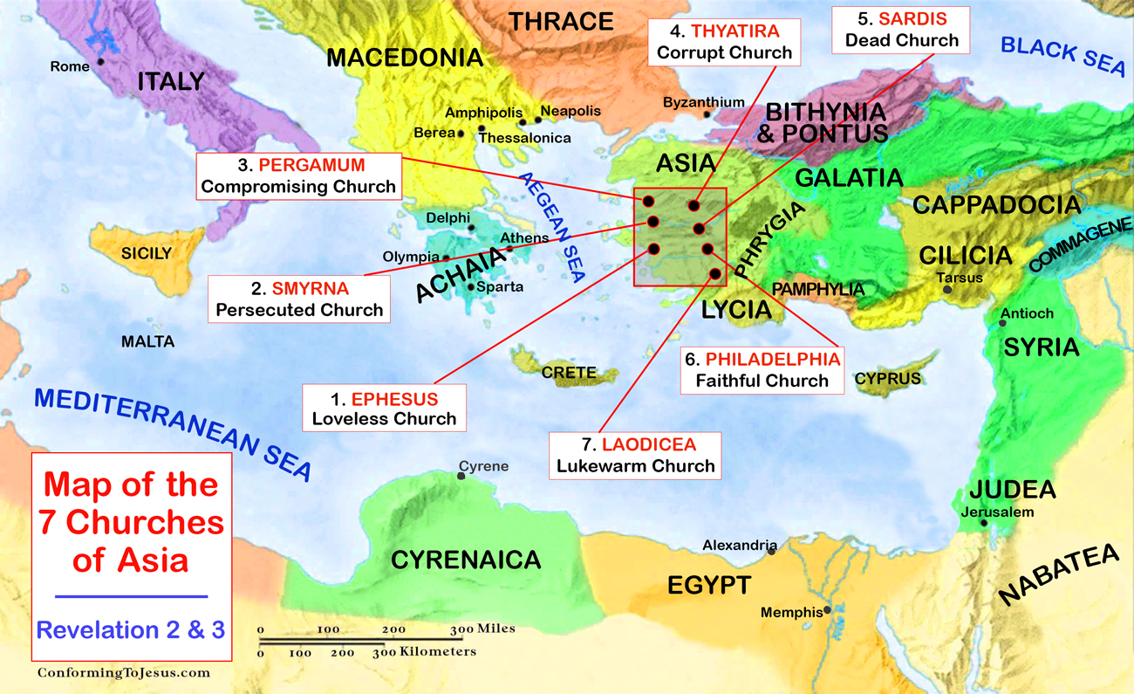

Slide 8
1st Century Roman Asia
One of the wealthiest provinces in the Roman Empire at this time.
Epicenter of the imperial cult (worship of the emperor as a god)
Refusal to participate in emperor worship had its consequences:
Economic (exclusion from work)
Social (ostracized in community)
Legal (imprisonment or death)

Slide 9
Situation of the Readers
Them
Us
Decades removed from Christ
Enjoyed material prosperity
Pressure to worship to the emperor
Choosing between faithfulness & comfort
Faced false teaching of compromise
Centuries removed from Christ
Enjoy (even more) material prosperity
Pressure to bow to the state / zeitgeist
Choosing between faithfulness & comfort
Face false teaching of compromise

Slide 10
Converting the Imagination
The visions of Revelation do not work through rational logic but imagination.
God is equipping us with us images with which to see and understand the world.
Revelation combines images and a narrative to shape our reality.
But the symbolic world is no less real than the world we see. Maybe more real.

Slide 11
Tips for Reading Revelation
Read aloud or listen.
Read long, continuous chunks.
Visualize what is being described.
Feel the emotions being evoked.
Keep the big picture in view.
Find the comfort or challenge.

Slide 12
Revelation 1
Hear, see, & feel what John is relaying

Slide 13
Jesus in Revelation 1
1:5 - ”The Faithful Witness” (martus)
Daniel 7 – Son of Man + Ancient of Days
Dominion over kingdoms – “Behold, He is coming with the clouds” (1:7)
Lord of History – “Head & hair were white, feet like burnished bronze” (14)
17 - Response: Fear; Message: Comfort
12-13, 20 – Jesus among the churches

Slide 14
The Letters in Revelation 2-3
Jesus is… (description, see chapter 1)
Jesus knows… (church’s situation)
Jesus says… (comfort or challenge)
Jesus will… (promise, see ch. 21-22)
“He who has an ear, let him hear what the Spirit says to the churches.”

Slide 15
Revelation 2-3
Where do you see the external pressures (persecution or prosperity) on these Christians?
Where do you see warnings about the spiritual dangers (compromise or apathy)?
What else stands out to you about the letters?

Slide 16
The Revelation
In Two Weeks (1/3)
4. Revelation 4-5: Throne Room

