Slide 1
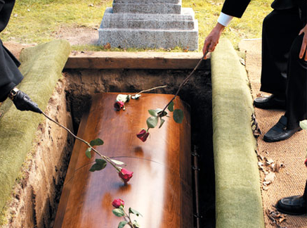
David’s last wish
I Kings 2: 1-4

Slide 2
David knew everything must die
David was familiar with death
Goliath the Philistine (I Samuel 17)
Joab murders Abner (II Samuel 3)
Uriah the Hittite (II Samuel 11)
David’s first child died as a baby (II Samuel 12)
Absalom’s death (II Samuel 18)
And much more throughout David’s life.
David was not allowed to build the temple because of the “blood on his hands”

Slide 3
David knew everything must die
“I am going the way of all the earth…”
Hebrews 9:27
Knowing death is inevitable for all things, why then would we desire to focus our goals on material things?

Slide 4
David knew everything must die
Everything that has a beginning has an end, except the gravity of the Word of God.
Matthew 6:30
Mark 13:31
The sooner we realize life is too short to waste on vain things, the sooner we can begin living everyday with anticipation for Heaven.
Matthew 13:44-47

Slide 5
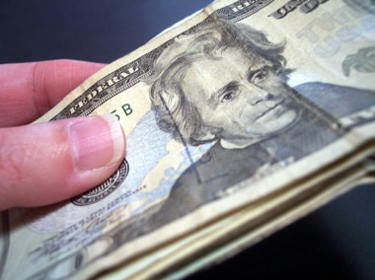
David knew success was found in God
We live in the wealthiest nation in earth’s history.
The worlds motto “He who dies with the most toys wins”…wins what?!!
Is that how Christians should live?
A Christian should measure success by their spiritual legacy, not their material wealth.

Slide 6
David knew success was found in God
David wanted Solomon to keep strong and faithful in order to please God, and for his own well being.
David was proud when Solomon was crowned King. He was able to die peacefully and joyfully.
I Kings 1:48
Proverbs 13:22

Slide 7
David Knew God Keeps his Promises
II Peter 3: 7-9
David understood that time is irrelevant to the master of the Universe. God has never made a promise or prophecy that didn’t occur as He said.
There are many who served God faithfully before Christ came in the flesh. Though they didn’t know of salvation in Christ, they did know God would reward those who please Him.
Hebrews 11: 13-16
Hebrews 12: 1-2

Slide 8
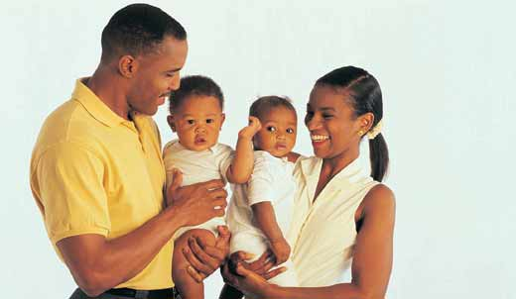
Proverbs 3: 1-12

Slide 9
David’s last wish
I Kings 2: 1-4

