Slide 2
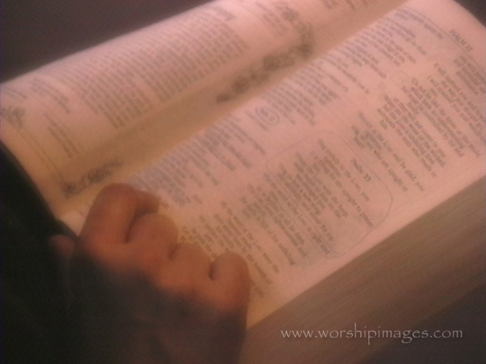
USING the BIBLE for DAILY DECISION MAKING

Slide 3
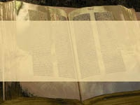
BELIEF – mental acceptance of and conviction in the truth, actuality, or validity of something; Something believed or accepted as true, especially a particular tenet or body of tenets accepted by a group.

Slide 4
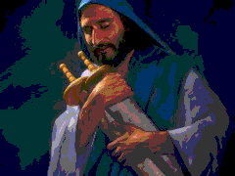
Romans 10:16 But they have not all obeyed the gospel. For Isaiah says, Lord, who has believed what he has heard from us?

Slide 5
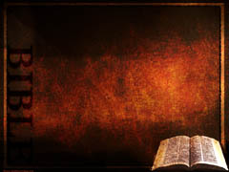
Psalm 19:1 The heavens declare the glory of God, and the sky above proclaims his handiwork. 2 Day to day pours out speech, and night to night reveals knowledge. 3 There is no speech, nor are there words, whose voice is not heard. 4 Their measuring line goes out through all the earth, and their words to the end of the world. In them he has set a tent for the sun, 5 which comes out like a bridegroom leaving his chamber, and, like a strong man, runs its course with joy. 6 Its rising is from the end of the heavens, and its circuit to the end of them, and there is nothing hidden from its heat.

Slide 6
7 The law of the LORD is perfect, reviving the soul; the testimony of the LORD is sure, making wise the simple; 8 the precepts of the LORD are right, rejoicing the heart; the commandment of the LORD is pure, enlightening the eyes; 9 the fear of the LORD is clean, enduring forever; the rules of the LORD are true, and righteous altogether.
REMEMBER – TRUTH IS OBJECTIVE! (Jeremiah 10:23)

Slide 7
Romans 10:16 But they have not all obeyed the gospel. For Isaiah says, Lord, who has believed what he has heard from us? 17 So faith comes from hearing, and hearing through the word of Christ.

Slide 8
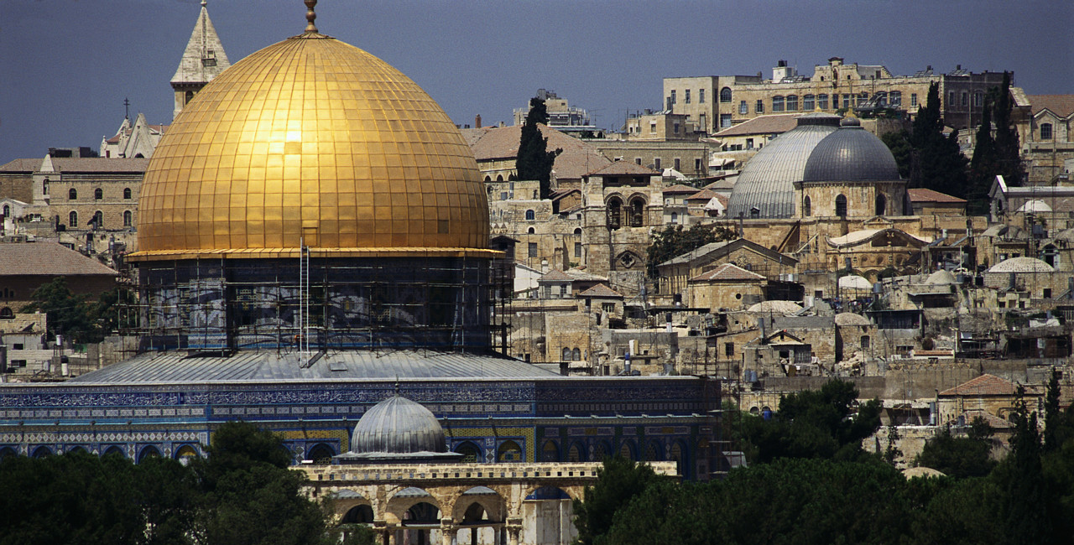
RELIGIOUS DIVERSITY DISPLAYS POWER OF SUBJECTIVISM!

Slide 9
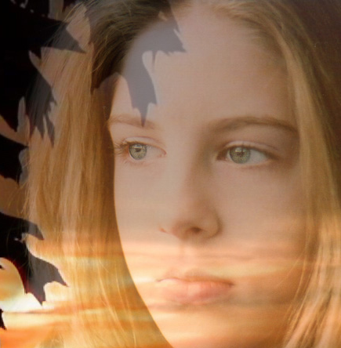
POPULAR
Following the crowd

Slide 10
TRADITIONAL
Following the family

Slide 11
FAIRNESS
Following the ethical

Slide 12
EMOTIONAL
Following the feeling

Slide 13
Why Be So Concerned?
Belief Determines Behavior!

Slide 14
Why Be So Concerned?
Behavior Matters to God!

Slide 15
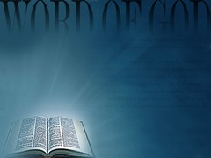
Give diligence to present thyself approved unto God, a workman that need not to be ashamed, rightly dividing the word of truth.
2nd Timothy 2:15

Slide 16
Give diligence to present thyself approved unto God, a workman that need not to be ashamed, rightly dividing the word of truth.
2nd Timothy 2:15

Slide 17
Give diligence to present thyself approved unto God, a workman that need not to be ashamed, rightly dividing the word of truth.
2nd Timothy 2:15

Slide 18
12 Yea, and all that would live godly in Christ Jesus shall suffer persecution. 13 But evil men and impostors shall wax worse and worse, deceiving and being deceived. 14 But abide thou in the things which thou hast learned and hast been assured of, knowing of whom thou hast learned them. 15 And that from a babe thou hast known the sacred writings which are able to make thee wise unto salvation through faith which is in Christ Jesus.
2nd Timothy 3:12-17

Slide 19
16 Every scripture inspired of God is also profitable for teaching, for reproof, for correction, for instruction which is in righteousness. 17 That the man of God may be complete, furnished completely unto every good work.
2nd Timothy 3:12-17

Slide 20
Scripture God Breathed
2nd Timothy 3:12-17

Slide 21
Doctrine
2nd Timothy 3:12-17

Slide 22
Reproof
2nd Timothy 3:12-17

Slide 23
Correction
2nd Timothy 3:12-17

Slide 24
Instruction
in righteousness
2nd Timothy 3:12-17

Slide 25
…thoroughly furnished unto every good work!
APPROVED UNTO GOD!
2nd Timothy 3:12-17

Slide 26
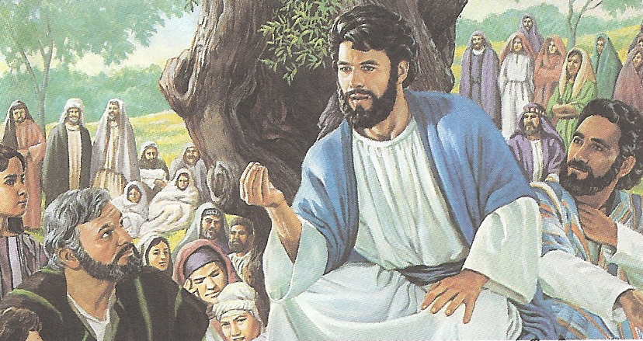

Slide 27
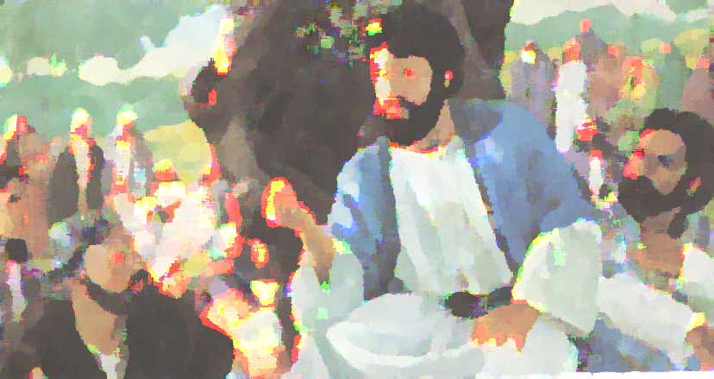
It is Written!

