Slide 1
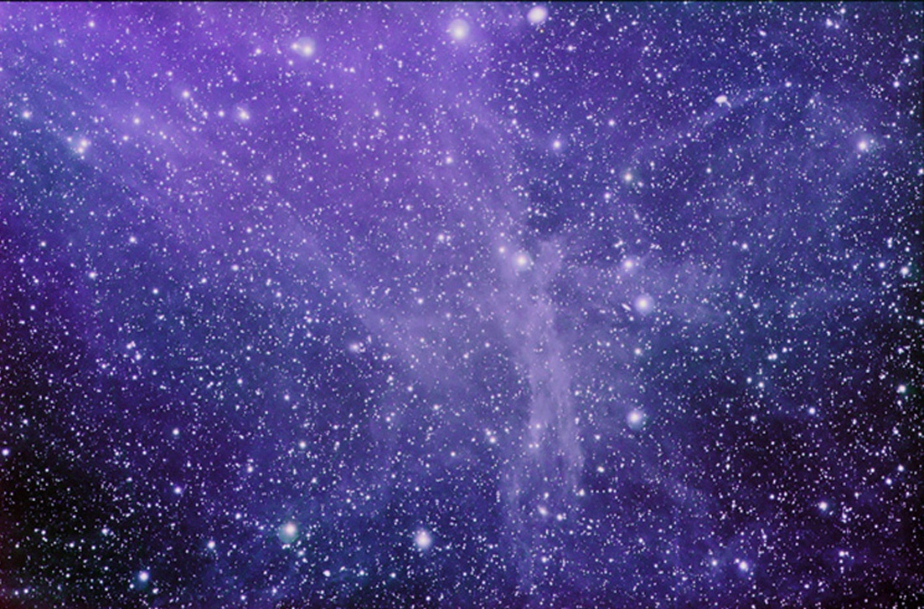
Psalm 8:1-8
O LORD, our Lord, how excellent is Your name in all the earth, who have set Your glory above the heavens!
Out of the mouth of babes and nursing infants You have ordained strength, because of Your enemies, that You may silence the enemy and the avenger.
When I consider Your heavens, the work of Your fingers, the moon and the stars, which You have ordained, what is man that You are mindful of him, and the son of man that You visit him?
For You have made him a little lower than the angels, and You have crowned him with glory and honor. You have made him to have dominion over the works of Your hands; You have put all things under his feet, all sheep and oxen—even the beasts of the field, the birds of the air, and the fish of the sea that pass through the paths of the seas.

Slide 2
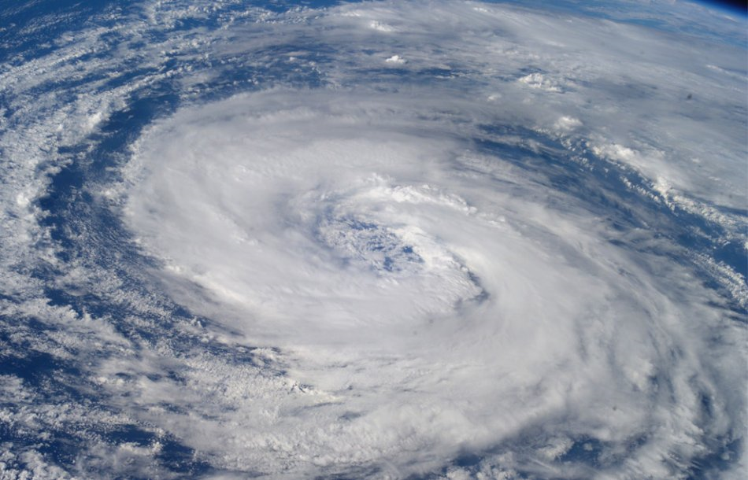
HURRICANE IKE

Slide 3
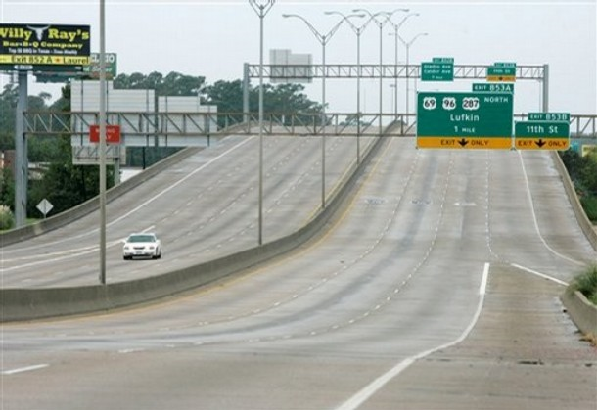
HURRICANE IKE

Slide 4
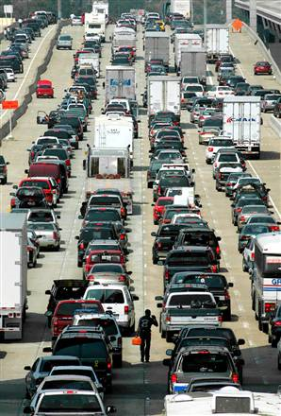
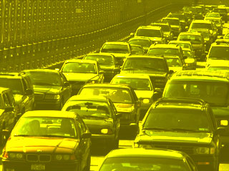
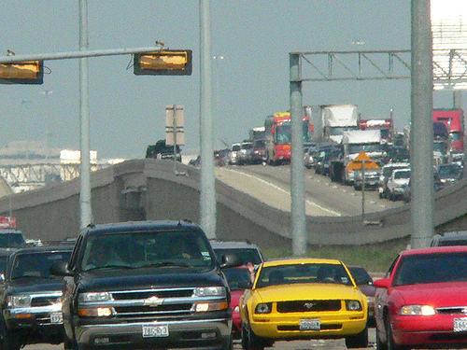
HURRICANE IKE

Slide 5
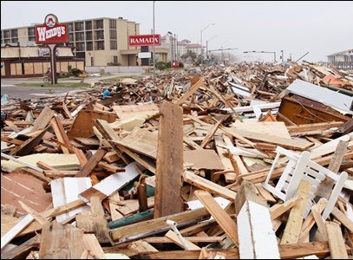
HURRICANE IKE

Slide 6
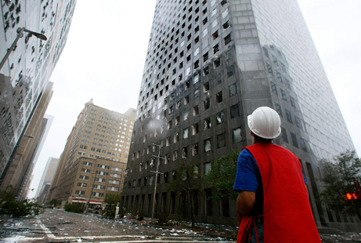
HURRICANE IKE

Slide 7
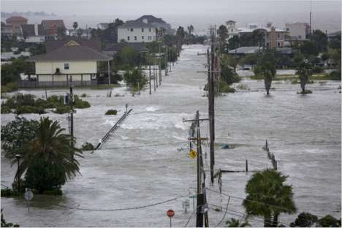
HURRICANE IKE

Slide 8
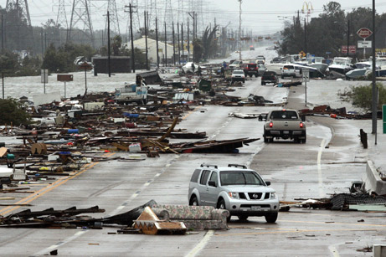
HURRICANE IKE

Slide 9
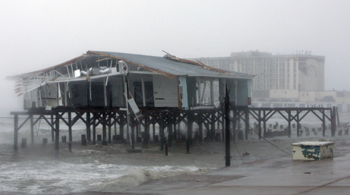
HURRICANE IKE

Slide 10
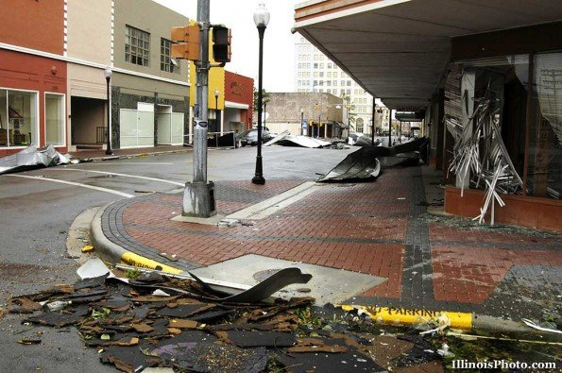
HURRICANE IKE

Slide 11
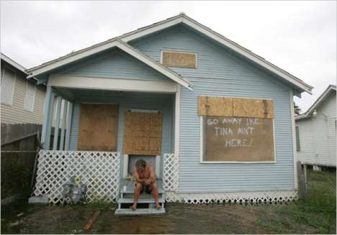
HURRICANE IKE

Slide 12
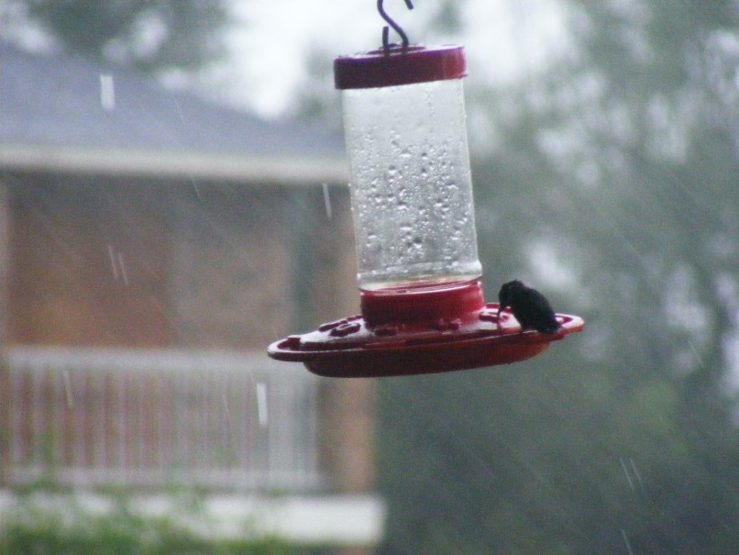
HURRICANE IKE

Slide 13
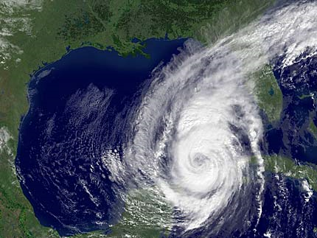
Houston
Galveston

Slide 15
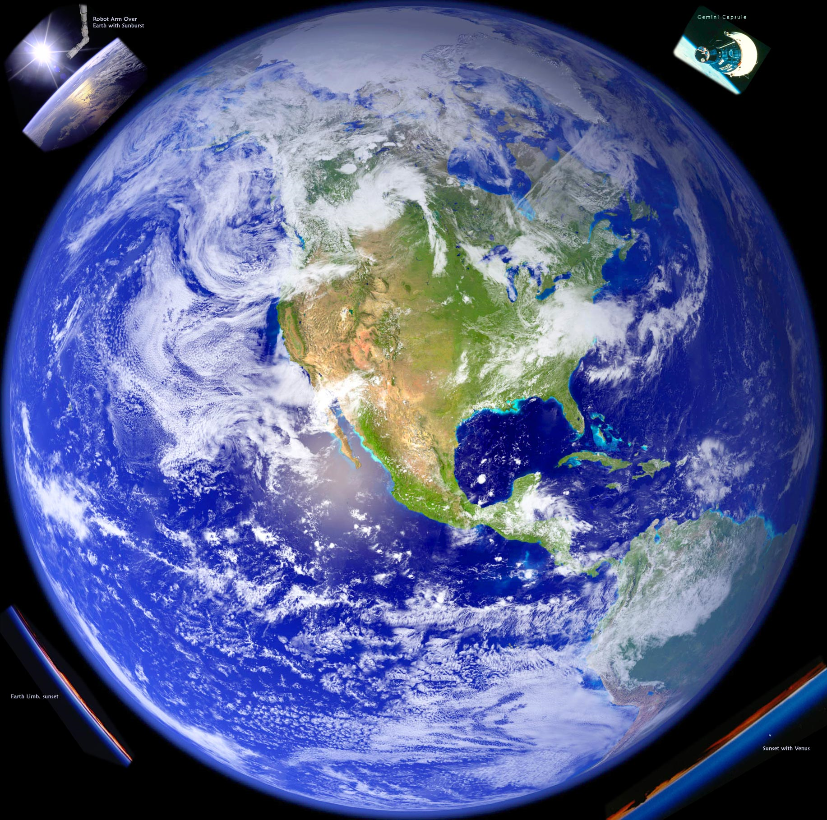

Slide 16
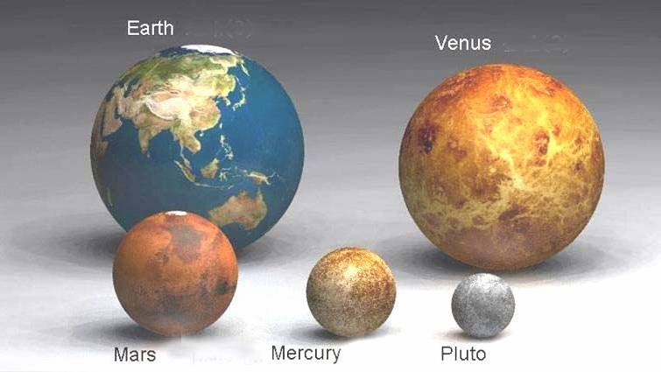
PERSPECTIVE
EARTH: A LARGE PLANET?

Slide 17
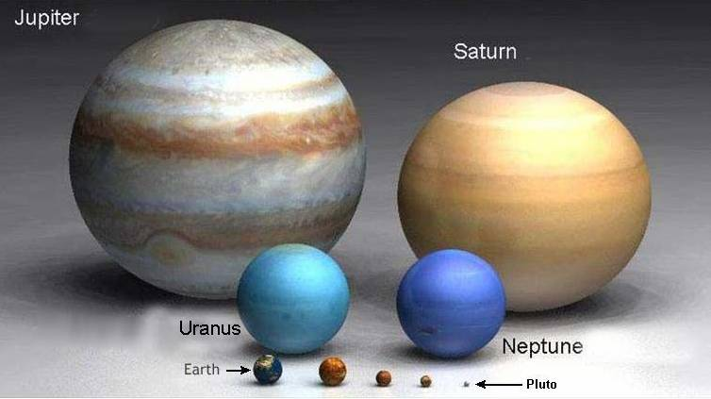
PERSPECTIVE
Jupiter
EARTH: A LARGE PLANET?

Slide 18
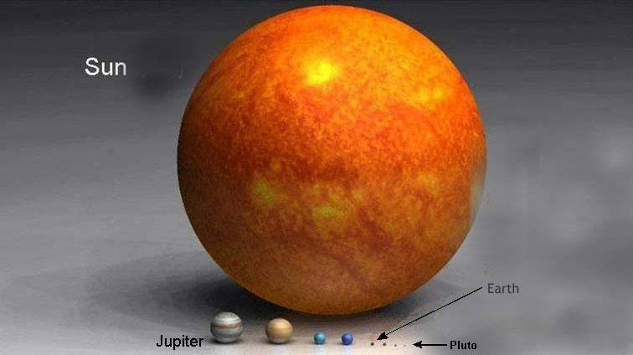
PERSPECTIVE
EARTH: A LARGE PLANET?

Slide 19
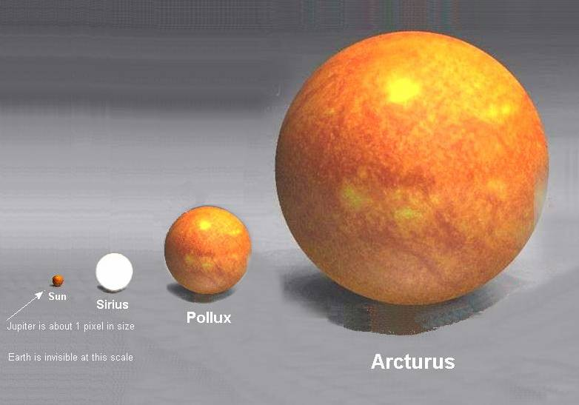
PERSPECTIVE
THE SUN: A LARGE STAR?

Slide 20
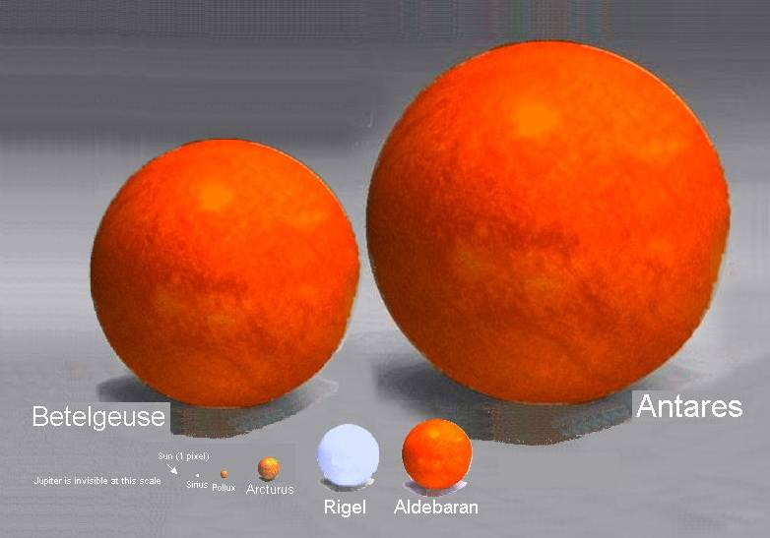
PERSPECTIVE
Job 9:9 He made the Bear, Orion, and the Pleiades, and the chambers of the south.
Job 38:31 "Can you bind the cluster of the Pleiades, or loose the belt of Orion?"
THE SUN: A LARGE STAR?

Slide 21
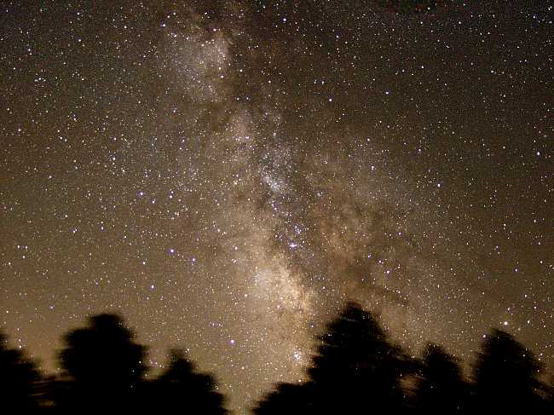
PERSPECTIVE
OUR GALAXY: THE MILKY WAY

Slide 22
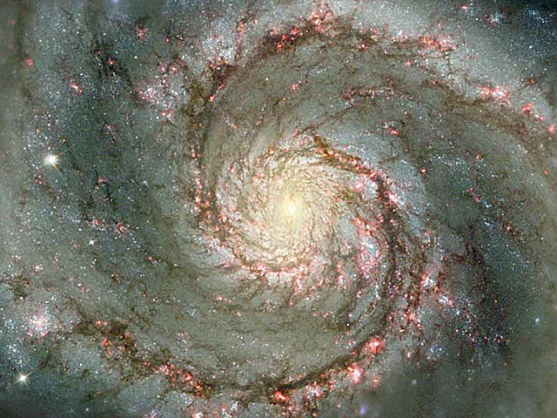
PERSPECTIVE
OUR GALAXY: THE MILKY WAY

Slide 23
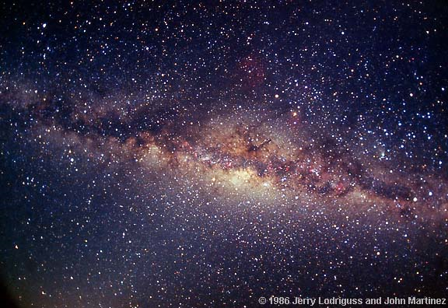
PERSPECTIVE
OUR GALAXY: THE MILKY WAY

Slide 24
PERSPECTIVE
He counts the number of the stars; He calls them all by name. Great is our Lord, and mighty in power; His understanding is infinite.
Psalm 147:4-5
Lift up your eyes on high, and see who has created these things, who brings out their host by number; He calls them all by name, by the greatness of His might and the strength of His power; not one is missing.
Isaiah 40:26
OUR GOD: ABOVE THE UNIVERSE

Slide 25
PERSPECTIVE
O LORD, our Lord, how excellent is Your name in all the earth, who have set Your glory above the heavens!
Psalm 8:1
When I consider Your heavens, the work of Your fingers, the moon and the stars, which You have ordained, what is man that You are mindful of him, and the son of man that You visit him? For You have made him a little lower than the angels, and You have crowned him with glory and honor.
Psalm 8:3-5
OUR GOD: ABOVE THE UNIVERSE

Slide 26
PERSPECTIVE
"And He has made from one blood every nation of men to dwell on all the face of the earth, and has determined their preappointed times and the boundaries of their dwellings, so that they should seek the Lord, in the hope that they might grope for Him and find Him, though He is not far from each one of us…"
Acts 17:26-27
OUR GOD: ABOVE THE UNIVERSE

Slide 27
PERSPECTIVE
Draw near to God and He will draw near to you. Cleanse your hands, you sinners; and purify your hearts, you double-minded.
James 4:8
Therefore humble yourselves under the mighty hand of God, that He may exalt you in due time, casting all your care upon Him, for He cares for you.
1 Peter 5:6-7
OUR GOD: ABOVE THE UNIVERSE

Slide 28
PERSPECTIVE
Nevertheless the solid foundation of God stands, having this seal: "The Lord knows those who are His," and, "Let everyone who names the name of Christ depart from iniquity."
2 Timothy 2:19
OUR GOD: ABOVE THE UNIVERSE

Slide 29
PERSPECTIVE
"Are not five sparrows sold for two copper coins? And not one of them is forgotten before God.
"But the very hairs of your head are all numbered. Do not fear therefore; you are of more value than many sparrows."
Luke 12:6-7
OUR GOD: ABOVE THE UNIVERSE

Slide 30
PERSPECTIVE
Let your gentleness be known to all men. The Lord is at hand.
Be anxious for nothing, but in everything by prayer and supplication, with thanksgiving, let your requests be made known to God; and the peace of God, which surpasses all understanding, will guard your hearts and minds through Christ Jesus.
Philippians 4:5-7
OUR GOD: ABOVE THE UNIVERSE

Slide 31
Psalm 8:1-8
O LORD, our Lord, how excellent is Your name in all the earth, who have set Your glory above the heavens!
Out of the mouth of babes and nursing infants You have ordained strength, because of Your enemies, that You may silence the enemy and the avenger.
When I consider Your heavens, the work of Your fingers, the moon and the stars, which You have ordained, what is man that You are mindful of him, and the son of man that You visit him?
For You have made him a little lower than the angels, and You have crowned him with glory and honor. You have made him to have dominion over the works of Your hands; You have put all things under his feet, all sheep and oxen—even the beasts of the field, the birds of the air, and the fish of the sea that pass through the paths of the seas.

