Slide 1
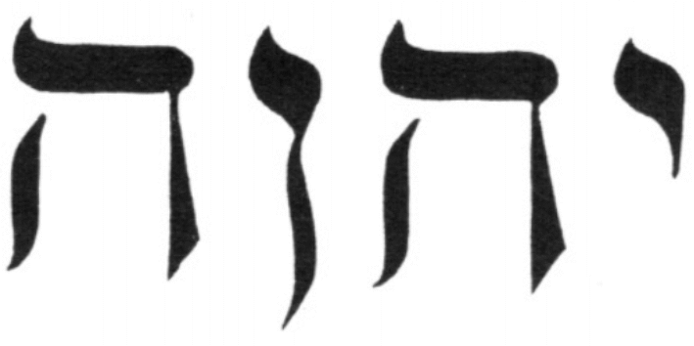
Seeking After God
ELOHIM
YHWH
ADONAI
Heb 11:6
John 1:1-5
Ex 4:10
Gen 18:3; Gen 19:2
Gen 22:10-12
Gen 1:26
Ex 3:14
Ex 6:2-3
Psalms 110:1,4
Jn 8:51
Deut 6:4
Heb 11:17-18

