Slide 1

The Bible
The Origin, Inspiration, and Translation
The Canon of the Bible
Is There A Conspiracy?

Slide 2


False View # 2
The “Big Conspiracy”
Certain Books Were Left Out Of The Canon Because The Church Didn’t Want People To Know The True Story.
These “Lost Books” Are Now Coming To The Surface Which Is Finally Revealing The True Story of Jesus.

Slide 3
False View # 2
The “Big Conspiracy”
What Are These Lost Books?
They Are What Is Called
Psuedepigrapha Writings
Most Are Gnostic Writings

Slide 4
Gnosticism In The Bible
1 Tim 6:20-21
“O Timothy, guard what has been entrusted to you, avoiding worldly and empty chatter and the opposing arguments of what is falsely called ‘knowledge’ — which some have professed and thus gone astray from the faith.”

Slide 5
Gnosticism In The Bible
2 John 7
“For many deceivers have gone out into the world, those who do not acknowledge Jesus Christ as coming in the flesh. This is the deceiver and the antichrist.”

Slide 6
Gnosticism In The Bible
1 John 4:3
“And every spirit that does not confess Jesus is not from God; and this is the spirit of the antichrist, of which you have heard that it is coming, and now it is already in the world.”

Slide 7
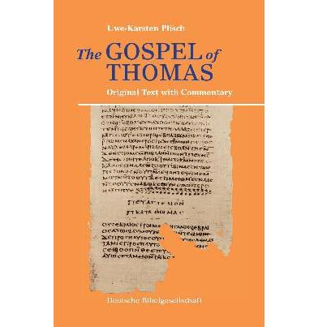
The Gospel of Thomas
(2nd Century)

Slide 8
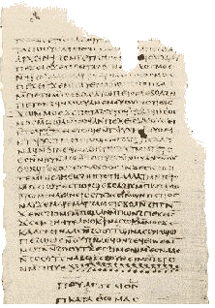
The Gospel of Thomas
(2nd Century)
The Oldest Copies (Coptic) Were Found In The 1940’s In Nag Hammadi, Egypt (3rd-4th Century).
Gnostic Writing of the 2nd Century
The Recording of Jesus’ Secret Sayings Recorded By His Twin Brother.
Gnostics Often Emphasized or Used the More Obscure Characters of the Bible…Thomas, Mary, Judas.

Slide 9
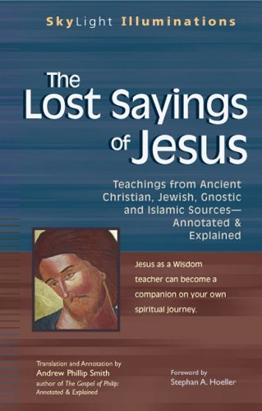
The Gospel of Thomas
(2nd Century)
114 Simon Peter said to them, “Make Mary leaves us, for females don’t deserve life.”
Jesus said, “I will guide her to make her male, so that she too may become a living spirit resembling you males. For every female who makes herself male will enter the kingdom of heaven.”

Slide 10
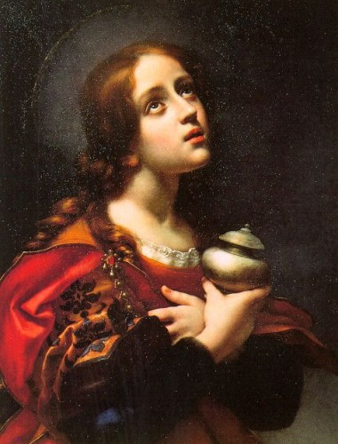

The Gospel of Mary (Magdalene)
(2nd Century)
Another Gnostic Writing
Describes Mary As Able To Explain Jesus’ Secret Wisdom To His Apostles.

Slide 11
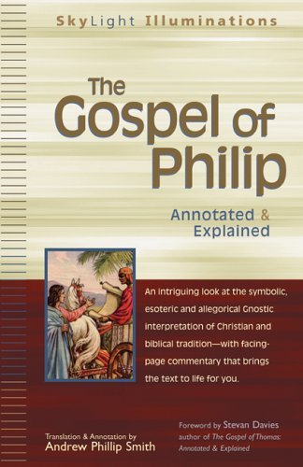
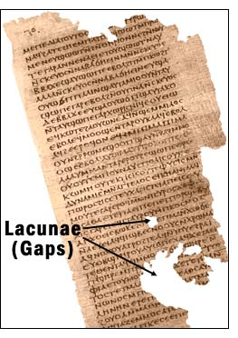
The Gospel of Philip
(3rd or 4th Century)
Another Gnostic Work
Mary Is Described As A Companion Of Jesus.

Slide 12
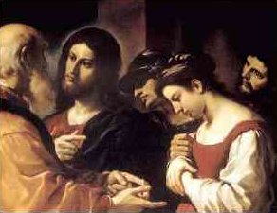
The Gospel of Philip
(3rd or 4th Century)
“And the companion of the Savior is Mary Magdalene. Christ loved her more than all the disciples and used to kiss her often on her mouth.
The rest of the disciples were offended by it and expressed disapproval. They said to him, ‘Why do you love her more than all of us?’”
In Gnostic Writings…
Kiss On The Mouth = Giving Knowledge From The Mouth

Slide 13
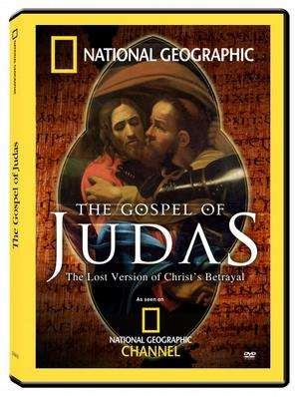
The Gospel of Judas
(2nd Century)

Slide 14
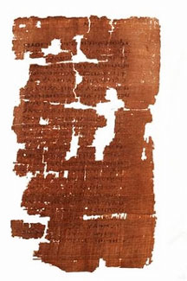
The Gospel of Judas
(2nd Century)
We Had No Physical Copy of This Book Until 1970.
Before We Only Had Some Possible References To It In Other Writings.
Paints A Different Picture of Judas. He Only Betrayed Jesus At His Request. He Was Actually A Chief Apostle.

Slide 15
The Gospel of Judas
(2nd Century)
Bible
Judas Allowed Satan
To Fill His Heart
And Betrayed Jesus
Gospel of
Judas
Judas Was A
Superior Apostle
Who Betrayed Jesus
In Obedience

Slide 16

Is This A Conspiracy?
These Books Are Not Lost. There Is Nothing New About Them!

Slide 17
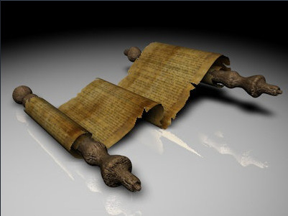
Irenaeus, Against Heresies, I.31
“They declare that Judas the traitor was thoroughly acquainted with these things, and that he alone, knowing the truth as no others did, accomplished the mystery of the betrayal; by him all things, both early and heavenly, were thus thrown into confusion. They produce a fictitious history of this kind, which they style the Gospel of Judas.”

Slide 18
Hyppolytus, Cathechetical Lecture 6.31
“Let none read the Gospel according to Thomas for it is the work not of one of the twelve Apostles, but of one of the three wicked disciples of Manes.”

Slide 19
Why This Is Not A Conspiracy
These Books Are Not Lost. There Is Nothing New About Them.
These Books Were Not Written By The Claimed Authors (A Literary Style).
They Were Known In The Ancient World And Considered False Gospels.
They Are Not Early Like The Biblical Books.
Though They Are Called Gospels They Are Nothing Like The Gospels of the Bible.
They Show The Sinful Perversion Of Some In The Ancient World and Even Today.

Slide 20
Four Different Groups of Books Exist
Homologuomena (Agreement) - Books recognized by all, early and succeeding generations, as being canonical.
Antilegomena (Spoken Against) - Books that were disputed as to their canonicity by some.
Pseudepigrapha (False Writing) - Books rejected by all as not being part of the biblical canon.
Apocrypha (Secret) - Books that were accepted by some, but rejected by most.

Slide 21
Old Testament
Homologuomena – Accepted By All
  All 39 Books Except 5 Books.
The Antilegomena – Rejected By Some
  Song of Solomon
  Ecclesiastes
  Esther
  Ezekiel
  Proverbs

Slide 22
Old Testament
Pseudepigrapha – Rejected By All
These books were written between the years 200 B.C. and A.D. 200. (well after the Old Testament and some even after the New).
Although they claim to have been written by biblical authors, they actually express religious fancy and magic in their stories.
However, not everything in them was false and useless and, even though they were not inspired books, the New Testament writers might have used a number of them in their writings.
-- Giesler and Nix, A General Introduction To The Bible. Page 262

Slide 23
The Book of Jubilee
The Letter of Aristeas
The Book of Adam and Eve
The Martyrdom of Isaiah
1 Enoch
The Testament of the Twelve Patriarchs
The Sibyline Oracle
The Assumption of Moses
2 Enoch
2 Baruch
3 Baruch
3 Maccabees
4 Maccabees
Pirke Aboth
The Story of Ahikar
The Psalms of Solomon
Psalm 151
The Fragment of A Zadokite Work
-- Giesler and Nix, A General Introduction To The Bible. Page 263

Slide 24
Old Testament
Apocrypha – Accepted By Some, But Rejected By Most.
The meaning of the term “Apocrypha” is “hidden or secret.” These books were thought to contain hidden or secret knowledge known only to a few.
The books, which number fifteen, are accepted by some as being canonical.
They were all written during the intertestimental period.
The Roman Catholic Church Didn’t Officially Accept Them Until 1546 (Council of Trent).

Slide 25
1. The First Book of Esdras (also known as Third Esdras)
2. The Second Book of Esdras (also known as Fourth Esdras)
3. Tobit
4. Judith
5. The Additions to the Book of Esther
6. The Wisdom of Solomon
7. Ecclesiasticus, or the Wisdom of Jesus the Son of Sirach
8. Baruch
9. The Letter of Jeremiah (This letter is sometimes incorporated as the last chapter of Baruch. When this is done the number of books is fourteen instead of fifteen.)
10. The Prayer of Azariah and the Song of the Three Young Men
11. Susanna
12. Bel and the Dragon
13. The Prayer of Manasseh
14. The First Book of Maccabees
15. The Second Book of Maccabees
Jesus Never Mentioned
Or Quoted From Them

Slide 26
New Testament
Homologuomena – Accepted By All
  20 out of 27 books are part of the Homologoumena.
  1. Matthew - Philemon
  2. 1 Peter
  3. 1 John

Slide 27
New Testament
  The Antilegomena – Rejected By Some
  7 books of the New Testament are found in this category.
  1) Hebrews
  2) James
  3) 2 Peter
  4) 2 John
  5) 3 John
  6) Jude
  7) Revelation

Slide 28
New Testament
280 Books
Pseudepigrapha – Rejected By All
From the 2nd-4th Centuries, many books were written that were nothing more than fanciful and heretical writings. Eusebius called them “totally absurd.”
These books indicated the heretical teachings of the gnostics, docetics (Jesus was not human), and ascetic (All flesh is evil) groups.
They were never accepted as being canonical.
-- Giesler and Nix, A General Introduction To The Bible. Page 300

Slide 29
The Gospel of Thomas
Protevangelium of James
The Gospel of Philip
The Gospel of Judas
The Gospel of Mary
Life of Adam and Eve -- translation of the Slavonic version
Life of Adam and Eve -- translation of the Greek version (a.ka. The Apocalypse of Moses)
The Apocalypse of Adam
The Book of Adam
The Second Treatise of the Great Seth
Enoch (another version)
Melchizedek
The Book of Abraham
The Testament of Abraham
The Apocalypse of Abraham NEW July 18, 2004
Joseph and Aseneth
Selections from The Book of Moses
Revelation of Moses
The Ascension of Isaiah
The Revelation of Esdras
The Book of Jubilees
Tales of the Patriarchs
The Letter of Aristeas

Slide 30
M
Q
Luke
J
MK

