Slide 1
2010 REPORT
BY
JESUS TREVINO
LAKE JACKSON, TX.

Slide 2
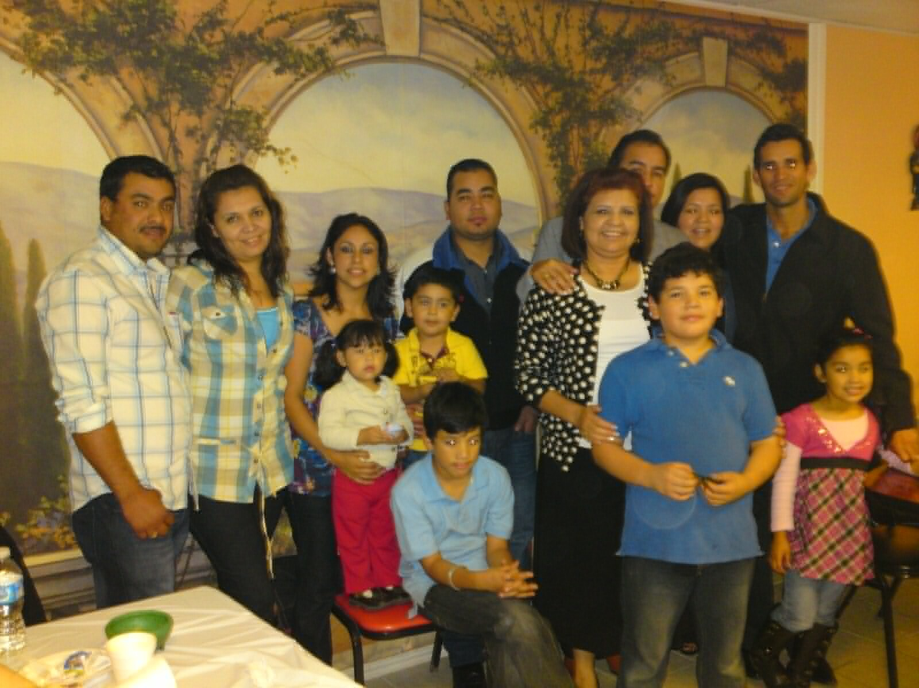

Slide 3
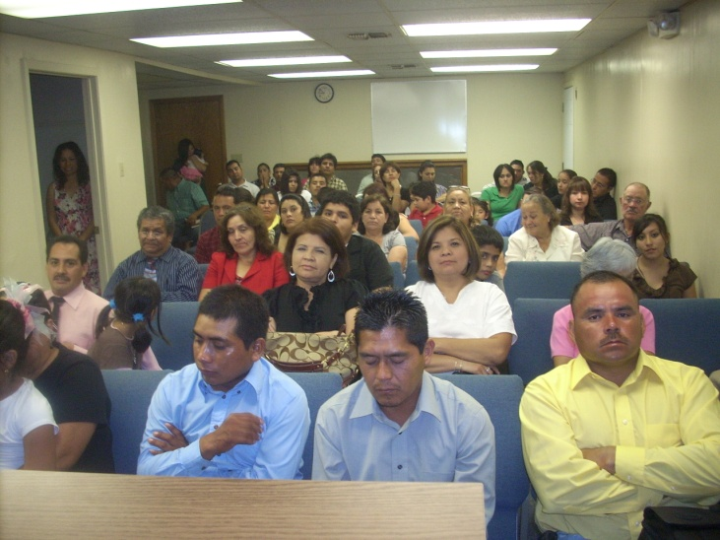

Slide 4
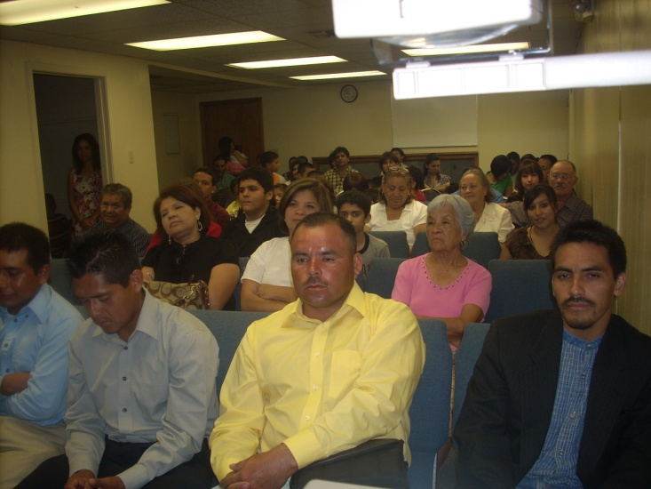

Slide 5
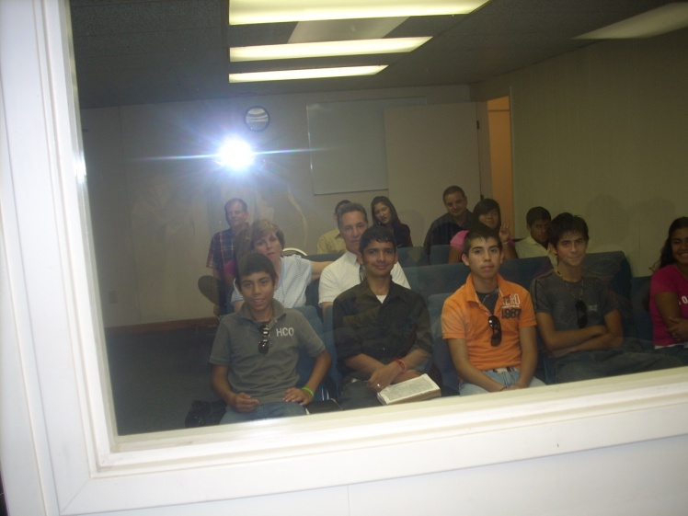

Slide 6
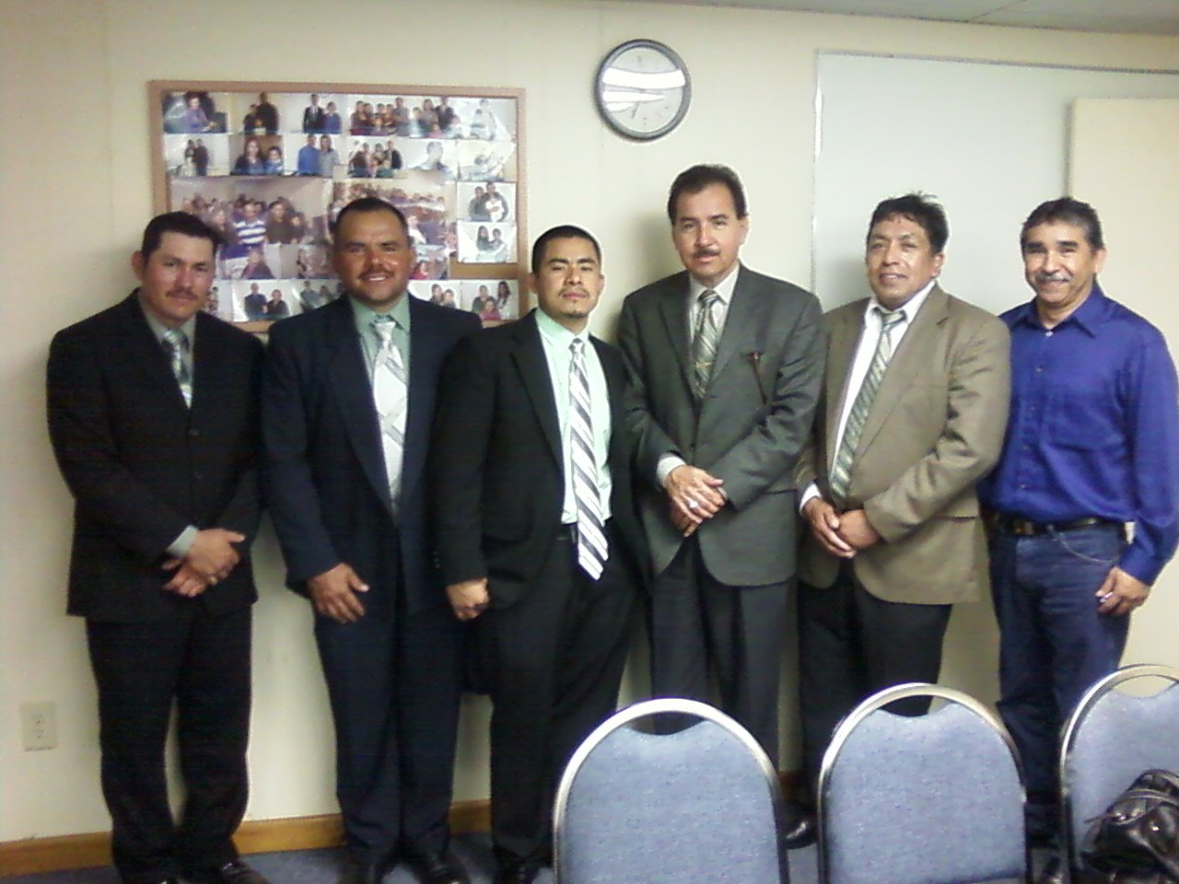

Slide 7
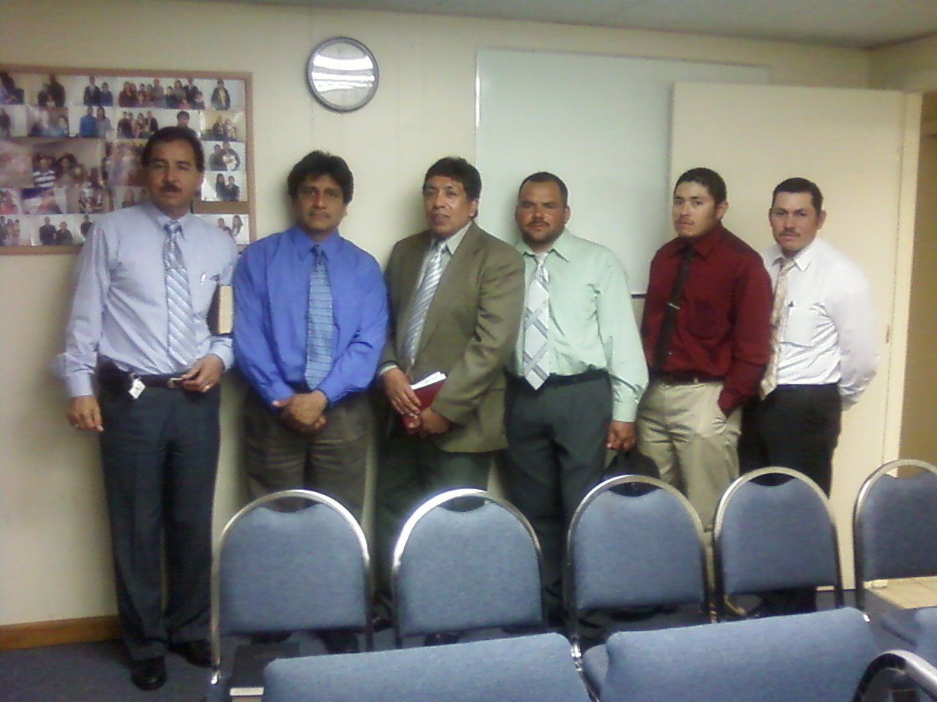

Slide 8
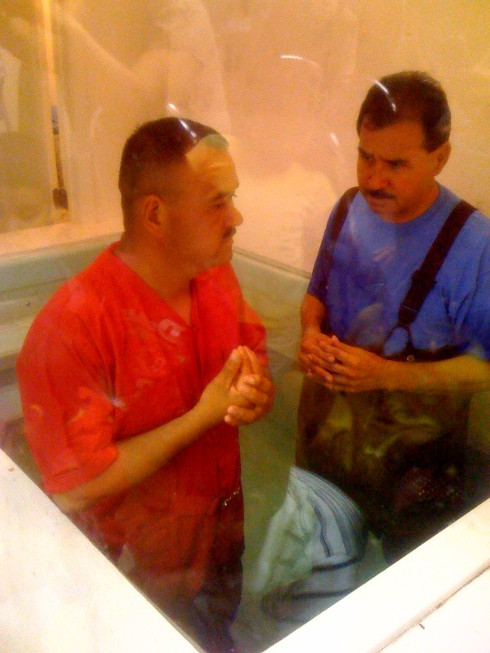

Slide 9
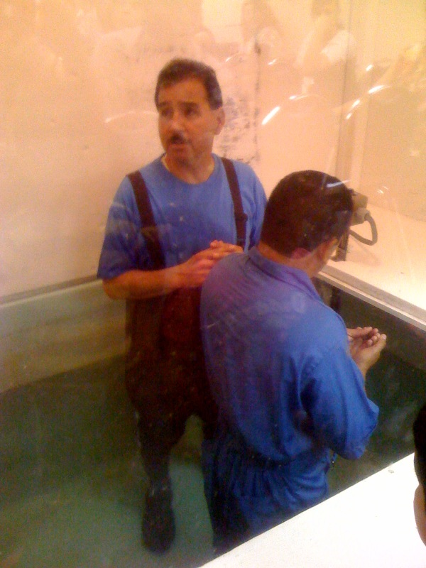

Slide 10
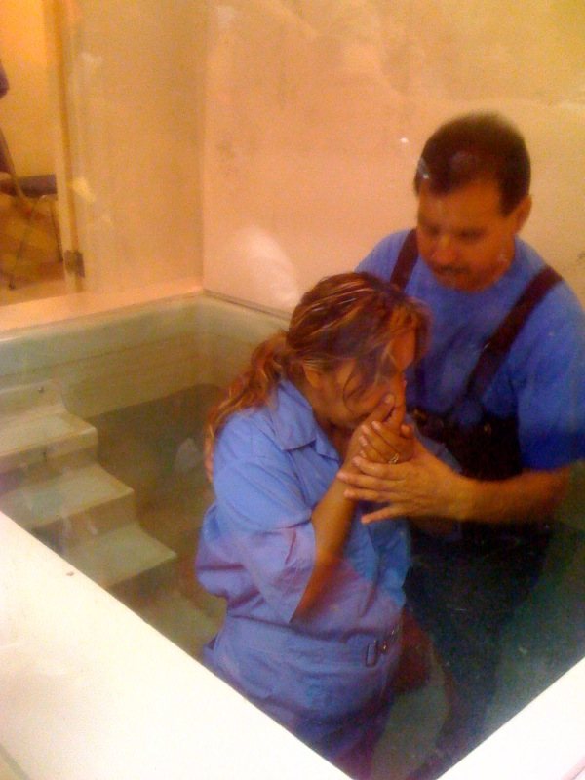

Slide 12
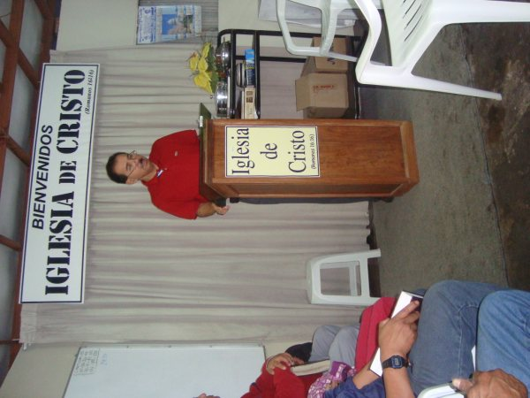

Slide 13
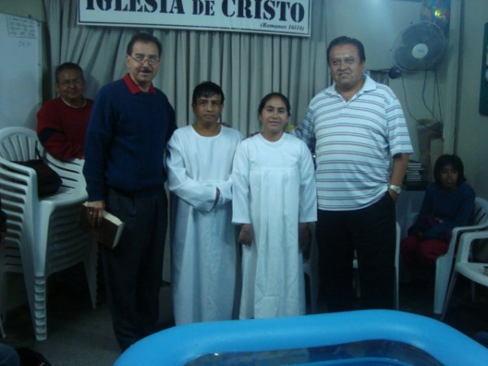

Slide 14
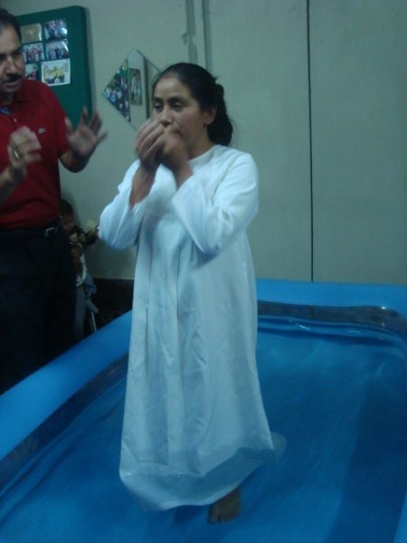

Slide 15
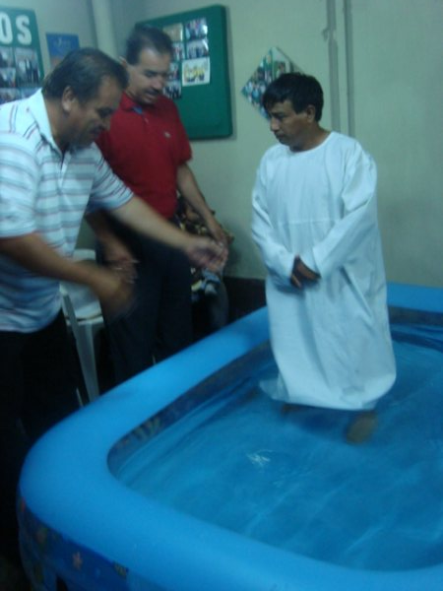

Slide 16
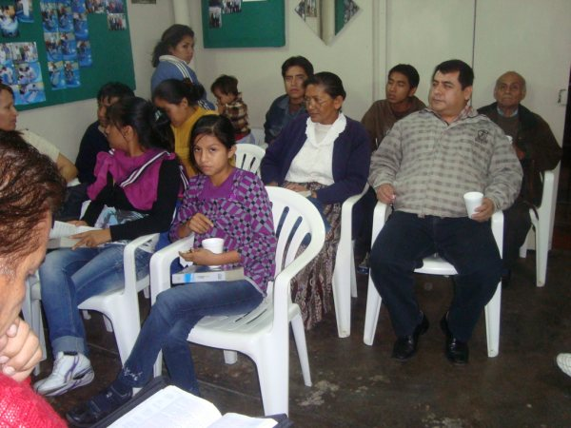

Slide 17
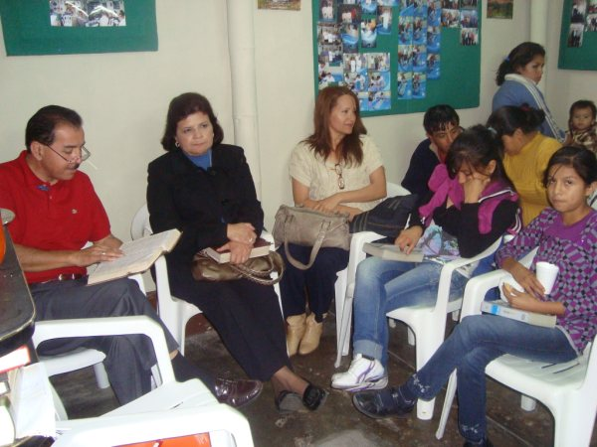

Slide 18
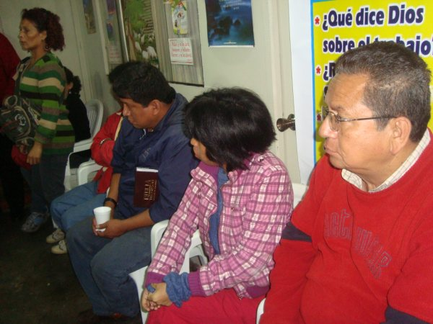

Slide 19
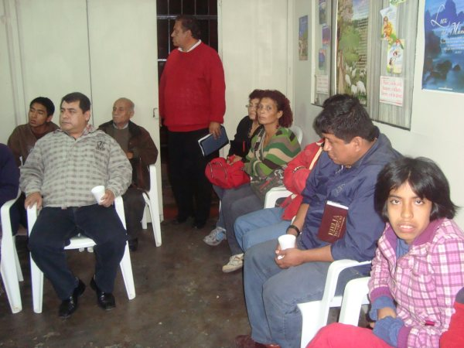

Slide 20
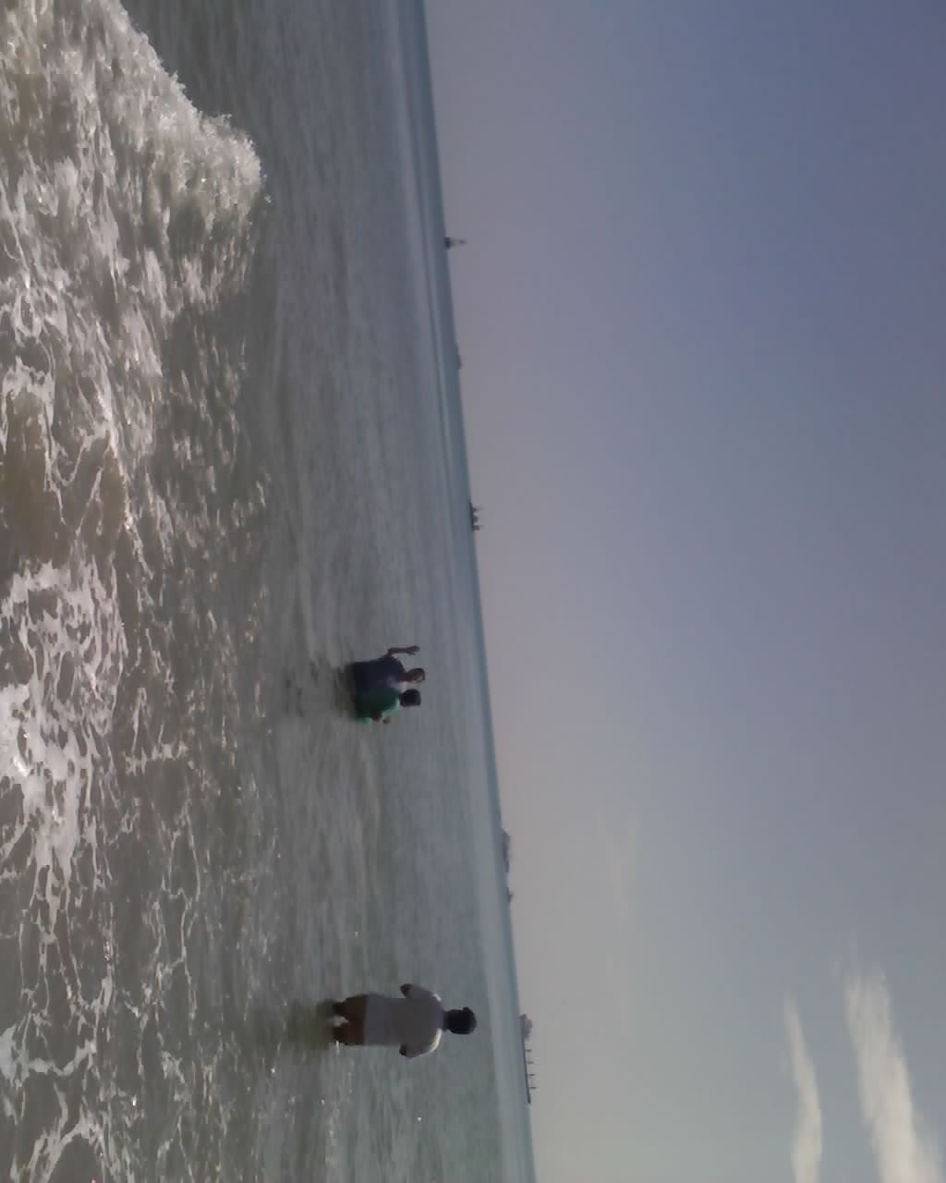

Slide 21
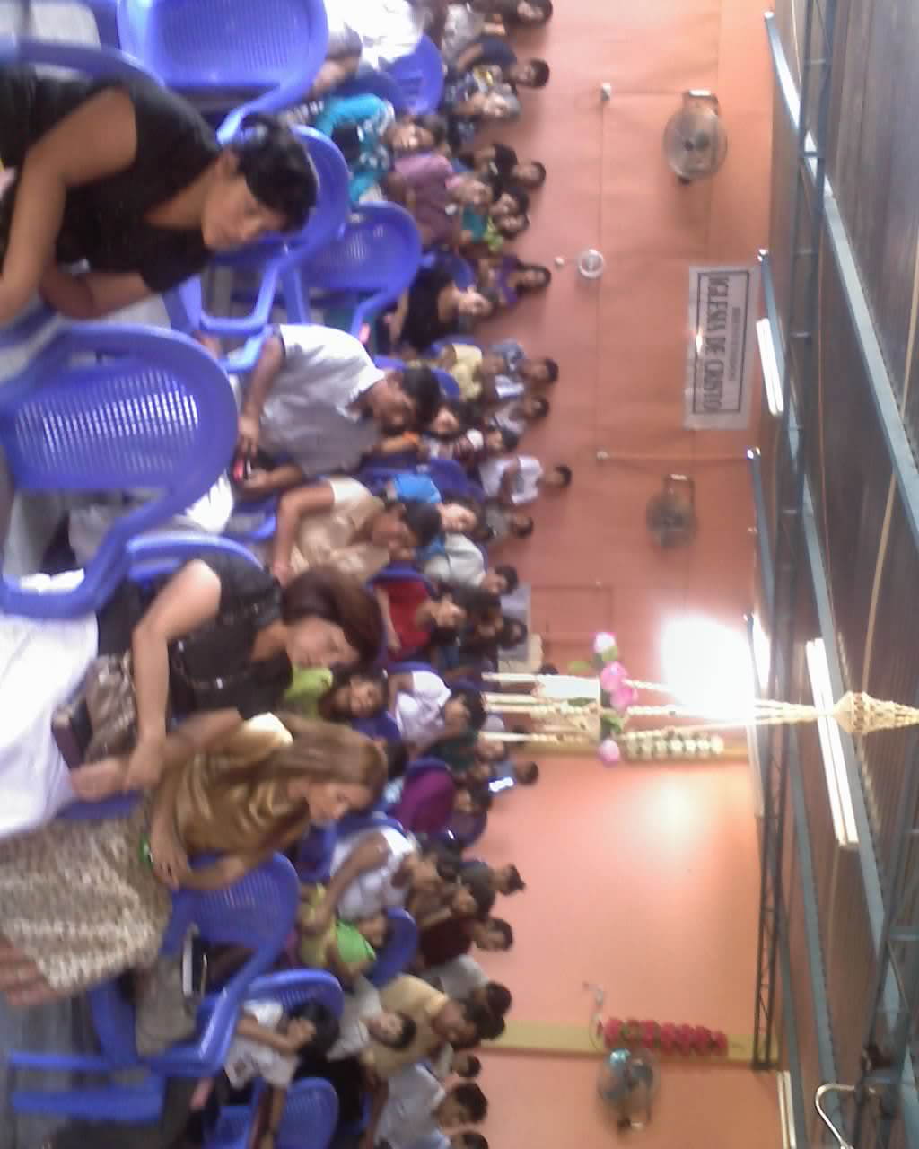

Slide 22
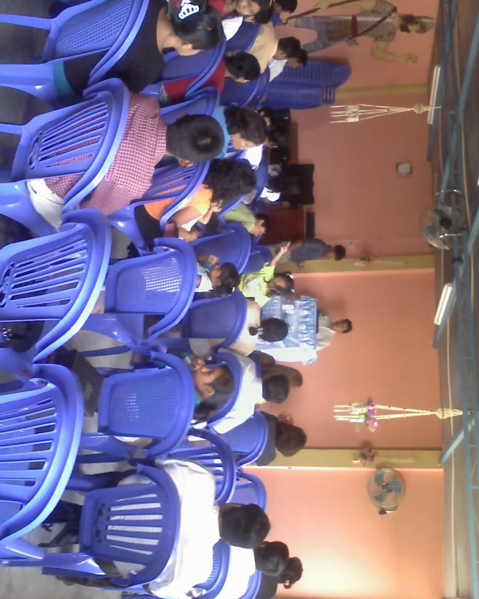

Slide 23
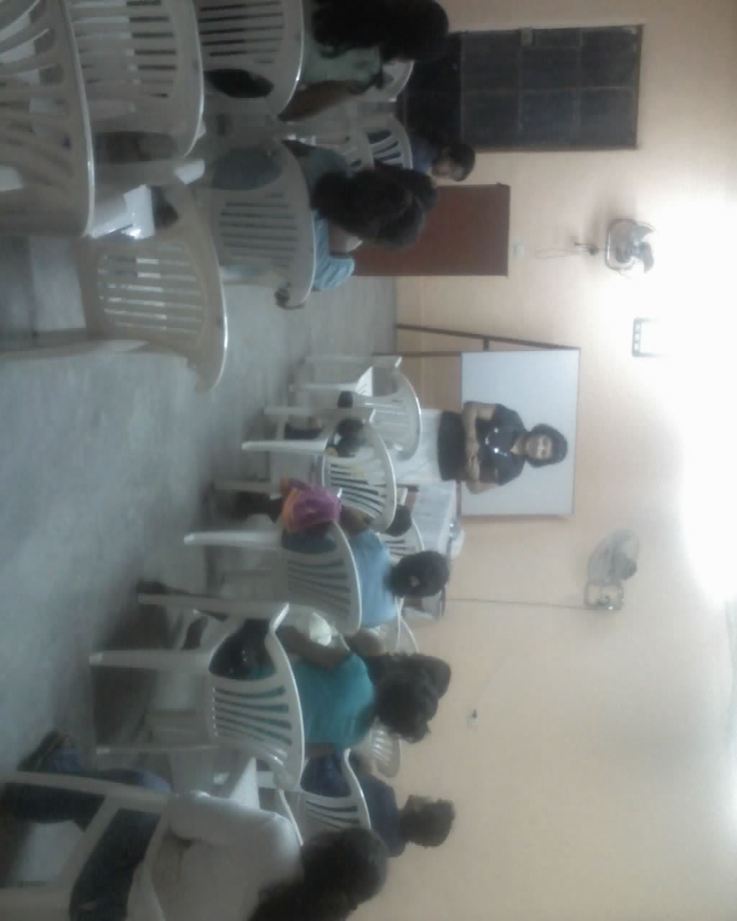

Slide 24
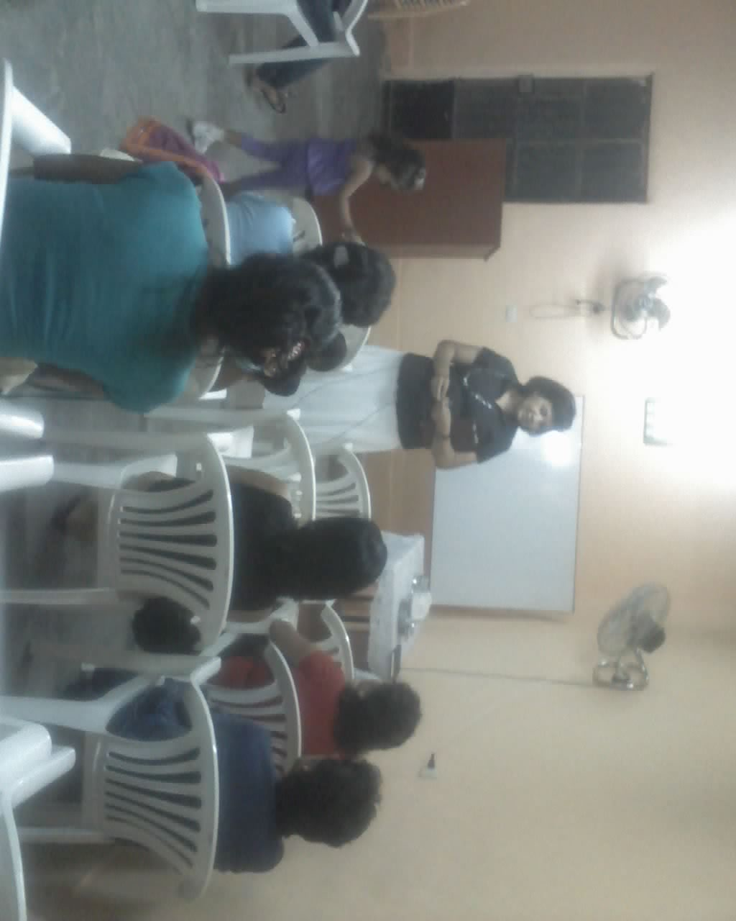

Slide 25
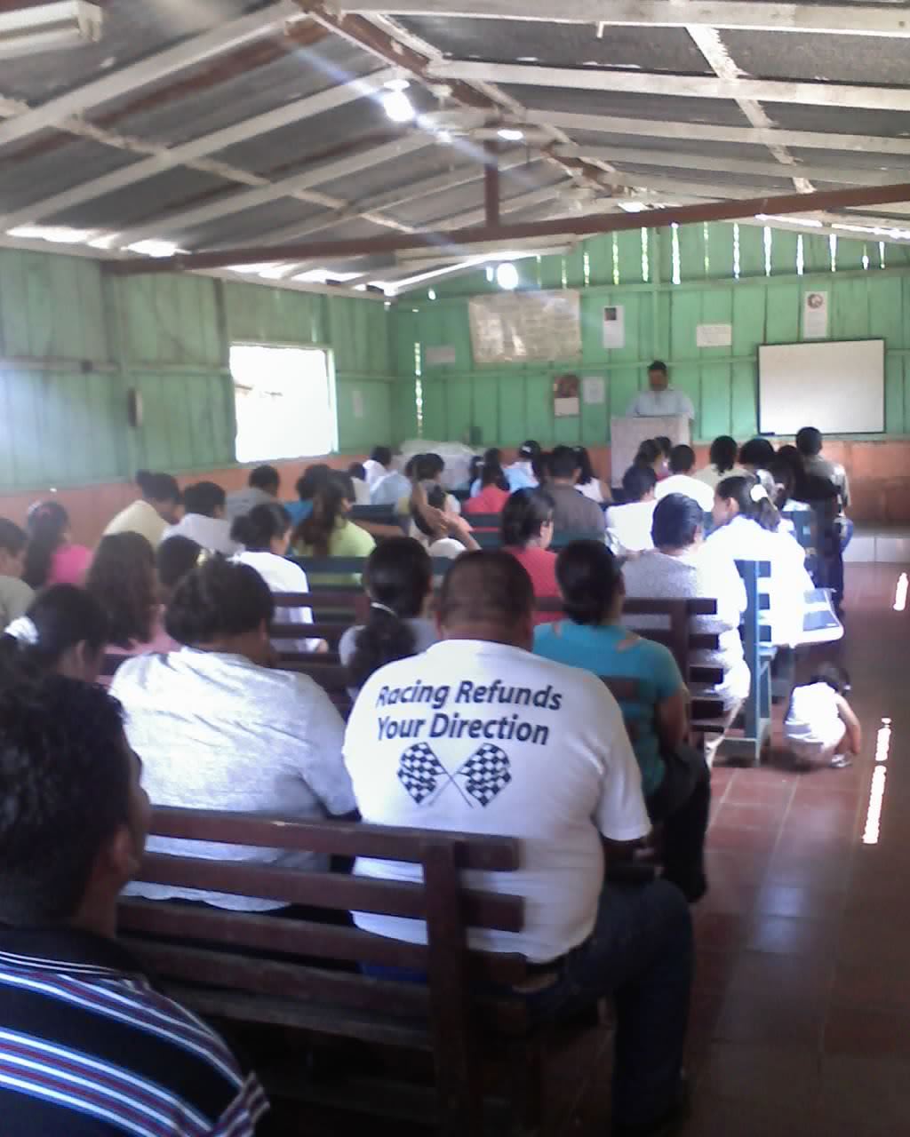

Slide 26
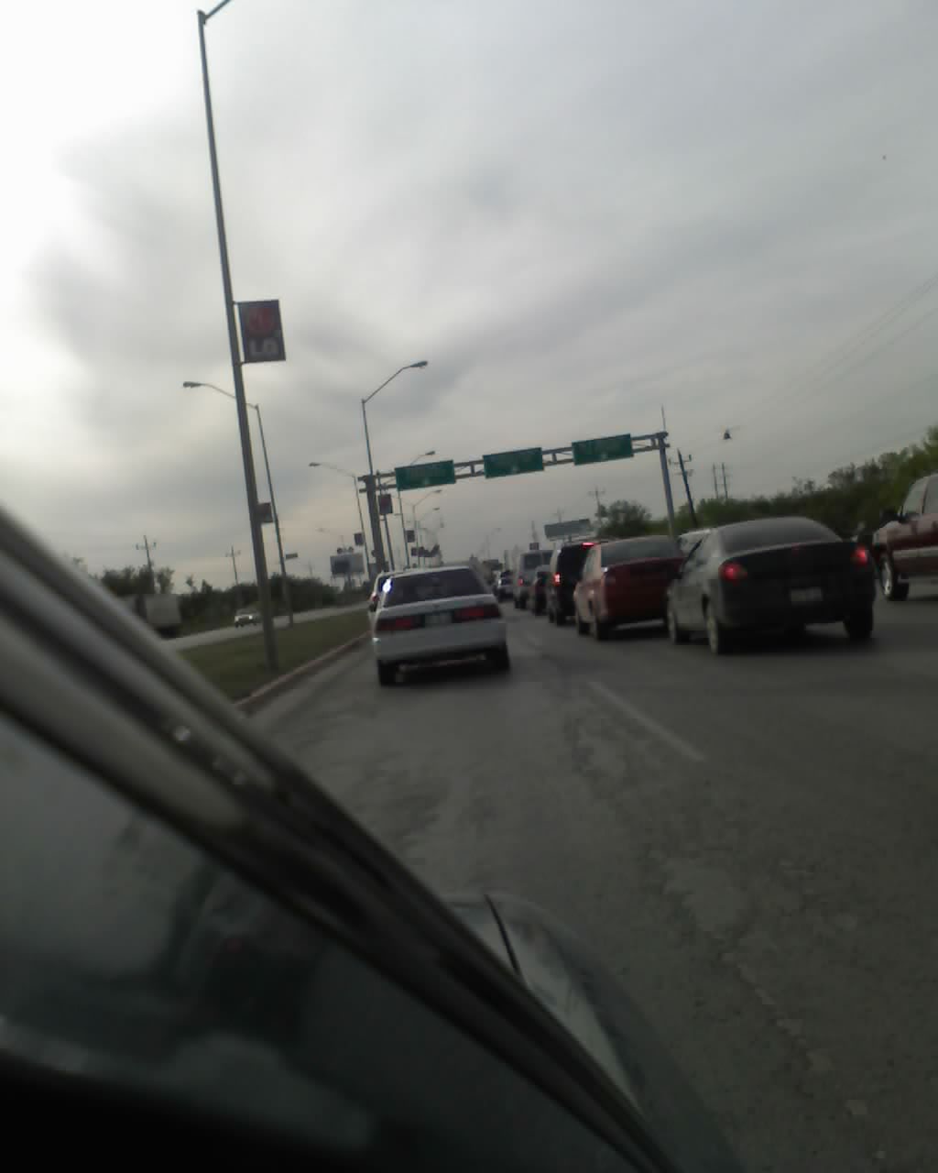

Slide 27
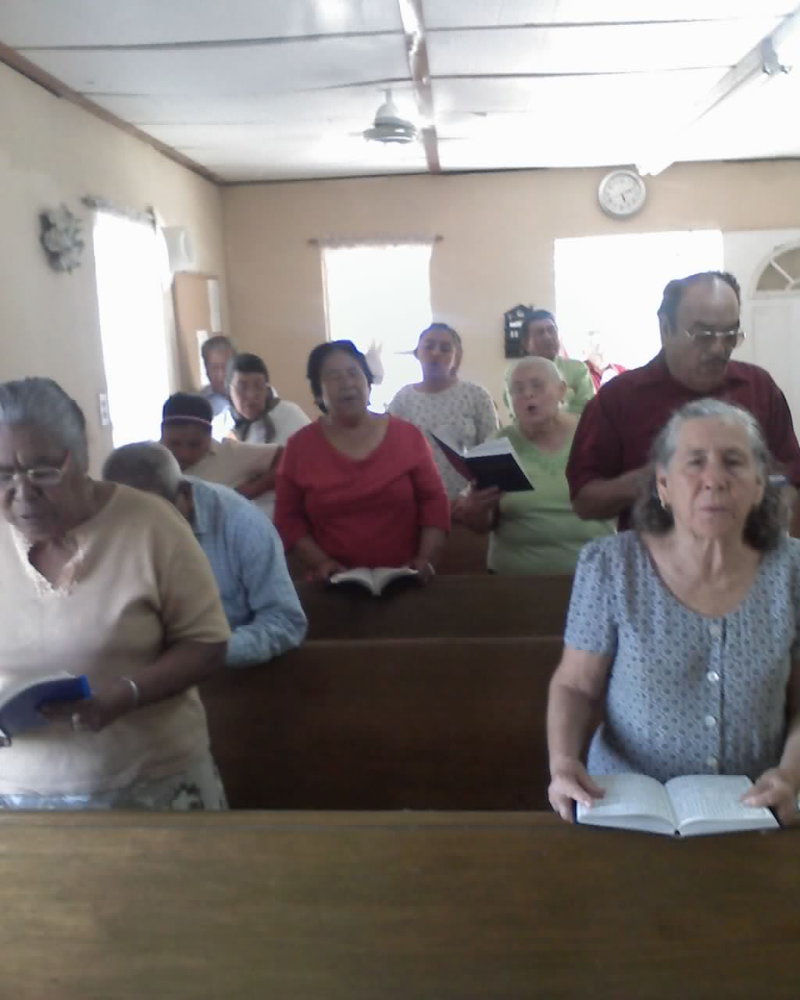

Slide 28
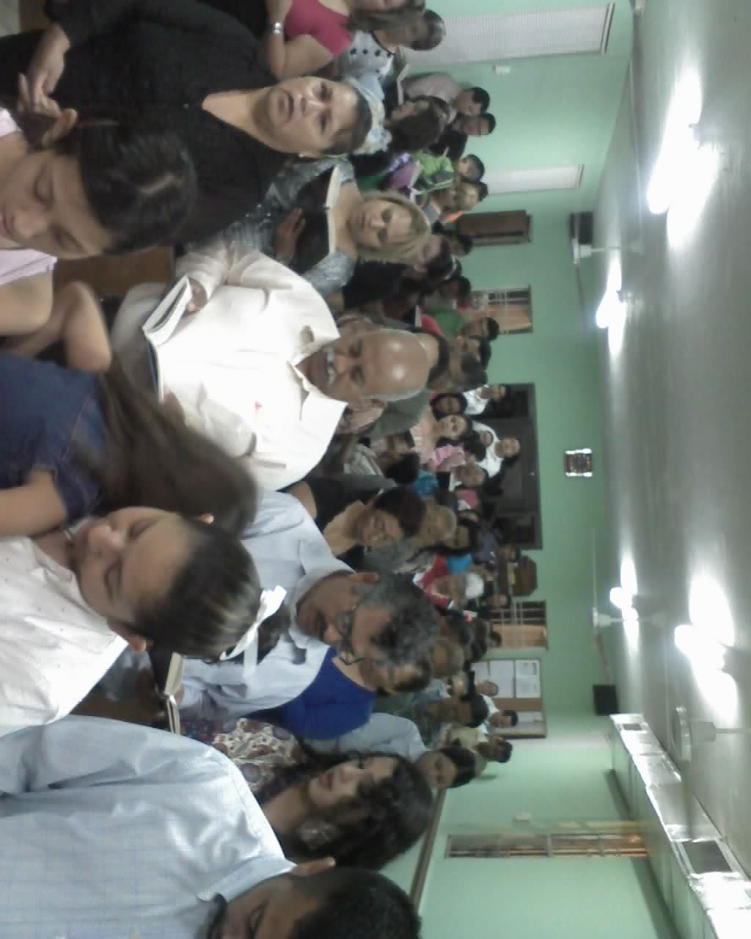

Slide 29
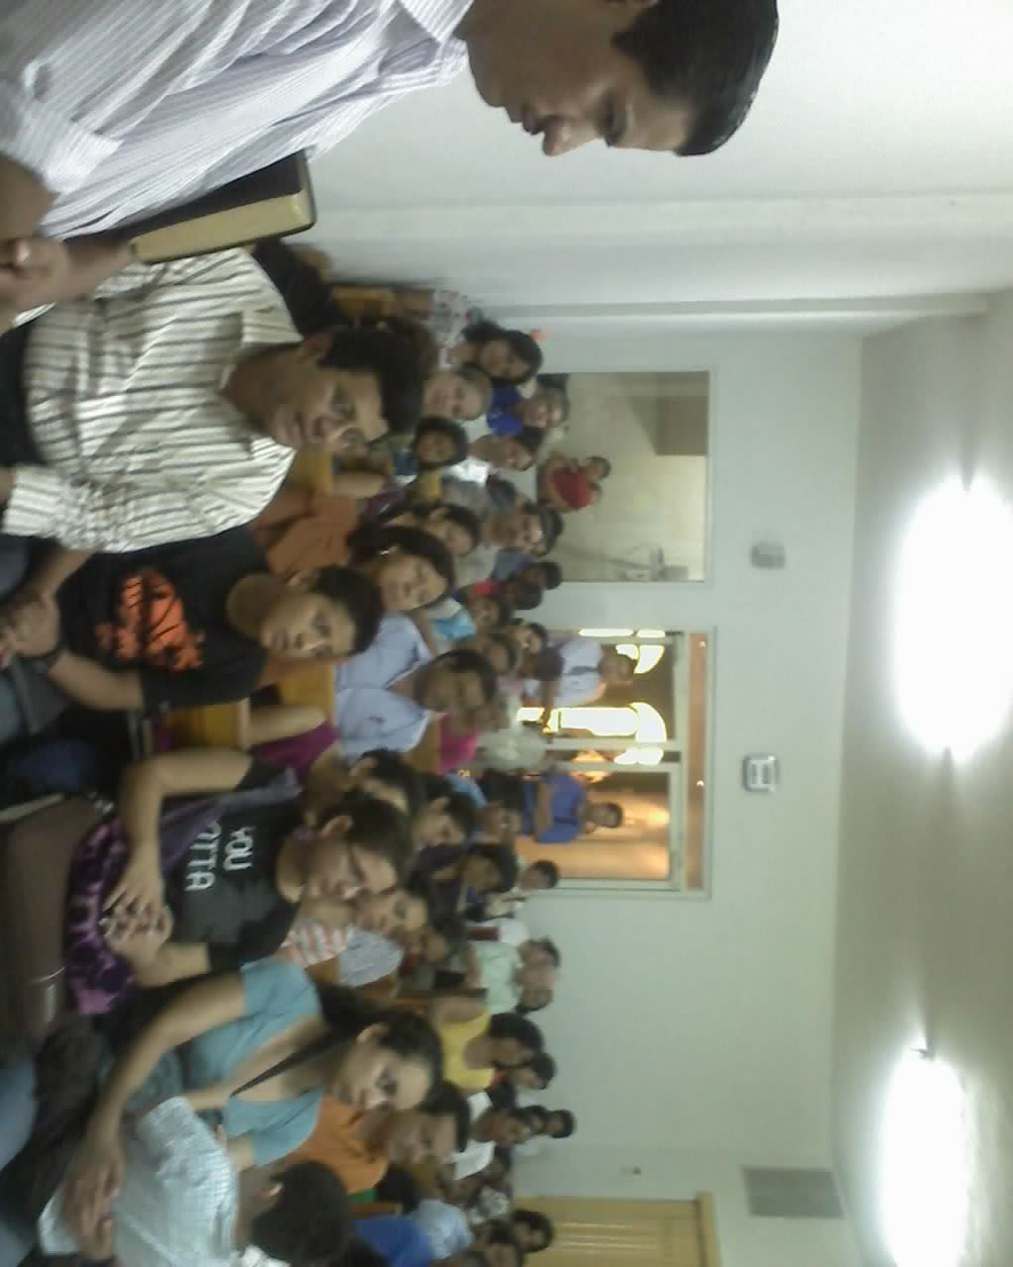

Slide 30
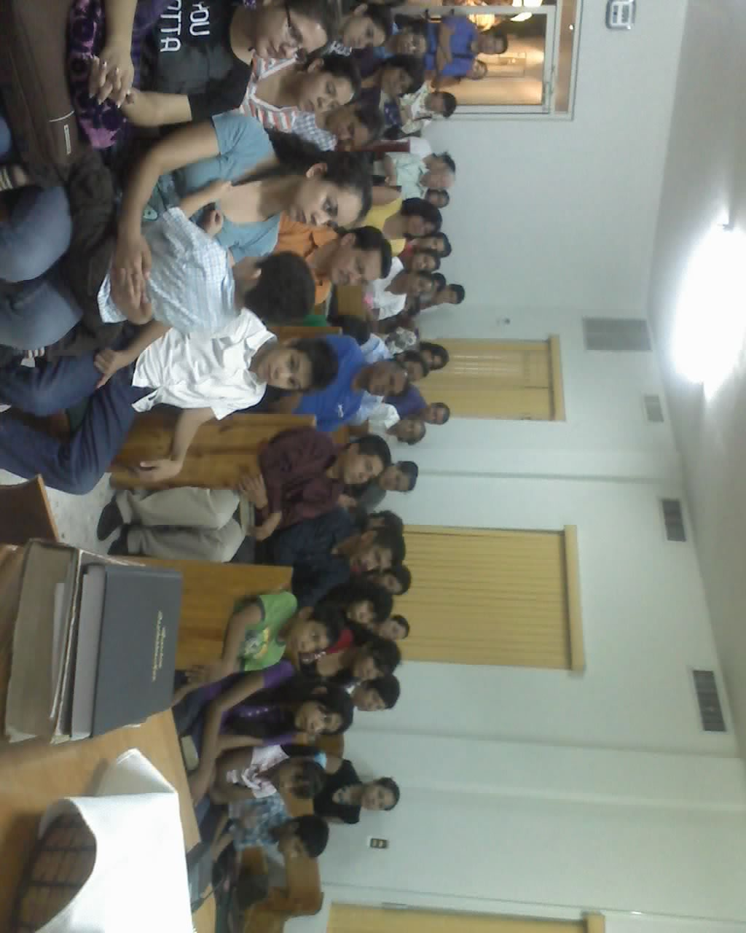

Slide 31
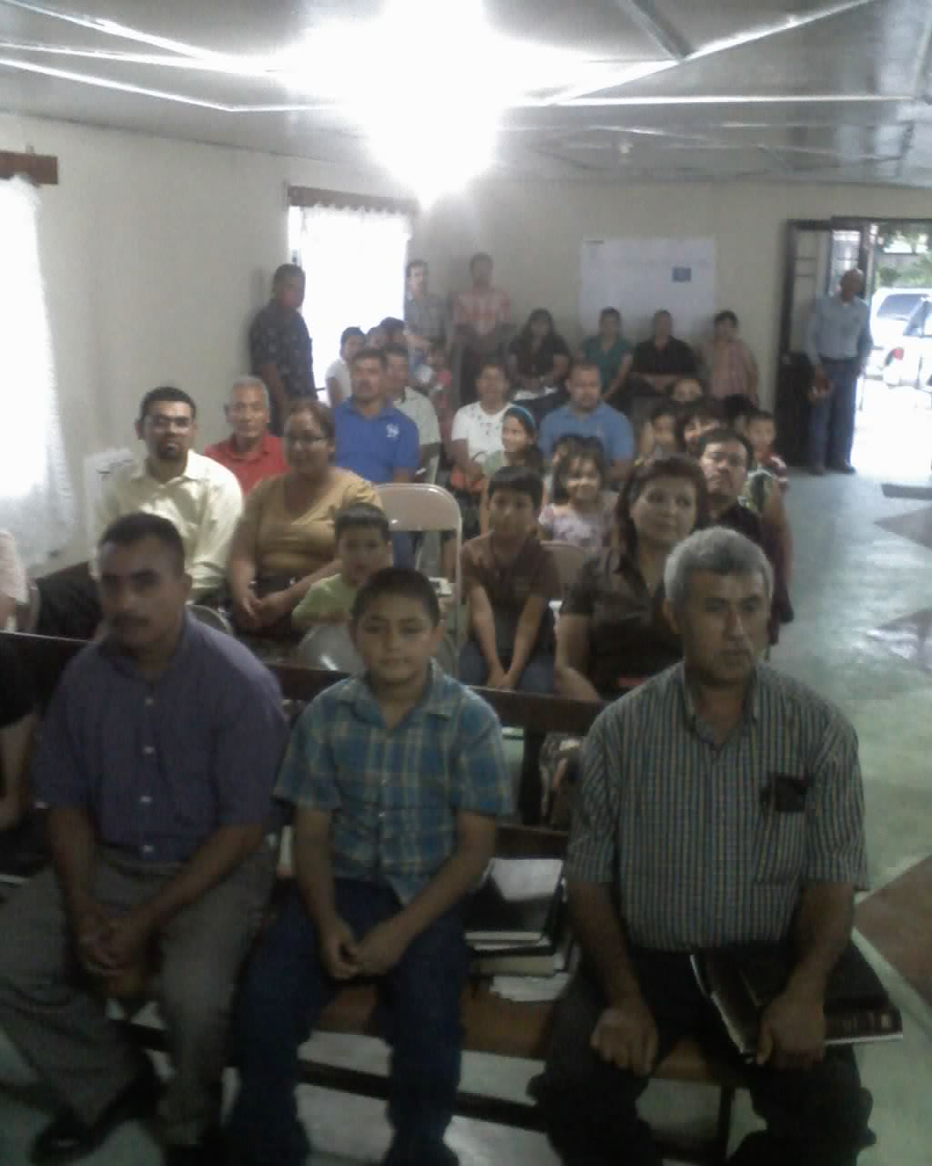

Slide 32
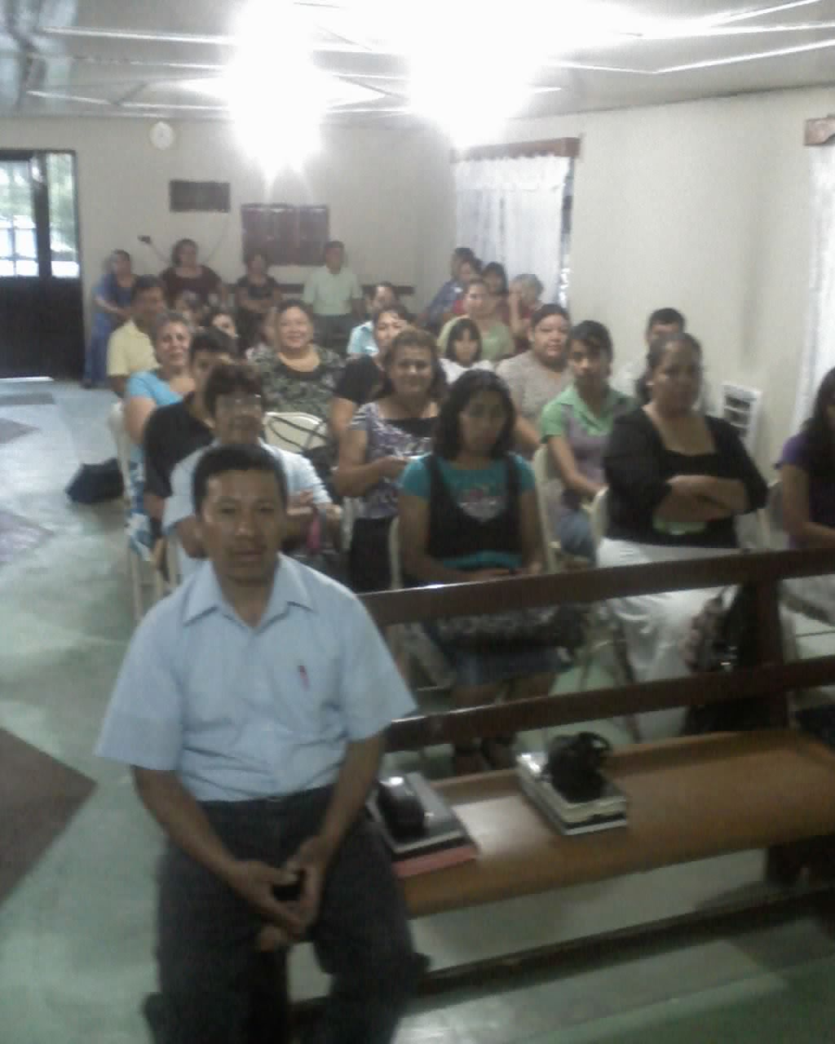

Slide 33
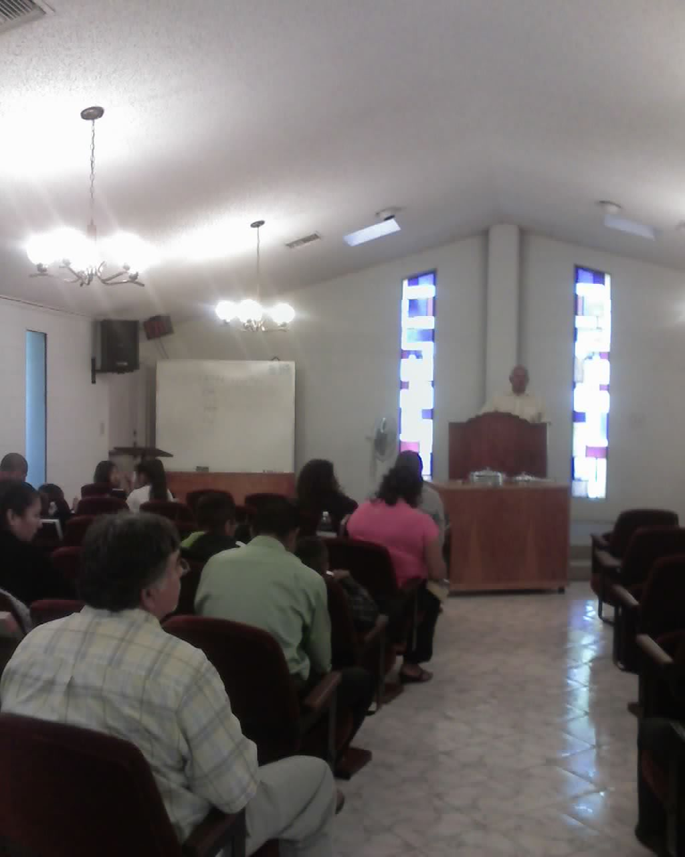

Slide 34
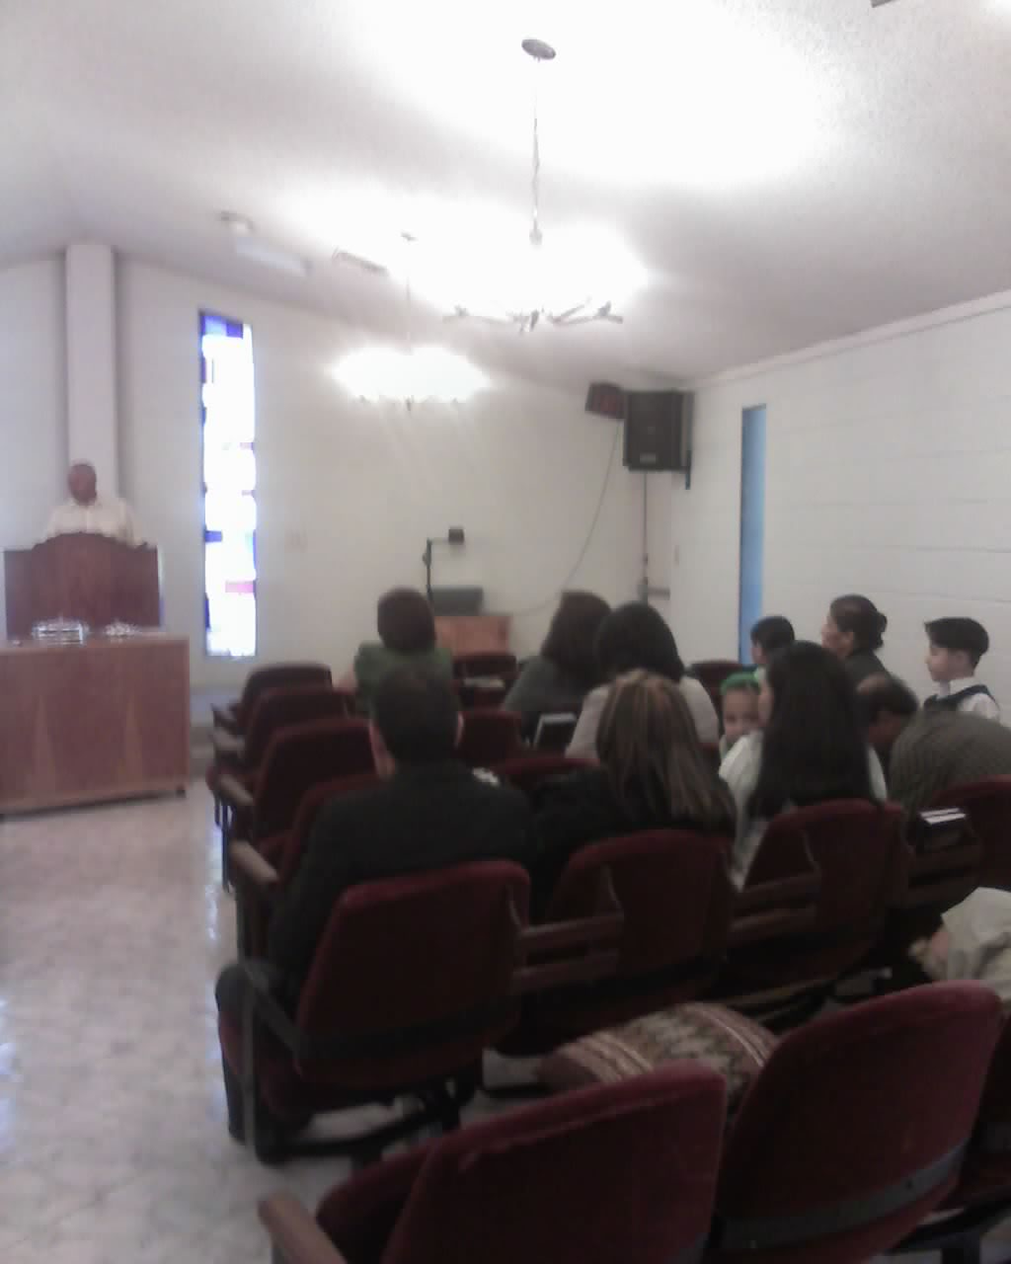

Slide 35
THE SALVATION
REV. 7:10
After these things I looked, and behold, a great multitude which no one could number, of all nations, tribes, peoples, and tongues, standing before the throne and before the Lamb, clothed with white robes, with palm branches in their hands.

Slide 36
1 PETER 1:5
Who are kept by the power of God through faith for salvation ready to be revealed in the last time.

Slide 37
GRACE
EPHESIANS 2:5
Even when we were dead in trespasses, made us alive together with Christ (by grace you have been saved).

Slide 38
ROMANS 6:23
For the wages of sin is death, but the gift of God is eternal life in Christ Jesus our Lord.
Odsonia – Wages
Charisma – Gift

Slide 39
FAITH
ROMANS 5:1
Therefore, having been justified by faith, we have peace with God through our Lord Jesus Christ.
1 PETER 1:9
Receiving the end of your faith – the salvation of your souls.

Slide 40
HEBREWS 5:9
And having been perfected, He became the author of eternal salvation to all who obey Him.
HEBREWS 11:6,7
But without faith it is impossible to please Him, for he who comes to God must believe that He is, and that He is a rewarder of those who diligently seek Him.

Slide 41
WORKS
JAMES 2:24
You see then that a man is justified by works, and not by faith only.
EPHESIANS 2:10
That in the dispensation of the fullness of the times He might gather together in one all things in Christ, both which are in heaven and which are on earth – in Him.

Slide 42
MATTHEW 25:31
“When the Son of Man comes in His glory, and all the holy angels with Him, then He will sit on the throne of His glory.
1 THESSALONIANS 1:3
Remembering without ceasing your work of faith, labor of love, and patience of hope in our Lord Jesus Christ in the sight of our God and Father.

Slide 43
PREACHING
1 COR 1:21
For since, in the wisdom of God, the world through wisdom did not know God, it pleased God through the foolishness of the message preached to save those eho believe.

Slide 44
ROMANS 10:13-14
For “whoever calls on the name of the LORD shall be saved”.
How then shall they call on Him in whom they have not believed? And how shall they believe in Him of whom they have not heard? And how shall they hear without a preacher?

Slide 45
ACTS 22:10
“So I said, “What shall I do, Lord? And the Lord said to me, ‘Arise and go into Damascus, and there you will be told all things which are appointed for you to do’.

Slide 46
BLOOD
ROMANS 5:9
Much more then, having now been justified by His blood, we shall be saved from wrath through Him.
REVELATION 7:14. And I said to him, “Sir, you know.” So he said to me, “These are the ones who come out of the great tribulation, and washed their robes and made them white in the blood of the Lamb.

Slide 47
1 JOHN 1:7-10
But if we walk in the light as He is in the light, we have fellowship with one another, and the blood of Jesus Christ His Son cleanses us from all sin.
If we say that we have no sin, we deceive ourselves, and the truth is not in us.
If we confess our sins, He is faithful and just to forgive us our sins and to cleanse us from all unrighteousness.
If we say that we have not sinned, we make Him a liar, and His word is not in us.

Slide 48
BAPTISM
I PETER 3:21
There is also an antitype which now saves us – baptism (not the removal of the filth of the flesh, but the answer of a good conscience toward God), through the resurrection of Jesus Christ.

Slide 49
MARK 16:16
“He who believes and is baptized will be saved; but he who does not believe will be condemned.
ACTS 2:38
The Peter said to them, “Repent, and let every one of you be baptized in the name of Jesus Christ for the remission of sins; and you shall receive the gift of the Holy Spirit.

Slide 50
ACTS 22:16
And now why are you waiting? Arise and be baptized, and wash away your sins, calling on the name of the Lord.
GALATIANS 3:27
For as many of you as were baptized into Christ have put on Christ.

