Slide 1
The Power of Scripture In My Life
“For the word of God is living and powerful, and sharper than any two-edged sword , piercing even to the division of soul and spirit, and of joints and marrow, and is a discerner of the thoughts and intents of the heart. 13 And there is no creature hidden from His sight, but all things are naked and open to the eyes of Him to whom we must give account. Heb. 4:12-13

Slide 2
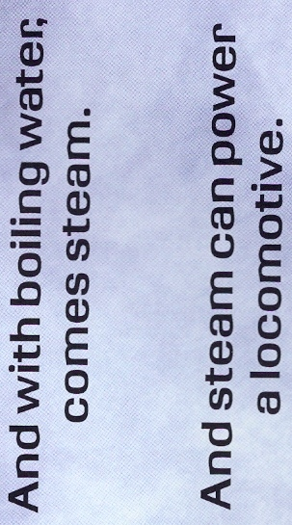
Our Potential

Slide 3
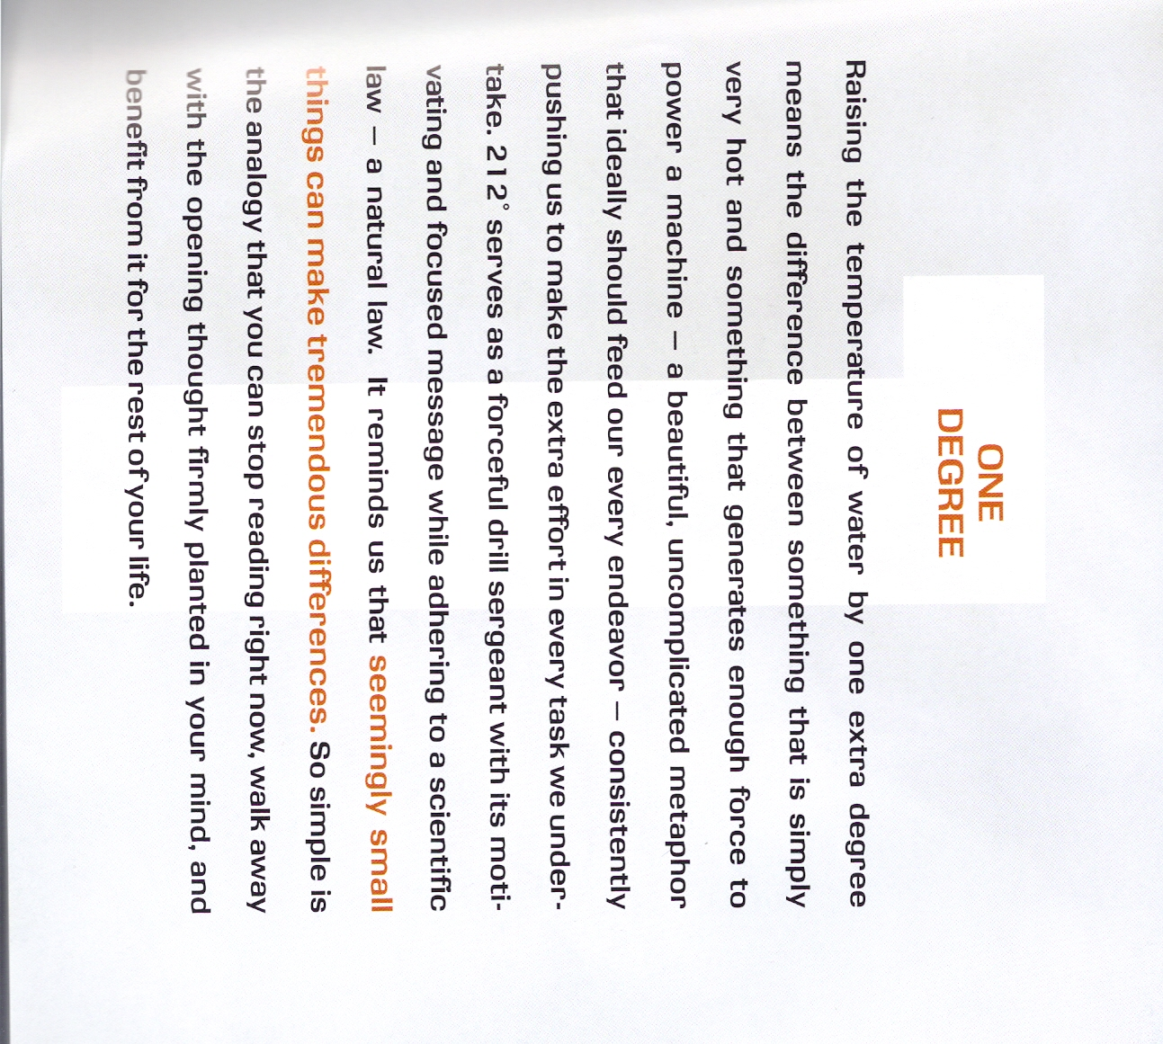
Our Potential

Slide 4
Introduction in Scripture
In the opening statement of the Bible we are told that God exist and created everything else we can know about. Introduction - Gen 1:1 “In the beginning God created the heavens and the earth.”
Heb 1:1 “God, who at various times and in various ways spoke in time past to the fathers by the prophets, 2 has in these last days spoken to us by His Son,”
2 Tim 3:16 “All Scripture is given by inspiration of God, and is profitable for.. that the man of God may be complete”

Slide 5
Facts & Thoughts “Inches make a champion.” Vince Lombadi
Professional Golf; The average margin of victory for the last 25 years in all 4 major tournaments combined was less than 3 strokes.
The margin of victory between an Olympic Gold Medal and no medal is extremely small:
Men’s 200 meter freestyle – 1.42 seconds
Women’s 200 meter freestyle - .59 seconds
Men’s 800 meter race - .71 seconds
Women’s 800 meter race - .13 seconds

Slide 6
Facts from Scripture
God destroyed all but eight souls because of man’s wicked behavior, started over with a new slate. God has an attitude about sin. Sin separates us from God, but He has a plan for reconciling man to Him. Choosing one family through which the savior would come. The New Testament reveals the coming of this savior who is part Deity, part man, and what He did for us. While not succinctly stated, it is all there to be understood.

Slide 7
Stories of Service

Slide 8
Stories of Service “To get what we’ve never had, we must do what we’ve never done.” Anon
Examples of faith reviewed for us in Hebrews the 11th chapter. For us, to God; Rom 12:1“I beseech you therefore, brethren, by the mercies of God, that you present your bodies a living sacrifice, holy, acceptable to God, which is your reasonable service.”
To others; “to prepare God's people for works of service , so that the body of Christ may be built up”. Eph 4:12

Slide 9
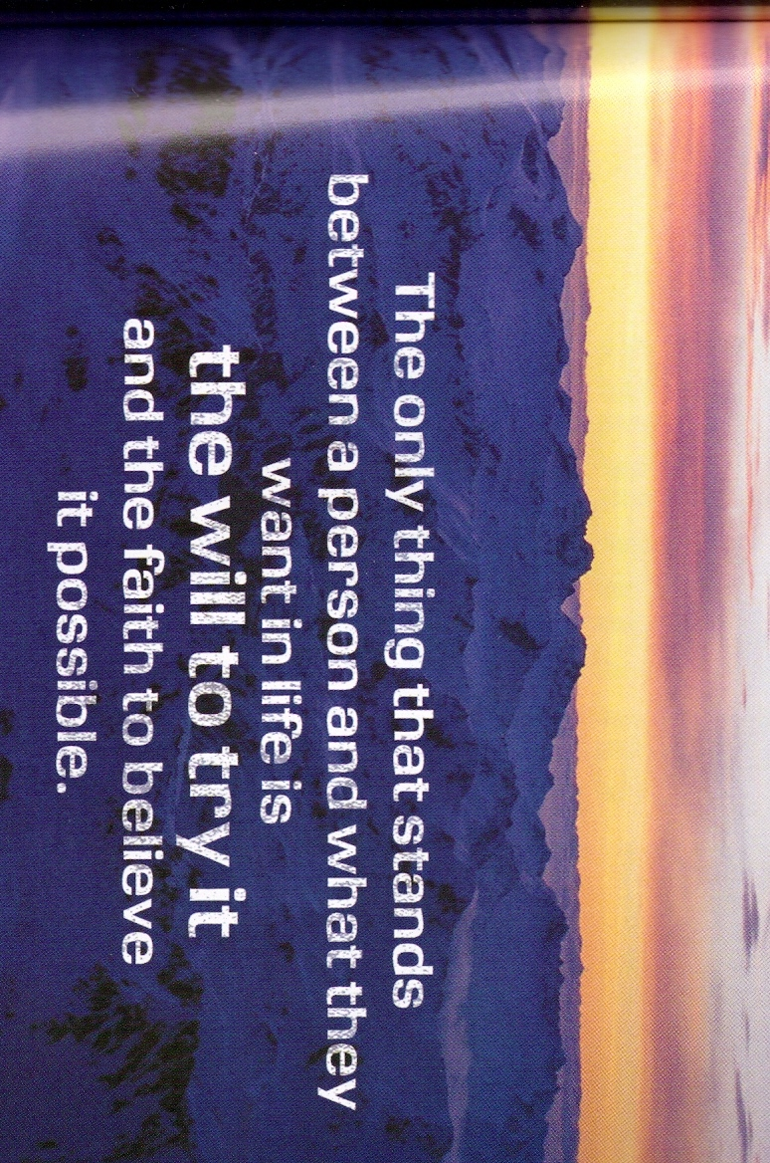
Attitude Counts
“Set your mind on things above, not on things on the earth.” Col 3:2

Slide 10
Leadership
“For to this you were called, because Christ also suffered for us, leaving us an example , that you should follow His steps:” 1 Peter 2:21

Slide 11
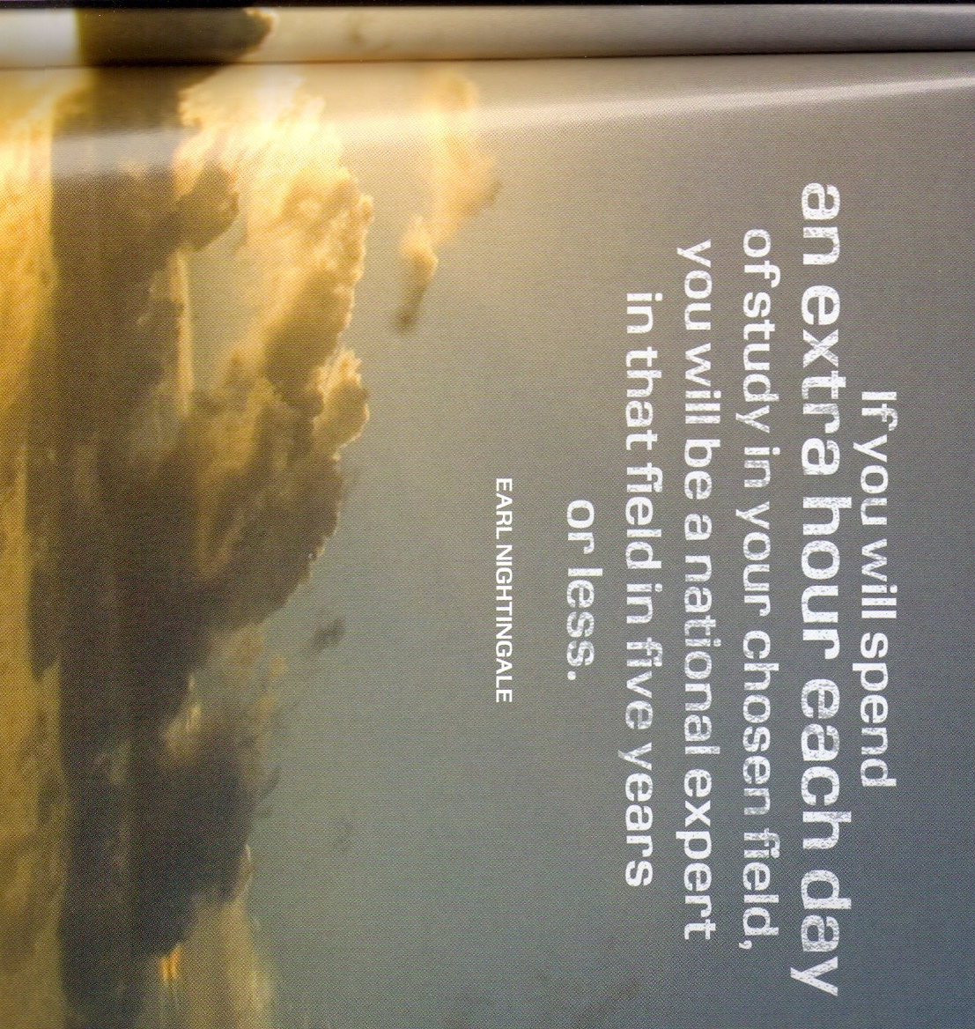
Commitment
“And the things that you have heard from me among many witnesses, commit these to faithful men who will be able to teach others also.” 2 Tim 2:3

Slide 12
Belief
“But without faith it is impossible to please Him, for he who comes to God must believe that He is, and that He is a rewarder of those who diligently seek Him.” Heb 11:6

Slide 13
Reflections Let 212 serve as your constant reminder, it’s your new way of thinking – your new way of acting.
Kindness; “And be kind to one another, tenderhearted, forgiving one another, even as God in Christ forgave you.” Eph 4:32
Complaining – “If only … I could” ; “Do all things without complaining and disputing,” Phil 2:14
Prune diversions; “But seek first the kingdom of God and His righteousness, and all these things shall be added to you.” Matt 6:33
Risks; “Finally, there is laid up for me the crown of righteousness, which the Lord, the righteous Judge, will give to me on that Day, and not to me only but also to all who have loved His appearing.” 2 Tim 4:7

Slide 14
Encouragement
“It’s time to turn up the heat!”
“Finally, brethren, whatever things are true, whatever things are noble, whatever things are just, whatever things are pure, whatever things are lovely, whatever things are of good report, if there is any virtue and if there is anything praiseworthy — meditate on these things.” Phil 4:8-9
“but grow in the grace and knowledge of our Lord and Savior Jesus Christ. To Him be the glory both now and forever. Amen.” 2 Peter 3:17-18

