Slide 2
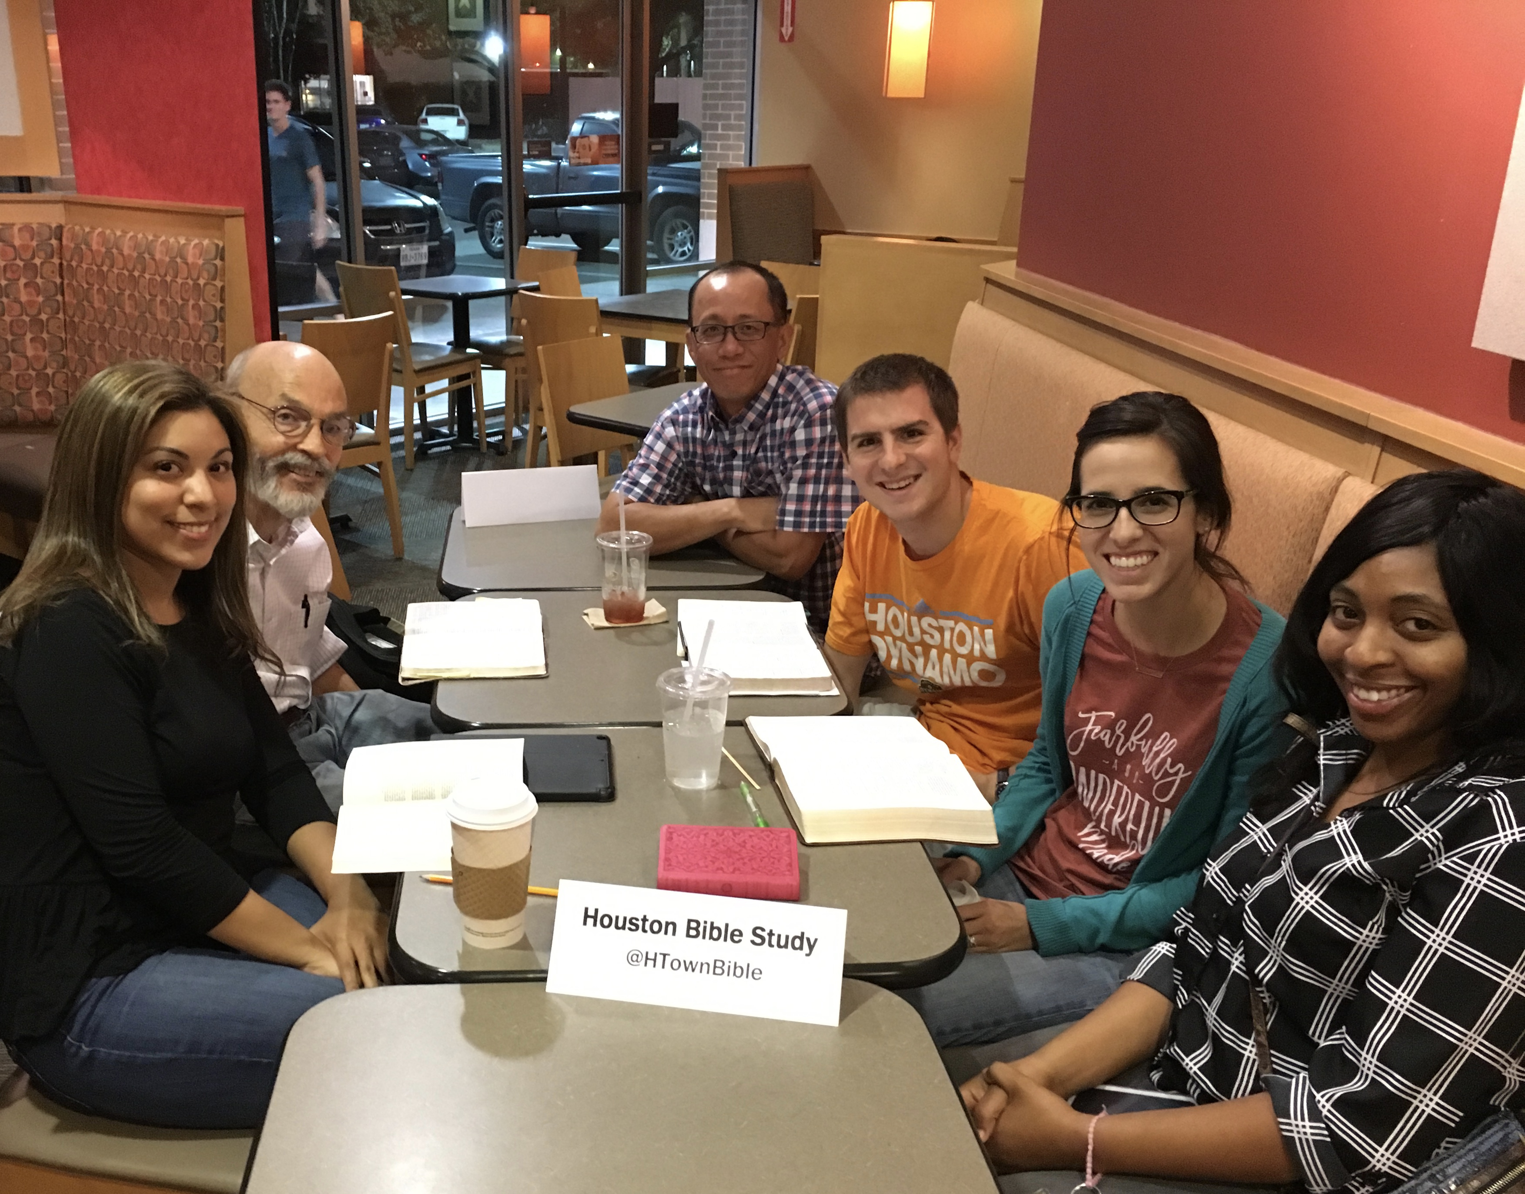
HOUSTON BIBLE STUDY @HTownBible

Slide 3
HOUSTON BIBLE STUDY @HTownBible
What Can I Do?
Pray
Promote
Participate

Slide 4
Compassion For a Leper
Learning from Jesus in Mark chapter 1

Slide 5
Compassion for a Leper Mark 1:32-45
Observations
Jesus healed so that people would believe in his message.
Jesus healed because he had compassion for the hurting.

Slide 6
Compassion for a Leper Mark 1:32-45
Applications
We are the lepers that have been healed by Jesus.
We are called to feel compassion for the hurting.

