Slide 1
Book of Isaiah
Chapters 1-12
Judgment (and Hope) for Judah and Jerusalem

Slide 3
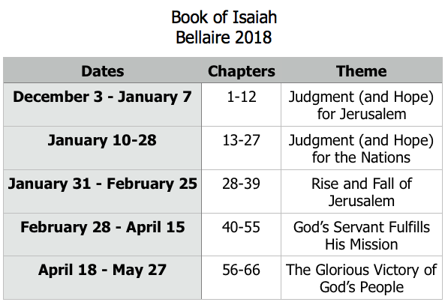
Class Plan

Slide 4
Isaiah 1-12
Isaiah 1-5 – General Messages for Judah & Jerusalem
Isaiah 6 – Isaiah’s Call
Isaiah 7-12 – Specific Messages for Judah & Jerusalem

Slide 5
Isaiah 6
Jehovah on the throne.
Holiness of God.
Pollution and purification.
Refusal to listen.
Israel cut down, stump remains.

Slide 6
Pattern of Judgment and Hope
Rebellion
Restoration
Repentance
Retribution

Slide 7
Isaiah Highlights
A child will be born, and will sit on the throne of David, governing in peace forever.
Chapter 9

Slide 8
Isaiah Highlights
Draw from the springs of salvation! Give thanks to His great and holy name!
Chapter 12

Slide 9
Isaiah Highlights
God sings a sad love song about His vineyard, Israel.
Chapter 5

Slide 10
Isaiah Highlights
The mountain of the house of the Lord, nations flow to it.
Chapter 2

Slide 11
Isaiah Highlights
In that day the Branch of the Lord will be beautiful and glorious…”
Chapter 4

Slide 12
Isaiah Highlights
Isaiah sees God and is called to the prophetic work.
Chapter 6

Slide 13
Isaiah Highlights
The virgin shall conceive and bear a son, Immanuel.
Chapter 7

Slide 14
Isaiah Highlights
Assyrian conquest of Israel foretold with child named “swift-spoil-speedy-prey.”
Chapter 8

Slide 15
Isaiah Highlights
”Come now, let us reason together says the Lord, though your sins be as scarlet, they will be as white as snow.”
Chapter 1

Slide 16
Isaiah Highlights
God will remove jewelry and accessories of wealthy Jerusalem women.
Chapter 3

Slide 17
Isaiah Highlights
A shoot will spring from the stem of Jesse.
Chapter 11

Slide 18
Isaiah Highlights
Assyria condemned as God’s tool that became prideful.
Chapter 10

Slide 19
Structure of Isaiah
Isaiah 1-39
Judgment
Isaiah 40-66
Hope

Slide 20
History Around Isaiah
Assyrian Captivity
Israel (Northern)
Israel (United Kingdom)
Return
Judah (Southern)
Babylonian Captivity
= Isaiah

Slide 21
Book of Isaiah
Chapters 13-27
Judgment and Hope for the Nations

