Slide 1
Book of Isaiah
Chapters 13-27
Judgment (and Hope) for the Nations

Slide 2
History Around Isaiah
Assyrian Captivity
Israel (Northern)
Israel (United Kingdom)
Return
Judah (Southern)
Babylonian Captivity
= Isaiah

Slide 3
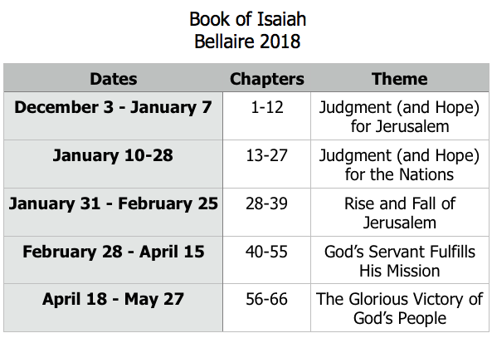
Class Plan

Slide 4
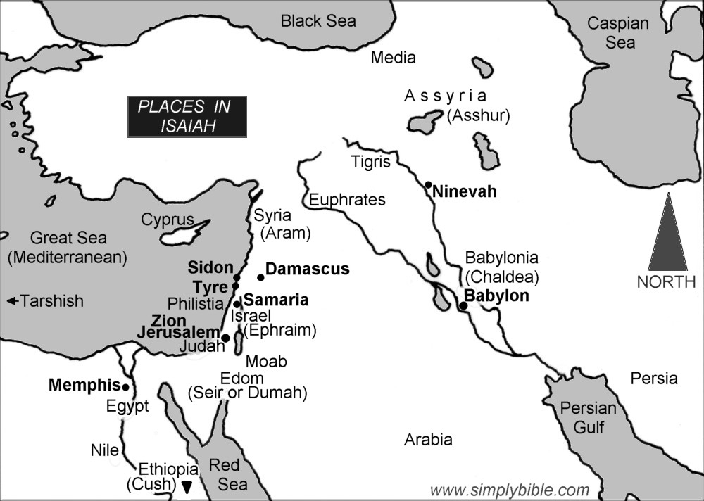

Slide 5
Isaiah 13-27
Isaiah 13-23 – The Nations
Babylon
Assyria
Philistia
Moab
Syria
Israel
Ethiopia
Egypt
Edom
Jerusalem
Tyre
Isaiah 24-27 – The World

Slide 6
Babylon in the Bible
Genesis 11 – The Tower of Babylon
Historical Books – Conqueror of Judah
Prophets – God will humble the arrogance.
Daniel – Head of crushed statue; tree that is cut down; Nebuchadnezzar made a beast.
1 Peter 5:13 – Rome nicknamed Babylon.
Revelation – Babylon the great harlot.

Slide 7
Babylon: Isaiah 13, 14, 21
How is Babylon described? From man’s perspective? From God’s?
What is God’s plan for Babylon?
Is there a path for Babylon’s redemption?
What do we learn from all this?

Slide 8
Book of Isaiah
Chapters 13-27
Judgment and Hope for the Nations
Wednesday, January 17:
Assyria & Egypt (ch.14,19,20)

Slide 9
Structure of Isaiah
1-12 : Judgment/Hope for Judah & Jerusalem
Isaiah 1-39
Judgment
13-27 : Judgment/Hope for the Nations & World
28-39 :
Isaiah 40-66
Hope

Slide 10
Isaiah Highlights
”Come now, let us reason together says the Lord, though your sins be as scarlet, they will be as white as snow.”
Chapter 1

Slide 11
Isaiah Highlights
The mountain of the house of the Lord, nations flow to it.
Chapter 2

Slide 12
Isaiah Highlights
God will remove jewelry and accessories of wealthy Jerusalem women.
Chapter 3

Slide 13
Isaiah Highlights
In that day the Branch of the Lord will be beautiful and glorious…”
Chapter 4

Slide 14
Isaiah Highlights
God sings a sad love song about His vineyard, Israel.
Chapter 5

Slide 15
Isaiah Highlights
Isaiah sees God and is called to the prophetic work.
Chapter 6

Slide 16
Isaiah Highlights
The virgin shall conceive and bear a son, Immanuel.
Chapter 7

Slide 17
Isaiah Highlights
Assyrian conquest of Israel foretold with child named “swift-spoil-speedy-prey.”
Chapter 8

Slide 18
Isaiah Highlights
A child will be born, and will sit on the throne of David, governing in peace forever.
Chapter 9

Slide 19
Isaiah Highlights
Assyria condemned as God’s tool that became prideful.
Chapter 10

Slide 20
Isaiah Highlights
A shoot will spring from the stem of Jesse.
Chapter 11

Slide 21
Isaiah Highlights
Draw from the springs of salvation! Give thanks to His great and holy name!
Chapter 12

Slide 22
Isaiah Highlights
God’s oracle concerning Babylon.
Chapter 13-14, 21

Slide 23
Isaiah Highlights
God’s oracle concerning Syria/Israel.
Chapter 17

Slide 24
Isaiah Highlights
God’s oracle concerning Ethiopia (Cush).
Chapter 18

Slide 25
Pattern of Judgment and Hope
Rebellion
Restoration
Repentance
Retribution

Slide 26
Book of Isaiah
Chapters 13-27
Judgment and Hope for the Nations
Sunday, January 17:
Babylon (ch.14,19,20)

