Slide 1
Book of Isaiah
Chapters 13-27
Judgment (and Hope) for the Nations

Slide 2
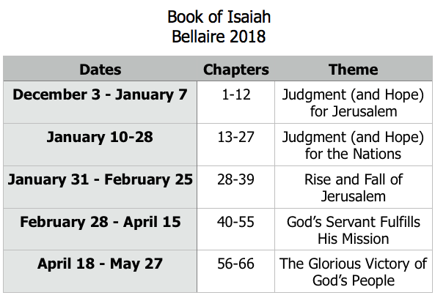
Class Plan

Slide 3
Isaiah 13-27
Isaiah 13-23 – The Nations
Babylon
Assyria
Philistia
Moab
Syria
Israel
Ethiopia
Egypt
Edom
Jerusalem
Tyre
Isaiah 24-27 – The World

Slide 4
God Deals with the World Isaiah 24-27
God’s brings judgment and destruction on the world, renewal for His people.
A composite picture of God’s dealings with His creation, not a specific event.
Main ideas can be applicable to God’s judgments in history, including final.

Slide 5
The Tale of Two Cities (ch.24-27)
The City of Man
The City of God
“The city of chaos is broken down; every house is shut up so that none may enter… Desolation is left in the city.”
(24:1-13)
“For the Lord of hosts will reign on Mount Zion and in Jerusalem…The Lord of hosts will prepare a lavish banquet…on this mountain.”
(24:23; 25:6)
Look for the two cities in ch.26-27.

Slide 6
Structure of Isaiah
1-12 : Judgment/Hope for Judah & Jerusalem
Isaiah 1-39
Judgment
Isaiah 40-66
Hope

Slide 7
Isaiah Highlights
The virgin shall conceive and bear a son, Immanuel.
Chapter 7

Slide 8
Isaiah Highlights
”Come now, let us reason together says the Lord, though your sins be as scarlet, they will be as white as snow.”
Chapter 1

Slide 9
Isaiah Highlights
Assyria condemned as God’s tool that became prideful.
Chapter 10

Slide 10
Isaiah Highlights
Isaiah sees God and is called to the prophetic work.
Chapter 6

Slide 11
Isaiah Highlights
Draw from the springs of salvation! Give thanks to His great and holy name!
Chapter 12

Slide 12
Isaiah Highlights
God sings a sad love song about His vineyard, Israel.
Chapter 5

Slide 13
Isaiah Highlights
The mountain of the house of the Lord, nations flow to it.
Chapter 2

Slide 14
Isaiah Highlights
A child will be born, and will sit on the throne of David, governing in peace forever.
Chapter 9

Slide 15
Isaiah Highlights
In that day the Branch of the Lord will be beautiful and glorious…”
Chapter 4

Slide 16
Isaiah Highlights
Assyrian conquest of Israel foretold with child named “swift-spoil-speedy-prey.”
Chapter 8

Slide 17
Isaiah Highlights
A shoot will spring from the stem of Jesse.
Chapter 11

Slide 18
Isaiah Highlights
God will remove jewelry and accessories of wealthy Jerusalem women.
Chapter 3

Slide 19
Structure of Isaiah
1-12 : Judgment/Hope for Judah & Jerusalem
Isaiah 1-39
Judgment
13-27 : Judgment/Hope for the Nations & World
Isaiah 40-66
Hope

Slide 20
Isaiah Highlights
God’s oracle concerning Babylon.
Chapter 13-14, 21

Slide 21
Isaiah Highlights
God’s oracle concerning Egypt
Chapter 19-20

Slide 22
Isaiah Highlights
God brings destruction on the whole earth.
Chapter 24

Slide 23
Isaiah Highlights
God’s oracle concerning Ethiopia (Cush).
Chapter 18

Slide 24
Isaiah Highlights
God’s oracle concerning Syria/Israel.
Chapter 17

Slide 25
Isaiah Highlights
God prepares a banquet on His mountain, swallows up death forever.
Chapter 25

Slide 26
Isaiah Highlights
God’s oracle concerning Moab.
Chapter 15-16

Slide 27
Isaiah Highlights
God’s oracle concerning the Valley of Vision (Jerusalem)
Chapter 22

Slide 28
Structure of Isaiah
1-12 : Judgment/Hope for Judah & Jerusalem
Isaiah 1-39
Judgment
13-27 : Judgment/Hope for the Nations & World
28-39 :
Isaiah 40-66
Hope

Slide 29
Book of Isaiah
Chapters 28-39
The Rise and Fall of Jerusalem

Slide 30
Pattern of Judgment and Hope
Rebellion
Restoration
Repentance
Retribution

Slide 31
History Around Isaiah
Assyrian Captivity
Israel (Northern)
Israel (United Kingdom)
Return
Judah (Southern)
Babylonian Captivity
= Isaiah

Slide 32
Book of Isaiah
Chapters 28-39
The Rise and Fall of Jerusalem

