Slide 1
Book of Isaiah
Chapters 28-39
The Rise and Fall of Jerusalem

Slide 2
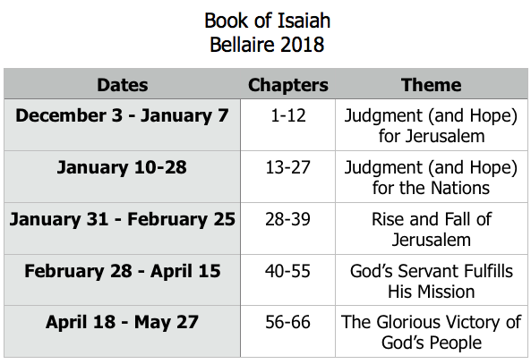
Class Plan

Slide 3
History Around Isaiah
Assyrian Captivity
Israel (Northern)
Israel (United Kingdom)
Return
Judah (Southern)
Babylonian Captivity
= Isaiah

Slide 4
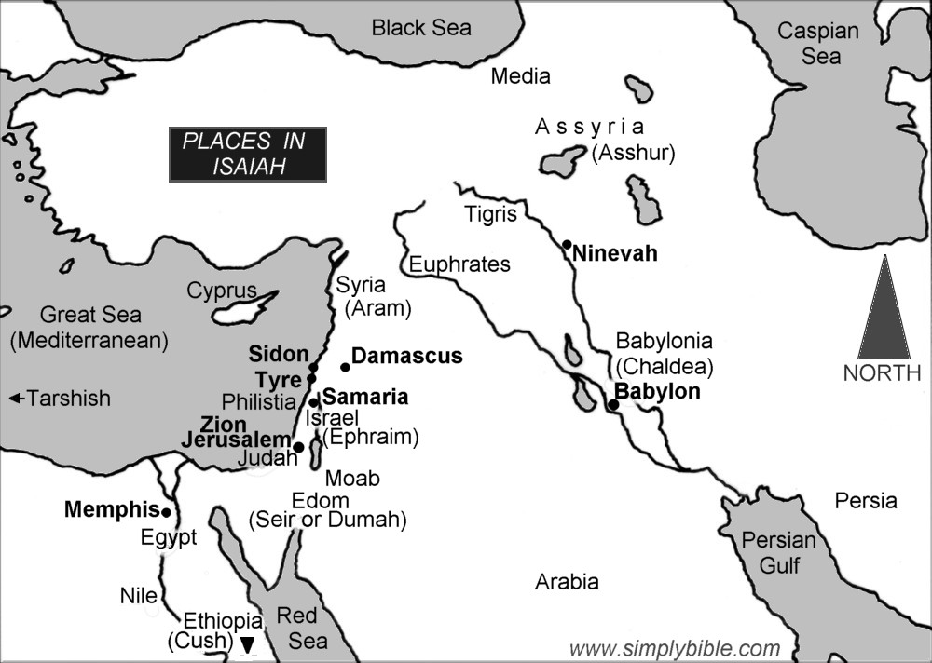

Slide 5
Isaiah 28-39:
Rise and Fall of Jerusalem
Isaiah 28-35 Prophecies of Jerusalem’s Rise and Fall
Isaiah 36-39
Historical account of Jerusalem’s Rise and Fall

Slide 6
Isaiah 36-37
Assyria – see Isaiah 10:5-12; 14:24-27
“Conduit of the upper pool on the highway of the fuller’s field.” (36:2) – Where Isaiah met Ahaz (7:3)
Eliakim and Shebna (36:3) – see Isaiah 22:15-23
Jerusalem relying on Egypt? (36:6,9) – Keep in mind
“each of his vine and fig tree…” (36:16) – Picture of Solomon’s kingdom (1 Kings 4:25) and promised coming kingdom (Micah 4:4)
Hamath, Arpad, Samaria (36:19) – Cities in Syria & Israel (10:9), who Assyria destroyed (see ch. 7-8)

Slide 7
Isaiah 36-37
The Remnant (37:4) – Isaiah 1:9; 4:3; 6:13; 7:3, 21-22; 10:20; 11:11, 16
“that all the kingdoms of the earth may know that you alone, LORD, are God.” (37:20) – similar to God purpose in Exodus (see Exodus 9:15-16)
Word against king of Assyria – Isaiah 10
“this will be a sign for you…” (37:30) – contrast Ahab refusing a sign (ch.7)
“zeal of the Lord of hosts will perform this.” (37:32) – Same thing said in Isaiah 9:7 of Messianic triumph

Slide 8
Pattern of Judgment and Hope
Rebellion
Restoration
Repentance
Retribution

Slide 9
Structure of Isaiah
1-12 : Judgment/Hope for Judah & Jerusalem
Isaiah 1-39
Judgment
Isaiah 40-66
Hope

Slide 10
Isaiah Highlights
Draw from the springs of salvation! Give thanks to His great and holy name!
Chapter 12

Slide 11
Isaiah Highlights
In that day the Branch of the Lord will be beautiful and glorious…”
Chapter 4

Slide 12
Isaiah Highlights
A shoot will spring from the stem of Jesse.
Chapter 11

Slide 13
Isaiah Highlights
God sings a sad love song about His vineyard, Israel.
Chapter 5

Slide 14
Isaiah Highlights
A child will be born, and will sit on the throne of David, governing in peace forever.
Chapter 9

Slide 15
Isaiah Highlights
Assyrian conquest of Israel foretold with child named “swift-spoil-speedy-prey.”
Chapter 8

Slide 16
Isaiah Highlights
The virgin shall conceive and bear a son, Immanuel.
Chapter 7

Slide 17
Isaiah Highlights
”Come now, let us reason together says the Lord, though your sins be as scarlet, they will be as white as snow.”
Chapter 1

Slide 18
Isaiah Highlights
God will remove jewelry and accessories of wealthy Jerusalem women.
Chapter 3

Slide 19
Isaiah Highlights
Assyria condemned as God’s tool that became prideful.
Chapter 10

Slide 20
Isaiah Highlights
Isaiah sees God and is called to the prophetic work.
Chapter 6

Slide 21
Isaiah Highlights
The mountain of the house of the Lord, nations flow to it.
Chapter 2

Slide 22
Structure of Isaiah
1-12 : Judgment/Hope for Judah & Jerusalem
Isaiah 1-39
Judgment
13-27 : Judgment/Hope for the Nations & World
Isaiah 40-66
Hope

Slide 23
Isaiah Highlights
God’s oracle concerning Babylon.
Chapter 13-14, 21

Slide 24
Isaiah Highlights
God’s oracle concerning Egypt
Chapter 19-20

Slide 25
Isaiah Highlights
God brings destruction on the whole earth.
Chapter 24

Slide 26
Isaiah Highlights
God’s oracle concerning Ethiopia (Cush).
Chapter 18

Slide 27
Isaiah Highlights
God’s oracle concerning Syria/Israel.
Chapter 17

Slide 28
Isaiah Highlights
God prepares a banquet on His mountain, swallows up death forever.
Chapter 25

Slide 29
Isaiah Highlights
God’s oracle concerning Moab.
Chapter 15-16

Slide 30
Isaiah Highlights
God’s oracle concerning the Valley of Vision (Jerusalem)
Chapter 22

Slide 31
Structure of Isaiah
1-12 : Judgment/Hope for Judah & Jerusalem
Isaiah 1-39
Judgment
13-27 : Judgment/Hope for the Nations & World
28-39 : The Rise and Fall of Jerusalem
Isaiah 40-66
Hope

Slide 32
Isaiah Highlights
Assyria besieges and taunts the city of Jerusalem
Chapter 36

Slide 33
Isaiah Highlights
Hezekiah calls to God and 185,000 Assyrians are killed.
Chapter 37

Slide 34
Book of Isaiah
Chapters 28-39
The Rise and Fall of Jerusalem

