Slide 1
Book of Isaiah
Chapters 13-27
Judgment (and Hope) for the Nations

Slide 3
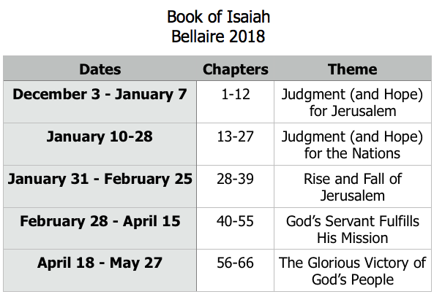
Class Plan

Slide 4
Isaiah 13-27
Isaiah 13-23 – The Nations
Babylon
Assyria
Philistia
Moab
Syria
Ethiopia
Egypt
Edom
Jerusalem
Tyre
If Isaiah is preaching to Judah, why include messages about the nations?
Isaiah 24-27 – The World

Slide 5
Isaiah 17:12-14
Ah, the thunder of many peoples; they thunder like the thundering of the sea! Ah, the roar of nations; they roar like the roaring of mighty waters! The nations roar like the roaring of many waters, but he will rebuke them, and they will flee far away, chased like chaff on the mountains before the wind and whirling dust before the storm. At evening time, behold, terror! Before morning, they are no more! This is the portion of those who loot us, and the lot of those who plunder us.
Psalm 2!

Slide 6
Themes in Isaiah 13-27
Pride of nations humbled
Purposes of God stand
Path for nations to come to God

Slide 7
Isaiah 13-27
Isaiah 13-23 – The Nations
Babylon
Assyria
Philistia
Moab
Syria
Ethiopia
Egypt
Edom
Jerusalem
Tyre
If Isaiah is preaching to Judah, why include messages about the nations?
What do we learn from all this?
Isaiah 24-27 – The World

Slide 8
Book of Isaiah
Chapters 13-27
Judgment and Hope for the Nations
Sunday, January 14:
Babylon (ch.13,14,21)

Slide 9
Pattern of Judgment and Hope
Rebellion
Restoration
Repentance
Retribution

Slide 10
Isaiah Highlights
A child will be born, and will sit on the throne of David, governing in peace forever.
Chapter 9

Slide 11
Isaiah Highlights
Draw from the springs of salvation! Give thanks to His great and holy name!
Chapter 12

Slide 12
Isaiah Highlights
God sings a sad love song about His vineyard, Israel.
Chapter 5

Slide 13
Isaiah Highlights
The mountain of the house of the Lord, nations flow to it.
Chapter 2

Slide 14
Isaiah Highlights
In that day the Branch of the Lord will be beautiful and glorious…”
Chapter 4

Slide 15
Isaiah Highlights
Isaiah sees God and is called to the prophetic work.
Chapter 6

Slide 16
Isaiah Highlights
The virgin shall conceive and bear a son, Immanuel.
Chapter 7

Slide 17
Isaiah Highlights
Assyrian conquest of Israel foretold with child named “swift-spoil-speedy-prey.”
Chapter 8

Slide 18
Isaiah Highlights
”Come now, let us reason together says the Lord, though your sins be as scarlet, they will be as white as snow.”
Chapter 1

Slide 19
Isaiah Highlights
God will remove jewelry and accessories of wealthy Jerusalem women.
Chapter 3

Slide 20
Isaiah Highlights
A shoot will spring from the stem of Jesse.
Chapter 11

Slide 21
Isaiah Highlights
Assyria condemned as God’s tool that became prideful.
Chapter 10

Slide 22
Structure of Isaiah
Isaiah 1-39
Judgment
Isaiah 40-66
Hope

Slide 23
History Around Isaiah
Assyrian Captivity
Israel (Northern)
Israel (United Kingdom)
Return
Judah (Southern)
Babylonian Captivity
= Isaiah

Slide 24
Book of Isaiah
Chapters 13-27
Judgment and Hope for the Nations
Sunday, January 14:
Babylon (ch.13,14,21)

