Slide 1
Book of Isaiah
Chapters 1-12
Judgment (and Hope) for Judah and Jerusalem

Slide 2
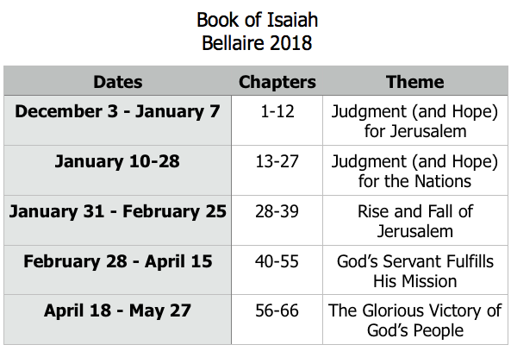
Class Plan

Slide 3
Judgment and Hope
Rebellion
Restoration
Repentance
Retribution

Slide 4
Isaiah 11-12
Where is this in the pattern?
Connections to other passages of hope in 1-12?
Contrasts to passages of judgment in 1-12?

Slide 5
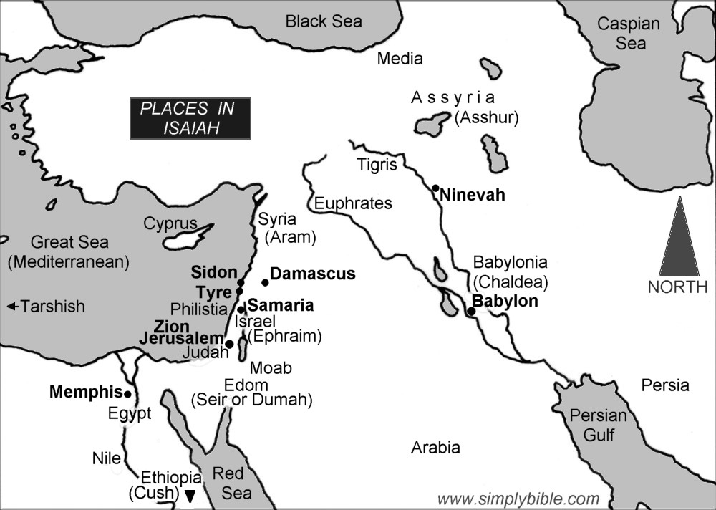

Slide 6
History Around Isaiah
Assyrian Captivity
Israel (Northern)
Israel (United Kingdom)
Return
Judah (Southern)
Babylonian Captivity
= Isaiah

Slide 7
Structure of Isaiah
Isaiah 1-39
Judgment
Isaiah 40-66
Hope

Slide 8
Isaiah Highlights
”Come now, let us reason together says the Lord, though your sins be as scarlet, they will be as white as snow.”
Chapter 1

Slide 9
Isaiah Highlights
The mountain of the house of the Lord, nations flow to it.
Chapter 2

Slide 10
Isaiah Highlights
In that day the Branch of the Lord will be beautiful and glorious…”
Chapter 4

Slide 11
Isaiah Highlights
God sings a sad love song about His vineyard, Israel.
Chapter 5

Slide 12
Isaiah Highlights
Isaiah sees God and is called to the prophetic work.
Chapter 6

Slide 13
Isaiah Highlights
A shoot will spring from the stem of Jesse.
Chapter 11

Slide 14
Isaiah Highlights
Draw from the springs of salvation! Give thanks to His great and holy name!
Chapter 12

Slide 15
Book of Isaiah
Chapters 1-12
Judgment and Hope for Judah and Jerusalem

Slide 16
Isaiah 2
Mountain of the Lord’s house
Rebellion
Restoration
Repentance
“Their city is filled with…”
“The Lord alone will be exalted in that day.”
Retribution
“the loftiness of man will be humbled”
“the terror of the Lord and splendor…”

