Slide 1
Book of Isaiah
Chapters 1-12
Judgment (and Hope) for Judah and Jerusalem

Slide 2
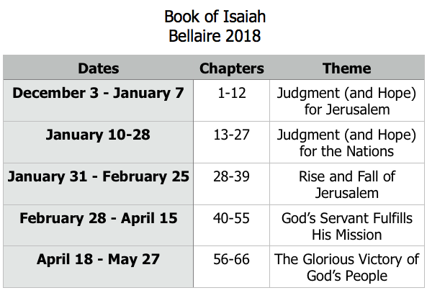
Class Plan

Slide 3
Pick one verse from chapters 1-5 that best characterizes each R-word.
Rebellion
Restoration
Repentance
Retribution

Slide 4
History Around Isaiah
Assyrian Captivity
Israel (Northern)
Israel (United Kingdom)
Return
Judah (Southern)
Babylonian Captivity
= Isaiah

Slide 5
Structure of Isaiah
Isaiah 1-39
Judgment
Isaiah 40-66
Hope

Slide 6
Isaiah Highlights
The mountain of the house of the Lord, nations flow to it.
Chapter 2

Slide 7
Isaiah Highlights
God sings a sad love song about His vineyard, Israel.
Chapter 5

Slide 8
Isaiah Highlights
”Come now, let us reason together says the Lord, though your sins be as scarlet, they will be as white as snow.”
Chapter 1

Slide 9
Isaiah Highlights
Draw from the springs of salvation! Give thanks to His great and holy name!
Chapter 12

Slide 10
Isaiah Highlights
God will remove jewelry and accessories of wealthy Jerusalem women.
Chapter 3

Slide 11
Isaiah Highlights
Isaiah sees God and is called to the prophetic work.
Chapter 6

Slide 12
Isaiah Highlights
In that day the Branch of the Lord will be beautiful and glorious…”
Chapter 4

Slide 13
Isaiah Highlights
A shoot will spring from the stem of Jesse.
Chapter 11

Slide 14
Book of Isaiah
Chapters 1-12
Judgment and Hope for Judah and Jerusalem

Slide 15
Isaiah 2
Mountain of the Lord’s house
Rebellion
Restoration
Repentance
“Their city is filled with…”
“The Lord alone will be exalted in that day.”
Retribution
“the loftiness of man will be humbled”
“the terror of the Lord and splendor…”

