Slide 1
Book of Isaiah
Chapters 1-12
Judgment (and Hope) for Judah and Jerusalem

Slide 2
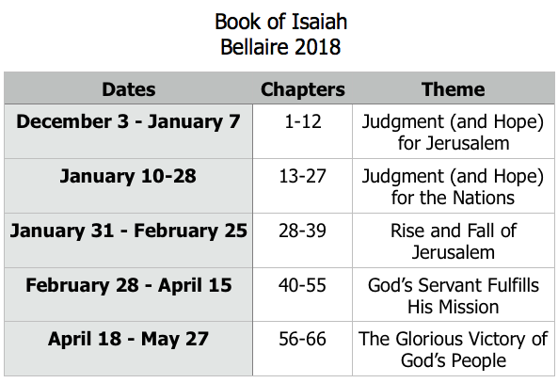
Class Plan

Slide 3
Isaiah 1-12
Isaiah 1-5 – General Messages for Judah & Jerusalem
Isaiah 6 – Isaiah’s Call
Isaiah 7-12 – Specific Messages for Judah & Jerusalem

Slide 4
History Around Isaiah
Assyrian Captivity
Israel (Northern)
Israel (United Kingdom)
Return
Judah (Southern)
Babylonian Captivity
= Isaiah

Slide 5
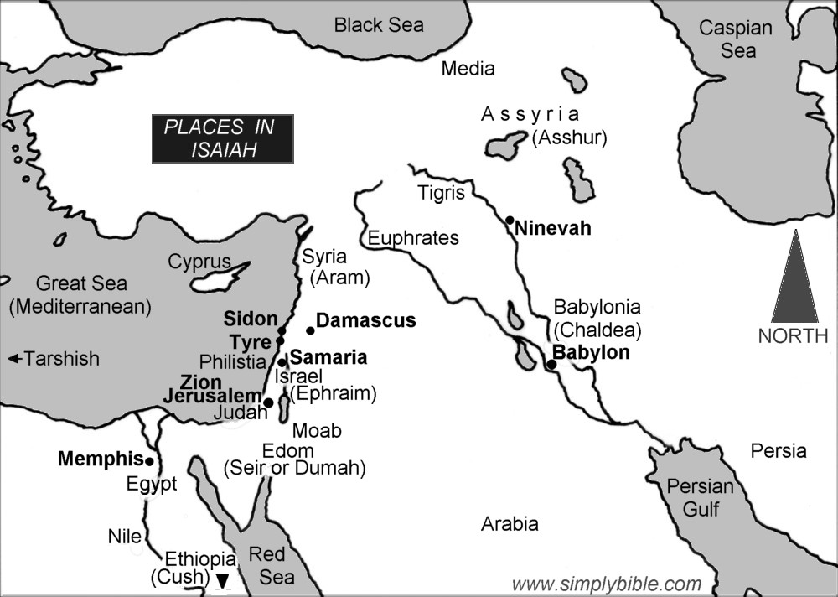
Isaiah 7 Review
Recap:
Syria/Israel ally against Judah.
Isaiah tells Ahaz to trust.
Syria/Israel will not last.
Assyria/Egypt will ‘shave’ Judah.
Themes:
Jehovah controls the nations.
Trust in God, not in man.
“In that day”: Judgment and refining.
The promise of “God with us.”

Slide 6
Look for these themes in Isaiah 8 & 9
God in control.
Trust in God (or not).
Judgment and refining.
God’s presence with His people.

Slide 7
Pattern of Judgment and Hope
Rebellion
Restoration
Repentance
Retribution

Slide 8
Isaiah Highlights
God sings a sad love song about His vineyard, Israel.
Chapter 5

Slide 9
Isaiah Highlights
A child is born, named “swift-spoil-speedy-prey”, foretelling Assyrian conquest of Israel.
Chapter 8

Slide 10
Isaiah Highlights
God will remove jewelry and accessories of wealthy Jerusalem women.
Chapter 3

Slide 11
Isaiah Highlights
Draw from the springs of salvation! Give thanks to His great and holy name!
Chapter 12

Slide 12
Isaiah Highlights
The mountain of the house of the Lord, nations flow to it.
Chapter 2

Slide 13
Isaiah Highlights
A child will be born, and will sit on the throne of David, governing in peace forever.
Chapter 9

Slide 14
Isaiah Highlights
The virgin shall conceive and bear a son, Immanuel.
Chapter 7

Slide 15
Isaiah Highlights
”Come now, let us reason together says the Lord, though your sins be as scarlet, they will be as white as snow.”
Chapter 1

Slide 16
Isaiah Highlights
A shoot will spring from the stem of Jesse.
Chapter 11

Slide 17
Isaiah Highlights
Isaiah sees God and is called to the prophetic work.
Chapter 6

Slide 18
Isaiah Highlights
In that day the Branch of the Lord will be beautiful and glorious…”
Chapter 4

Slide 19
Structure of Isaiah
Isaiah 1-39
Judgment
Isaiah 40-66
Hope

Slide 20
Book of Isaiah
Chapters 1-12
Judgment and Hope for Judah and Jerusalem

