Slide 1
Book of Isaiah
Chapters 1-12
Judgment and Hope for Judah and Jerusalem

Slide 2
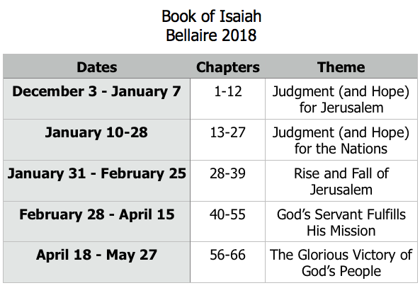
Class Plan

Slide 3
Isaiah 1
Why is God angry?
What is He going to do about it?
What is the goal of God’s action?

Slide 4
Judgment and Hope
Isaiah 1:18-20
Rebellion
Restoration
Repentance
Isaiah 1:2-17
Isaiah 1:25-27
Retribution
Isaiah 1:21-24, 28-30

Slide 5
Isaiah 5:1-7
Rebellion
Restoration
Repentance
(see Isaiah 4)
Retribution

Slide 6
History Around Isaiah
Assyrian Captivity
Israel (Northern)
Israel (United Kingdom)
Return
Judah (Southern)
Babylonian Captivity
= Isaiah

Slide 7
Structure of Isaiah
Isaiah 1-39
Judgment
Isaiah 40-66
Hope

Slide 8
Isaiah Highlights
”Come now, let us reason together says the Lord, though your sins be as scarlet, they will be as white as snow.”
Chapter 1

Slide 9
Isaiah Highlights
The mountain of the house of the Lord, nations flow to it.
Chapter 2

Slide 10
Isaiah Highlights
In that day the Branch of the Lord will be beautiful and glorious…”
Chapter 4

Slide 11
Isaiah Highlights
God sings a sad love song about His vineyard, Israel.
Chapter 5

Slide 12
Isaiah Highlights
Isaiah sees God and is called to the prophetic work.
Chapter 6

Slide 13
Book of Isaiah
Chapters 1-12
Judgment and Hope for Judah and Jerusalem

