Slide 1
Book of Isaiah
Chapters 28-39
The Rise and Fall of Jerusalem

Slide 2
Structure of Isaiah
1-12 : Judgment/Hope for Judah & Jerusalem
Isaiah 1-39
Judgment
Isaiah 40-66
Hope

Slide 3
Isaiah Highlights
Draw from the springs of salvation! Give thanks to His great and holy name!
Chapter 12

Slide 4
Isaiah Highlights
In that day the Branch of the Lord will be beautiful and glorious…”
Chapter 4

Slide 5
Isaiah Highlights
A shoot will spring from the stem of Jesse.
Chapter 11

Slide 6
Isaiah Highlights
God sings a sad love song about His vineyard, Israel.
Chapter 5

Slide 7
Isaiah Highlights
A child will be born, and will sit on the throne of David, governing in peace forever.
Chapter 9

Slide 8
Isaiah Highlights
Assyrian conquest of Israel foretold with child named “swift-spoil-speedy-prey.”
Chapter 8

Slide 9
Isaiah Highlights
The virgin shall conceive and bear a son, Immanuel.
Chapter 7

Slide 10
Isaiah Highlights
”Come now, let us reason together says the Lord, though your sins be as scarlet, they will be as white as snow.”
Chapter 1

Slide 11
Isaiah Highlights
God will remove jewelry and accessories of wealthy Jerusalem women.
Chapter 3

Slide 12
Isaiah Highlights
Assyria condemned as God’s tool that became prideful.
Chapter 10

Slide 13
Isaiah Highlights
Isaiah sees God and is called to the prophetic work.
Chapter 6

Slide 14
Isaiah Highlights
The mountain of the house of the Lord, nations flow to it.
Chapter 2

Slide 15
Structure of Isaiah
1-12 : Judgment/Hope for Judah & Jerusalem
Isaiah 1-39
Judgment
13-27 : Judgment/Hope for the Nations & World
Isaiah 40-66
Hope

Slide 16
Isaiah Highlights
God’s oracle concerning Babylon.
Chapter 13-14, 21

Slide 17
Isaiah Highlights
God’s oracle concerning Egypt
Chapter 19-20

Slide 18
Isaiah Highlights
God brings destruction on the whole earth.
Chapter 24

Slide 19
Isaiah Highlights
God’s oracle concerning Ethiopia (Cush).
Chapter 18

Slide 20
Isaiah Highlights
God’s oracle concerning Syria/Israel.
Chapter 17

Slide 21
Isaiah Highlights
God prepares a banquet on His mountain, swallows up death forever.
Chapter 25

Slide 22
Isaiah Highlights
God’s oracle concerning Moab.
Chapter 15-16

Slide 23
Isaiah Highlights
God’s oracle concerning the Valley of Vision (Jerusalem)
Chapter 22

Slide 24
Structure of Isaiah
1-12 : Judgment/Hope for Judah & Jerusalem
Isaiah 1-39
Judgment
13-27 : Judgment/Hope for the Nations & World
28-39 : The Rise and Fall of Jerusalem
Isaiah 40-66
Hope

Slide 25
Isaiah Highlights
Assyria besieges and taunts the city of Jerusalem
Chapter 36

Slide 26
Isaiah Highlights
Hezekiah calls to God and 185,000 Assyrians are killed.
Chapter 37

Slide 27
Isaiah Highlights
”Behold, I am laying in Zion a stone…he who believes in it will not be ashamed.”
Chapter 28

Slide 28
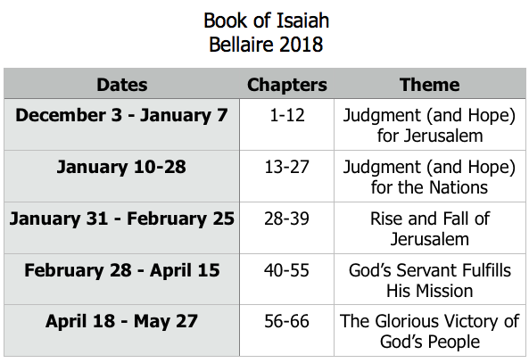
Class Plan

Slide 30
Isaiah 28-39:
Rise and Fall of Jerusalem
Isaiah 28-35 Prophecies of Jerusalem’s Rise and Fall
Isaiah 36-39
Historical account of Jerusalem’s Rise and Fall

Slide 31
Isaiah 28
28:1-13 – A picture of Israel’s downfall and punishment.
28:14-22 – A warning for Judah to trust in God.
28:23-29 – The nature of God’s judgment.

Slide 32
Pattern of Judgment and Hope
Israel (28:1-13)
Rebellion
Restoration
“…but they would not listen.” (28:12)
“In that day, the Lord of hosts will become a beautiful crown.” (28:5)
Retribution
“…trodden under foot.” (28:3)

Slide 33
Pattern of Judgment and Hope
Judah (28:14-22)
“Do not carry on as scoffers.” (28:22)
Rebellion
Restoration
Repentance
“We have made a covenant with death.” (28:15)
“I am laying in Zion a stone...” (28:16)
Retribution
“...the overwhelming scourge...” (28:18)

Slide 34
Book of Isaiah
Chapters 28-39
The Rise and Fall of Jerusalem

Slide 35
History Around Isaiah
Assyrian Captivity
Israel (Northern)
Israel (United Kingdom)
Return
Judah (Southern)
Babylonian Captivity
= Isaiah

