Slide 1
Book of Isaiah
Chapters 28-39
The Rise and Fall of Jerusalem

Slide 2
Structure of Isaiah
1-12 : Judgment/Hope for Judah & Jerusalem
Isaiah 1-39
Judgment
Isaiah 40-66
Hope

Slide 3
Isaiah Highlights (1-12)
“In that day the Branch of the Lord will be beautiful and glorious…”
The virgin shall bear a son, his name will be “Immanuel.”
A child will be born; will sit on David’s throne, governing in peace forever.
The mountain of the house of the Lord, nations flow to it.
God will remove jewelry/accessories of wealthy Jerusalem women.
A shoot will spring from the stem of Jesse.
God sings a sad love song about his vineyard, Israel.
Assyria condemned as God’s tool that became prideful.
“Come, let us reason together, says the Lord. Though your sins are as scarlet, they will be as white as snow.”
Isaiah sees God and is called to the prophetic work.
Draw from the springs of salvation! Give thanks to His great and holy name!
Assyrian conquest of Israel foretold w/ child named “swift-spoil-speedy-prey.”
4
7
9
2
3
11
5
10
1
6
12
8

Slide 4
Structure of Isaiah
1-12 : Judgment/Hope for Judah & Jerusalem
Isaiah 1-39
Judgment
13-27 : Judgment/Hope for the Nations & World
Isaiah 40-66
Hope

Slide 5
Isaiah Highlights (13-27)
The Nations (“God’s oracle concerning…”)
Valley of Vision (Jerusalem)
Syria & Israel
Tyre
Ethiopia
Babylon
Egypt
Moab
The World
A happy song of a vineyard (restored Israel) that is secure and fruitful!
God prepares a banquet on His mountain, swallows up death forever.
God brings destruction on the whole earth.
The wicked die and are destroyed, the dead of God’s people rise again.
22
17
23
18
13-14
21
19-20
15-16
27
25
24
26

Slide 6
Structure of Isaiah
1-12 : Judgment/Hope for Judah & Jerusalem
Isaiah 1-39
Judgment
13-27 : Judgment/Hope for the Nations & World
28-39 : The Rise and Fall of Jerusalem
Isaiah 40-66
Hope

Slide 7
Isaiah Highlights (28-39)
“This people draw near with their words and honor me with lip service, but they remove their hearts far from me.”
Assyria besieges and taunts the city of Jerusalem
God’s warning to Judah: Do not trust in an Egyptian alliance!
“Behold, I am laying in Zion a stone…he who believes in it will not be put to shame.”
Hezekiah calls to God and 185,000 Assyrians are killed
29
36
30-31
28
37

Slide 8
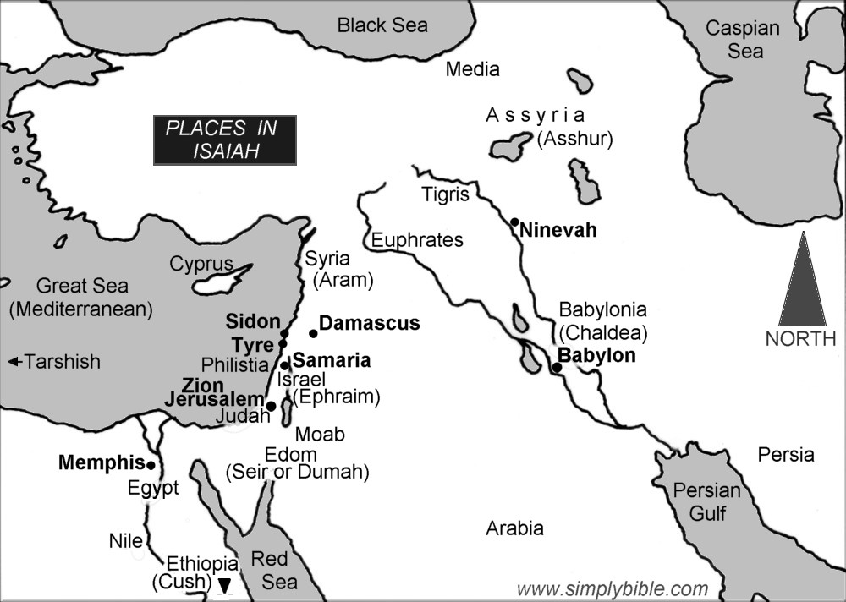

Slide 9
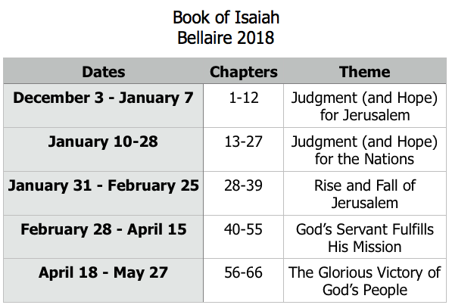
Class Plan

Slide 10
Isaiah 28-39:
Rise and Fall of Jerusalem
Isaiah 28-35 Prophecies of Jerusalem’s Rise and Fall
Isaiah 36-39
Historical account of Jerusalem’s Rise and Fall
36: Jerusalem surrounded
37: Assyrians destroyed

Slide 11
Isaiah 30-31: Don’t Trust in Egypt

Slide 12
Egypt in the Old Testament
Genesis:
Genesis 12: Abram goes to Egypt during famine; lies about Sarah and is rebuked by God.
Genesis 13: Lot enticed by cities of the valley, which look “like the land of Egypt, like the garden of the Lord.”
Genesis 16: Abram takes Hagar, the Egyptian maid, taking God’s plan into his own hands.
Genesis 26: God tells Isaac, “Do not go down to Egypt” when famine arises.
Genesis 37-50: Joseph sold to Egypt, brings family down to save them from the famine.

Slide 13
Egypt in the Old Testament
Exodus and Wilderness:
Exodus 1-14: God judges Egypt, delivers Israel.
Exodus 14: At Red Sea, people complain about being rescued from Egypt (!).
Numbers 11: “We miss the leeks, onions, garlic, and melons of Egypt!!”
Numbers 14: After spying out Canaan and fearing, the people move to appoint a leader to return to Egypt.
Repeated: “The Lord, who brought you up out of the land of Egypt.”
Deuteronomy 17: God warns of Israelite kings who will go to Egypt for horses/chariots.

Slide 14
Egypt in the Old Testament
Era of the Kings:
1 Kings 10: Solomon imports horses and chariots from Egypt.
2 Kings 17: Hoshea, the last king of Israel, attempts an alliance with Egypt while subjugated by Assyria. Doesn’t work…
2 Kings 18: Assyria warns Jerusalem about making an alliance with Egypt. (Hezekiah trusts in God instead, and city is saved)
2 Kings 23: Pharaoh goes to war with Assyria, Josiah rides out to meet him and gets killed.
Jeremiah: During Babylonian crisis, prophet warns repeatedly to not flee to Egypt. People do not listen, take Jeremiah there against his will.

Slide 15
Isaiah 30-31: Don’t Trust in Egypt
Because you have said, “We have made a covenant with death, and with Sheol we have an agreement, when the overwhelming whip passes through it will not come to us, for we have made lies our refuge, and in falsehood we have taken shelter.” (Isaiah 28:15)
“Because this people draw near with their words And honor Me with their lip service, But they remove their hearts far from Me, And their reverence for Me consists of tradition learned by rote… Woe to those who deeply hide their plans from the Lord, And whose deeds are done in a dark place, And they say, “Who sees us?” or “Who knows us?”
(Isaiah 29:13,15)

Slide 16
Isaiah 30-31: Don’t Trust in Egypt
What is the Egypt that we often turn to instead of seeking/trusting in God?
What’s the appeal of “Egypt” and why is trusting in God unattractive?

Slide 17
Book of Isaiah
Chapters 28-39
The Rise and Fall of Jerusalem
*Isaiah 32 & 35 for Sunday*

Slide 18
History Around Isaiah
Assyrian Captivity
Israel (Northern)
Israel (United Kingdom)
Return
Judah (Southern)
Babylonian Captivity
= Isaiah

