Slide 1
Book of Isaiah
December 2017 – May 2018
*Take a few minutes to fill out the quiz*

Slide 2
Isaiah 1
Why is God angry?
What is He going to do about it?
What is the goal of God’s action?

Slide 3
History Around Isaiah
Assyrian Captivity
Israel (Northern)
Israel (United Kingdom)
Return
Judah (Southern)
Babylonian Captivity
= Isaiah

Slide 4
Structure of Isaiah
Isaiah 1-39
Judgment
Isaiah 40-66
Hope

Slide 5
Isaiah Highlights
The mountain of the house of the Lord, nations flow to it.
Chapter 2

Slide 6
Isaiah Highlights
Isaiah sees God and is called to the prophetic work.
Chapter 6

Slide 7
Isaiah Highlights
The virgin shall bear a son, his name will be “Immanuel.”
Chapter 7

Slide 8
Isaiah Highlights
A shoot (branch) will come forth from the stump of Jesse.
Chapter 11

Slide 9
Isaiah Highlights
The Lord hosts a lavish banquet on the mountain.
Chapter 25

Slide 10
Isaiah Highlights
Hezekiah and Jerusalem are delivered from the Assyrians.
Chapter 37

Slide 11
Isaiah Highlights
A voice calls in the wilderness, “Prepare the Lord’s way!”
Chapter 40

Slide 12
Isaiah Highlights
Cyrus is foretold as the anointed one to free God’s people.
Chapter 44/45

Slide 13
Isaiah Highlights
God’s servant will suffer and die a sacrificial death.
Chapter 52/53

Slide 14
Isaiah Highlights
“The Spirit of the Lord is upon me to preach good news!”
Chapter 61

Slide 15
Isaiah Highlights
God creates new heavens and a new earth.
Chapter 65/66

Slide 16
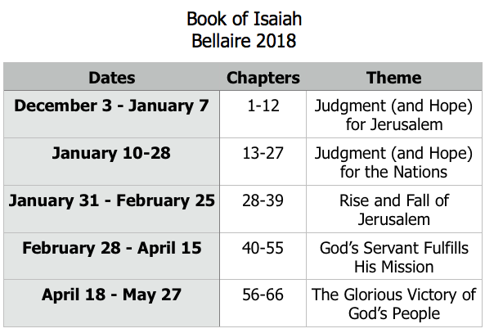
Class Plan

Slide 17
Book of Isaiah
December 2017 – May 2018

