Slide 1
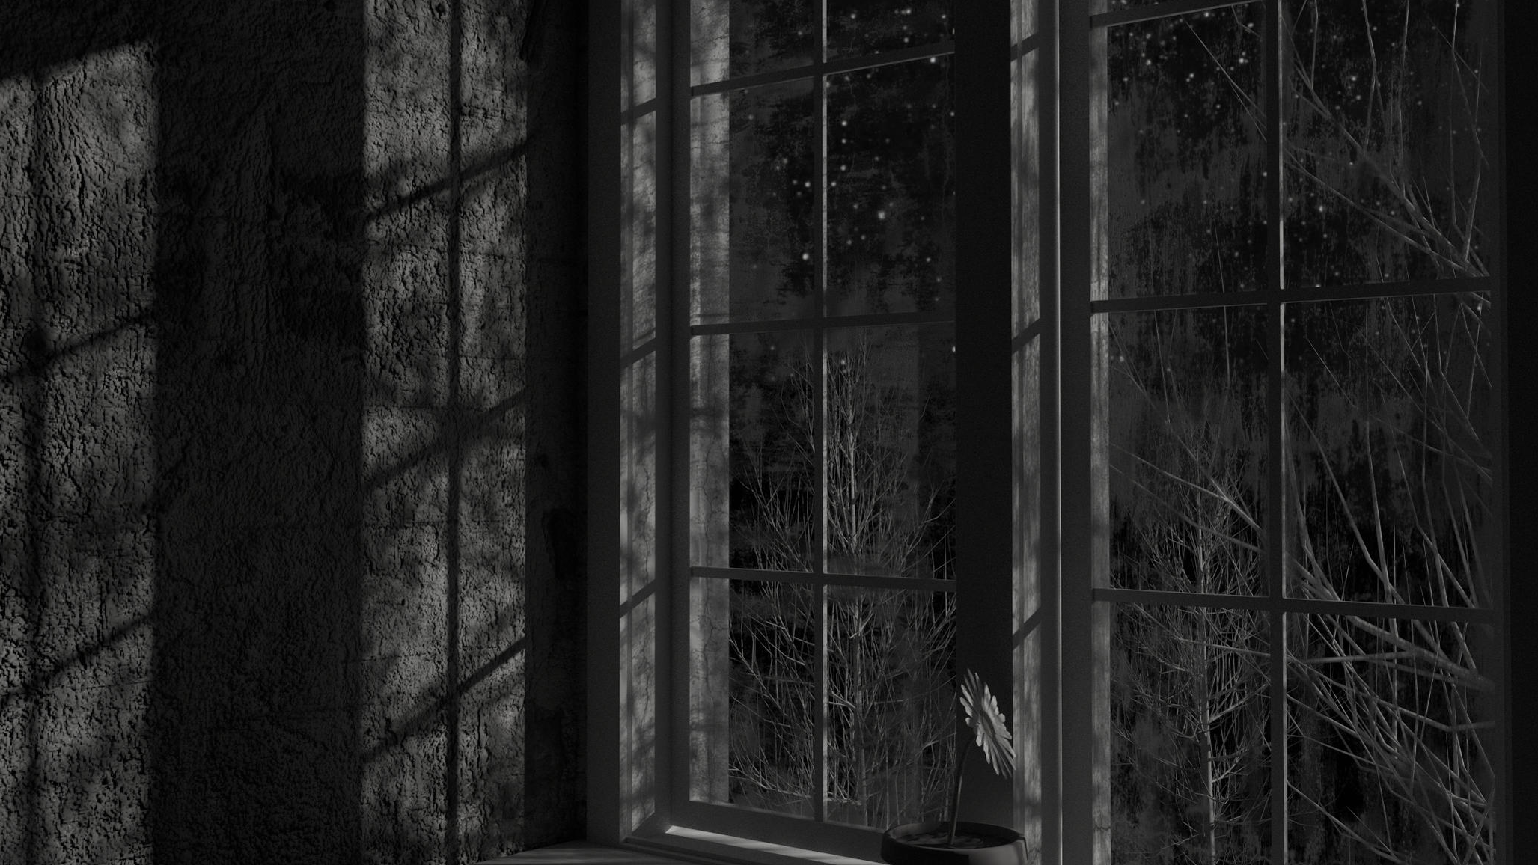
Lessons Learned
…at 3 in the Morning

Slide 2
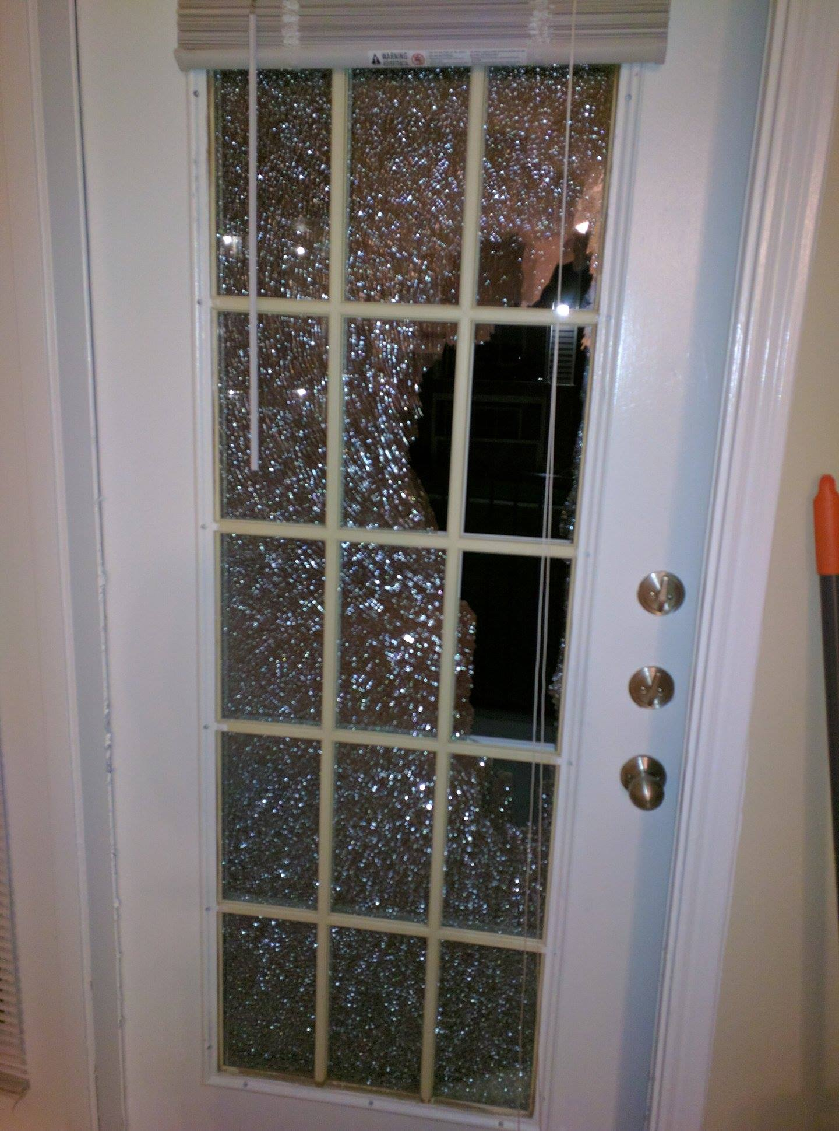

Slide 3
COMPLACENCY can be DANGEROUS
READINESS is our DEFENSE
LIGHT brings DIRECTION
GODLY FRIENDS make a DIFFERENCE
Lessons Learned
…at 3 in the Morning

Slide 4
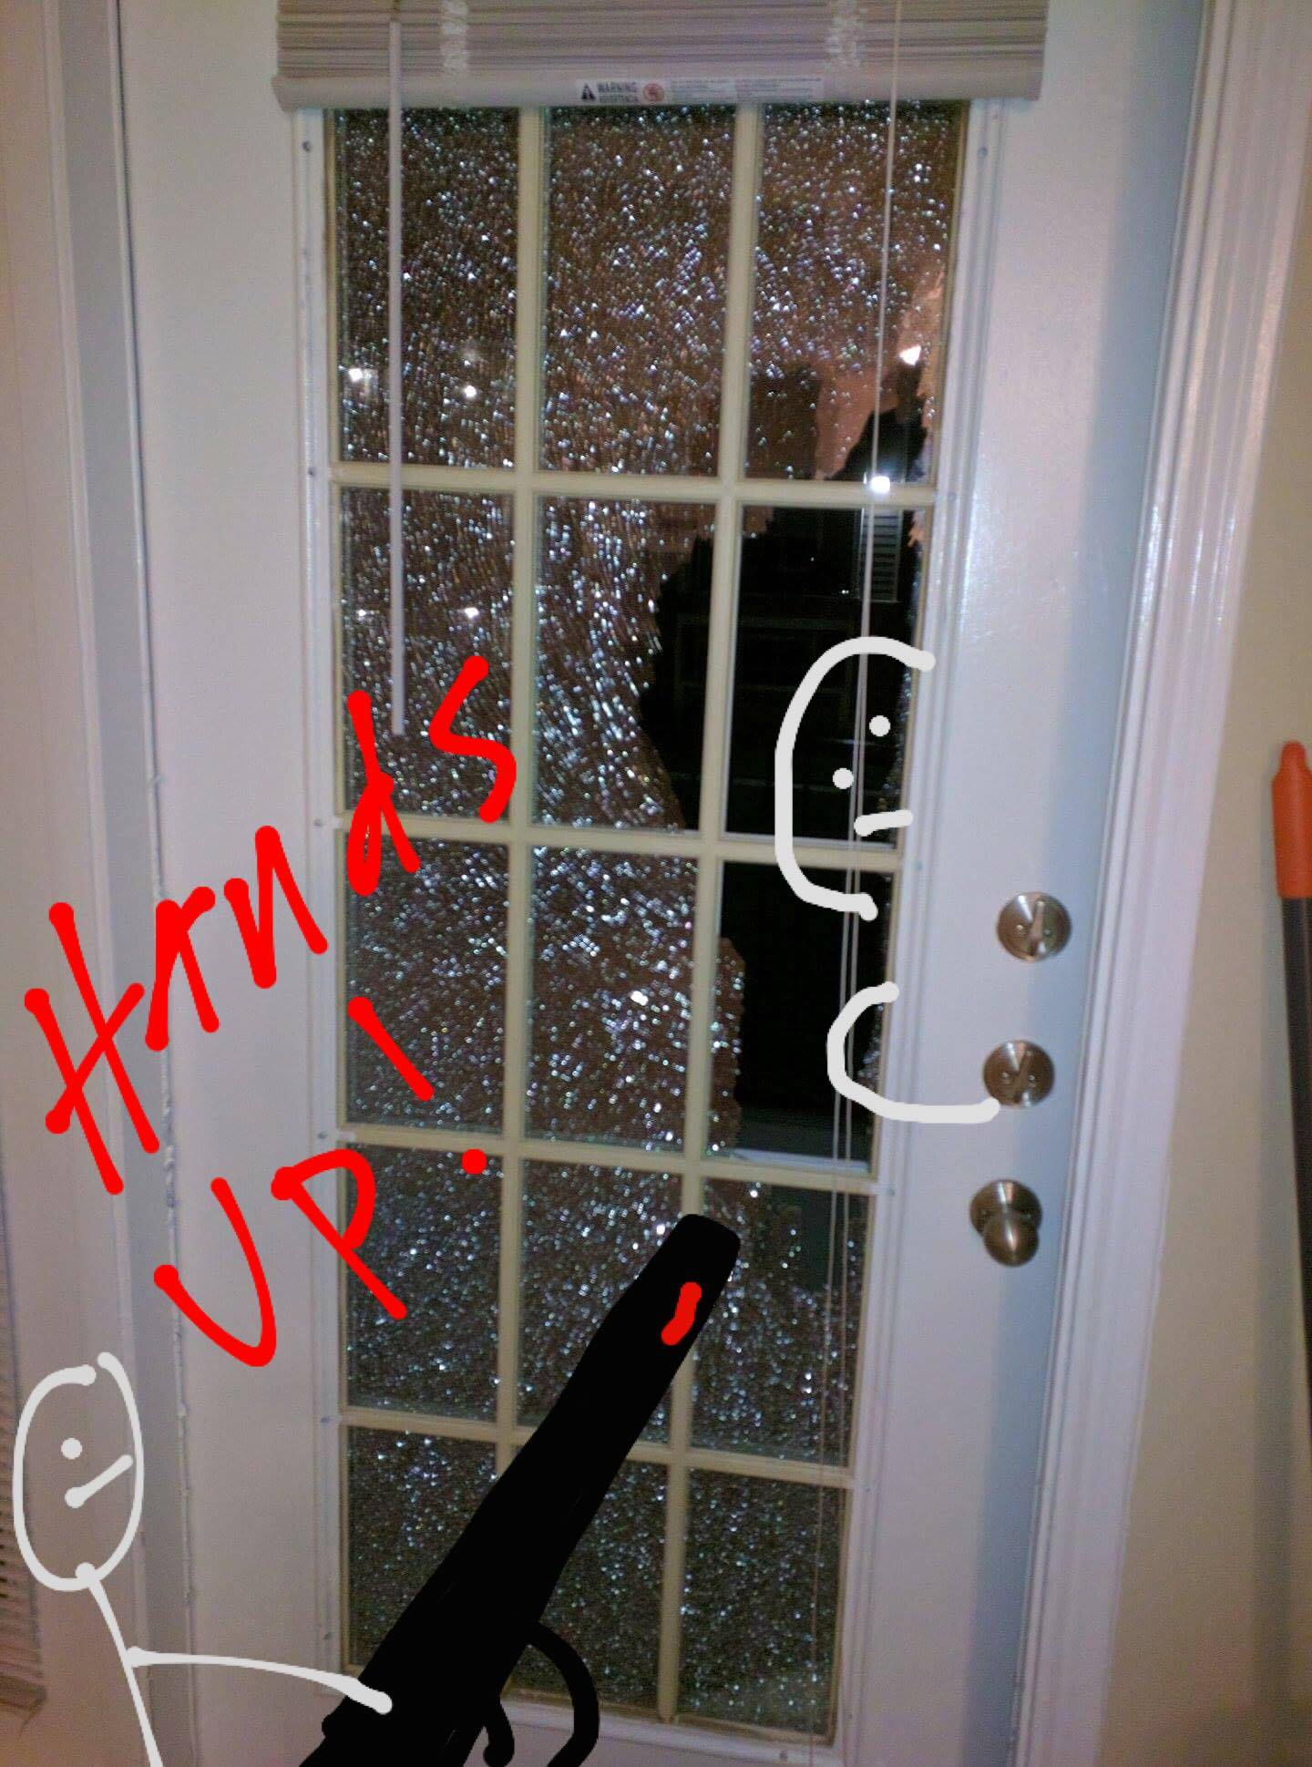

Slide 5
COMPLACENCY can be DANGEROUS
READINESS is our DEFENSE
LIGHT brings DIRECTION
GODLY FRIENDS make a DIFFERENCE
Lessons Learned
…at 3 in the Morning

