Slide 1
Book of Isaiah
Chapters 28-39
The Rise and Fall of Jerusalem

Slide 2
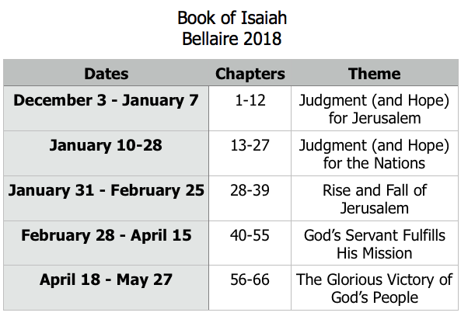
Class Plan

Slide 3
Prophecies of Assyrian Crisis (28-33)
”Woe” to Ephraim (Israel) - 28:1
“Woe” to Ariel (Jerusalem) - 29:1
“Woe” to those who trust Egypt - 30:1
“Woe” to the Destroyer (Assyria) - 33:1
Prophecies Beyond the Crisis (34-35)
God’s wrath against all his enemies
Restoration, Redemption, Return
Account of the Crisis & Beyond (36-39)
Assyrians besiege Jerusalem, God saves
Hezekiah shows off wealth to Babylonians

Slide 4
Isaiah 38 – Hezekiah’s Illness
How does this story fit into the larger section of Isaiah?
What do we learn about Hezekiah?
What do we learn about God?

Slide 5
Isaiah 39 – Hezekiah’s Mistake
What is Hezekiah doing and why?
How might we make the same mistake?

Slide 6
Babylon in Isaiah (so far)
Possible References to Babylonian Exile/Return (?)
5:5-7 – “I will lay it waste…the men of Judah His delightful plant.”
5:13 – “My people go into exile for lack of knowledge.”
6:11 – “Until the land is utterly desolate.”
11:12 – “Will gather the dispersed of Judah.”
32:13-14 – “the land of my people, thorns and briars…the populated city forsaken.”
34:9-17 – “Zion will be desolate…”
35:10 – “the ransomed will return to Zion…”

Slide 7
Babylon in Isaiah (so far)
Isaiah 13-14 (also 21)
Babylon judged for her arrogance & wickedness.
God will use the Medes to destroy Babylon.
Implied that Babylon will oppress God’s people.
After that, God will humble Babylon.
Isaiah 39
Hezekiah exposes Zion to Babylonians.
God foretells that Babylon will carry it away.
Not in Hezekiah’s time...

Slide 8
= Isaiah’s life
Assyrian Captivity
Israel (Northern)
Israel (United Kingdom)
Return
Judah (Southern)
Babylonian Captivity
Book of Isaiah:
1-39: Present Crises
Syrian Crisis under Ahaz (1-12)
Assyrian Crisis under Hezekiah (28-39)
40-66: Future Hope
Return after Babylonian Crisis
Highly Messianic

Slide 9
Structure of Isaiah
1-12 : Judgment/Hope for Judah & Jerusalem
Isaiah 1-39
Judgment
Isaiah 40-66
Hope

Slide 10
Isaiah Highlights (1-12)
“In that day the Branch of the Lord will be beautiful and glorious…”
The virgin shall bear a son, his name will be “Immanuel.”
A child will be born; will sit on David’s throne, governing in peace forever.
The mountain of the house of the Lord, nations flow to it.
God will remove jewelry/accessories of wealthy Jerusalem women.
A shoot will spring from the stem of Jesse.
God sings a sad love song about his vineyard, Israel.
Assyria condemned as God’s tool that became prideful.
“Come, let us reason together, says the Lord. Though your sins are as scarlet, they will be as white as snow.”
Isaiah sees God and is called to the prophetic work.
Draw from the springs of salvation! Give thanks to His great and holy name!
Assyrian conquest of Israel foretold w/ child named “swift-spoil-speedy-prey.”
4
7
9
2
3
11
5
10
1
6
12
8

Slide 11
Structure of Isaiah
1-12 : Judgment/Hope for Judah & Jerusalem
Isaiah 1-39
Judgment
13-27 : Judgment/Hope for the Nations & World
Isaiah 40-66
Hope

Slide 12
Isaiah Highlights (13-27)
The Nations (“God’s oracle concerning…”)
Valley of Vision (Jerusalem)
Syria & Israel
Tyre
Ethiopia
Babylon
Egypt
Moab
The World
A happy song of a vineyard (restored Israel) that is secure and fruitful!
God prepares a banquet on His mountain, swallows up death forever.
God brings destruction on the whole earth.
The wicked die and are destroyed, the dead of God’s people rise again.
22
17
23
18
13-14
21
19-20
15-16
27
25
24
26

Slide 13
Structure of Isaiah
1-12 : Judgment/Hope for Judah & Jerusalem
Isaiah 1-39
Judgment
13-27 : Judgment/Hope for the Nations & World
28-39 : The Rise and Fall of Jerusalem
Isaiah 40-66
Hope

Slide 14
Isaiah Highlights (28-39)
The Lord slaughters the nations in a great, heavenly, bloody, greasy sacrifice.
Hezekiah foolishly shows off his wealth to the Babylonians.
“This people draw near with their words and honor me with lip service, but they remove their hearts far from me.”
Assyria besieges and taunts the city of Jerusalem.
“The Destroyer” will be destroyed after he is done destroying.
Hezekiah falls fatally ill, prays to God and gets 15 years of life.
God’s warning to Judah: Do not trust in an Egyptian alliance!
“Behold, I am laying in Zion a stone…he who believes in it will not be put to shame.”
The Spirit is poured out, bringing life, righteousness, peace, and security to God’s people.
Hezekiah calls to God and 185,000 Assyrians are killed.
The ransomed return to Zion on the Highway of Holiness.
34
39
29
36
33
38
30-31
28
32
37
35

Slide 15
Upcoming Classes
Sunday, 25 February – Isaiah 40
Wednesday, 28 February – Isaiah 41
Sunday, March 4 – Review Isaiah 1-39
Wednesday March 7 – Isaiah 42

Slide 16
Book of Isaiah
Chapters 28-39
The Rise and Fall of Jerusalem
*Isaiah 40 for Sunday*

