Slide 1
Book of Isaiah
Chapters 40-55
God’s Servant Fulfills His Mission

Slide 2
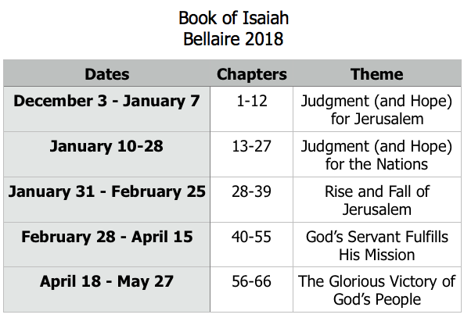
Class Plan

Slide 3
Structure of Isaiah
1-12 : Judgment/Hope for Judah & Jerusalem
Isaiah 1-39
Judgment
Isaiah 40-66
Hope

Slide 4
Isaiah Highlights (1-12)
“In that day the Branch of the Lord will be beautiful and glorious…”
The virgin shall bear a son, his name will be “Immanuel.”
A child will be born; will sit on David’s throne, governing in peace forever.
The mountain of the house of the Lord, nations flow to it.
God will remove jewelry/accessories of wealthy Jerusalem women.
A shoot will spring from the stem of Jesse.
God sings a sad love song about his vineyard, Israel.
Assyria condemned as God’s tool that became prideful.
“Come, let us reason together, says the Lord. Though your sins are as scarlet, they will be as white as snow.”
Isaiah sees God and is called to the prophetic work.
Draw from the springs of salvation! Give thanks to His great and holy name!
Assyrian conquest of Israel foretold w/ child named “swift-spoil-speedy-prey.”
4
7
9
2
3
11
5
10
1
6
12
8

Slide 5
Structure of Isaiah
1-12 : Judgment/Hope for Judah & Jerusalem
Isaiah 1-39
Judgment
13-27 : Judgment/Hope for the Nations & World
Isaiah 40-66
Hope

Slide 6
Isaiah Highlights (13-27)
The Nations (“God’s oracle concerning…”)
Valley of Vision (Jerusalem)
Syria & Israel
Tyre
Ethiopia
Babylon
Egypt
Moab
The World
A happy song of a vineyard (restored Israel) that is secure and fruitful!
God prepares a banquet on His mountain, swallows up death forever.
God brings destruction on the whole earth.
The wicked die and are destroyed, the dead of God’s people rise again.
22
17
23
18
13-14
21
19-20
15-16
27
25
24
26

Slide 7
Structure of Isaiah
1-12 : Judgment/Hope for Judah & Jerusalem
Isaiah 1-39
Judgment
13-27 : Judgment/Hope for the Nations & World
28-39 : The Rise and Fall of Jerusalem
Isaiah 40-66
Hope

Slide 8
Isaiah Highlights (28-39)
The Lord slaughters the nations in a great, heavenly, bloody, greasy sacrifice.
Hezekiah foolishly shows off his wealth to the Babylonians.
“This people draw near with their words and honor me with lip service, but they remove their hearts far from me.”
Assyria besieges and taunts the city of Jerusalem.
“The Destroyer” will be destroyed after he is done destroying.
Hezekiah falls fatally ill, prays to God and gets 15 years of life.
God’s warning to Judah: Do not trust in an Egyptian alliance!
“Behold, I am laying in Zion a stone…he who believes in it will not be put to shame.”
The Spirit is poured out, bringing life, righteousness, peace, and security to God’s people.
Hezekiah calls to God and 185,000 Assyrians are killed.
The ransomed return to Zion on the Highway of Holiness.
34
39
29
36
33
38
30-31
28
32
37
35

Slide 9
= Isaiah’s life
Assyrian Captivity
Israel (Northern)
Israel (United Kingdom)
Return
Judah (Southern)
Babylonian Captivity
Book of Isaiah:
1-39: Present Crises
Syrian Crisis under Ahaz (1-12)
Assyrian Crisis under Hezekiah (28-39)
40-66: Future Hope
Return after Babylonian Crisis
Highly Messianic

Slide 10
Isaiah 40 – A New Call
What is the message God is sending to His people?
What is the significance of the message for those in captivity?
What is the significance of the message for us?

Slide 11
Isaiah 40 in the New Testament
Matthew 3
Now in those days John the Baptist came, preaching in the wilderness of Judea, saying, “Repent, for the kingdom of heaven is at hand.” For this is the one referred to by Isaiah the prophet when he said,
“The voice of one crying in the wilderness, ‘Make ready the way of the Lord, Make His paths straight!’”

Slide 12
Isaiah 40 in the New Testament
1 Peter 2
Since you have in obedience to the truth purified your souls for a sincere love of the brethren, fervently love one another from the heart, for you have been born again not of seed which is perishable but imperishable, that is, through the living and enduring word of God. For,
“All flesh is like grass, And all its glory like the flower of grass. The grass withers, And the flower falls off, But the word of the Lord endures forever.”
And this is the word which was preached to you.

Slide 13
Isaiah 40 in the New Testament
Revelation 22
And he said to me, “Do not seal up the words of the prophecy of this book, for the time is near. Let the one who does wrong, still do wrong; and the one who is filthy, still be filthy; and let the one who is righteous, still practice righteousness; and the one who is holy, still keep himself holy.”
“Behold, I am coming quickly, and My reward is with Me, to render to every man according to what he has done. I am the Alpha and the Omega, the first and the last, the beginning and the end.”

Slide 14
Upcoming Classes
Wednesday, 28 February – Isaiah 41
Sunday, March 4 – Review Isaiah 1-39
Wednesday, March 7 – Isaiah 42
Sunday, March 11 – Isaiah 43 (Kerry)

Slide 15
Book of Isaiah
Chapters 40-55
The Servant Fulfills His Mission
*Isaiah 41 for Wednesday*

Slide 16
