Slide 1
Book of Isaiah
Chapters 40-55
God’s Servant Fulfills His Mission

Slide 2
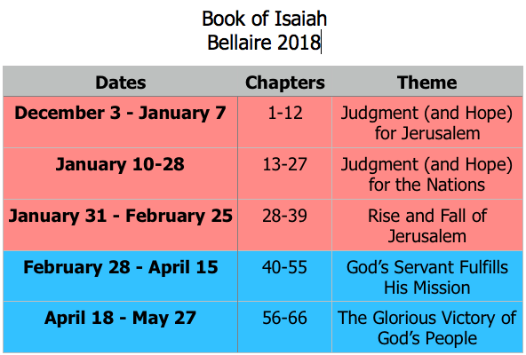
Class Plan

Slide 3
Themes Laid Out in Isaiah 41
God is coming.
There is no God but Jehovah.
Idols, nations, are nothing.
God will strengthen His people.

Slide 4
God Lays Outs a Challenge
Isaiah 41:1 – “Let us come together for judgment.”
Isaiah 41:21 – “Present your case,” the Lord says.
Who is God challenging in 41:1-7?
Who is God challenging in 41:21-29?

Slide 5
God’s “Servant” so far in Isaiah
Isaiah 20:3 – “Even as my servant, Isaiah…”
Isaiah 22:20 – “I will summon my servant, Eliakim.”
Isaiah 37:35 – “for my servant, David’s sake.”
God’s servant is not just one who does God’s will, but one to whom God is committed.

Slide 6
God’s “Servant” in Isaiah 41?
41:8 – But you, Israel, my servant, Jacob, whom I have chosen … said to you, “You are my servant.”
Because Israel is God’s servant, what will He do for them?

Slide 7
Isaiah 41 in our Hymns
”Fear not, I am with thee, O be not dismayed,
For I am thy God, and will still give thee aid.
I’ll strengthen thee, help thee, and cause thee to stand,
Upheld by my gracious, omnipotent hand.”
- How Firm a Foundation
(Isaiah 41:10)

Slide 8
Isaiah 41 in the New Testament
Revelation 22
And he said to me, “Do not seal up the words of the prophecy of this book, for the time is near. Let the one who does wrong, still do wrong; and the one who is filthy, still be filthy; and let the one who is righteous, still practice righteousness; and the one who is holy, still keep himself holy.”
“Behold, I am coming quickly, and My reward is with Me, to render to every man according to what he has done. I am the Alpha and the Omega, the first and the last, the beginning and the end.”

Slide 9
Isaiah 41 in the New Testament
1 Corinthians 8 (ESV)
Therefore, as to the eating of food offered to idols, we know that “an idol has no real existence,” and that “there is no God but one.” For although there may be so-called gods in heaven or on earth—as indeed there are many “gods” and many “lords”— yet for us there is one God, the Father, from whom are all things and for whom we exist, and one Lord, Jesus Christ, through whom are all things and through whom we exist.

Slide 10
Upcoming Classes
Sunday, March 4 – Review Isaiah 1-39
Wednesday, March 7 – Isaiah 42
Sunday, March 11 – Isaiah 43 (Kerry)

Slide 11
Structure of Isaiah
1-12 : Judgment/Hope for Judah & Jerusalem
Isaiah 1-39
Judgment
Isaiah 40-66
Hope

Slide 12
Isaiah Highlights (1-12)
“In that day the Branch of the Lord will be beautiful and glorious…”
The virgin shall bear a son, his name will be “Immanuel.”
A child will be born; will sit on David’s throne, governing in peace forever.
The mountain of the house of the Lord, nations flow to it.
God will remove jewelry/accessories of wealthy Jerusalem women.
A shoot will spring from the stem of Jesse.
God sings a sad love song about his vineyard, Israel.
Assyria condemned as God’s tool that became prideful.
“Come, let us reason together, says the Lord. Though your sins are as scarlet, they will be as white as snow.”
Isaiah sees God and is called to the prophetic work.
Draw from the springs of salvation! Give thanks to His great and holy name!
Assyrian conquest of Israel foretold w/ child named “swift-spoil-speedy-prey.”
4
7
9
2
3
11
5
10
1
6
12
8

Slide 13
Structure of Isaiah
1-12 : Judgment/Hope for Judah & Jerusalem
Isaiah 1-39
Judgment
13-27 : Judgment/Hope for the Nations & World
Isaiah 40-66
Hope

Slide 14
Isaiah Highlights (13-27)
The Nations (“God’s oracle concerning…”)
Valley of Vision (Jerusalem)
Syria & Israel
Tyre
Ethiopia
Babylon
Egypt
Moab
The World
A happy song of a vineyard (restored Israel) that is secure and fruitful!
God prepares a banquet on His mountain, swallows up death forever.
God brings destruction on the whole earth.
The wicked die and are destroyed, the dead of God’s people rise again.
22
17
23
18
13-14
21
19-20
15-16
27
25
24
26

Slide 15
Structure of Isaiah
1-12 : Judgment/Hope for Judah & Jerusalem
Isaiah 1-39
Judgment
13-27 : Judgment/Hope for the Nations & World
28-39 : The Rise and Fall of Jerusalem
Isaiah 40-66
Hope

Slide 16
Isaiah Highlights (28-39)
The Lord slaughters the nations in a great, heavenly, bloody, greasy sacrifice.
Hezekiah foolishly shows off his wealth to the Babylonians.
“This people draw near with their words and honor me with lip service, but they remove their hearts far from me.”
Assyria besieges and taunts the city of Jerusalem.
“The Destroyer” will be destroyed after he is done destroying.
Hezekiah falls fatally ill, prays to God and gets 15 years of life.
God’s warning to Judah: Do not trust in an Egyptian alliance!
“Behold, I am laying in Zion a stone…he who believes in it will not be put to shame.”
The Spirit is poured out, bringing life, righteousness, peace, and security to God’s people.
Hezekiah calls to God and 185,000 Assyrians are killed.
The ransomed return to Zion on the Highway of Holiness.
34
39
29
36
33
38
30-31
28
32
37
35

Slide 17
Structure of Isaiah
1-12 : Judgment/Hope for Judah & Jerusalem
Isaiah 1-39
Judgment
13-27 : Judgment/Hope for the Nations & World
28-39 : The Rise and Fall of Jerusalem
Isaiah 40-66
Hope
40-55 : God’s Servant Fulfills His Mission

Slide 18
Isaiah Highlights (28-39)
A voice cries, “In the wilderness prepare the way of the Lord!”
Do not fear, worm Jacob, I will help you…pulverize mountains.
40
41

Slide 19
Book of Isaiah
Chapters 40-55
The Servant Fulfills His Mission

Slide 20
= Isaiah’s life
Assyrian Captivity
Israel (Northern)
Israel (United Kingdom)
Return
Judah (Southern)
Babylonian Captivity
Book of Isaiah:
1-39: Present Crises
Syrian Crisis under Ahaz (1-12)
Assyrian Crisis under Hezekiah (28-39)
40-66: Future Hope
Return after Babylonian Crisis
Highly Messianic

Slide 21
