Slide 1
Book of Isaiah
Mid-Term Review
Chapters 1-39

Slide 2
The Prophets of Israel
”Interpreters of History”
Past, present, and future.
What does is mean?
The prophets reveal what God is up to in history.

Slide 3
History of Israel
Abraham, Isaac, Jacob, 12 sons
Slaves in Egypt (400 years)
Wilderness (40 years)
Conquer Canaan
Israel (United Kingdom)

Slide 4
History of Israel
Assyrian Captivity
Israel (Northern)
Israel (United Kingdom)
Return
Judah (Southern)
Babylonian Captivity
= Isaiah’s life
Isaiah 1:1 – “The vision of Isaiah the son of Amoz, which he saw concerning Judah and Jerusalem in the days of Uzziah, Jotham, Ahaz, and Hezekiah, kings of Judah.”

Slide 5
= Isaiah’s life
Assyrian Captivity
Israel (Northern)
Israel (United Kingdom)
Return
Judah (Southern)
Babylonian Captivity
Book of Isaiah:
1-39: Present Crises
Ahaz: Threat from Israel & Syria (ch.1-12)
Hezekiah: Threat from Assyria (ch.28-39)
40-66: Future Hope
Return after Babylonian Crisis
Highly Messianic

Slide 6
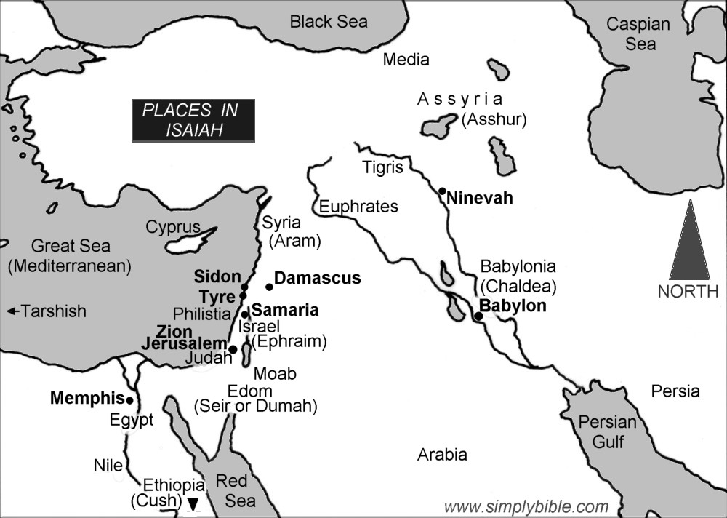

Slide 7
Structure of Isaiah
Isaiah 1-39
Judgment
Isaiah 40-66
Hope

Slide 8
Isaiah 1-39
Isaiah 1-12 : Judah
1-5 – General messages of judgment and hope
6 – Isaiah’s call to the work of a prophet
7-12 – Specific messages for Syrian crisis
Isaiah 13-27 : the Nations
13-23 – Judgment and hope for nations
24-27 – Judgment and hope for whole world
Isaiah 28-39 : Jerusalem
28-33 – Specific messages for Assyrian crisis
34-35 – General message for Jerusalem
36-39 – The stories of Hezekiah

Slide 9
Judgment and Hope
Rebellion
Restoration
Repentance
Retribution

Slide 10
Rebellion
Restoration
Repentance
Retribution
Concerning Judah
Chapter 1:21-2:25

Slide 11
Rebellion
Restoration
Repentance
Retribution
Concerning Judah & Israel
Chapter 4:2-5:7

Slide 12
Rebellion
Restoration
Repentance
Retribution
Concerning Egypt/Assyria
Chapter 19:11-25

Slide 13
Rebellion
Restoration
Repentance
Retribution
Concerning World
Chapter 24:17-25:12

Slide 14
Rebellion
Restoration
Repentance
Retribution
Concerning Judah
Chapter 32:9-20

Slide 15
Rebellion
Restoration
Repentance
Retribution
Concerning Jerusalem
Chapters 36-37

Slide 16
Structure of Isaiah
1-12 : Judgment/Hope for Judah & Jerusalem
Isaiah 1-39
Judgment
Isaiah 40-66
Hope

Slide 17
Isaiah Highlights (1-12)
“In that day the Branch of the Lord will be beautiful and glorious…”
The virgin shall bear a son, his name will be “Immanuel.”
A child will be born; will sit on David’s throne, governing in peace forever.
The mountain of the house of the Lord, nations flow to it.
God will remove jewelry/accessories of wealthy Jerusalem women.
A shoot will spring from the stem of Jesse.
God sings a sad love song about his vineyard, Israel.
Assyria condemned as God’s tool that became prideful.
“Come, let us reason together, says the Lord. Though your sins are as scarlet, they will be as white as snow.”
Isaiah sees God and is called to the prophetic work.
Draw from the springs of salvation! Give thanks to His great and holy name!
Assyrian conquest of Israel foretold w/ child named “swift-spoil-speedy-prey.”
4
7
9
2
3
11
5
10
1
6
12
8

Slide 18
Structure of Isaiah
1-12 : Judgment/Hope for Judah & Jerusalem
Isaiah 1-39
Judgment
13-27 : Judgment/Hope for the Nations & World
Isaiah 40-66
Hope

Slide 19
Isaiah Highlights (13-27)
The Nations (“God’s oracle concerning…”)
Valley of Vision (Jerusalem)
Syria & Israel
Tyre
Ethiopia
Babylon
Egypt
Moab
The World
A happy song of a vineyard (restored Israel) that is secure and fruitful!
God prepares a banquet on His mountain, swallows up death forever.
God brings destruction on the whole earth.
The wicked die and are destroyed, the dead of God’s people rise again.
22
17
23
18
13-14
21
19-20
15-16
27
25
24
26

Slide 20
Structure of Isaiah
1-12 : Judgment/Hope for Judah & Jerusalem
Isaiah 1-39
Judgment
13-27 : Judgment/Hope for the Nations & World
28-39 : The Rise and Fall of Jerusalem
Isaiah 40-66
Hope

Slide 21
Isaiah Highlights (28-39)
The Lord slaughters the nations in a great, heavenly, bloody, greasy sacrifice.
Hezekiah foolishly shows off his wealth to the Babylonians.
“This people draw near with their words and honor me with lip service, but they remove their hearts far from me.”
Assyria besieges and taunts the city of Jerusalem.
“The Destroyer” will be destroyed after he is done destroying.
Hezekiah falls fatally ill, prays to God and gets 15 years of life.
God’s warning to Judah: Do not trust in an Egyptian alliance!
“Behold, I am laying in Zion a stone…he who believes in it will not be put to shame.”
The Spirit is poured out, bringing life, righteousness, peace, and security to God’s people.
Hezekiah calls to God and 185,000 Assyrians are killed.
The ransomed return to Zion on the Highway of Holiness.
34
39
29
36
33
38
30-31
28
32
37
35

Slide 22
Structure of Isaiah
1-12 : Judgment/Hope for Judah & Jerusalem
Isaiah 1-39
Judgment
13-27 : Judgment/Hope for the Nations & World
28-39 : The Rise and Fall of Jerusalem
Isaiah 40-66
Hope
40-55 : God’s Servant Fulfills His Mission

Slide 23
Isaiah Highlights (28-39)
A voice cries, “In the wilderness prepare the way of the Lord!”
Do not fear, worm Jacob, I will help you…pulverize mountains.
40
41

Slide 24
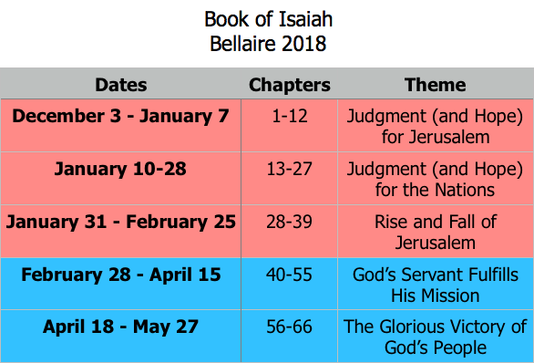
Class Plan

Slide 25
Book of Isaiah
Chapters 40-55
The Servant Fulfills His Mission

