Slide 1
Book of Isaiah
Chapters 40-55
God’s Servant Fulfills His Mission

Slide 2
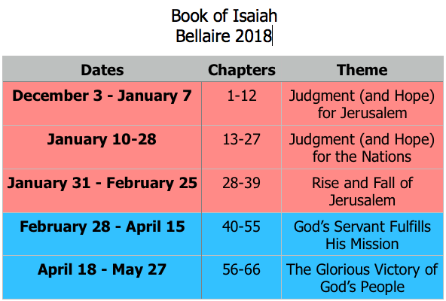
Class Plan

Slide 3
= Isaiah’s life
Assyrian Captivity
Israel (Northern)
Israel (United Kingdom)
Return
Judah (Southern)
Babylonian Captivity
Book of Isaiah:
1-39: Present Crises
Syrian Crisis under Ahaz (1-12)
Assyrian Crisis under Hezekiah (28-39)
40-66: Future Hope
Return after Babylonian Crisis
Highly Messianic

Slide 5
Themes Laid Out in Isaiah 40
God is coming.
There is no God but Jehovah.
Idols, nations, are nothing.
God will strengthen His people.

Slide 6
God’s “Servant” in Isaiah
Isaiah 20:3 – “Even as my servant, Isaiah…”
Isaiah 22:20 – “I will summon my servant, Eliakim.”
Isaiah 37:35 – “for my servant, David’s sake.”
God’s servant is not just one who does God’s will, but one to whom God is committed.
41:8 – But you, Israel, my servant, Jacob, whom I have chosen … said to you, “You are my servant.”

Slide 7
Isaiah 42
How does this fit with Babylonian captivity/return?
How are the themes introduced in chapter 40 built upon?
What do we learn about God’s servant?

Slide 8
Isaiah 42 in the New Testament
Luke 3
Now when all the people were baptized, and when Jesus also had been baptized and was praying, the heavens were opened, and the Holy Spirit descended on him in bodily form, like a dove; and a voice came from heaven, “You are my beloved Son; with you I am well pleased.”

Slide 9
Isaiah 42 in the New Testament
Matthew 12
Jesus, aware of [the Pharisees’ plot], withdrew from there. And many followed him, and he healed them all and ordered them not to make him known. This was to fulfill what was spoken by the prophet Isaiah:
“Behold, my servant whom I have chosen, my beloved with whom my soul is well pleased. I will put my Spirit upon him, and he will proclaim justice to the Gentiles. He will not quarrel or cry aloud, nor will anyone hear his voice in the streets; a bruised reed he will not break, and a smoldering wick he will not quench, until he brings justice to victory; and in his name the Gentiles will hope.”

Slide 10
Isaiah 42 in the New Testament
2 Corinthians 5
From now on, therefore, we regard no one according to the flesh. Even though we once regarded Christ according to the flesh, we regard him thus no longer. Therefore, if anyone is in Christ, he is a new creation. The old has passed away; behold, the new has come. All this is from God, who through Christ reconciled us to himself and gave us the ministry of reconciliation; that is, in Christ God was reconciling the world to himself, not counting their trespasses against them, and entrusting to us the message of reconciliation.

Slide 11
Isaiah 42 in the New Testament
Revelation 21
Then I saw a new heaven and a new earth, for the first heaven and the first earth had passed away, and the sea was no more. And I saw the holy city, new Jerusalem, coming down out of heaven from God, prepared as a bride adorned for her husband. And I heard a loud voice from the throne saying, “Behold, the dwelling place of God is with man. He will dwell with them, and they will be his people, and God himself will be with them as their God. He will wipe away every tear from their eyes, and death shall be no more, neither shall there be mourning, nor crying, nor pain anymore, for the former things have passed away.”
And he who was seated on the throne said, “Behold, I am making all things new.”

Slide 12
Structure of Isaiah
1-12 : Judgment/Hope for Judah & Jerusalem
Isaiah 1-39
Judgment
Isaiah 40-66
Hope

Slide 13
Isaiah Highlights (1-12)
“In that day the Branch of the Lord will be beautiful and glorious…”
The virgin shall bear a son, his name will be “Immanuel.”
A child will be born; will sit on David’s throne, governing in peace forever.
The mountain of the house of the Lord, nations flow to it.
God will remove jewelry/accessories of wealthy Jerusalem women.
A shoot will spring from the stem of Jesse.
God sings a sad love song about his vineyard, Israel.
Assyria condemned as God’s tool that became prideful.
“Come, let us reason together, says the Lord. Though your sins are as scarlet, they will be as white as snow.”
Isaiah sees God and is called to the prophetic work.
Draw from the springs of salvation! Give thanks to His great and holy name!
Assyrian conquest of Israel foretold w/ child named “swift-spoil-speedy-prey.”
4
7
9
2
3
11
5
10
1
6
12
8

Slide 14
Structure of Isaiah
1-12 : Judgment/Hope for Judah & Jerusalem
Isaiah 1-39
Judgment
13-27 : Judgment/Hope for the Nations & World
Isaiah 40-66
Hope

Slide 15
Isaiah Highlights (13-27)
The Nations (“God’s oracle concerning…”)
Valley of Vision (Jerusalem)
Syria & Israel
Tyre
Ethiopia
Babylon
Egypt
Moab
The World
A happy song of a vineyard (restored Israel) that is secure and fruitful!
God prepares a banquet on His mountain, swallows up death forever.
God brings destruction on the whole earth.
The wicked die and are destroyed, the dead of God’s people rise again.
22
17
23
18
13-14
21
19-20
15-16
27
25
24
26

Slide 16
Structure of Isaiah
1-12 : Judgment/Hope for Judah & Jerusalem
Isaiah 1-39
Judgment
13-27 : Judgment/Hope for the Nations & World
28-39 : The Rise and Fall of Jerusalem
Isaiah 40-66
Hope

Slide 17
Isaiah Highlights (28-39)
The Lord slaughters the nations in a great, heavenly, bloody, greasy sacrifice.
Hezekiah foolishly shows off his wealth to the Babylonians.
“This people draw near with their words and honor me with lip service, but they remove their hearts far from me.”
Assyria besieges and taunts the city of Jerusalem.
“The Destroyer” will be destroyed after he is done destroying.
Hezekiah falls fatally ill, prays to God and gets 15 years of life.
God’s warning to Judah: Do not trust in an Egyptian alliance!
“Behold, I am laying in Zion a stone…he who believes in it will not be put to shame.”
The Spirit is poured out, bringing life, righteousness, peace, and security to God’s people.
Hezekiah calls to God and 185,000 Assyrians are killed.
The ransomed return to Zion on the Highway of Holiness.
34
39
29
36
33
38
30-31
28
32
37
35

Slide 18
Structure of Isaiah
1-12 : Judgment/Hope for Judah & Jerusalem
Isaiah 1-39
Judgment
13-27 : Judgment/Hope for the Nations & World
28-39 : The Rise and Fall of Jerusalem
Isaiah 40-66
Hope
40-55 : God’s Servant Fulfills His Mission

Slide 19
Isaiah Highlights (28-39)
A voice cries, “In the wilderness prepare the way of the Lord!”
Do not fear, worm Jacob, I will help you…pulverize mountains.
“My Servant, whom I uphold…I have put my Spirit upon him.”
40
41
42

Slide 20
Book of Isaiah
Chapters 40-55
The Servant Fulfills His Mission

