Slide 2
Mind
“deep thought” (Strong)
“faculty of understanding, feeling, desiring” (Thayer)
Deuteronomy 6

Slide 3
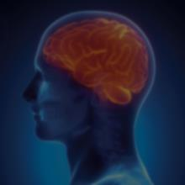
The Human Brain
- It consumes about 20% of all the oxygen in your body.
- It is the fattest organ in your body comprising of over 60% fat.
- There are about 100,000 miles of blood vessels in the average human brain.
- The brain also has no pain receptors so it doesn’t actually feel pain.
- The brain of a baby triples in size during the first year & keeps growing to age 18.
- Did you know that you think an average of 70,000 thoughts per day?
(Source Rehabchicago.org)

Slide 5
Teach Your Children
- The Bible
- To memorize scripture
- Reason for the hope in them
- The grace and truth of Jesus
Deuteronomy 6

Slide 6
Take Home:
Love Him with Your Mind
Reason – Isa 1:18
Knowledge – Heb 10:16
Memorize – Psa 119:148
Visualize – Psa 8:3; Eph 3:21-22
Transformation – Rom 12:2
Deuteronomy 6

