Slide 3
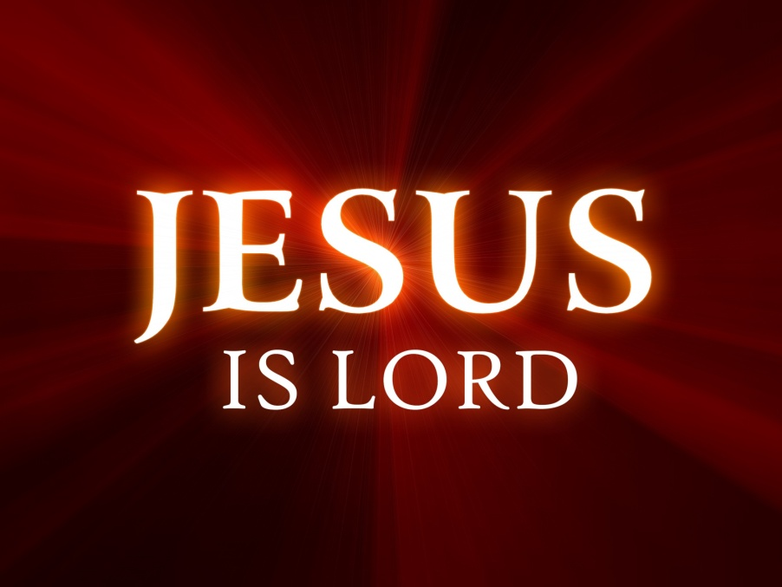
⁵ For although there may be so-called gods in heaven or on earth—as indeed there are many “gods” and many “lords”— ⁶ yet for us there is one God, the Father, from whom are all things and for whom we exist, and one Lord, Jesus Christ, through whom are all things and through whom we exist. 1 Corinthians 8:5-6

Slide 4
⁹ Therefore God has highly exalted him and bestowed on him the name that is above every name, ¹⁰ so that at the name of Jesus every knee should bow, in heaven and on earth and under the earth, ¹¹ and every tongue confess that Jesus Christ is Lord, to the glory of God the Father.. Philippians 2:9-11

Slide 5
²⁰ But our citizenship is in heaven, and from it we await a Savior, the Lord Jesus Christ, ²¹ who will transform our lowly body to be like his glorious body, by the power that enables him even to subject all things to himself. Philippians 3:20-21

Slide 6
¹¹ Beloved, I urge you as sojourners and exiles to abstain from the passions of the flesh, which wage war against your soul. ¹² Keep your conduct among the Gentiles honorable, so that when they speak against you as evildoers, they may see your good deeds and glorify God on the day of visitation. 1 Peter 2:11-12

