Slide 1
WELCOME TO Bellaire CHURCH OF CHRIST
WE ARE GLAD YOU’RE HERE
Scripture reading: Ephesians 4:11-16
Notes:
The passage that was just read provides a goal for the church. God intends his church to be a growing thriving group of individuals. As we’ve just read- God gave gifts for the intention of efication. Building up!!! Making stronger! Improving.
Unfortunately sometime we can employ different tactics that do just the opposite. Instead of making the strong stronger we instead make the weak weaker. Or we make the strong weaker. To as a whole cultivate weakness.
And that’s simply what I’d like to look at for our time this morning.
I want to consider some things that cultivate weakness that we need to avoid.
I want to look at 4 main points that I think are very dangerous that are often employed that will cultivate weakness as opposed to strength.

Slide 2
Cultivating Weakness
Notes:
The passage that was just read provides a goal for the church. God intends his church to be a growing thriving group of individuals. As we’ve just read- God gave gifts for the intention of efication. Building up!!! Making stronger! Improving.
Unfortunately sometime we can employ different tactics that do just the opposite. Instead of making the strong stronger we instead make the weak weaker. Or we make the strong weaker. To as a whole cultivate weakness.
And that’s simply what I’d like to look at for our time this morning.
I want to consider some things that cultivate weakness that we need to avoid.
I want to look at 4 main points that I think are very dangerous that are often employed that will cultivate weakness as opposed to strength.

Slide 3
Ignoring Weak Behavior:
1 Cor. 5:6 “A little leaven leavens the whole lump”
“Ignorance leads to tolerance, tolerance leads to acceptance, and acceptance can lead to practice.”
We witness weak behavior and say nothing…
We complain behind their backs
We justify ourselves by saying “they know better.”
Notes:
1 Cor. 5:6
When we look at things that are weak or sinful and do nothing–when we allow sin to go unchecked that sin that weakness it grows it will spread.
When we look at such things and just turn a blind eye thinking “eh, it’ll work itself out. Just give it some time and it will change on it’s own. A lot of times that’s just wishful thinking.
Ignoring leads to tolerating leads to accepting.
So often we see things that are wrong and inappropriate or things that could be drastically improved and we say nothing. Or maybe I should qualify that and say that we say nothing to their face. We never approach them
This does not mean we shouldn’t use some great tact
And be careful how we come across in our correction or criticism. But so often there are things that we don’t like or that we observe that we think could be far better, rather tell an individual or discuss with someone ways to improve, we just complain behind their backs.
And maybe we do this and never talk to them personally b/c we feel justified that “they should know better.”

Slide 4
Ignoring Weak Behavior:
Often we may know better in a general sense but not be able to see it personally.
Ex. Toastmasters
“the constructive criticism is often far better than praise.”
Many people know the criticism they receive and may have given it to others.
The Example from David and Nathan (2 Samuel. 12:5-6)
David knew the wrong generally but didn’t see it personally.
Notes:
But consider this. Often we may know better (in a general sense but are not able to see it in ourselves).
Ex. Toastmasters- I started going to this club that you may have heard of called Toastmasters. It is basically a club focused on public speaking. Everyone does very short impromptu speeches at the beginning meeting followed by 3 prepared speeches. I will tell you though that my reason for the club has nothing to do with simply giving speeches. The payoff in my position is that every prepared speech is given an evaluation by a fellow member. Each speaker has someone who is selected to evaluate them and after they are done they give a short talk evaluating their performance.
The person running the meeting last Wednesday morning said that he thinks that over the years there has been a drastic improvement in the evaluations. When they began, he said, there was a lot of hesitation to offer criticism, it was mostly praise. But that the club has gotten far better at offering very good constructive criticism. And that this is in many ways far better than praise. It is those suggestions for improvement that make us better speakers and allow us to grow.
What I think is very interesting is that when the criticism is given, I would imagine everyone knows what is being told to them. They may have even offered some of the same criticism to other people.
So often it is very easy to point out flaws and give good criticism to improve but not realize that you may do the same things.
We may know better generally but not know better personally.
I think David is a great example of that.
He knew better generally speaking, but he didn’t realize that was himself. Nathan had to finish that parable by saying YOU ARE THE MAN. David knew better he just didn’t realize he was the one making that mistake until someone was willing to tell him.
2 Samuel 12
It is because of this bold man of courage who tells him personally

Slide 5
Ignoring Weak Behavior:
We ought not get frustrated with people that we have not talked to personally.
Matt. 18
Gossip (Eph. 4:29; James 4:11; Titus 3:1-3)
Constructive criticism and rebuke is a good thing!!!
Proverbs 27:5-6
Notes:
We need to be careful. To get frustrated with someone and not bring it to them personally because we will be violating Matt. 18
^{Eph. 4:29} Do not let any unwholesome talk come out of your mouths, but only what is helpful for building others up according to their needs, that it may benefit those who listen.
If we are going to get angry at people for not changing and not doing something right when we have never point blank told them, never sat down and made it very clear what could be improved then we are doing that individual NO FAVORS.
We need to be reminded that this is a good thing that we can offer.
Prov. 27:6
That is exactly why I wanted to join the club. I wanted to know where I could improve. And they do a wonderful job of
What is interesting is that they vote on all these things, who gave the best speech, but also who gave the best evaluation. And
After the speech is done there is someone that stands up and gives basically a short speech of an evaluation of the speech they’ve been assigned.

Slide 6
Making Excuses for the Weak:
Notes:
Making excuses for the weak will cultivate weakness- making excuses for someone else’s weakness will also cultivate weakness.

Slide 7
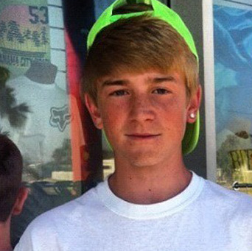
ETHAN COUCH
f
Notes:
Allow me to introduce you, if you have not been introduced already, to Ethan Couch.
June 15, 2013 There was a stranded motorist name Breanna Mitchell who had her SUV parked along side the road. A wife and daughter went to go help her in the process another individual who a youth pastor had stopped to help as well.
Meanwhile, 16-year old Ethan couch had just previously stole a couple of cases of beer at the local walmart had been partying with his friend and decided to go out for another beer run.
He was driving an F-350 with 7 passengers with him including 2 in the bed of truck going 70 miles per hour in a 40 mile per hour zone. when he lost control.
He struck and killed Breanna Mitchell and the 3 individuals who were there helping her.
The pickup also rammed a parked car, sending it into another car traveling in the opposite lane, before the truck rolled over and smashed into a tree.
The individuals riding in the back bed were thrown from the truck one suffering some internal injuries and broken bones, the other landed on his head and has been paralyzed being only able to smile and blink.
It was revealed during the trial that Couch's blood-alcohol level was 0.24 – three times the adult limit, though minors aren't allowed any alcohol in their system – and that he was also on the prescription drug Valium.
Can you guess how much time in Jail Ethan received?
None!!!
Ethan’s parents are quite wealthy and
Ethan was driving his father’s pickup truck and
Killed 4 and injured 12

Slide 8
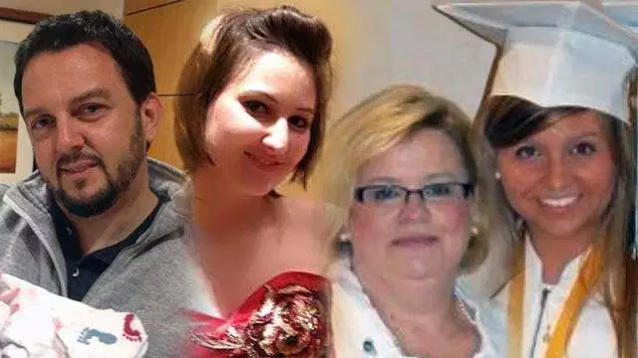
F
Notes:
Allow me to introduce you, if you have not been introduced already, to Ethan Couch.
June 15, 2013 There was a stranded motorist name Breanna Mitchell who had her SUV parked along side the road. A wife and daughter went to go help her in the process another individual who a youth pastor had stopped to help as well.
Meanwhile, 16-year old Ethan couch had just previously stole a couple of cases of beer at the local walmart had been partying with his friend and decided to go out for another beer run.
He was driving an F-350 with 7 passengers with him including 2 in the bed of truck going 70 miles per hour in a 40 mile per hour zone. when he lost control.
He struck and killed Breanna Mitchell and the 3 individuals who were there helping her.
The pickup also rammed a parked car, sending it into another car traveling in the opposite lane, before the truck rolled over and smashed into a tree.
The individuals riding in the back bed were thrown from the truck one suffering some internal injuries and broken bones, the other landed on his head and has been paralyzed being only able to smile and blink.
It was revealed during the trial that Couch's blood-alcohol level was 0.24 – three times the adult limit, though minors aren't allowed any alcohol in their system – and that he was also on the prescription drug Valium.
Can you guess how much time in Jail Ethan received?
None!!!
Ethan’s parents are quite wealthy and
Ethan was driving his father’s pickup truck and
Killed 4 and injured 12

Slide 9
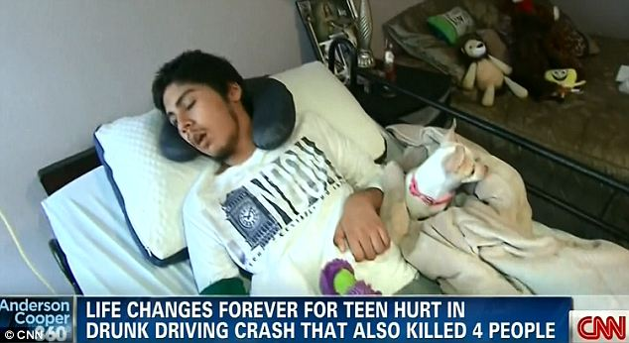
f

Slide 10
ETHAN COUCH
STOLE ALCOHOL
SPEEDING (70 IN A 40MPH ZONE)
LOADED ON VALIUM
DUI (0.24 BLOOD ALCOHOL LEVEL)
CAUSED CAR CRASH
INJURED 9 (INCLUDING ONE PARALYZED)
KILLED 4
NO JAIL TIME!!!
Notes:
Allow me to introduce you, if you have not been introduced already, to Ethan Couch.
June 15, 2013 There was a stranded motorist name Breanna Mitchell who had her SUV parked along side the road. A wife and daughter went to go help her in the process another individual who a youth pastor had stopped to help as well.
Meanwhile, 16-year old Ethan couch had just previously stole a couple of cases of beer at the local walmart had been partying with his friend and decided to go out for another beer run.
He was driving an F-350 with 7 passengers with him including 2 in the bed of truck going 70 miles per hour in a 40 mile per hour zone. when he lost control.
He struck and killed Breanna Mitchell and the 3 individuals who were there helping her.
The pickup also rammed a parked car, sending it into another car traveling in the opposite lane, before the truck rolled over and smashed into a tree.
The individuals riding in the back bed were thrown from the truck one suffering some internal injuries and broken bones, the other landed on his head and has been paralyzed being only able to smile and blink.
It was revealed during the trial that Couch's blood-alcohol level was 0.24 – three times the adult limit, though minors aren't allowed any alcohol in their system – and that he was also on the prescription drug Valium.
Can you guess how much time in Jail Ethan received?
None!!!
Ethan’s parents are quite wealthy and
Ethan was driving his father’s pickup truck and
Killed 4 and injured 12

Slide 11
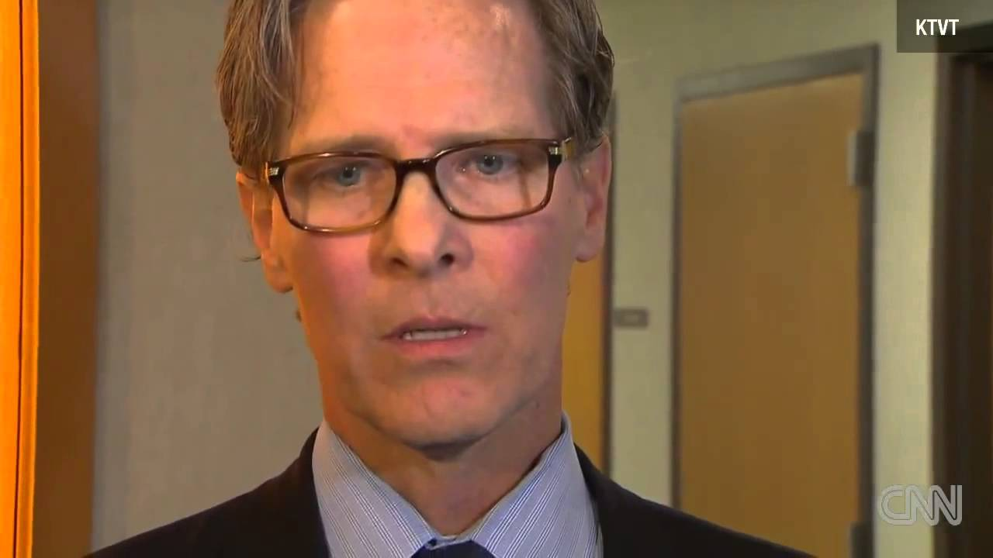
“He is the product of wealthy, privileged parents who never set limits for the boy”
“A VICTIM OF
AFFLUENZA”:
“He’d lost the ability to understand the relationship between action and consequence.”
Notes:
SUFFERED FROM AFLUENZA---
Ethan is the victim- don’t you see says his attourney.
according to one psychologist -- the product of wealthy, privileged parents who never set limits for the boy.
To a judge, who sentenced Couch to 10 years' probation but no jail time, he's a defendant in need of treatment.
The attourney argued that his parents gave him everything he wanted and “he’d lost the ability to understand the relationship between action and consequence.”
So as a result he shouldn’t be punished by the law for bad behavior either??????
This makes no sense until you find that Ethan Couch’s parents are filthy rich.
They payed what would appear to be incredibly large settlements to several of the family who had brought charges against them. The only amount that was disclosed was regarding molina the individual who was paralyzed. They got two million.
And they agreed to pay for rehabilitation centers for him to get treatment.
The rehabilitation facility near Newport Beach, California that the teen was expected to attend would cost his family approximately $500,000 annually. However, he was sentenced to a state facility which requires the family to only pay $1100 per month^{[11][12]} The facility offers a 90-day treatment program that includes horse riding, mixed martial arts, massage and cookery, a swimming pool, basketball and six acres of land.

Slide 12
Making Excuses for the Weak:
We make no one stronger by
Making excuses for their sin
Covering the tracks of the offender
Paying for the offenders mistakes
Protecting people from every consequence
“Nothing changes when nothing ever changes”
Does God do that for us? (Gen. 3; Heb. 12:4-11)
Does God accept excuses (Exod. 4)
Some may be willing to repent until we make excuses for them
Matthew 18:6
Notes:
It scares me to think that some people would be ready to repent but because they have all these excuses made for them (or b/c sometimes we makes all these excuses for them) they aren’t able- they stay weak, they don’t improve.
What did this kid just learn?
You really think he learned about taking responsibility for his actions? You think he’s gonna learn that from getting a pass and getting to spend his time under “probation” at his mansion and going to rehab facilities that with karate classes and message classes.
You think we help people by allowing people to sin while we make excuses for them? And certainly nothing will ever change when we reward that kind of behavior.
Covering the tracks behind them. Paying for the offenses of others while they go on doing the same thing.
Nothing changes when nothing ever changes.

Slide 13
Rewarding Weak Behavior:
Ex. DMV
Jer. 6:13-14
What is learned by these kinds of rewards?
Notes:
You know the Lord was mad when people were paying people to tell them it was ok to sin. False prophets
Don’t you think the Lord gets mad when we reward the sinner.
Yeah that kind of thinking is foreign here!!!
Today when a child does wrong and throws a tantrum that’s what so many do, well maybe if I give them a new toy they will feel better.
Or that kid isn’t getting terrible grades maybe if I give them a new Ipad
What did they really just learn–

Slide 14
Sunshine all the time makes a desert

Slide 15
Accusing the Fault-finder as Opposed to the One at Fault

Slide 16
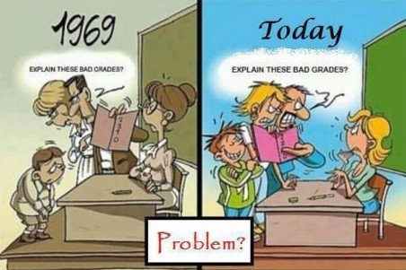
f
Notes:
I think some of those of you who are teachers might really appreciate this.
We defend the one who is doing wrong and defend the person who is doing something right.

Slide 17
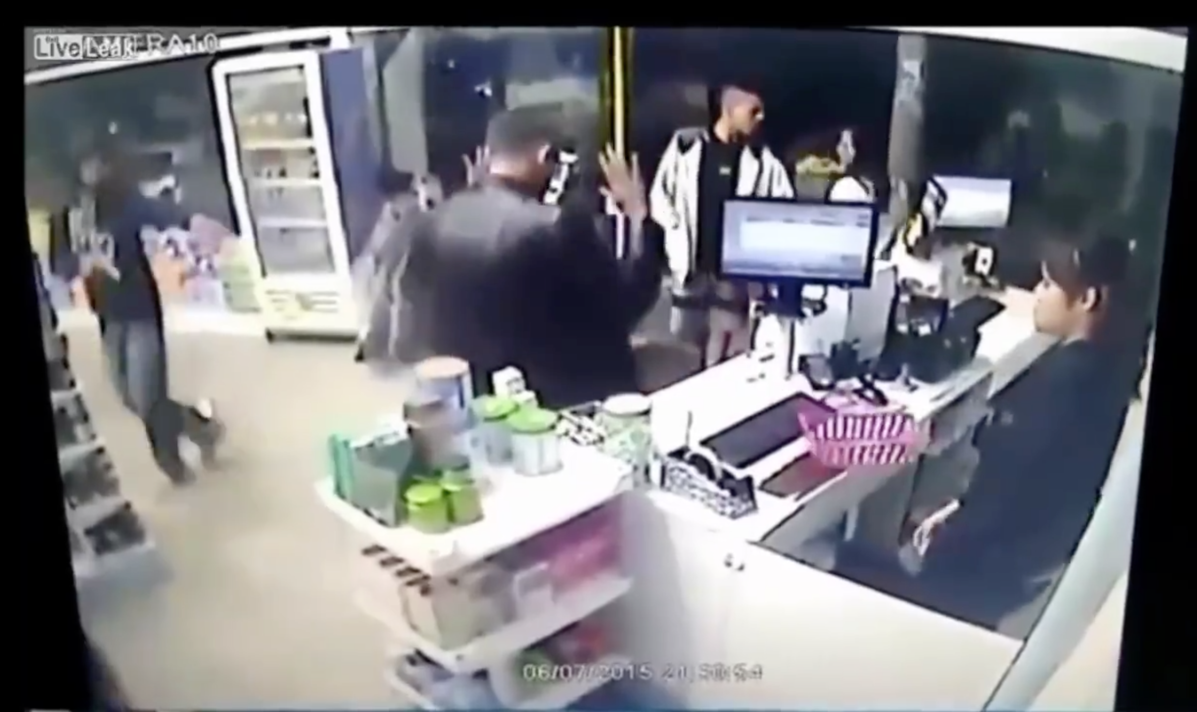
“Question lies in the necessity of shooting him? Could he have accomplished the same thing without firing his weapon?”
Notes:
Just to provide an another illustration
Ex. Video- of an individual who there while robbing a bank and happens to be someone who carries. So this guy has a gone and is saying this is a robbery and so the victim shoots him and kicks away that gun.
Question lies in the necessity of shooting him? Could he have accomplished the same thing without firing his weapon?
And of course you know there were people commenting and saying. He could have handled that differently- he didn’t have to shoot him…what???
That’s the kind of mentality so many people have. Let’s not talk about the person who’s waving his gun around robbing the store. Let’s talk about the guy who used his gun to keep innocent people safe.
I don’t say this in regard to all situations. But that is something that the media has jumped on time and time again. Whats the tag line when something like this happens with the police so often.
Another police officer kills young man.
The tag lines haven’t been near as much young person gets shot while trying to rob convenient store, while assulting an officer, while committing horrible crime.
Again not saying there haven’t been abuses in law-enforcement.
But that has so often been the mentality of our culture.

Slide 18
Accusing the Fault-finder as Opposed to the One at Fault
Accusing the teacher for the students poor grades
Accusing law enforcement as opposed to the law breaker
Accusing the church as opposed to the sinner.
“The church is full of hypocrites.”
Accusing the one trying to offer rebuke as opposed to the one trying to sin.
Matt. 23:37
Notes:
Happens in schools happens.
We are getting it so backwards.
This is something condemned of Jersualem by Jesus.
That’s been Israel’s history. Prophet comes to tells the people of their sin- and they reject. What a terrible person- they’ll kill him.
Because of this
What is amazing is that a lot of people do these kinds of things thinking that it will make strength.

Slide 19
Cultivating Weakness

Slide 20
WELCOME TO Bellaire CHURCH OF CHRIST
WE ARE GLAD YOU’RE HERE

