Slide 1
Bellaire Church of Christ
May 6, 2012
Go Unto All the World
Song Service

Slide 2
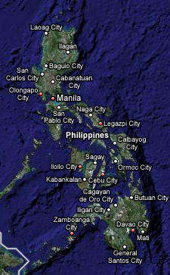
Preachers Supported by Bellaire Church of Christ
Henry Kelley
Ogdensburg, WI
Derek Chambers
Albuquerque, NM
Bart Campbell
Globe, AZ
Robinson Pulveras
Jimmy Domingo
Carlito Abella
Philippines
Hendrik Joubert
Mebane, NC
Bill Beasley
Iron Station, NC
Stan Wenck
Douglasville, GA
Alan Wood
Victoria, TX
Ruben Amador
Houston, TX
Jack Smith
Bellaire, TX
Steve Garrett
Bellaire, TX
Santiago Soto
Alajuela, Costa Rica
Gene Mabry
Missouri City, TX
Jesus Trevino
Lake Jackson, TX

Slide 3
Preaching Reports
(Jack Smith)
Mt 28:16-20
Bart Campbell – Arizona
Derek Chambers – New Mexico
#499 I Want To Be a Worker (Michael Robinson)
#273 I’m Not Ashamed to Own My Lord (Michael Robinson)

Slide 4
Preaching Reports
(Mark Mann)
Acts 17:1-4
Stan Wenck – Georgia
Bill Beasley – North Carolina
#75 I Am The Vine (David Ford)
#406 More About Jesus (David Ford)
Prayer

Slide 5
Preaching Reports
(Mike Pharris)
John 5:31-37
Ruben Amador – Central/South America
Gene Mabry – Missouri City, Texas
Robinson Pulveras – Philippines
#180 Wonderful Story of Love (Robert)
#522 For Christ and the Church (Robert)
#194 When We All Get to Heaven (Robert)

Slide 6
Invitation, Lord’s Supper, Closing
Invitation (Jack Smith)
  #317 All Things Are Ready (Steve)
Lord’s Supper
Closing Song
  #227 There Is a Habitation (Steve)
Announcements
Closing Prayer

