Slide 1
CAN WE PASS THE TEST?
LUKE 9:18-25
Notes:
To view this presentation, first, turn up your volume and second, launch the self-running slide show.

Slide 2
CAN WE PASS THE TEST?
19 They replied, “Some say John the Baptist; others say Elijah; and still others, that one of the prophets of long ago has come back to life.”
What Does It Mean To Follow Jesus?
22 And he said, “The Son of Man must suffer many things and be rejected by the elders, chief priests and teachers of the law, and he must be killed and on the third day be raised to life.” (9:22)

Slide 3
CAN WE PASS THE TEST?
“Peter took him aside and began to rebuke him. “Never, Lord!” he said. “This shall never happen to you!” ²³ Jesus turned and said to Peter, “Get behind me, Satan! You are a stumbling block to me; you do not have in mind the things of God, but the things of men.” (Matthew 16:22-23)
What Does Discipleship Cost?

Slide 4
CAN WE PASS THE TEST?
23 Then he said to them all: “If anyone would come after me, he must deny himself and take up his cross daily and follow me. ²⁴ For whoever wants to save his life will lose it, but whoever loses his life for me will save it. ²⁵ What good is it for a man to gain the whole world, and yet lose or forfeit his very self? ²⁶ If anyone is ashamed of me and my words, the Son of Man will be ashamed of him when he comes in his glory and in the glory of the Father and of the holy angels. ²⁷ I tell you the truth, some who are standing here will not taste death before they see the kingdom of God.” (22-27)

Slide 5
CAN WE PASS THE TEST?
The first thing we must do is deny ourselves.
Second Jesus tells us that we must take up our cross.
The third requirement for discipleship is to follow Him.

Slide 6
CAN WE PASS THE TEST?
But we aren’t nearly as enthused when the Lord tells us to:
Care for widows and orphans
Live simply so we can give generously
Forgive those who have hurt us
Love our enemies and pray for those who try to take advantage of us
Put the building of His kingdom before the building of our own
Confess Him before others; even those who won’t like what we have to say
Keep our promises even when it hurts
Stop Gossiping

Slide 7
154 - MY ONLY HOPE IS YOU - TITLE

Slide 8
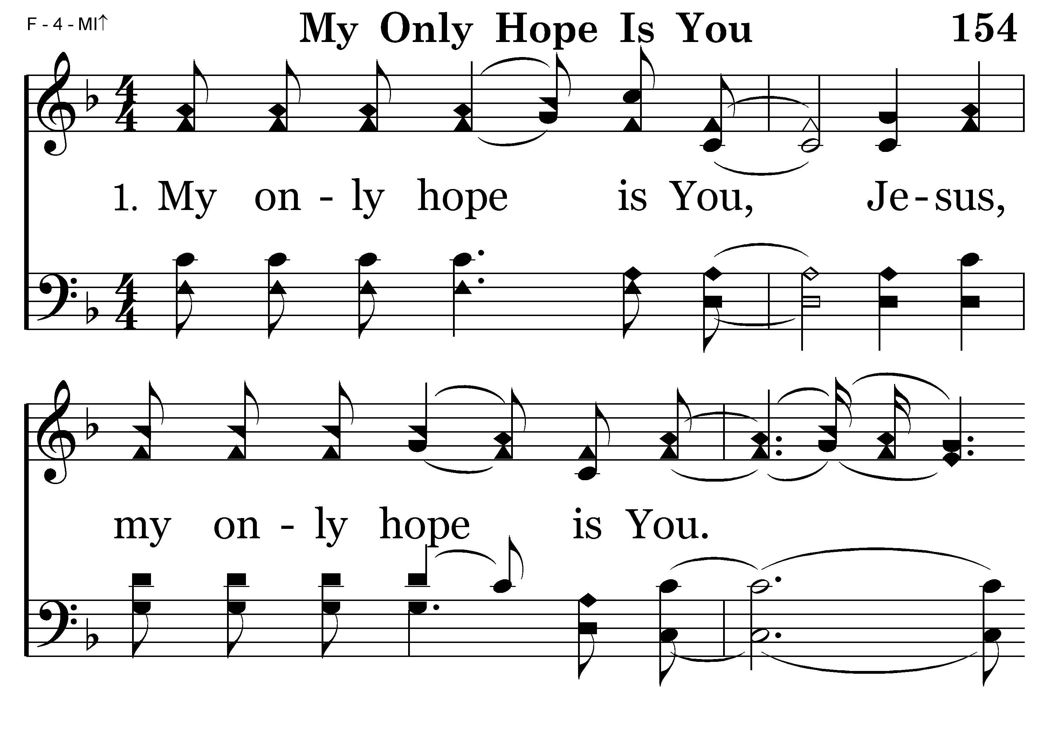
154 - MY ONLY HOPE IS YOU – 1.1

Slide 9
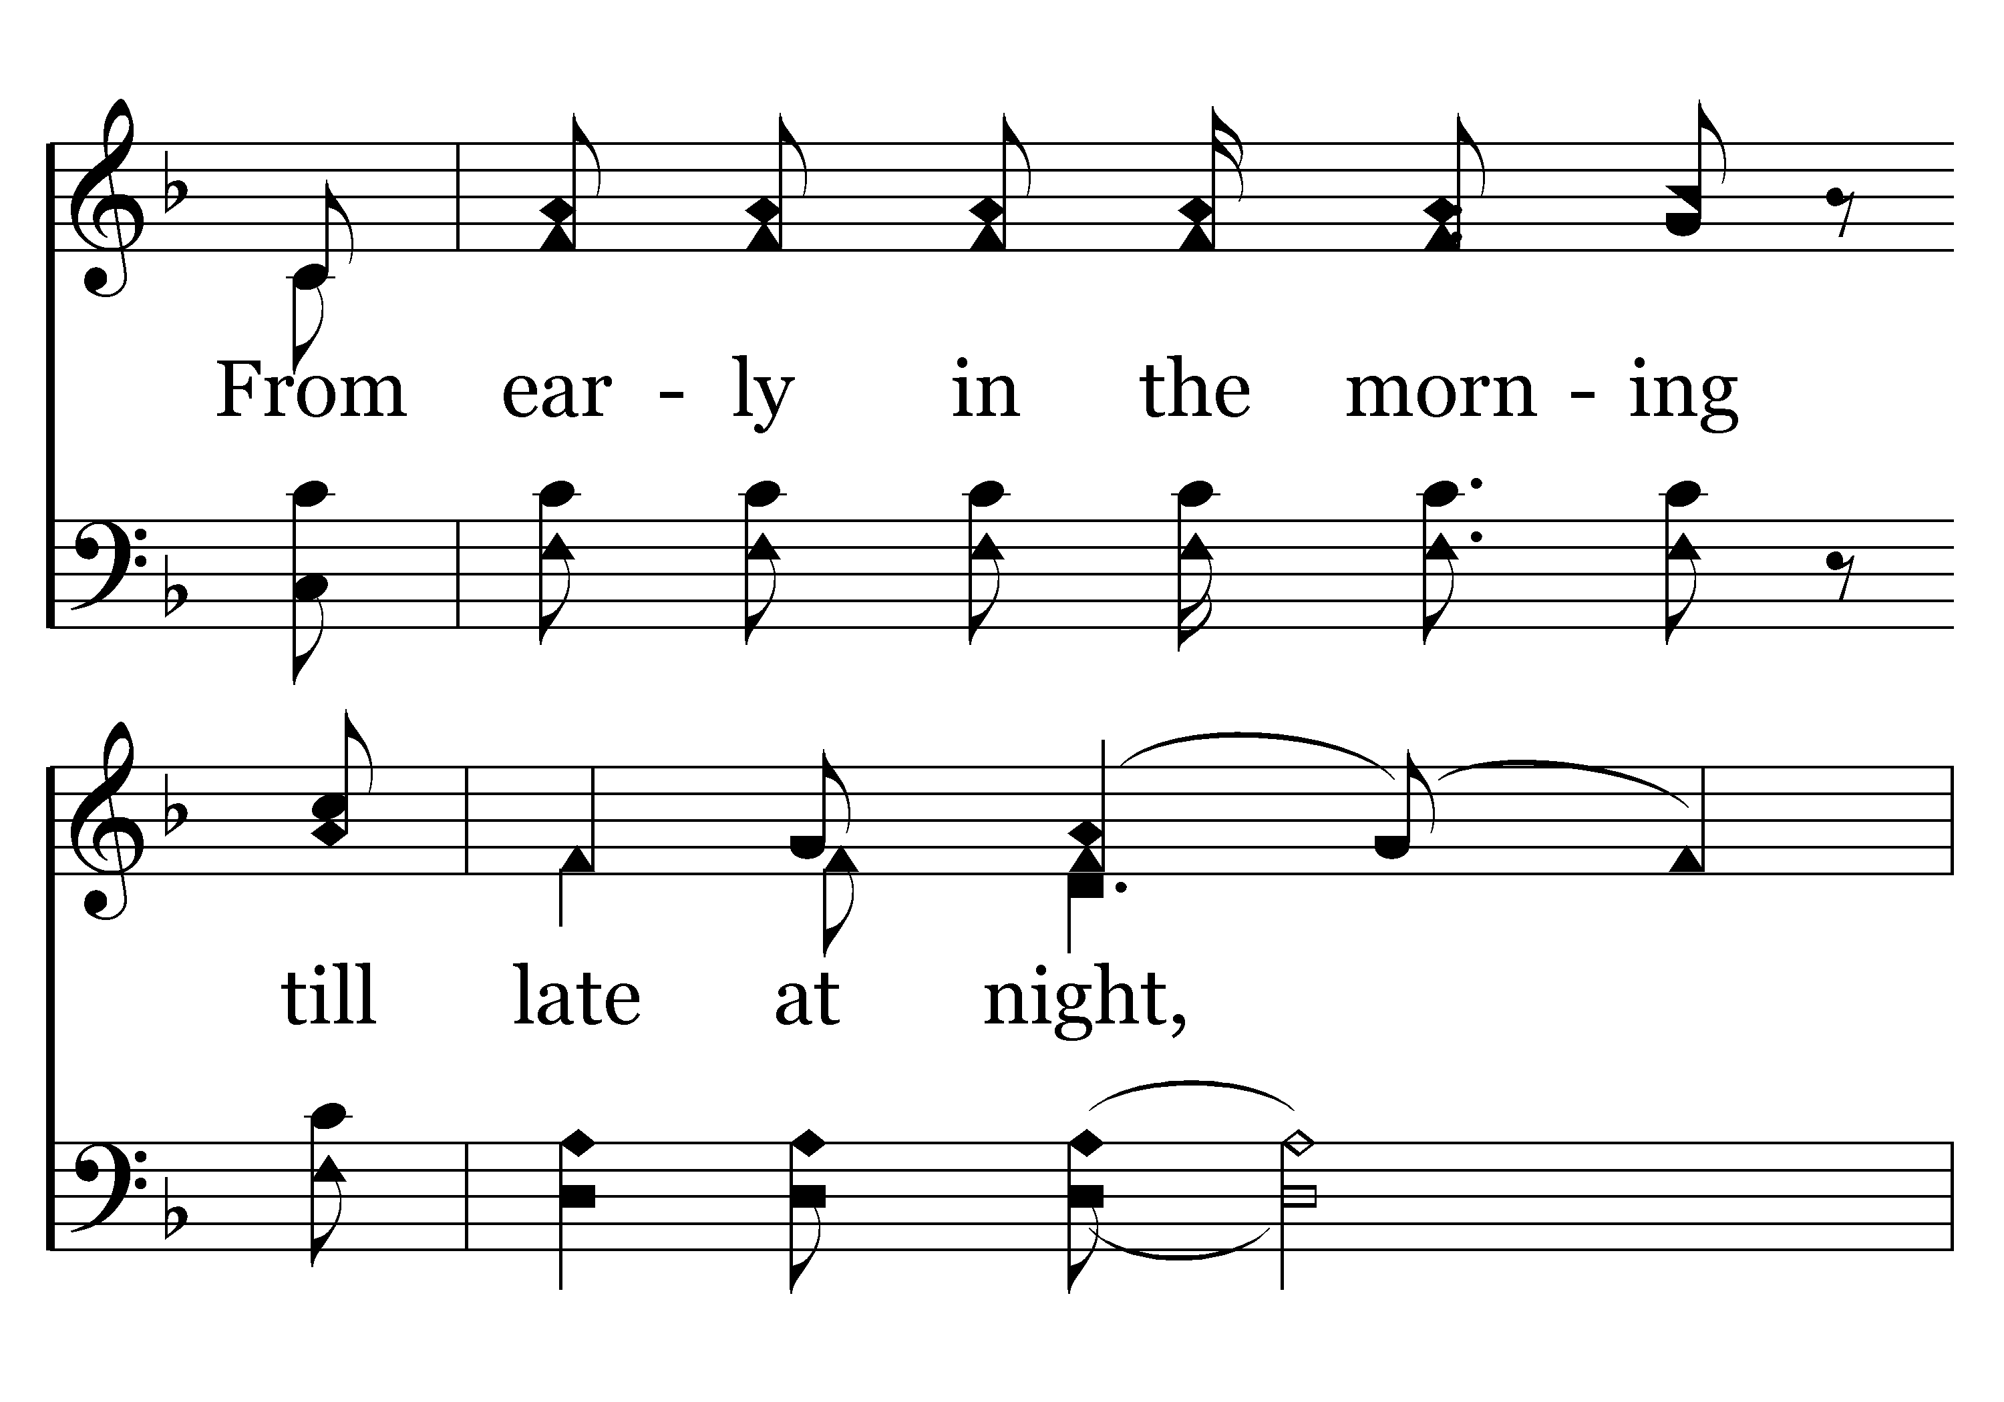
154 - MY ONLY HOPE IS YOU – 1.2

Slide 10
154 - MY ONLY HOPE IS YOU – 1.3

Slide 11
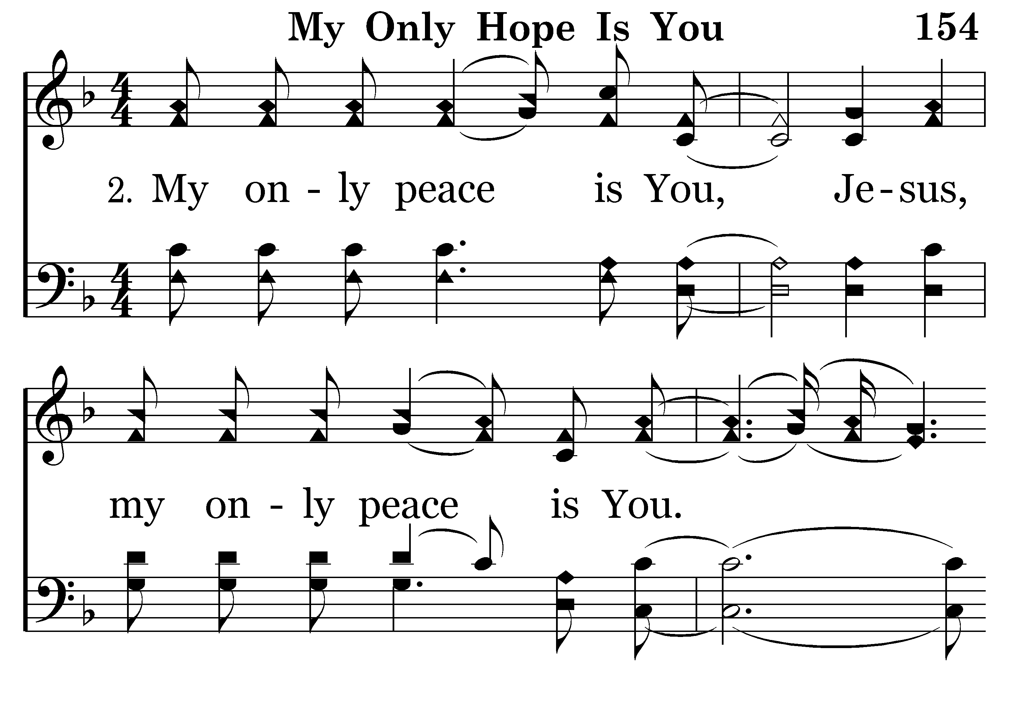
154 - MY ONLY HOPE IS YOU – 2.1

Slide 12
154 - MY ONLY HOPE IS YOU – 2.2

Slide 13
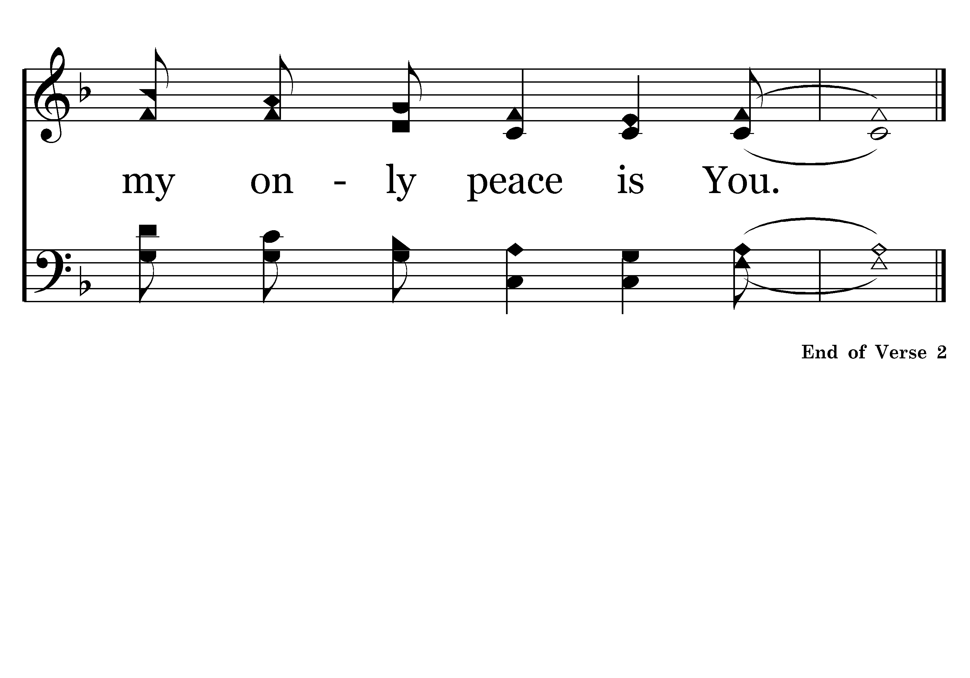
154 - MY ONLY HOPE IS YOU – 2.3

Slide 14
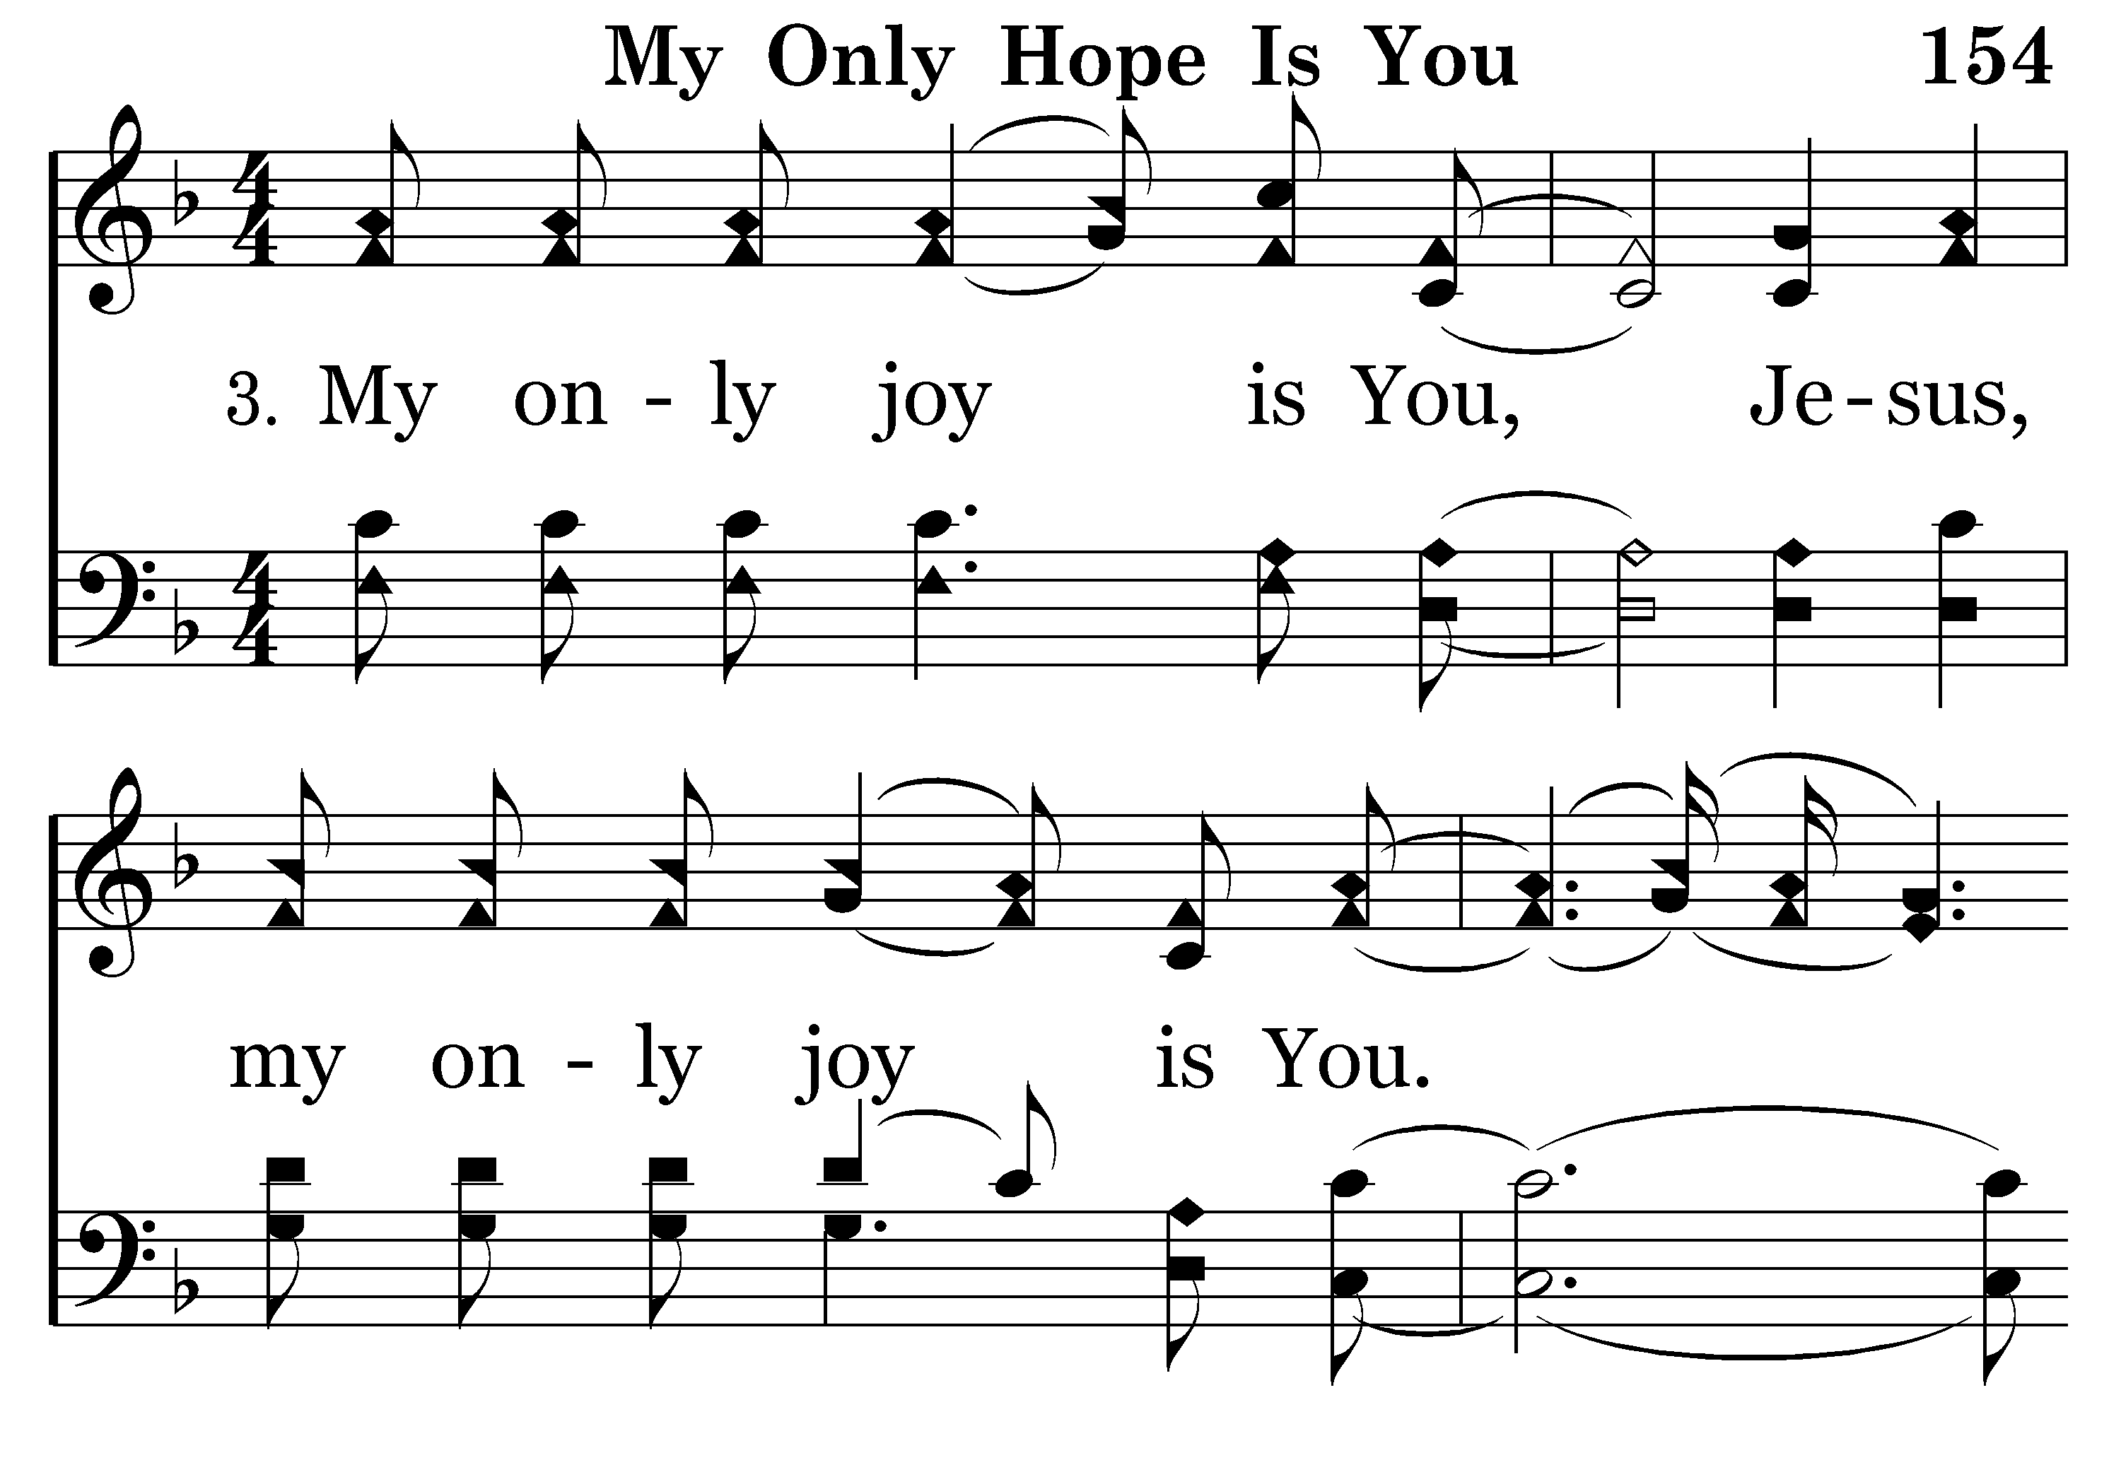
154 - MY ONLY HOPE IS YOU – 3.1

Slide 15
154 - MY ONLY HOPE IS YOU – 3.2

Slide 16
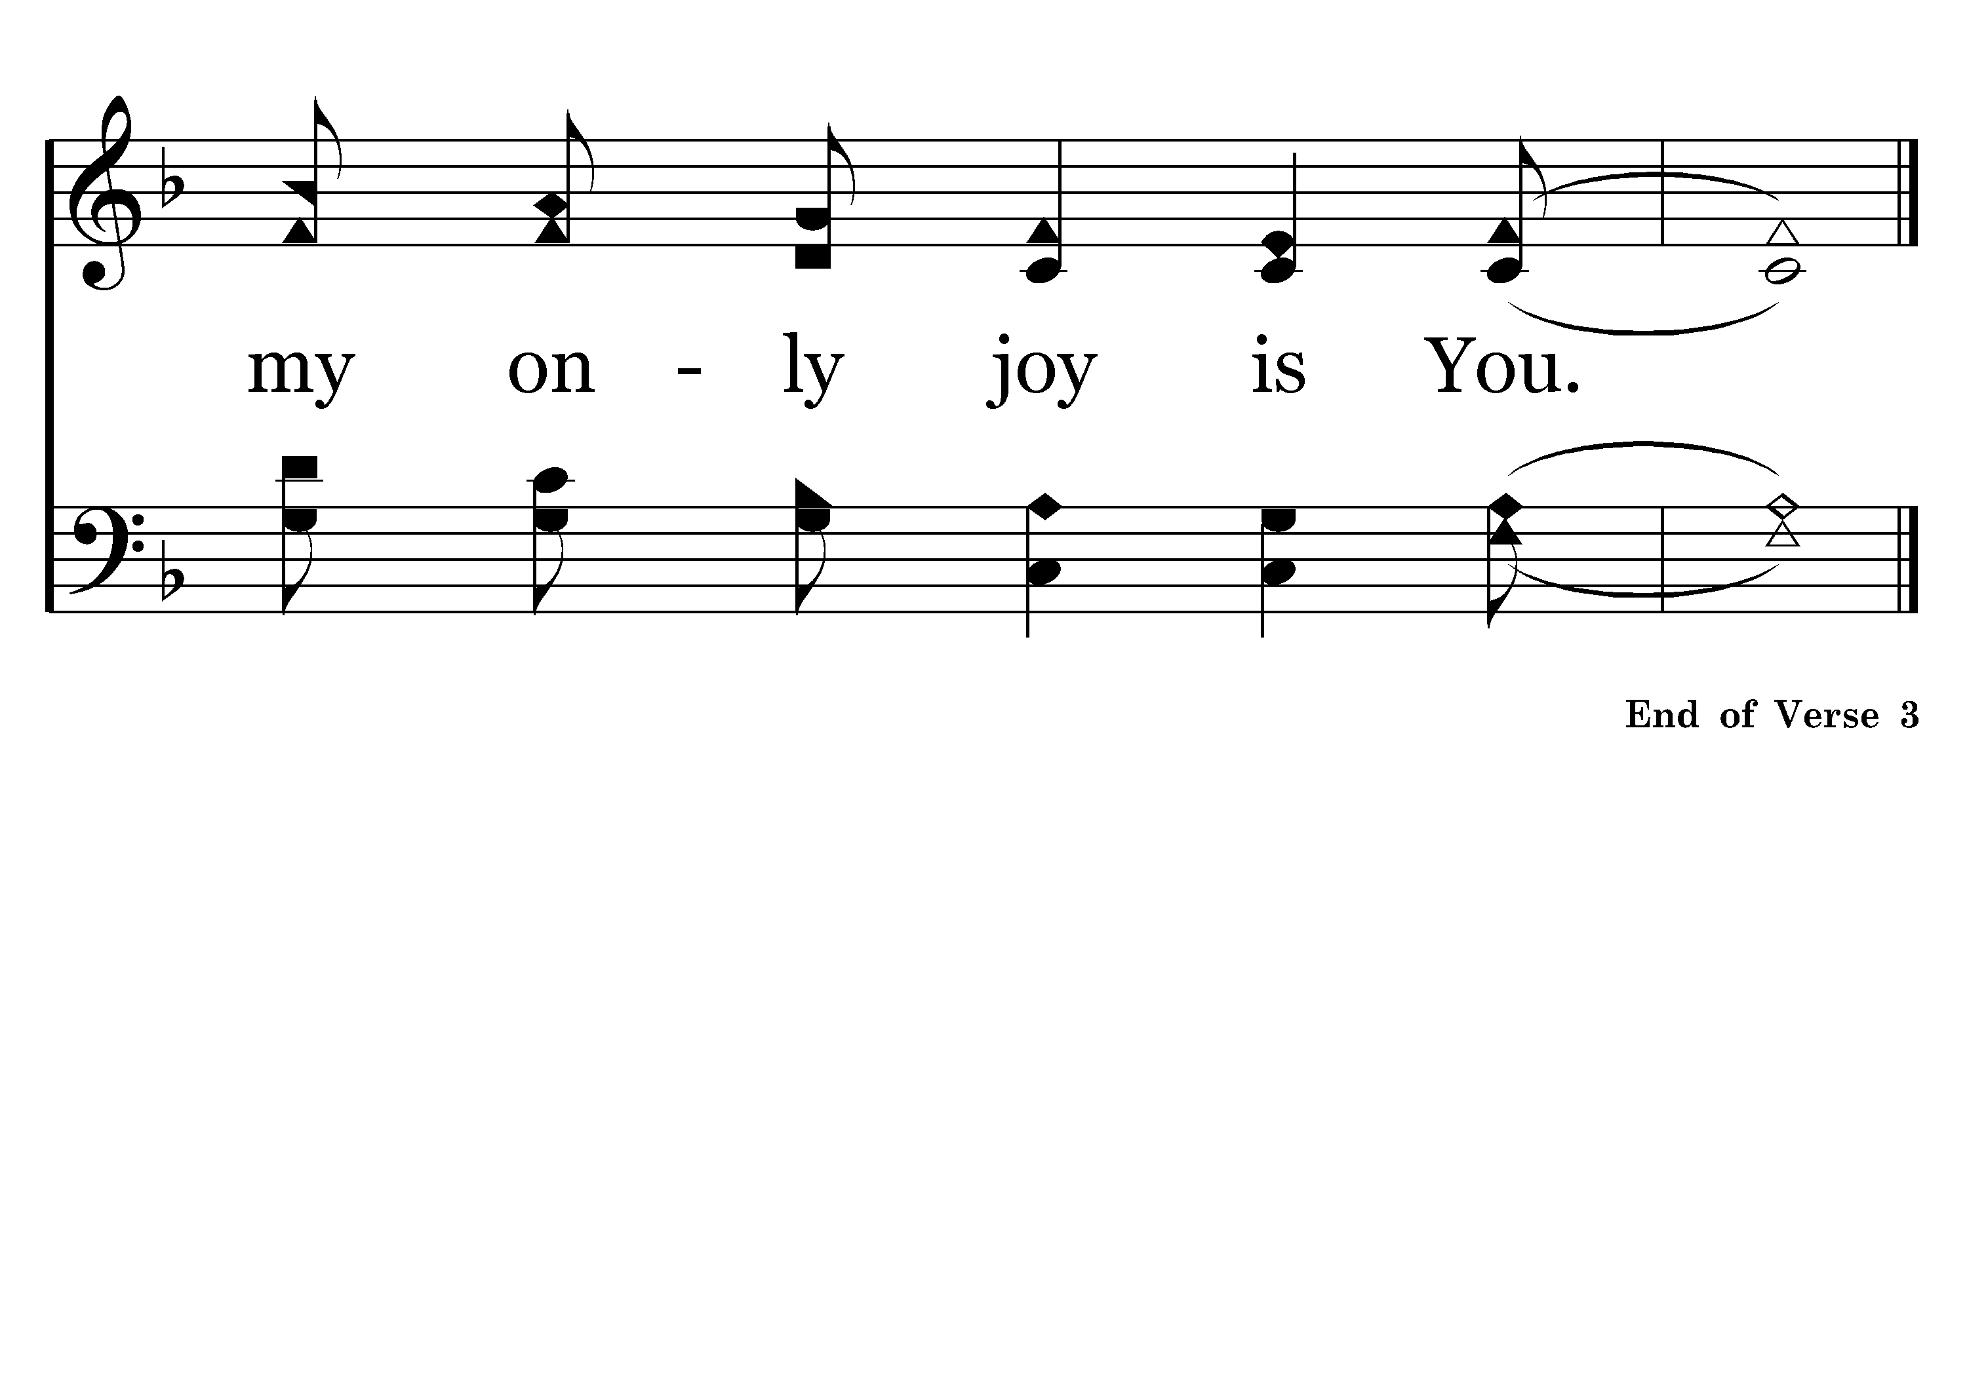
154 - MY ONLY HOPE IS YOU – 3.3

Slide 17
154 - MY ONLY HOPE IS YOU – 4.1

Slide 18
154 - MY ONLY HOPE IS YOU – 4.2

Slide 19
154 - MY ONLY HOPE IS YOU – 4.3

