Slide 2

Evangelism
Some Thoughts on Sharing the Gospel
Bellaire Church of Christ
February 17, 2012
Notes:
Not an evangelism expert
Had enough personal experiences, been enough places and seen enough to share some observations
I hope you will say “If this guy can do it, then I certainly can”

Slide 3

A Fishing Story
Notes:
Town with a lovely lake – wouldn’t it be nice if we caught some fish
Fishing Society – loved everything about fishing
Studied fishing – wrote books – debated fishing techniques – collected lures – sent people to study fishing techniques in other parts of the world – had fishing lectures – Became recognized as fishing experts. The only problem was – no one ever fished
Have we turned evangelism into just an intellectual exercise? We have to fish!
We can’t have someone do our fishing for us.

Slide 4
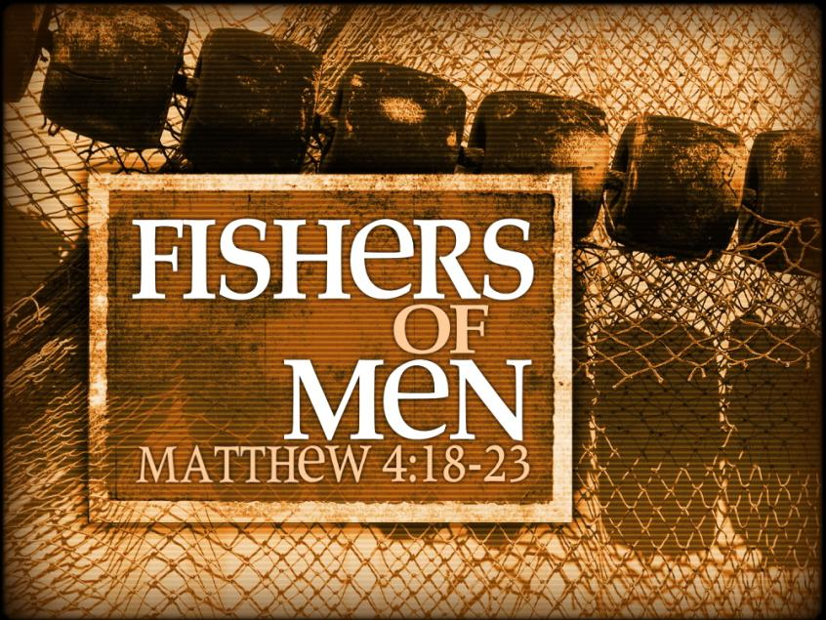
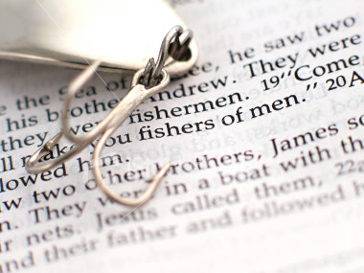
"Come, follow me," Jesus said, "and I will make you fishers of men.” Mt 4:19
Notes:
One reason to use the fishing story is that is the paradigm the Lord used.
We are commanded to fish.

Slide 5
We are Commanded to Fish
“Go into all the world and preach the gospel to every creature.”
Mark 16:15
Notes:
The gospel is important
Notice that this is a command of Christ to His followers - that means you and me. Does it matter how often we come to services or how pure we try to adhere to doctrinal matters if we don’t follow this command of Christ.
<TR>

Slide 6

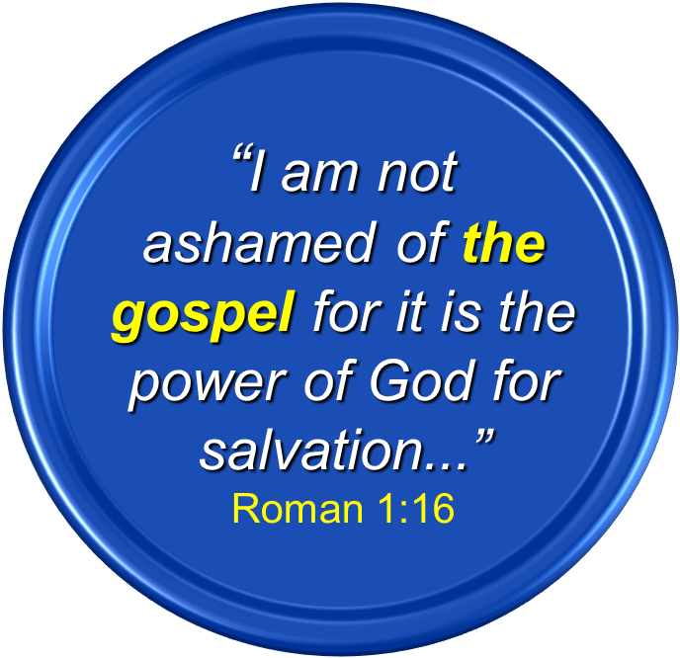

We are Told What to Fish With
“I am not ashamed of the gospel for it is the power of God for salvation...”
Roman 1:16
GOSPEL
Notes:
The gospel is the bait, nothing more and nothing less. Let me reemphasize this… nothing more and nothing less
Someone had been a Christian over 30 years and confessed, “I’ve never converted anyone”
Two questions – Are you fishing…are you trying?
If so, then what are you fishing with? You may be teaching very good things – very important things – very useful things – but it may not be the gospel – and it is ONLY in the gospel where we find the power of God to save

Slide 7
Everyone Should be Able to Fish
But in your hearts set apart Christ as Lord. Always be prepared to give an answer to everyone who asks you to give the reason for the hope that you have.
1Peter 3:15
Notes:
This is an instruction to every Christian.
I contend that every Christian should be able to do this whether you have been a Christian for 5 minutes or fifty years.
And furthermore it should be a natural part of being a Christian just like praying or worshipping. It should come naturally and not have to be a church program or special skill.
I am reminded of going to baseball games. Baseball is a slow game compared to soccer, basketball, or football. Attention began to wane so owners started trying to spice it up. If you go to baseball game now it is like someone is throwing a party. They have races and giveaways (hats, balls, stuff), fireworks, cheerleaders, etc. It occurred to me that they were trying to make it so that people would come to a game that didn’t even like baseball. I sometimes think that this is what we do with evangelism. We are constantly trying to come with things to get people that don’t want to do evangelism to do evangelism, by coming up with some method that makes it easy, or fun, and if that doesn’t work we will just try to guilt everyone into it.
I’m going to frame my observations about evangelism around this passage.
First I want to share the number one question I am asked in my Q&A sessions.

Slide 8



Number 1 Question:
What is the first thing you say to someone?
Notes:
We seem to freeze up at the thought of sharing the gospel with someone. We want to know how to get started.

Slide 9
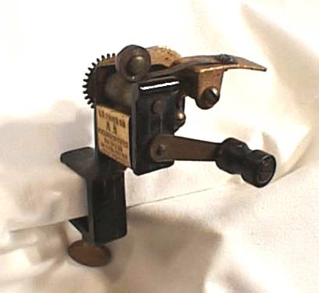
Looking for a mechanistic approach
Notes:
There is no mechanistic approach.
We are looking for those 10 things we say to someone and then they want to jump into the baptisitry.
<TR>So let me share with you some key success factors that I think are needed in sharing the gospel with someone.

Slide 10
In your heart set apart Christ as Lord.
But in your hearts set apart Christ as Lord. Always be prepared to give an answer to everyone who asks you to give the reason for the hope that you have.
1Peter 3:15
Notes:
The starting point for evangelism is inside of us. It is driven by the condition of our hearts. This is the starting point – our hearts need to be in it.

Slide 11
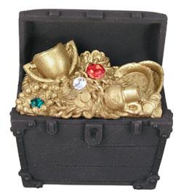
Where Our Hearts are…
PASSION
“for where your treasure is, there your heart will be also.”
Mt 6:21
Notes:
Where our treasure is
What is in our heart is what is important to us
<TR Our hearts generate passion and this should be self evident to us.

Slide 12

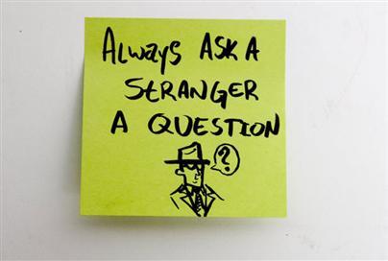
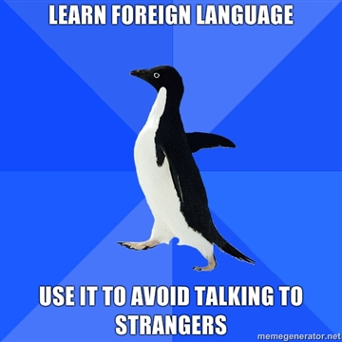
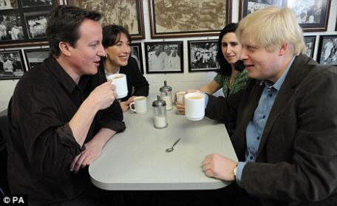
We Already Know How to Talk with Strangers
Notes:
So here is the answer to “What do I say first to someone?” We already know how to do this. We talk to strangers. If you think a minute I bet every one here can recall a recent conversation with a stranger.

Slide 13
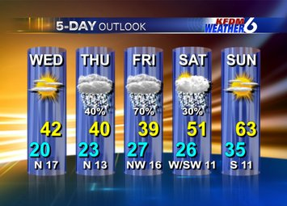



PASSION
Notes:
What about the weather? Couponing? Health? We can get pretty passionate about a tire sale!

Slide 14
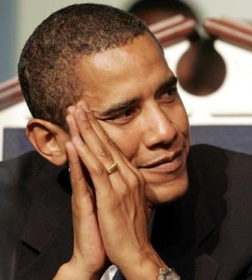
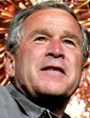
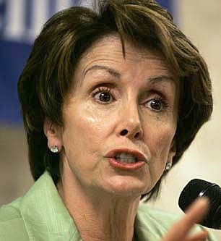
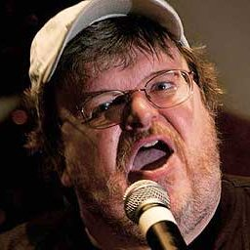

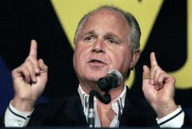

PASSION
Notes:
Does politics generate passion? Why?
Ever had a passionate discussion with a perfect stranger over politics? Why?
It is important to us. For some people it defines our lives.

Slide 15

PASSION

Slide 16



PASSION
Notes:
Auburn is playing Florida tonight and here I am stuck a church service!!!

Slide 17

PASSION

Slide 18

PASSION

Slide 19


PASSION
Let Me Tell You About My Grandchildren
Notes:
Ever seen this license plate?
Sit next to a grandmother and you are not going to be there very long before the photos come out.

Slide 20
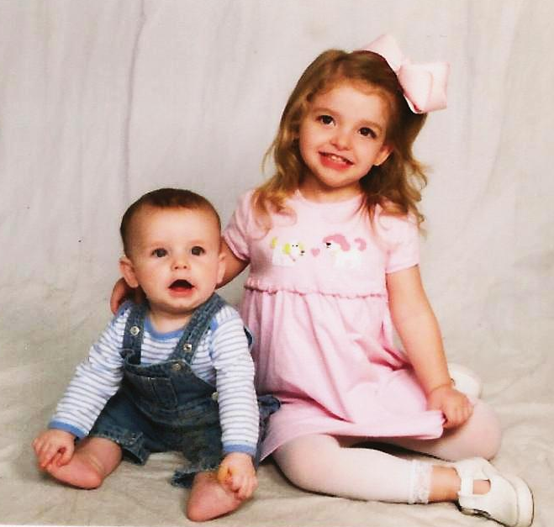
PASSION
Landon
1 yr
Caroline
3 yrs
Notes:
And oh, by the way…see how I just managed to slip a couple of photographs of my grandchildren!
The point is that we will find a way to establish rapport and bring the subject up if we are passionate about it.

Slide 21
Common sense is needed when speaking to “outsiders”
“Conduct yourselves with wisdom toward outsiders, making the most of the opportunity. Let your speech always be with grace, as though seasoned with salt, so that you will know how you should respond to each person.”
Colossians 4:5-6
Notes:
Doesn’t mean we go tackle people like some fanatic.
Find a way to find common ground, establish rapport and introduce the topic.

Slide 22


“If the fire is there the methods will take care of themselves.”
PASSION
Some Wise Person
Notes:
We know how to do it. So why don’t we?

Slide 23

Where is our passion?
Why don’t we have more passion for the gospel?
PASSION
Notes:
Here are some observations about our lack of passion: (you may have some other ideas, feel free to share them with me afterwards)

Slide 24

Perhaps we are missing a sense of what God has done for us.
JUSTICE
MERCY
We will never appreciate God’s mercy
if don’t understand His justice
Notes:
If we appreciate what God has done for us then it will change our attitude.
Many of us are in a passionless relationship.
We are more excited about a good deal on tires than we are about sharing the gospel.
Many of us grew up in the church and our confidence is in our obedience to things we accepted and obeyed from our parents. We never have the sense of rescue.
Can you relate to Ps 51?
We don’t see or feel that the gospel is “good news.” A sense of what God has done for us will create a great passion for sharing with others.

Slide 25

Perhaps we don’t have a love for the lost.
"What man among you, if he has a hundred sheep and has lost one of them, does not leave the ninety-nine in the open pasture and go after the one which is lost until he finds it? When he has found it, he lays it on his shoulders, rejoicing.” Luke 15:4-5
We are “the one”
Notes:
Have we developed the love for the lost that the Lord had for us?

Slide 26

Perhaps we don’t have a love for the lost.
We must develop a sympathy for people and a realization they are “dead” forever without the gospel.
“And you were dead in your trespasses and sins, in which you formerly walked according to the course of this world…” Eph. 2:1-2
Notes:
We were dead spiritually. If we die separated from God there remains no hope.
We can help save people from eternal death.

Slide 27

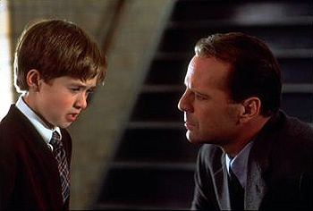
“Sixth sense” approach.
“I see dead people. They are walking around like regular people. They don’t know they are dead…and they need my help.”
Do you see dead people? Do you care?
Notes:
They are spiritually dead – separated from God.
They are deathly ill and you have the cure – right there in your hand.
I feel this every time I go through the Atlanta airport

Slide 28

Whaaaaat!?
“So Moses went back to the LORD and said, "Oh, what a great sin these people have committed! They have made themselves gods of gold. But now, if You will, forgive their sin--and if not, please blot me out from Your book which You have written!”
Ex. 32:32
Notes:
How did Moses feel such sympathy for the wayward and lost condition of his brethren?

Slide 29
Whaaaaat!?
“I have great sorrow and unceasing grief in my heart, for
I could wish that I myself were accursed,
separated from Christ for the sake of my brethren, my kinsmen according to the flesh,”
Romans 9:3
Notes:
Paul reflected this same attitude. How can he say this? Can we? What are we willing to sacrifice for the lost? Our beach homes? Our cable TV?
Certainly not our souls.

Slide 30
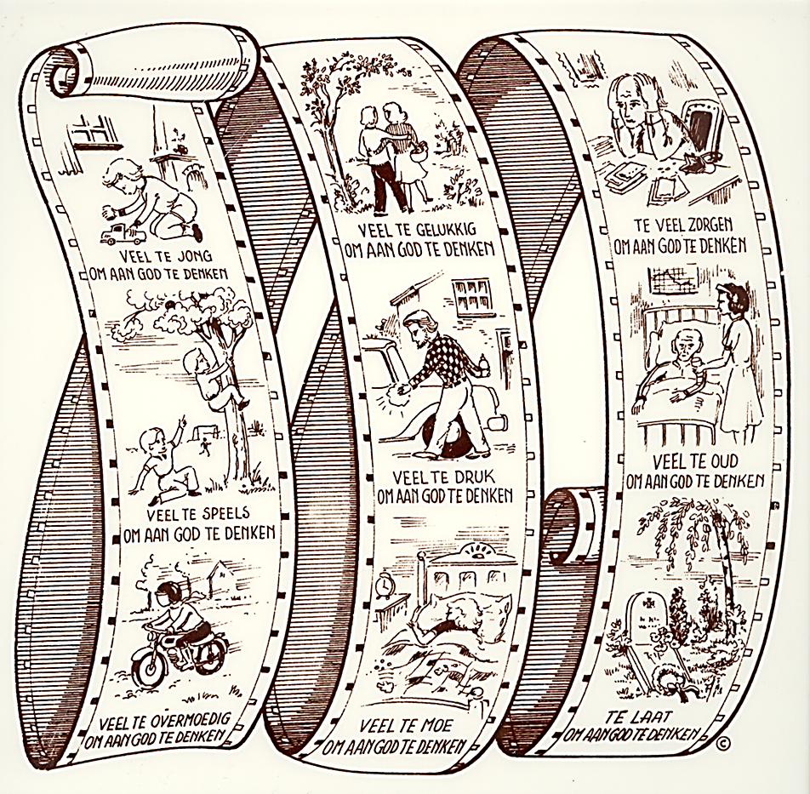
Perhaps our lives are overcrowded.
Notes:
This is from a tile that hung in our house when we lived in The Netherlands. I bring this for my Nederland friend here tonight. It is called the Movie of Life.

Slide 31
Perhaps we think we don’t know enough.
Realize that the gospel is empowering
And when I came to you, brethren, I did not come with superiority of speech or of wisdom, proclaiming to you the testimony of God. For I determined to know nothing among you except Jesus Christ, and Him crucified.
1Co 2:1
Notes:
We have created an environment of such doctrinal complexity that many think they don’t know enough to share the gospel.
Yet what did Paul say? It took me a long time to understand this. I thought it hyperbole.
Now I think he was right on target. If we can explain this statement and how to respond to it we have shared the gospel.

Slide 32
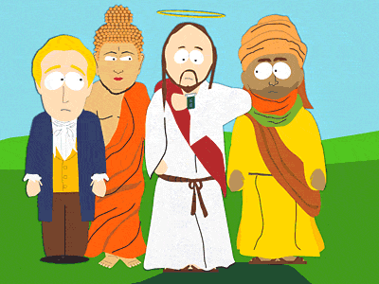


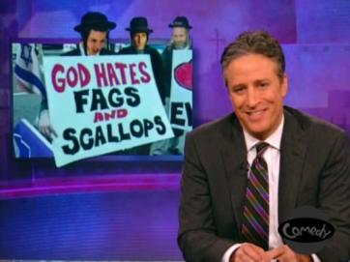


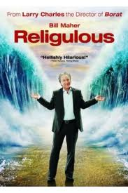

Perhaps we are afraid of rejection.
Christianity, in all of its forms is now openly mocked in all arenas of our culture (news, movies, etc.)
Notes:
Militant atheism is on the rise. It is becoming politically incorrect to be a Christian.
When I was a little boy you were admired if you were a gospel preacher or a Christian.
Now you are portrayed as an idiot, a buffoon, narrow-minded, prejudiced. Don’t take comfort when you see Catholics being attacked of belittled, even Mormons. You are included in that group. They are attacking all religious thought.

Slide 33
Always be prepared to give an answer
But in your hearts set apart Christ as Lord. Always be prepared to give an answer to everyone who asks you to give the reason for the hope that you have.
1Peter 3:15
Notes:
The starting point for evangelism is inside of us. It is driven by the condition of our hearts. And we must always be prepared to give an answer.

Slide 34
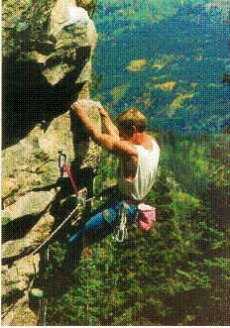
PREPARATION
Do your homework.
Study the materials, backgrounds, arguments, scriptures, etc.
Develop the “will to win”
(which is really the “will to prepare to win”)
Notes:
Don’t start rock climbing mountains. Requires years of practice and training.
It’s not just having the will to climb mountains but having the will to prepare to climb mountains.
Heaven will be of more value than rock climbing or football!

Slide 35

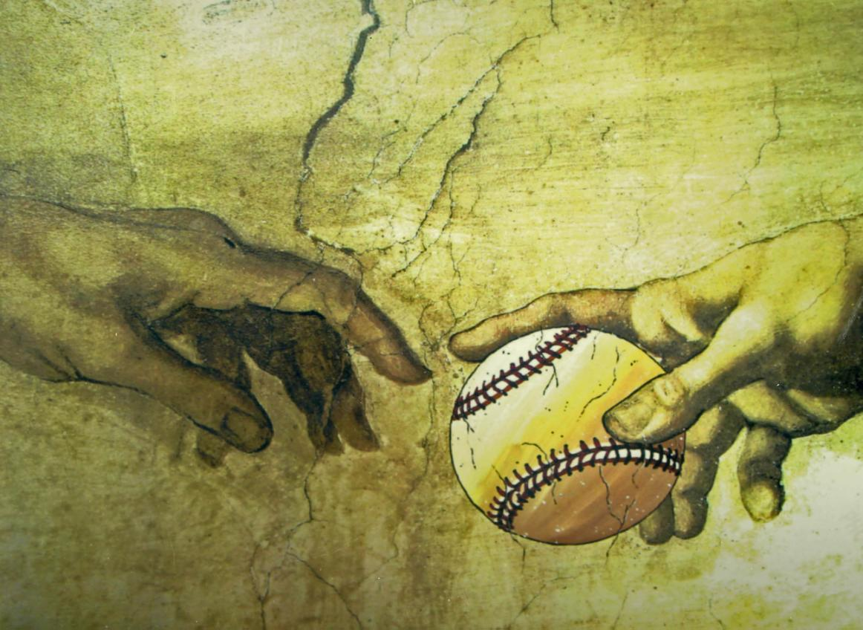

PREPARATION
Develop interest
Notes:
To hard to learn? We can learn ANYTHING our heart purposes for us.
Someone once remarked that there child just couldn’t learn the books of the OT. They were too hard.
Remember Pokemon? Japanese names. Watched in amazement as 5 years olds could rattle off every name.
The 30 year old version of this is Fantasy Football leagues….and baseball stats. I hear men speak in great detail of incredible statistics but couldn’t give you three verses strung together about God’s plan of redemption!

Slide 36
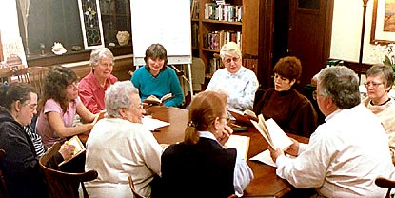
PRACTICE
Study together
Role play
Builds confidence
Notes:
Preparation can take many forms.
This is one of our key purposes for our Bible study meetings.
If you don’t attend Bible study I can tell you several reasons why you aren’t but more than anything I can tell you two things about yourself: you do not have a passion for the lost and you are not trying to convert anyone to Christ.

Slide 37
To everyone who asks you
But in your hearts set apart Christ as Lord. Always be prepared to give an answer to everyone who asks you to give the reason for the hope that you have.
1Peter 3:15
Notes:
Why would anyone ask us? They should see something in us. A joy perhaps; a peace that passes understanding perhaps.
We need to live in such a way that people we come in contact with us can see a difference and that provides us the opportunity to explain our beliefs. If they seeing us serving and loving in a selfish and selfcentered world they may ask. If they see us demonstrating peace and an abundant life in situations where they would panic they may ask us.
When I am speaking to a stranger I love to actually get the conversation to a point that they actually ask me to share the gospel with them!

Slide 38
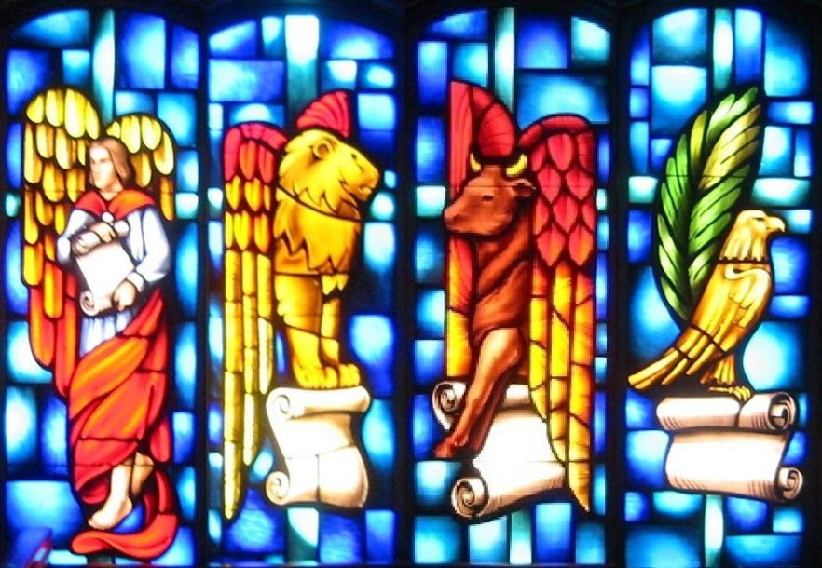


The Fifth Gospel
Matthew
Mark
Luke
John
YOU!
Notes:
Irish preacher once said there were 5 gospels, MMLJ and you!
“You are the only Bible the world will ever know”
What does your gospel look like? Does it look like this guy?

Slide 39
Give the reason for your hope
But in your hearts set apart Christ as Lord. Always be prepared to give an answer to everyone who asks you to give the reason for the hope that you have.
1Peter 3:15
Notes:
The reason for the hope that is with in us. What is this hope that is within us?
What is this hope?

Slide 40
What is the Hope Within Us?
We give thanks to God, the Father of our Lord Jesus Christ, praying always for you, since we heard of your faith in Christ Jesus and the love which you have for all the saints; because of the hope laid up for you in heaven, of which you previously heard in the word of truth, the gospel which has come to you, just as in all the world also it is constantly bearing fruit and increasing, even as it has been doing in you also since the day you heard of it and understood
the grace of God in truth; (Colossians 1:1-6)
Notes:
Our hope is based upon the grace of God found in the gospel.
The gospel is our hope.
<TR> Again in Col 1:23

Slide 41
What is the Hope Within Us?
if indeed you continue in the faith firmly established and steadfast, and not moved away from the hope of the gospel that you have heard,
Colossians 1:23
Notes:
The gospel is our hope.

Slide 42
The Hope of the Gospel
“I am not ashamed of the gospel for it is the power of God for salvation...”
Roman 1:16
Notes:
We keep coming back to this passage. And we will keep coming back to this passage. It only took me about 25 years of coming to this passage until I finally understood it, believed it, and started practicing it!
We learn a lot about this in…

Slide 43
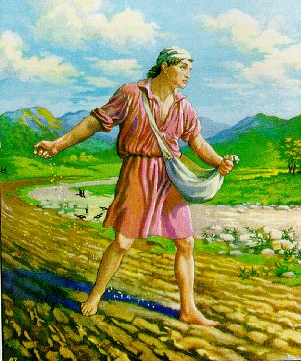
Where do I Start?
Parable of the Sower
Notes:
The Parable of the Sower was a story that Jesus gave us that provides us with a good illustration of how the gospel is to be handled.

Slide 44

Beside the Road
Rocky Ground
Among the Thorns
Good Soil
Mark 4:3-14
Notes:
Hearken; Behold, there went out a sower to sow:
4 And it came to pass, as he sowed, some fell by the way side, and the fowls of the air came and devoured it up.
5 And some fell on stony ground, where it had not much earth; and immediately it sprang up, because it had no depth of earth:
6 But when the sun was up, it was scorched; and because it had no root, it withered away.
7 And some fell among thorns, and the thorns grew up, and choked it, and it yielded no fruit.
8 And other fell on good ground, and did yield fruit that sprang up and increased; and brought forth, some thirty, and some sixty, and some an hundred.
Joh 15:5; Col 1:6
9 And he said unto them, He that hath ears to hear, let him hear.
14 The seed is the word of God
The responsibility lies on our shoulders.
Notice that 3 out of the 4 areas where the sedd was sown it produced nothing. Jesus, Himself didn’t convert everyone, niether will we. But if we are not sowing, or we are sowint with the wrong thing we will certainly not be productive.
Understand a crucial factor here – the seed is the word – the gospel

Slide 45
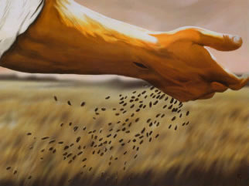
What is our objective?
Sow the seed!
Notes:
What was the sower doing? Was he just a stupid sower? He was sowing the seed. Why was he sowing it on rocky/thorny ground? He was just sowing.
I think sometime we get too caught up in getting results. When we start making numbers our focus it causes us to lose our focus.
We should be focused on sowing the seed, and letting God worry about the hearts. God asked us to sow by faith in Him. Almost like Gideon and the lappers at the stream.
When we focus on results it causes at least two problems:

Slide 46


When we focus on results we become
Soil Inspectors
Not too rocky, Not too thorny – it’s just right!
Yep – that’s good soil!
Notes:
We start becoming Soil Inspectors.
Did the sower do this? No. He was just sowing. We tend to pre-judge peoples hearts. We are not going to sow over here or over there because we will not get the results WE want. We start measuring evangelistic efforts like a business. We decide whether the soil is good. I’ve seen a lot of people that have come to faith in Christ that in the past I would have thought never would have been interested, because the priority was sharing the gospel.

Slide 47




When we focus on results we become
Soil Preparers
The soil is ready, time to pop in the gospel!
Notes:
Another results-oriented problem is that we become Soil Preparers.
We judge that these people need to learn a lot of stuff before they can become a Christian. We can’t just simply share the good news of Jesus Christ with someone. We need to disavow them of any wrong headed notions of erroneous ideas before they can hear the gospel message. Or we want to make sure that they will be strong Christians before we convert them.
One evidence of this I have seen is that we have essentially one and only way to convert people…

Slide 48

Every time you sow the seed
You are Successful!
(regardless of the results!)

Slide 49
How do we convert people?
The “Bible Study”
Notes:
We have to get them into a Bible Study. We want to prepare the soil.
Usually takes about 3 months. Very difficult to get people into a Bible study. Why? They know it is a huge investment of their precious time and they know that you are trying to convert them to something that doesn’t matter anyway (postmodernism)
What are we teaching? This is typically a 3 month course of study. No standard curriculum but it typically is lessons on Bible authority, followed by lessons on the work and worship of the church and then if they are still with us we might let them know a little about the plan of redemption – the gospel.
Usually catechism classes – to convert people to the Church of Christ.
After three months often find them not interested – after investing a great deal of time
Not against having Bible Studies, just realize that to PRESENT the gospel to someone (what the Lord is asking us to do, and that IS where the power is) can be done in a short presentation.
<TR> Most of our current touted approaches to evangelism are based on getting someone into the “Bible Study”

Slide 50
The Gospel Can Be Shared In One Session!
One Session
Pentecost Acts 2:14-41 | Believed, Confessed | Believed, Confessed
Samaritans Acts 8:5-13 | Believed | Believed
Ethiopian Eunuch Acts 8:35-39 | Believed, Confessed | Believed, Confessed
Cornelius Acts 10:34-48 | Believed | Believed
Lydia Acts 16:13-15 | Believed | Believed
The Jailor Acts 16:25-34 | Believed | Believed
First Gospel Sermon
Jews
Baptized
V38-41
One Session
Preached Christ
Non-Jews
Baptized
V12-13
One Session
Preached Jesus
Proselyte
Baptized
V38
One Session
Preached gospel
Gentile
Baptized
V48
One Session
Preached gospel
Worshipper
Baptized
V15
One Session
Word of the Lord
Pagan
Baptized
V33
Notes:
Not saying that we should never have 3 month Bible Studies. I’m just saying that it is possible to convert someone in one session, and I an convinced that the message is one of the simple gospel message.
[Story of Rob and Coba]
That each one of us has the ability to tell others the good news about Jesus Christ and that this simple message is what powered the growth of the early church.

Slide 51
The Early Church Model
The propagation of The Great Commission - the first “social network”
“…you shall be my witnesses both in jerusalem, and in all judea and samaria, and even to the remotest part of the earth.” Acts 1:8
Notes:
As Christians travelled out from Jerusalem and around the Roman world either by choice or persecution a word of mouth process took place where Christians were sharing this message with others and the new converts did the same. This was the first social network. This is a viral expansion loop.

Slide 52
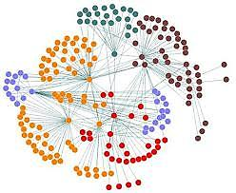
The Growth of the New Testament Church
Notes:
This word of mouth process fueled the growth of the early church.
TR > We think the gospel needs our help. We have lost faith in the gospel to accomplish God’s purpose.

Slide 53
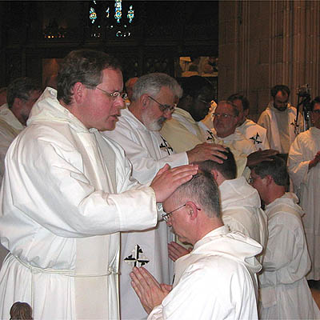
What Approach Should I Take?
Let others do the teaching:
Let those do evangelism who have the “gift of teaching”
Notes:
This approach says that the average member may not have the gift of teaching and therefore should just try to infuence others enough to get them to be willing to study the Bible and then hand them off to the preacher. I call this the Clergy-Laity approach. Again the idea is that the average member can’t handle the 3 month Bible study therefore we need to become “centers of influence” to hand them off to others.
Nothing wrong with handing people over to pastor, er preacher to teach

Slide 54
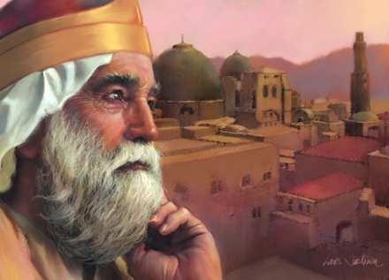
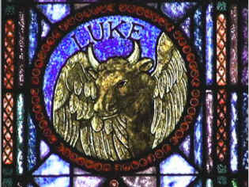
What Approach Should I Take?
Build a rapport: Gain their confidence first and then share the gospel
Luke
Ecclesiastes
Notes:
This approach assumes you have talked someone into a Bible Study and uses a book of the Bible such as Ecclesiates to study through and build a rapport with the person. Afterwards you study through Luke which will eventually study the gospel
Some start with a gospel and move into book of Acts.
I like this approach although I see it mainly as a long and time consuming approach to getting to and sharing the gospel.

Slide 55
What Approach Should I Take?
Turn our buildings, classes, and worship into an evangelistic tool
Notes:
Idea is to turn church service into a visitor centric service.
Get your buildings in shape and looking good – when a visitor comes you shoot off confetti cannons and overwhelm them with friendliness
Attract visitors by buildings, classes, singing (need to do these the best anyway)
Evangelistic effort becomes one of having members invite people to church
If you hook them in this manner then you might be able to hand them over to the preacher for the “bible study” Should do these things anyway. I Cor. 14:23-25 informs us that visitors can be favorably or unfavorable impressed by our services but our services should be geared for the worship of God and the mutual edification of its members.
Nothing wrong with inviting people to church, I find it to be ok if nothing else, but often throws up roadblocks to gospel. If you are close enough to someone to invite them to church I say just go ahead and share the gospel with them.

Slide 56
What Approach Should I Take?
Modeled after the marketing methods employed by evangelicals to create “mega churches”
“Churches adoption of marketing fads will actually hurt in the long run. Megachurches are the triumph of the generic. By copying their approach mainline Protestant churches are speeding their own numerical decline. Megachurches have found an innovation in marketing but these can go up in smoke in a minute.”
“Branding Faith: Why Some Churches Impact Culture and Others Don’t”, Phil Cooke
Notes:
Even our megachurch buddies on which this approach is based are starting to see problems with the results.
Gary Henry has travelled much and has observed and written much and is a very thoughtful and wise gospel preacher had this to say in a recent lecture:

Slide 57
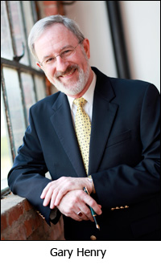




Gary Henry on church marketing:

Slide 58

Are we Painting the Pig?
Notes:
When we use other things other than the gospel aren’t we just painting the pig? We are trying to attract people to Christ with things that were never intended to be used to attract them.
<TR>

Slide 59

















“What we attract people with is what they are converted to.”
Some Wise Person
Notes:
We seem to want to do just about anything and everything to try to convert people except the one thing that God has told us has any power- the gospel.

Slide 60
What do we “attract” people with?
Our buildings?
Our singing?
Our classes?
Our study materials?
Our friendliness?
Our worship services?
Our doctrinal correctness?
Our marketing?
Our money?
Our middle-classness?
Notes:
Mt 11:25 come unto me all of you who are weary and are heavy laden – doesn’t sound like he is trying to convert the middle class.

Slide 61
We “attract” people with the gospel
“I am not ashamed of the gospel for it is the power of God for salvation...”
Roman 1:16
Notes:
The gospel is the bait, nothing more and nothing less. Let me reemphasize this… nothing more and nothing less

Slide 62

The Magic Bullet
THE GOSPEL
Notes:
If there is a magic bullet it is the one thing that really has the power of God to salvation.

Slide 63


THE gospel is not:
Notes:
[Don’t bring them to church – can just throw up a lot of questions
Recently Bryan Cook – “I have all these questions about the church of Christ” I deferred – “We must have a common ground or else we will just argue”]
The one gospel is not forms of worship
Or instrumental music
Or baptism
Or how the church uses the treasury
<TR> Basically what we have done is decided that the gospel needs our help. It is not powerful enough to do the what God had planned. We want it to accomplish far more. SO we have created… Gospel Helper!

Slide 64
The Power is in The Message
Not in our ability
Not in our cleverness
Not in our “attractiveness”
Notes:
Story of teenager that came up to me and hugged me thanking me as one of his friends had shared the gospel with him over pizza a couple of years earlier.
And let me say this. There is also a tendency when you find some method or approach that produces “visible results” to start promoting it as the best way or even the only way to convert someone. I’m not doing this. Let me be clear. There are places for 3 month Bible studies. All I am saying is whether in one hour or three months people need to hear the gospel and just like the examples in the NT it is possible to share the gospel with someone in one session.

Slide 65
Notes:
We have decided the gospel needs our help
Help it - We need to help the gospel with methods that take us outside the realm of primitive apostolic Christianity. There is nothing we can think of that wasn’t available to the apostles. Why do we think we can skirt apostolic authority and accomplish the will of God? This is what we have done in institutionalizing the church.
Change it –we added social activities, entertainment to add to the gospel’s appeal.
Replace it – we don’t feel that the gospel we are preaching is getting the numbers we want so we will just change it, strip it of it’s power by introducing a new hermenutic that we think will appeal more to a postmodern culture that the gospel itself.
Abandon it – when we are finally convinced that we can’t convert anyone anymore to the Church of Christ we turn in on ourselves. We become heresy detectors and try to find any hint of heresy within our brotherhood and thus we accomplish at least something in the kingdom.
One prominent approach being advocated today is …

Slide 66
Make it more “attractive”
Institutionalize it
Change it
Abandon it
We need a faith-based approach (faith in the gospel) rather than a results or methods focused approach!
Notes:
We have decided the gospel needs our help
Make it more attractive – with social programs/ entertainment/ buildings/ services
Institutionalize it - We need to help the gospel with methods that take us outside the realm of primitive apostolic Christianity. There is nothing we can think of that wasn’t available to the apostles. Why do we think we can skirt apostolic authority and accomplish the will of God? This is what we have done in institutionalizing the church. We have decided we can get more people that way.
Change it –we will just change it, strip it of it’s power by introducing a new hermeneutic that we think will appeal more to a postmodern culture that the gospel itself.
Abandon it – when we are finally convinced that we can’t convert anyone anymore to the Church of Christ we turn on ourselves. We become heresy detectors and try to find any hint of heresy within our brotherhood and thus we accomplish at least something in the kingdom.
The gospel doesn’t need our help. It needs our example and our faith! (God then uses us to accomplish His purpose)

Slide 67

May Need to Kill Some Sacred Cows
Notes:
It has taken me 25 years to rearrange my thinking. I realize and believe Rom 1:16. I see that the gospel needs more than my money, my friendliness, my influence – it needs me. Some are contented to never be personally involved in sharing the gospel but will be content to give their money to send around the world or even locally. The gospel needs us.
When I accidentally started converting people I became almost giddy with the results. So much so that if I shared the gospel with someone and they didn’t respond right then and there I would almost be depressed. Then I realized the message of the Parable of the Sower and began to feel a great joy when I had the priviledge to share the gospel with someone. I now feel a great sense of accomplishment knowing that that is what the Lord is asking me to do. It’s like, “Ken, you do your part – thank you very much - , and I’ll do my part.”

Slide 68

With gentleness and reverence
But in your hearts set apart Christ as Lord. Always be prepared to give an answer to everyone who asks you to give the reason for the hope that you have.
But do this with gentleness and reverence.
1Peter 3:15
Notes:
The starting point for evangelism is inside of us. It is driven by the condition of our hearts.

Slide 69
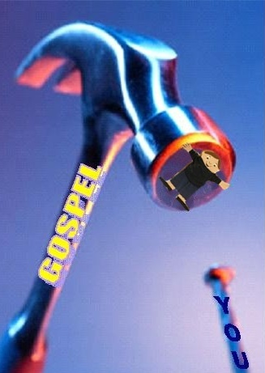
The “Gospel Hammer”
Notes:
Bryan asks friend at work – “Where do you go to church”
Answer “The only true church” “What church would that be?” “The church of Christ” “I don’t ever want to be part of that church”
Ugly

Slide 70
2 Timothy 2:23-26
“Don't have anything to do with foolish and stupid arguments, because you know they produce quarrels. And the Lord's servant must not quarrel; instead, he must be kind to everyone, able to teach, not resentful. Those who oppose him he must gently instruct, in the hope that God will grant them repentance leading them to a knowledge of the truth, and that they will come to their senses and escape from the trap of the devil, who has taken them captive to do his will.”
Notes:
It’s not about conquest, or ego, or arrogance or who knows the most Greek (don’t even need Greek to understand the gospel)
A pharisaic attitude will not convert many, if any.
The power is not in us. It is not in our ability. It is not in our smoothness of speech, or even our grasp of the scriptures. The power is in the message itself. Our job is to sow that message and if we do that it will have the effect God wants it to have.

Slide 71

Becoming an Effective Sower
Evangelism
Know the Gospel
Passion
Attitude
Notes:
Passion – for what the Lord has done for you
Attitude – love for the lost and reverence toward God
Know the Gospel – do enough preparation to tell the story

Slide 72
If we are missing Passion
we are not going to sow.
Evangelism
Passion
Attitude
Know the Gospel

Slide 73
If we are missing Attitude
then when we sow we will beat people up.
Evangelism
Passion
Attitude
Know the Gospel

Slide 74
If we don’t know
The Gospel we will either burn out, teach
a different gospel, or focus on growth tactics.
Evangelism
Passion
Attitude
Know the Gospel

Slide 75






5 Stages of Evangelistic “Maturity”
1
2
3
4
5
STAGE
AVOIDANCE
RELUCTANCE
EQUIPPED
CONFIDENT
COMMITTED
Never share the gospel with anyone
Occasionally will discuss religion with someone
Occasionally will share the gospel with someone
Ready, willing, and able to share the gospel with anyone
Actively pursue sharing the gospel with anyone, anytime, anywhere
Let others do it
If the subject comes up, retreat
Unprepared and unwilling to share the gospel
That is what my money is for!
But they have to bring it up
Usually only when backed into a corner
Not very prepared
That is what my preacher is for!
Need a push from someone else
Have spent some time in preparation
Prefer to assist someone else
Still quite afraid of rejection
That what our church should do!
Will go for it when the opportunity presents itself
Have spent significant time in preparation
Comfortable with message but lacking in zeal
Often motivated by guilt
Passionate and consumed with the mission to sow the seed
Actively seeks opportunities to share the gospel
Encourages and tries to help others
Motivated by joy
Notes:
Technique used in business analysis. I decided to try this on assessment of evangelism. It’s time we get practical and examine ourselves.
In business can’t jump levels. The good news is that in evangelism, you can go from a 1 to a 5 in a finger snap. I have seen it many times.

Slide 76


EVERYONE
deserves the opportunity to either accept or reject the gospel!
Notes:
The responsibility lies on our shoulders. Now, while I am trying to get you to see a deep responsibility to share the gospel with others I am not trying to “guilt” you into sharing the gospel as some would do.
Someone told me the other day, “If you are trying to share the gospel out of guilt then you don’t understand the gospel.”
I want you to discover or rediscover the sheer joy and accomplishment of sharing the gospel.

Slide 77
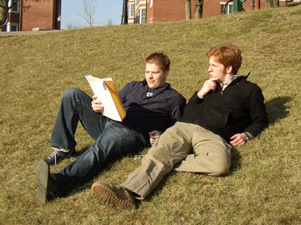
You Can Do It!
Every Christian should be able to share the gospel with anyone. We need:
Get it!
PASSION - In your heart, generate some passion and zeal
TO KNOW THE GOSPEL and practice sharing with others
A LOVE FOR THE LOST -Teach the gospel message to others with gentleness and reverence
EXAMPLE - Let others see your service, joy and passion for what God has done for you!
Learn it!
Share it!
Live it!
Notes:
You can do it
And we all should

Slide 79
What is the gospel?
Now I make known to you, brethren, the gospel which I preached to you, which also you received, in which also you stand, by which also you are saved,, if you hold fast the word which I preached to you, unless you believed in vain.
For I delivered to you as of first importance what I also received, that Christ died for our sins according to the Scriptures,
and that He was buried, and that
He was raised on the third day according to the Scriptures,
and that He appeared to Cephas, then to the twelve. After that He appeared to more than five hundred brethren at one time...
1 Corinthians 15:1-8
The Gospel:
Christ died for our sins
He was buried
He was raised
He appeared
Notes:
In 1 Cor 15:1-8 is one of the shortest presentations of the gospel you will ever hear. See, how long did that take? 1 minute?
This is what we will discuss in more detail tomorrow morning. Thank you for your indulgence tonight.
Invitation.
If you believe in the work of Jesus Christ and are willing to confess his name, repent of your sins, and be united with him in his death by being immersed then come tonight.
If you have need of the prayers of this body then come tonight.

