Slide 1
Book of Isaiah
Chapters 40-55
God’s Servant Fulfills His Mission

Slide 2
Structure of Isaiah
1-12 : Judgment/Hope for Judah & Jerusalem
Isaiah 1-39
Judgment
Isaiah 40-66
Hope

Slide 3
Isaiah Highlights (1-12)
“In that day the Branch of the Lord will be beautiful and glorious…”
The virgin shall bear a son, his name will be “Immanuel.”
A child will be born; will sit on David’s throne, governing in peace forever.
The mountain of the house of the Lord, nations flow to it.
God will remove jewelry/accessories of wealthy Jerusalem women.
A shoot will spring from the stem of Jesse.
God sings a sad love song about his vineyard, Israel.
Assyria condemned as God’s tool that became prideful.
“Come, let us reason together, says the Lord. Though your sins are as scarlet, they will be as white as snow.”
Isaiah sees God and is called to the prophetic work.
Draw from the springs of salvation! Give thanks to His great and holy name!
Assyrian conquest of Israel foretold w/ child named “swift-spoil-speedy-prey.”
4
7
9
2
3
11
5
10
1
6
12
8

Slide 4
Structure of Isaiah
1-12 : Judgment/Hope for Judah & Jerusalem
Isaiah 1-39
Judgment
13-27 : Judgment/Hope for the Nations & World
Isaiah 40-66
Hope

Slide 5
Isaiah Highlights (13-27)
The Nations (“God’s oracle concerning…”)
Valley of Vision (Jerusalem)
Syria & Israel
Tyre
Ethiopia
Babylon
Egypt
Moab
The World
A happy song of a vineyard (restored Israel) that is secure and fruitful!
God prepares a banquet on His mountain, swallows up death forever.
God brings destruction on the whole earth.
The wicked die and are destroyed, the dead of God’s people rise again.
22
17
23
18
13-14
21
19-20
15-16
27
25
24
26

Slide 6
Structure of Isaiah
1-12 : Judgment/Hope for Judah & Jerusalem
Isaiah 1-39
Judgment
13-27 : Judgment/Hope for the Nations & World
28-39 : The Rise and Fall of Jerusalem
Isaiah 40-66
Hope

Slide 7
Isaiah Highlights (28-39)
The Lord slaughters the nations in a great, heavenly, bloody, greasy sacrifice.
Hezekiah foolishly shows off his wealth to the Babylonians.
“This people draw near with their words and honor me with lip service, but they remove their hearts far from me.”
Assyria besieges and taunts the city of Jerusalem.
“The Destroyer” will be destroyed after he is done destroying.
Hezekiah falls fatally ill, prays to God and gets 15 years of life.
God’s warning to Judah: Do not trust in an Egyptian alliance!
“Behold, I am laying in Zion a stone…he who believes in it will not be put to shame.”
The Spirit is poured out, bringing life, righteousness, peace, and security to God’s people.
Hezekiah calls to God and 185,000 Assyrians are killed.
The ransomed return to Zion on the Highway of Holiness.
34
39
29
36
33
38
30-31
28
32
37
35

Slide 8
Structure of Isaiah
1-12 : Judgment/Hope for Judah & Jerusalem
Isaiah 1-39
Judgment
13-27 : Judgment/Hope for the Nations & World
28-39 : The Rise and Fall of Jerusalem
Isaiah 40-66
Hope
40-55 : God’s Servant Fulfills His Mission

Slide 9
Isaiah Highlights (40-55)
God chooses Cyrus, His anointed, to rebuild Jerusalem.
Look to Abraham your father: I blessed him; I will comfort you.
Do not fear, worm Jacob, I will help you…pulverize mountains.
Babylon the virgin is exposed and humiliated.
The Servant is crushed for the healing of God’s people.
God will redeem Israel from captivity like in Egypt.
“Come to the waters! Buy wine and milk without cost!”
”Can a woman forget her nursing child? …I will not forget…”
“You have wearied me with iniquities; I am the one who wipes out transgressions.”
How lovely are the feet who bring good news: “God reigns!”
Babylon’s idols bow down and are carried into captivity.
A voice cries, “In the wilderness prepare the way of the Lord!”
“My Servant, whom I uphold…I have put my Spirit upon him.”
“For a moment I forsook you, but with everlasting love I will have compassion on you.”
The Servant sets his face like flint to do his work.
44-45
51
41
47
53
48
55
49
43
52
46
40
42
54
50

Slide 10
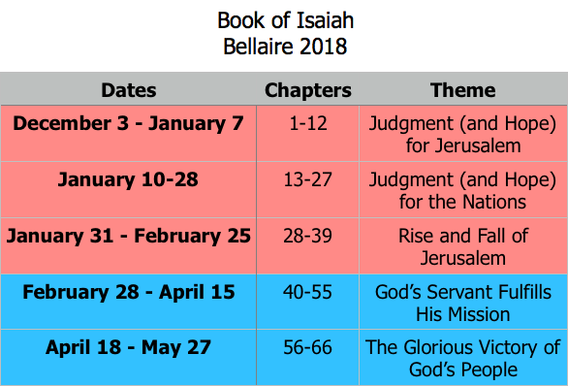
Class Plan

Slide 11
Isaiah 40-55
40 – Proclamation: God is about to act.
41-54 – God’s mission is carried out through The Servant.
Deliverance from Captivity
Downfall of Babylon
Suffering for intercession
55 – Invitation: Call to partake in what The Servant has accomplished.

Slide 12
Isaiah 55
God’s Invitation
What is God offering His people?
What is He calling them to do?

Slide 13
Isaiah 55 in the New Testament
John 7 (see Isaiah 55:1)
On the last day of the feast, the great day, Jesus stood up and cried out, “If anyone thirsts, let him come to me and drink. Whoever believes in me, as the Scripture has said, ‘Out of his heart will flow rivers of living water.’” Now this he said about the Spirit, whom those who believed in him were to receive, for as yet the Spirit had not been given, because Jesus was not yet glorified.

Slide 14
Isaiah 55 in the New Testament
Acts 13 (see Isaiah 55:3)
And we bring you the good news that what God promised to the fathers, this he has fulfilled to us their children by raising Jesus, as also it is written in the second Psalm, “‘You are my Son, today I have begotten you. ’And as for the fact that he raised him from the dead, no more to return to corruption, he has spoken in this way, “‘I will give you the holy and sure blessings of David.’ Therefore he says also in another psalm, “‘You will not let your Holy One see corruption.’ For David, after he had served the purpose of God in his own generation, fell asleep and was laid with his fathers and saw corruption, but he whom God raised up did not see corruption.

Slide 15
Book of Isaiah
Chapters 40-55
The Servant Fulfills His Mission

Slide 16
= Isaiah’s life
Assyrian Captivity
Israel (Northern)
Israel (United Kingdom)
Return
Judah (Southern)
Babylonian Captivity
Book of Isaiah:
1-39: Present Crises
Syrian Crisis under Ahaz (1-12)
Assyrian Crisis under Hezekiah (28-39)
40-66: Future Hope
Return after Babylonian Crisis
Highly Messianic

Slide 17
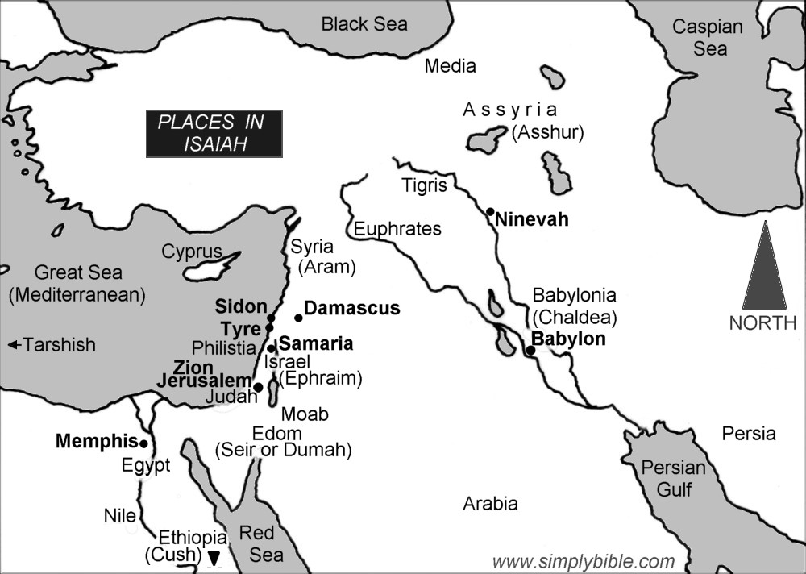

Slide 18
God’s “Servant” in Isaiah 41-55
God’s servant is not just one who does God’s will, but one to whom God is committed.
41:8 – But you, Israel, my servant, Jacob, whom I have chosen … said to you, “You are my servant.”
42:1 – “Behold, my servant, whom I uphold; my chosen one, in whom my soul delights…”
42:19 – “Who is blind but my servant, or so deaf as my messenger?”
43:10 – “You are my witnesses, declares the Lord, and my servant whom I have chosen.”
44:1,21 – “Jacob, my servant, I formed you…”

Slide 19
Isaiah 49
Conversation between God and Zion.
“The Lord has forsaken me…” (49:14)
Perspective from captivity.
“But I will not forget you…” (49:15)
Deserted land will become crowded (49:19)
“Where did these come from?” (49:21)
Bereavement of children (49:20-21)
“I will lift up my hand…” (49:22)
Kings of nations will bow down (49:23)
“Can captives be rescued?” (49:24)
“I will save your sons…” (49:25)

Slide 20
Isaiah 50
Dedication of the Servant to Mission
“Given me tongue of a disciple” (50:4)
The announcer of good news (40:1-11)
“The Lord has opened my ear” (50:5)
Unlike Israel’s deafness (42:18-20)
“Give my back to those who strike” (50:6)
Meekness of the servant (42:1-4)
“God helps me…set my face like flint” (50:7)
“…whom I uphold…” (42:1)
“Who among you fears the Lord?” (50:10)

