Slide 1
Book of Isaiah
Chapters 40-55
God’s Servant Fulfills His Mission

Slide 2
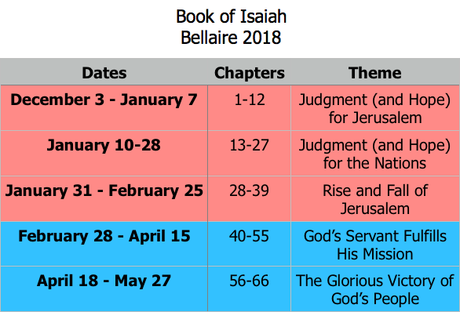
Class Plan

Slide 3
God’s “Servant” in Isaiah 40-55
Israel is God’s Servant.
41:8; 44:1-2, 21; 45:4
God chose Israel and is committed to help.
41:8-10; 44:1-5, 21-23; 45:4
God chose Israel to serve His purpose.
42:1-4; 43:8-13
Israel failed and had to be brought back.
42:18-22; 49:1-7
Coming back requires severe discipline.
50:4-11; 52:13-53:12

Slide 4
Jesus as God’s “Servant”
Matthew 2:13-15
Matthew 3:13-17
Matthew 4:12-17
Matthew 8:14-17
Matthew 12:15-21
Matthew 13:10-15
Matthew 15:1-9
Matthew 17:5
Matthew 27:14,26,38,57
Jesus perfectly carries out the mission given to Him as The Servant of the Lord, fulfilling the promise to Abraham by redeeming the true people of God.
(see Hebrews 10:1-10)

Slide 5
Christians Filling the Role of the “Servant”
Acts 13:44-52
Romans 10:14-17
2 Corinthians 5:16-6:10
Galatians 6:11-16
We, as the true Israel, are redeemed by Jesus and empowered by His Spirit to fulfill the purpose God has given us.

Slide 6
1-39
40-66
1-12
13-27
28-39
40-55
56-66
God brings destruction on the whole earth.
Chapter 24

Slide 7
1-39
40-66
1-12
13-27
28-39
40-55
56-66
God makes the worm Israel into a sledge that threshes mountains.
Chapter 41

Slide 8
1-39
40-66
1-12
13-27
28-39
40-55
56-66
God’s oracle against Babylon.
Chapter 13-14, 21

Slide 9
1-39
40-66
1-12
13-27
28-39
40-55
56-66
Hezekiah shows off his wealth to the Babylonians.
Chapter 39

Slide 10
1-39
40-66
1-12
13-27
28-39
40-55
56-66
The Destroyer will be destroyed when its done destroying.
Chapter 33

Slide 11
1-39
40-66
1-12
13-27
28-39
40-55
56-66
Everyone who thirsts, come to the waters!
Chapter 55

Slide 12
1-39
40-66
1-12
13-27
28-39
40-55
56-66
The ransomed return to Zion on the Highway of Holiness!
Chapter 35

Slide 13
1-39
40-66
1-12
13-27
28-39
40-55
56-66
God removes jewelry and accessories of greedy Jerusalem women.
Chapter 3

Slide 14
1-39
40-66
1-12
13-27
28-39
40-55
56-66
A shoot will spring forth from the stem of Jesse.
Chapter 11

Slide 15
1-39
40-66
1-12
13-27
28-39
40-55
56-66
God’s warning to Judah: Don’t trust in Egypt!
Chapter 30-31

Slide 16
Book of Isaiah
Chapters 40-55
The Servant Fulfills His Mission
*Chs.56-66 starting Wednesday*

Slide 17
Structure of Isaiah
1-12 : Judgment/Hope for Judah & Jerusalem
Isaiah 1-39
Judgment
Isaiah 40-66
Hope

Slide 18
Isaiah Highlights (1-12)
“In that day the Branch of the Lord will be beautiful and glorious…”
The virgin shall bear a son, his name will be “Immanuel.”
A child will be born; will sit on David’s throne, governing in peace forever.
The mountain of the house of the Lord, nations flow to it.
God will remove jewelry/accessories of wealthy Jerusalem women.
A shoot will spring from the stem of Jesse.
God sings a sad love song about his vineyard, Israel.
Assyria condemned as God’s tool that became prideful.
“Come, let us reason together, says the Lord. Though your sins are as scarlet, they will be as white as snow.”
Isaiah sees God and is called to the prophetic work.
Draw from the springs of salvation! Give thanks to His great and holy name!
Assyrian conquest of Israel foretold w/ child named “swift-spoil-speedy-prey.”
4
7
9
2
3
11
5
10
1
6
12
8

Slide 19
Structure of Isaiah
1-12 : Judgment/Hope for Judah & Jerusalem
Isaiah 1-39
Judgment
13-27 : Judgment/Hope for the Nations & World
Isaiah 40-66
Hope

Slide 20
Isaiah Highlights (13-27)
The Nations (“God’s oracle concerning…”)
Valley of Vision (Jerusalem)
Syria & Israel
Tyre
Ethiopia
Babylon
Egypt
Moab
The World
A happy song of a vineyard (restored Israel) that is secure and fruitful!
God prepares a banquet on His mountain, swallows up death forever.
God brings destruction on the whole earth.
The wicked die and are destroyed, the dead of God’s people rise again.
22
17
23
18
13-14
21
19-20
15-16
27
25
24
26

Slide 21
Structure of Isaiah
1-12 : Judgment/Hope for Judah & Jerusalem
Isaiah 1-39
Judgment
13-27 : Judgment/Hope for the Nations & World
28-39 : The Rise and Fall of Jerusalem
Isaiah 40-66
Hope

Slide 22
Isaiah Highlights (28-39)
The Lord slaughters the nations in a great, heavenly, bloody, greasy sacrifice.
Hezekiah foolishly shows off his wealth to the Babylonians.
“This people draw near with their words and honor me with lip service, but they remove their hearts far from me.”
Assyria besieges and taunts the city of Jerusalem.
“The Destroyer” will be destroyed after he is done destroying.
Hezekiah falls fatally ill, prays to God and gets 15 years of life.
God’s warning to Judah: Do not trust in an Egyptian alliance!
“Behold, I am laying in Zion a stone…he who believes in it will not be put to shame.”
The Spirit is poured out, bringing life, righteousness, peace, and security to God’s people.
Hezekiah calls to God and 185,000 Assyrians are killed.
The ransomed return to Zion on the Highway of Holiness.
34
39
29
36
33
38
30-31
28
32
37
35

Slide 23
Structure of Isaiah
1-12 : Judgment/Hope for Judah & Jerusalem
Isaiah 1-39
Judgment
13-27 : Judgment/Hope for the Nations & World
28-39 : The Rise and Fall of Jerusalem
Isaiah 40-66
Hope
40-55 : God’s Servant Fulfills His Mission

Slide 24
Isaiah Highlights (40-55)
God chooses Cyrus, His anointed, to rebuild Jerusalem.
Look to Abraham your father: I blessed him; I will comfort you.
Do not fear, worm Jacob, I will help you…pulverize mountains.
Babylon the virgin is exposed and humiliated.
The Servant is crushed for the healing of God’s people.
God will redeem Israel from captivity like in Egypt.
“Come to the waters! Buy wine and milk without cost!”
”Can a woman forget her nursing child? …I will not forget…”
“You have wearied me with iniquities; I am the one who wipes out transgressions.”
How lovely are the feet who bring good news: “God reigns!”
Babylon’s idols bow down and are carried into captivity.
A voice cries, “In the wilderness prepare the way of the Lord!”
“My Servant, whom I uphold…I have put my Spirit upon him.”
“For a moment I forsook you, but with everlasting love I will have compassion on you.”
The Servant sets his face like flint to do his work.
44-45
51
41
47
53
48
55
49
43
52
46
40
42
54
50

Slide 25
Isaiah 55 in the New Testament
John 7 (see Isaiah 55:1)
On the last day of the feast, the great day, Jesus stood up and cried out, “If anyone thirsts, let him come to me and drink. Whoever believes in me, as the Scripture has said, ‘Out of his heart will flow rivers of living water.’” Now this he said about the Spirit, whom those who believed in him were to receive, for as yet the Spirit had not been given, because Jesus was not yet glorified.

Slide 26
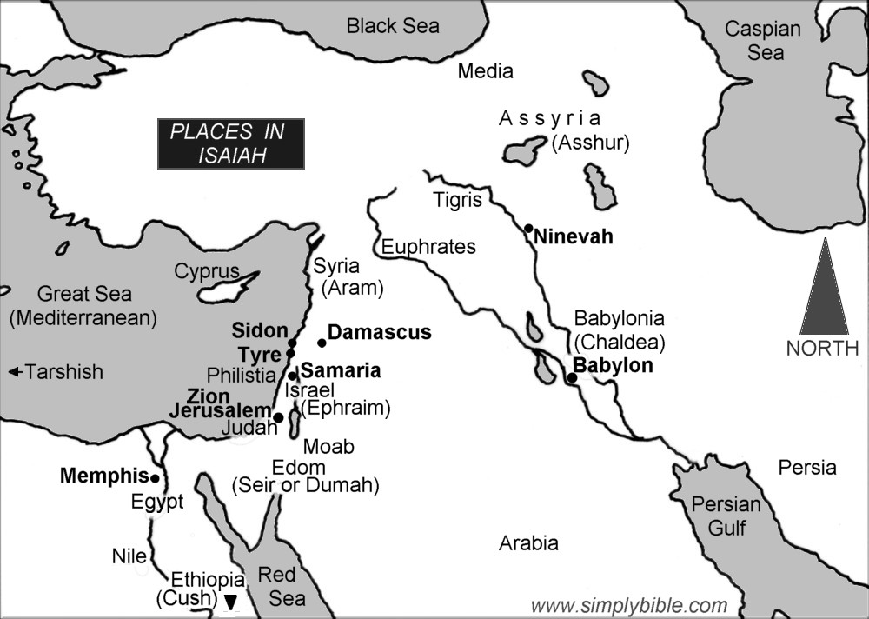

Slide 27
= Isaiah’s life
Assyrian Captivity
Israel (Northern)
Israel (United Kingdom)
Return
Judah (Southern)
Babylonian Captivity
Book of Isaiah:
1-39: Present Crises
Syrian Crisis under Ahaz (1-12)
Assyrian Crisis under Hezekiah (28-39)
40-66: Future Hope
Return after Babylonian Crisis
Highly Messianic

