Slide 1
Book of Isaiah
Chapters 56-66
Glorious Victory for God’s People

Slide 2
= Isaiah’s life
Assyrian Captivity
Israel (Northern)
Israel (United Kingdom)
Return
Judah (Southern)
Babylonian Captivity
Book of Isaiah:
1-39: Present Crises
Syrian Crisis under Ahaz (1-12)
Assyrian Crisis under Hezekiah (28-39)
40-66: Future Hope
Return after Babylonian Crisis
Highly Messianic

Slide 3
1-39
40-66
1-12
13-27
28-39
40-55
56-66
God brings destruction on the whole earth.
Chapter 24

Slide 4
1-39
40-66
1-12
13-27
28-39
40-55
56-66
God makes the worm Israel into a sledge that threshes mountains.
Chapter 41

Slide 5
1-39
40-66
1-12
13-27
28-39
40-55
56-66
God’s oracle against Babylon.
Chapter 13-14, 21

Slide 6
1-39
40-66
1-12
13-27
28-39
40-55
56-66
Hezekiah shows off his wealth to the Babylonians.
Chapter 39

Slide 7
1-39
40-66
1-12
13-27
28-39
40-55
56-66
The Destroyer will be destroyed when its done destroying.
Chapter 33

Slide 8
1-39
40-66
1-12
13-27
28-39
40-55
56-66
Everyone who thirsts, come to the waters!
Chapter 55

Slide 9
1-39
40-66
1-12
13-27
28-39
40-55
56-66
The ransomed return to Zion on the Highway of Holiness!
Chapter 35

Slide 10
1-39
40-66
1-12
13-27
28-39
40-55
56-66
God removes jewelry and accessories of greedy Jerusalem women.
Chapter 3

Slide 11
1-39
40-66
1-12
13-27
28-39
40-55
56-66
A shoot will spring forth from the stem of Jesse.
Chapter 11

Slide 12
1-39
40-66
1-12
13-27
28-39
40-55
56-66
God’s warning to Judah: Don’t trust in Egypt!
Chapter 30-31

Slide 13
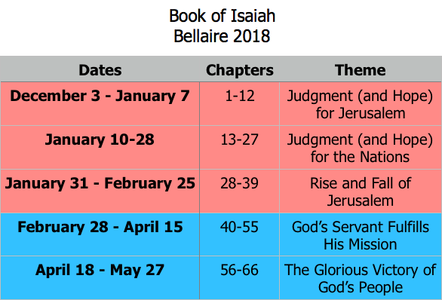
Class Plan

Slide 14
Isaiah 56:1
Thus says the Lord: “Keep justice, and do righteousness, for soon my salvation will come, and my righteousness be revealed.”
Isaiah 1-39 – Do justice and righteousness!
Isaiah 40-55 – God will act in righteousness.

Slide 15
61:1-9
The Commission of the Anointed One
60:1-22
61:10-62:12
Visions of Restored Jerusalem
59:15-21
63:1-6
Visions of Jehovah’s Judgment
59:9-15
63:7-64:12
Prayers for Jehovah’s Forgiveness
56:9-59:8
65:1-66:17
Rebukes of Current Jerusalem
56:1-8
66:18-24
The Place of Foreigners in God’s Zion

Slide 16
Isaiah 61:1-9
Who is speaking?
God’s Spirit on Him (The Servant - 42:1)
“Anointed” (Cyrus - 45:1)
What does he do?
Brings good news (40:9; 52:7)
Heals the brokenhearted (53:5)
Proclaims liberty/freedom (48:20)
“Favorable year of the Lord” (Leviticus 25)
Comforts those who mourn (40:1)
What is accomplished?
Ruins are rebuilt (44:26)
The nations are brought in (49:6)
God’s favor and justice are shown (40:12)

Slide 17
Isaiah 61 in the New Testament
Luke 4 (see Isaiah 61:1-9)
And he came to Nazareth, where he had been brought up. And as was his custom, he went to the synagogue on the Sabbath day, and he stood up to read. And the scroll of the prophet Isaiah was given to him. He unrolled the scroll and found the place where it was written, “The Spirit of the Lord is upon me, because he has anointed me to proclaim good news to the poor. He has sent me to proclaim liberty to the captives and recovering of sight to the blind, to set at liberty those who are oppressed, to proclaim the year of the Lord's favor.” And he rolled up the scroll and gave it back to the attendant and sat down. And the eyes of all in the synagogue were fixed on him. And he began to say to them, “Today this Scripture has been fulfilled in your hearing.”

Slide 18
Book of Isaiah
Chapters 56-66
Glorious Victory for God’s People
*60-62 for NEXT Wednesday*

Slide 19
Structure of Isaiah
1-12 : Judgment/Hope for Judah & Jerusalem
Isaiah 1-39
Judgment
Isaiah 40-66
Hope

Slide 20
Isaiah Highlights (1-12)
“In that day the Branch of the Lord will be beautiful and glorious…”
The virgin shall bear a son, his name will be “Immanuel.”
A child will be born; will sit on David’s throne, governing in peace forever.
The mountain of the house of the Lord, nations flow to it.
God will remove jewelry/accessories of wealthy Jerusalem women.
A shoot will spring from the stem of Jesse.
God sings a sad love song about his vineyard, Israel.
Assyria condemned as God’s tool that became prideful.
“Come, let us reason together, says the Lord. Though your sins are as scarlet, they will be as white as snow.”
Isaiah sees God and is called to the prophetic work.
Draw from the springs of salvation! Give thanks to His great and holy name!
Assyrian conquest of Israel foretold w/ child named “swift-spoil-speedy-prey.”
4
7
9
2
3
11
5
10
1
6
12
8

Slide 21
Structure of Isaiah
1-12 : Judgment/Hope for Judah & Jerusalem
Isaiah 1-39
Judgment
13-27 : Judgment/Hope for the Nations & World
Isaiah 40-66
Hope

Slide 22
Isaiah Highlights (13-27)
The Nations (“God’s oracle concerning…”)
Valley of Vision (Jerusalem)
Syria & Israel
Tyre
Ethiopia
Babylon
Egypt
Moab
The World
A happy song of a vineyard (restored Israel) that is secure and fruitful!
God prepares a banquet on His mountain, swallows up death forever.
God brings destruction on the whole earth.
The wicked die and are destroyed, the dead of God’s people rise again.
22
17
23
18
13-14
21
19-20
15-16
27
25
24
26

Slide 23
Structure of Isaiah
1-12 : Judgment/Hope for Judah & Jerusalem
Isaiah 1-39
Judgment
13-27 : Judgment/Hope for the Nations & World
28-39 : The Rise and Fall of Jerusalem
Isaiah 40-66
Hope

Slide 24
Isaiah Highlights (28-39)
The Lord slaughters the nations in a great, heavenly, bloody, greasy sacrifice.
Hezekiah foolishly shows off his wealth to the Babylonians.
“This people draw near with their words and honor me with lip service, but they remove their hearts far from me.”
Assyria besieges and taunts the city of Jerusalem.
“The Destroyer” will be destroyed after he is done destroying.
Hezekiah falls fatally ill, prays to God and gets 15 years of life.
God’s warning to Judah: Do not trust in an Egyptian alliance!
“Behold, I am laying in Zion a stone…he who believes in it will not be put to shame.”
The Spirit is poured out, bringing life, righteousness, peace, and security to God’s people.
Hezekiah calls to God and 185,000 Assyrians are killed.
The ransomed return to Zion on the Highway of Holiness.
34
39
29
36
33
38
30-31
28
32
37
35

Slide 25
Structure of Isaiah
1-12 : Judgment/Hope for Judah & Jerusalem
Isaiah 1-39
Judgment
13-27 : Judgment/Hope for the Nations & World
28-39 : The Rise and Fall of Jerusalem
Isaiah 40-66
Hope
40-55 : God’s Servant Fulfills His Mission

Slide 26
Isaiah Highlights (40-55)
God chooses Cyrus, His anointed, to rebuild Jerusalem.
Look to Abraham your father: I blessed him; I will comfort you.
Do not fear, worm Jacob, I will help you…pulverize mountains.
Babylon the virgin is exposed and humiliated.
The Servant is crushed for the healing of God’s people.
God will redeem Israel from captivity like in Egypt.
“Come to the waters! Buy wine and milk without cost!”
”Can a woman forget her nursing child? …I will not forget…”
“You have wearied me with iniquities; I am the one who wipes out transgressions.”
How lovely are the feet who bring good news: “God reigns!”
Babylon’s idols bow down and are carried into captivity.
A voice cries, “In the wilderness prepare the way of the Lord!”
“My Servant, whom I uphold…I have put my Spirit upon him.”
“For a moment I forsook you, but with everlasting love I will have compassion on you.”
The Servant sets his face like flint to do his work.
44-45
51
41
47
53
48
55
49
43
52
46
40
42
54
50

Slide 27
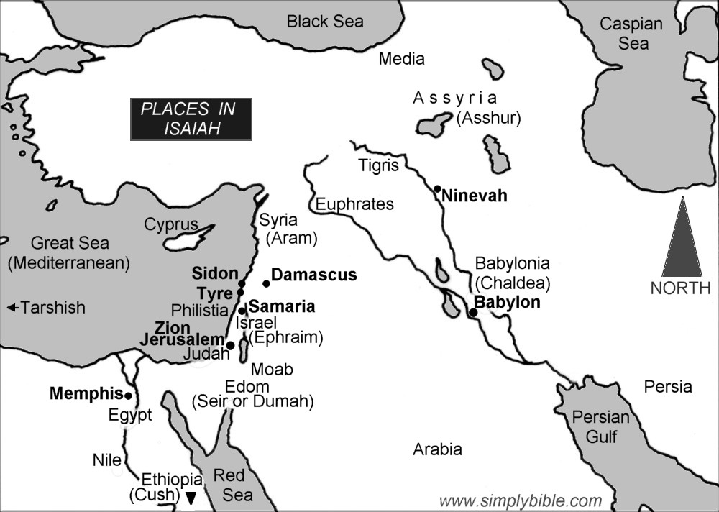

Slide 28
God’s “Servant” in Isaiah 40-55
Israel is God’s Servant.
41:8; 44:1-2, 21; 45:4
God chose Israel and is committed to help.
41:8-10; 44:1-5, 21-23; 45:4
God chose Israel to serve His purpose.
42:1-4; 43:8-13
Israel failed and had to be brought back.
42:18-22; 49:1-7
Coming back requires severe discipline.
50:4-11; 52:13-53:12

Slide 29
Isaiah 56-66
56:1-8
56:9-59:8
59:9-15
59:15-21
60:1-22
61:1-9
61:10-62:12
63:1-6
63:7-64:12
65:1-66:17
66:18-24

