Slide 1
Treating the Problem Not the Symptoms
Luke 5:17-26

Slide 2
Treating the Problem Not the Symptoms
That getting married is not the cure for loneliness
Throwing money at a problem does not make it go away
Taking a bunch of pills does not replace living a healthy lifestyle
Going to church does not make you right with God
Giving your kids what they want is not the same as being a good parent

Slide 4
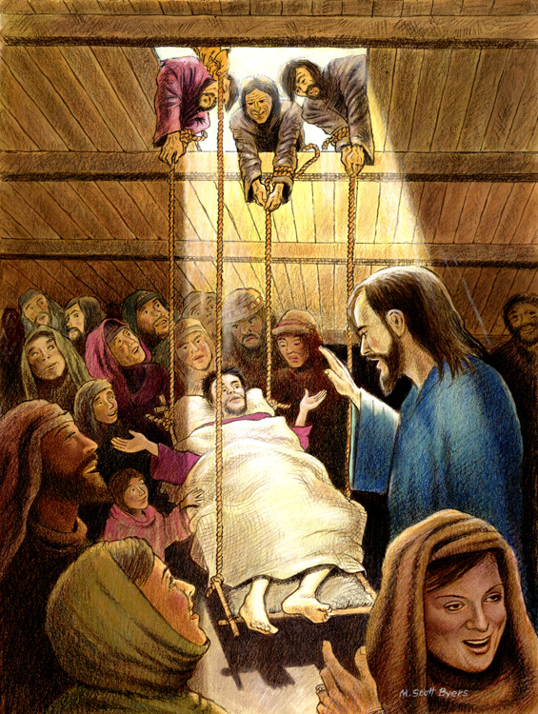

Slide 5
Treating the Problem Not the Symptoms
An Unexpected Diagnosis
Sometimes our greatest need is something we do not even see.
Let’s state this clearly: there is NOTHING that is more important than your relationship with Christ because this relationship/or lack thereof will impact you literally forever.

Slide 6
Treating the Problem Not the Symptoms
We have a tendency to assume that the biggest problems in our lives are the things such as:
Being more popular
Attaining a greater level of success
Earning more money
Gaining victory over a health issue
Being delivered from the pressures of life
Getting a particular person to like us
Keeping the peace

Slide 7
Treating the Problem Not the Symptoms
“Why are you thinking these things in your hearts? ²³ Which is easier: to say, ‘Your sins are forgiven,’ or to say, ‘Get up and walk’? ²⁴ But that you may know that the Son of Man has authority on earth to forgive sins….” He said to the paralyzed man, “I tell you, get up, take your mat and go home.”
Jesus basically said, “Do you want to see
evidence that I have the authority to
forgive sins?”

Slide 8
Treating the Problem Not the Symptoms
Take Home Points
First, we see the unique person of Jesus Christ.
Second, if Jesus is the one who can forgive sin, we should seek Him.
7 In him we have redemption through his blood, the forgiveness of sins, in accordance with the riches of God’s grace ⁸ that he lavished on us with all wisdom and understanding. [Ephesians 1:7-8]
Third, when God doesn’t do what we expect we
need to consider that God may be working on a
greater problem in our lives.

Slide 9
Treating the Problem Not the Symptoms
Fourth, this account challenges us to love boldly.

