Slide 1
Book of Isaiah
Chapters 56-66
Glorious Victory for God’s People

Slide 2
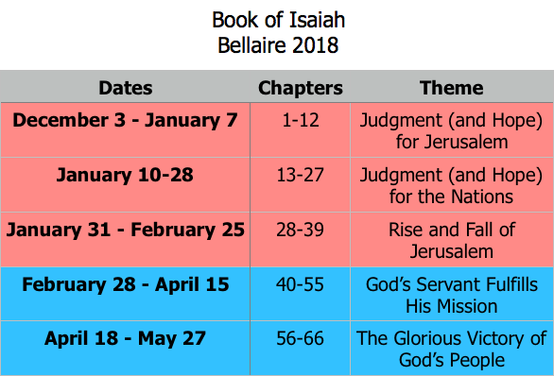
Class Plan

Slide 3
Isaiah 66:18-24
What are the basics of what is being described?
How is it a description of the Kingdom of God in Christ?
Genesis 1: Fellowship between God and man; fill the earth.
Genesis 11: Reversing the Tower of Babel, all tongues brought together.
Acts 2: All tongues come to Jerusalem, God’s glory goes forth.

Slide 4
= Isaiah’s life
Assyrian Captivity
Israel (Northern)
Israel (United Kingdom)
Return
Judah (Southern)
Babylonian Captivity
Book of Isaiah:
1-39: Present Crises
Syrian Crisis under Ahaz (1-12)
Assyrian Crisis under Hezekiah (28-39)
40-66: Future Hope
Return after Babylonian Crisis
Highly Messianic

Slide 5
Structure of Isaiah
1-12 : Judgment/Hope for Judah & Jerusalem
Isaiah 1-39
Judgment
Isaiah 40-66
Hope

Slide 6
Isaiah Highlights (1-12)
“In that day the Branch of the Lord will be beautiful and glorious…”
The virgin shall bear a son, his name will be “Immanuel.”
A child will be born; will sit on David’s throne, governing in peace forever.
The mountain of the house of the Lord, nations flow to it.
God will remove jewelry/accessories of wealthy Jerusalem women.
A shoot will spring from the stem of Jesse.
God sings a sad love song about his vineyard, Israel.
Assyria condemned as God’s tool that became prideful.
“Come, let us reason together, says the Lord. Though your sins are as scarlet, they will be as white as snow.”
Isaiah sees God and is called to the prophetic work.
Draw from the springs of salvation! Give thanks to His great and holy name!
Assyrian conquest of Israel foretold w/ child named “swift-spoil-speedy-prey.”
4
7
9
2
3
11
5
10
1
6
12
8

Slide 7
Structure of Isaiah
1-12 : Judgment/Hope for Judah & Jerusalem
Isaiah 1-39
Judgment
13-27 : Judgment/Hope for the Nations & World
Isaiah 40-66
Hope

Slide 8
Isaiah Highlights (13-27)
The Nations (“God’s oracle concerning…”)
Valley of Vision (Jerusalem)
Syria & Israel
Tyre
Ethiopia
Babylon
Egypt
Moab
The World
A happy song of a vineyard (restored Israel) that is secure and fruitful!
God prepares a banquet on His mountain, swallows up death forever.
God brings destruction on the whole earth.
The wicked die and are destroyed, the dead of God’s people rise again.
22
17
23
18
13-14
21
19-20
15-16
27
25
24
26

Slide 9
Structure of Isaiah
1-12 : Judgment/Hope for Judah & Jerusalem
Isaiah 1-39
Judgment
13-27 : Judgment/Hope for the Nations & World
28-39 : The Rise and Fall of Jerusalem
Isaiah 40-66
Hope

Slide 10
Isaiah Highlights (28-39)
Prophecies of the Assyrian Crisis
The Lord slaughters the nations in a great, heavenly, bloody, greasy sacrifice.
“This people draw near with their words and honor me with lip service, but they remove their hearts far from me.”
“The Destroyer” will be destroyed after he is done destroying.
God’s warning to Judah: Do not trust in an Egyptian alliance!
“Behold, I am laying in Zion a stone…he who believes in it will not be put to shame.”
The Spirit is poured out, bringing life, righteousness, peace, and security to God’s people.
The ransomed return to Zion on the Highway of Holiness.
Stories of Assyrian Crisis
Hezekiah foolishly shows off his wealth to the Babylonians.
Assyria besieges and taunts the city of Jerusalem.
Hezekiah falls fatally ill, prays to God and gets 15 years of life.
Hezekiah calls to God and 185,000 Assyrians are killed.
34
29
33
30-31
28
32
35
39
36
38
37

Slide 11
Structure of Isaiah
1-12 : Judgment/Hope for Judah & Jerusalem
Isaiah 1-39
Judgment
13-27 : Judgment/Hope for the Nations & World
28-39 : The Rise and Fall of Jerusalem
Isaiah 40-66
Hope
40-55 : God’s Servant Fulfills His Mission

Slide 12
Isaiah Highlights (40-55)
God chooses Cyrus, His anointed, to rebuild Jerusalem.
Look to Abraham your father: I blessed him; I will comfort you.
Do not fear, worm Jacob, I will help you…pulverize mountains.
Babylon the virgin is exposed and humiliated.
The Servant is crushed for the healing of God’s people.
God will redeem Israel from captivity like in Egypt.
“Come to the waters! Buy wine and milk without cost!”
”Can a woman forget her nursing child? …I will not forget…”
“You have wearied me with iniquities; I am the one who wipes out transgressions.”
How lovely are the feet who bring good news: “God reigns!”
Babylon’s idols bow down and are carried into captivity.
A voice cries, “In the wilderness prepare the way of the Lord!”
“My Servant, whom I uphold…I have put my Spirit upon him.”
“For a moment I forsook you, but with everlasting love I will have compassion on you.”
The Servant sets his face like flint to do his work.
44-45
51
41
47
53
48
55
49
43
52
46
40
42
54
50

Slide 13
Structure of Isaiah
1-12 : Judgment/Hope for Judah & Jerusalem
Isaiah 1-39
Judgment
13-27 : Judgment/Hope for the Nations & World
28-39 : The Rise and Fall of Jerusalem
Isaiah 40-66
Hope
40-55 : God’s Servant Fulfills His Mission
56-66 : Glorious Victory for Servants of the Lord

Slide 14
Isaiah Highlights (56-66)
62
Zion will be called Delight & Married, not Forsaken & Desolate.
The nations come and are made priests and Levites for the Lord.
The Lord puts on His armor to bring salvation and recompense.
Your gates will be open continually; they will not be closed.
Oh, that you would rend the heavens and come down!
Behold, I create a new heavens and a new earth!
My house will be called a house of prayer for all nations.
God treads the wine press alone, executing His wrath.
I dwell in a high and holy place, and with the contrite and lowly.
The Spirit of the Lord is on me…to proclaim good news to the poor.
Is this not the fast I choose, to loosen the bonds of wickedness?
66
59
60
64
65
56
63
57
61
58

Slide 15
God’s Sovereignty vs Human Responsibility
Isaiah 1:16-31
Isaiah 10:1-12
Isaiah 28:14-22
Isaiah 43:22-44:8; 44:21-23
Isaiah 55
Isaiah 58:13-59:2

Slide 16
Book of Isaiah

Slide 17
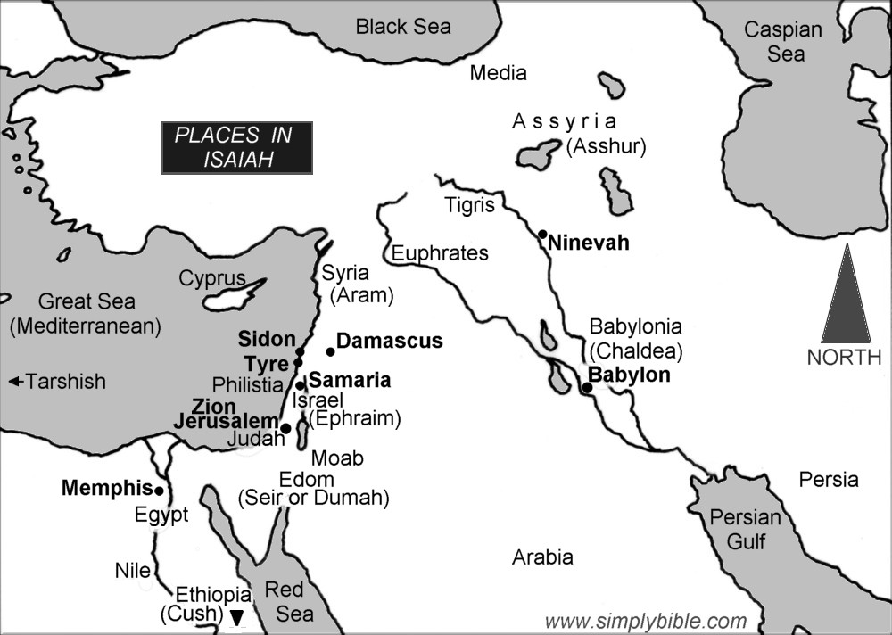

Slide 18
Isaiah 56:1
Thus says the Lord: “Keep justice, and do righteousness, for soon my salvation will come, and my righteousness be revealed.”
Isaiah 1-39 – Do justice and righteousness!
Isaiah 40-55 – God will act in righteousness.

Slide 19
Isaiah 56-66
ch. 61
The Work of the Anointed One
ch. 60
ch. 62
Visions of Restored Jerusalem
59:15-21
63:1-6
Visions of Jehovah’s Judgment
59:9-15
63:7-ch.64
Confession and Cry to Jehovah for Help
56:9-59:8
ch.65-66:17
Rebukes of Current Jerusalem
56:1-8
66:18-24

Slide 20
Isaiah 66 in the New Testament
Mark 9 (see Isaiah 66:24)
“Whoever causes one of these little ones who believe in me to sin, it would be better for him if a great millstone were hung around his neck and he were thrown into the sea. And if your hand causes you to sin, cut it off. It is better for you to enter life crippled than with two hands to go to hell, to the unquenchable fire. And if your foot causes you to sin, cut it off. It is better for you to enter life lame than with two feet to be thrown into hell. And if your eye causes you to sin, tear it out. It is better for you to enter the kingdom of God with one eye than with two eyes to be thrown into hell, ‘where their worm does not die and the fire is not quenched.’

