Slide 1
Christian Evidences
Summer 2018
June 6: Evidence that God exists.

Slide 2
Purposes of this study
To bolster our own assurance and confidence that the contents of the Bible are true
To have reasons and defenses for those who do not know the validity of the God, Jesus, and the Bible

Slide 3
Origins
Materialist
Biblical

Slide 4
Materialist viewpoint
Matter just happened to exist.
Matter has always existed.
Matter just formed out of nothing somehow.

Slide 5
Materialist viewpoint General Rule
Matter behaves and has always behaved in certain fixed ways.
(According to the laws of science that we can observe today.)

Slide 6
Materialist viewpoint
Big Bang
Chemical Evolution
Darwin & Biological Evolution

Slide 7
How did the stuff that went “bang” come about?
None of the materialist explanations can explain how the first matter came into existence.
Most explanations involve a “nothing” that is actually something.
For instance…

Slide 8
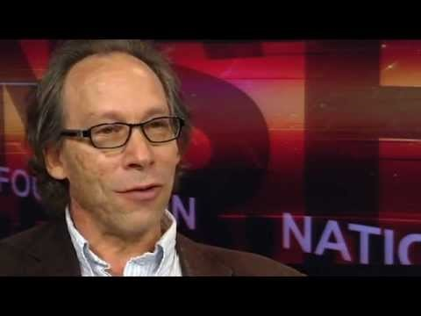

Slide 9
Where did the initial energy of the big bang come from?
Scientists are still searching…

Slide 10
Consider the probability
Atrophysicist, Erik Zackrisson - There are 700,000,000,000,000,000,000 (700 quintillion) planets in the universe, but only one like earth.
Earth, from a purely statistical standpoint, should not exist.
Then, by another remote chance the chemicals necessary for life, and the right temperature occurred on one of these planets, so that some of the matter came alive.
And then, by a very long series of chances, the living creatures developed into things like us.

Slide 11
How life evolved according to Darwin’s theory of evolution. The mechanism of his evolution is natural selection, so this would take billions of years.

Slide 12
Two Questions
Did all life on earth evolve on the scale described in Darwin’s theory?
How can we assess the validity or lack of validity of Darwin’s theory?

Slide 13
Biblical viewpoint
The universe was created by God with a certain order and laws to govern it.

Slide 14
Biblical viewpoint (How were things made and how are they governed)
Genesis 1
John 1:1-4
Psalm 33:6
Psalm 104

Slide 15
Biblical viewpoint (The creation proclaims of its own accord that it was made by God)
Psalm 19:1-2
The heavens declare the glory of God; the skies proclaim the work of his hands. Day after day they pour forth speech; night after night they reveal knowledge.
Romans 1:18-20
The wrath of God is being revealed from heaven against all the godlessness and wickedness of people, who suppress the truth by their wickedness, ¹⁹ since what may be known about God is plain to them, because God has made it plain to them. ²⁰ For since the creation of the world God’s invisible qualities—his eternal power and divine nature—have been clearly seen, being understood from what has been made, so that people are without excuse.

Slide 16
How does the creation proclaim the existence of God to you?

Slide 17
Evidences of Intelligent Design
Complex nano-technology within a cell. A level of engineering exists that is more advanced than anything we have created.
DNA – There is a wealth of information stored in DNA. It is a code of sorts that tells the cell what to do, like an instruction manual. Sounds like it may have a designer behind it.

Slide 18
Evidences of Intelligent Design
Acts 14:15-17
Good things on earth and our joy in them point to God.

