Slide 1
Christian Evidences
Summer 2018
June 10: Evidence that God exists.

Slide 2
Purposes of this study
To bolster our own assurance and confidence that the contents of the Bible are true
To have reasons and defenses for those who do not know the validity of the God, Jesus, and the Bible

Slide 3
Question to Consider
Do science and the Bible agree?

Slide 4
Biblical viewpoint
The universe was created by God with a certain order and laws to govern it.

Slide 5
Biblical viewpoint (The creation proclaims of its own accord that it was made by God)
Psalm 19:1-2
The heavens declare the glory of God; the skies proclaim the work of his hands. Day after day they pour forth speech; night after night they reveal knowledge.
Romans 1:18-20
The wrath of God is being revealed from heaven against all the godlessness and wickedness of people, who suppress the truth by their wickedness, ¹⁹ since what may be known about God is plain to them, because God has made it plain to them. ²⁰ For since the creation of the world God’s invisible qualities—his eternal power and divine nature—have been clearly seen, being understood from what has been made, so that people are without excuse.

Slide 6
Biblical viewpoint
Ecclesiastes 3:10-11
I have seen the business that God has given to the children of man to be busy with. He has made everything beautiful in its time. Also, he has put eternity into man’s heart, yet to that he cannot find out what God has done from the beginning to the end.

Slide 7
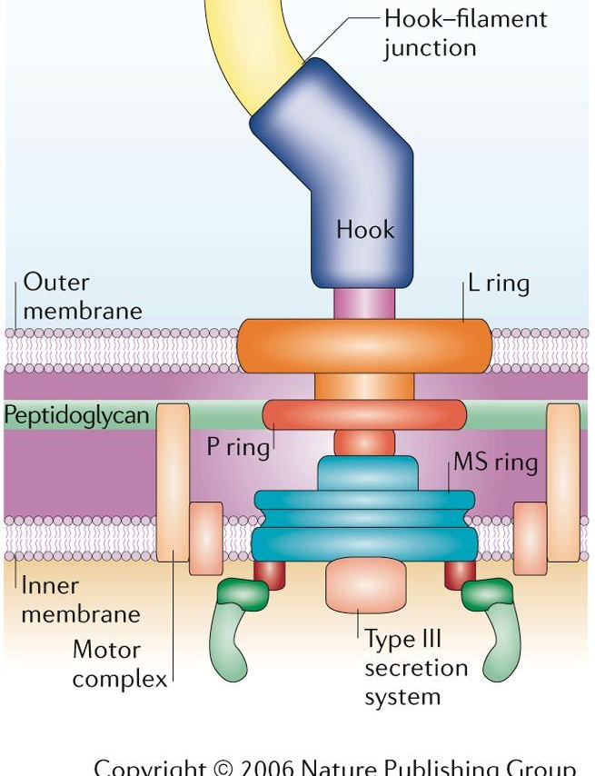
Evidences of Intelligent Design
There are complex nanotechnologies within a cell. A level of engineering exists that is more advanced than anything we have created.
How did this randomly evolve?

Slide 8
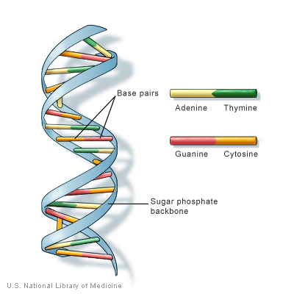
Evidences of Intelligent Design
DNA – There is a wealth of information stored in DNA. It is a code of sorts that tells the cell what to do, like an instruction manual.
Doesn’t it sound like it may have a designer behind it?

Slide 9
Evidences of Intelligent Design
In Physics
All seemingly arbitrary and unrelated constants in physics have one thing in common: they are precisely the values needed to have a universe capable of producing life.

Slide 10
Evidences of Intelligent Design
Gravity
If we increased the force of gravity by one part in ten thousand billion billion billion, animals near the size of human beings would be crushed.

Slide 11
Evidences of Intelligent Design
Expansion Rate
The expansion rate of the universe is fine tuned to one part in a trillion trillion trillion trillion trillion. If we changed it by one part in either direction (faster or slower), there would not be life in our universe.

Slide 12
Creator and Science
Science and “religion” have crossed paths, and they overlap into one another.
Can the scientific community and the Bible agree?

Slide 13
Creator and Science
“All scientific knowledge is, in principle, subject to change as new evidence becomes available.” – National Academy of Sciences
“Evidence for an intelligent designer becomes more compelling the more we understand about our carefully crafted habitat.” - Water Bradley

Slide 14
Creator and Science
“Science is the search for truth” - Linus Pauling (two-time Nobel Prize winner)
“The sum of Your word is truth, and every one of Your righteous rules endures forever.” Psalm 119:160

Slide 15
Creator and Science
As things stand today, it takes faith to believe in the materialist view and it also takes faith to believe that God exists and that he created the universe.
There are just some things that we will never know with absolute certainty.

Slide 16
Evidence of God: Ourselves
Psalm 139:14
We are wonderfully made
Psalm 8
He made us little lower than heavenly beings

Slide 17
Internal Evidence
Romans 2:14
Even Gentiles, who do not have God's written law, show that they know his law when they instinctively obey it, even without having heard it. (NLT)

Slide 18
Internal Evidence
Does everyone agree that what the Nazis did in the 1930s and 40s was wrong?
Does everyone agree that men ought to be unselfish and fair?

Slide 19
Internal Evidence
Mankind is born a sense of right and wrong.
Some have called it the Law of Nature
This innate sense of right and wrong is not invented by man, yet we all know that we ought to obey it.

Slide 20
Internal Evidence
Just as we see many laws in nature, man has his law.
Key difference: man can choose whether to obey the Law of Human Nature;
and many times, man does not keep this Law of Nature.

Slide 21
Internal Evidence
When we fail to keep this Natural Law, we always have an excuse ready.
These excuses are in and of themselves evidences that we feel the law pressing on us, and we have trouble bearing the fact that we have broken it, so we try to shift the blame.

Slide 22
Internal Evidence
For example…
That time you were unfair to your children because you were so tired.
That slightly shady business about the money came about when you were hard-up.
And what you promised to do for so-and-so and never have done; well you would have never guessed how crazily busy things were going to get.

Slide 23
Internal Evidence
Conclusion:
These excuses point to the existence of this Natural Law and the fact that we all believe in it.
And, this Natural Law points to God.

