Slide 1
Christian Evidences
Summer 2018
June 17: Does the Bible accurately portray the original writings?

Slide 2
Purposes of this study
To strengthen our own faith through the examination of evidence.
To equip ourselves with the tools needed to defend our faith.

Slide 3
Writings: Originals & Manuscripts
All original writings have most likely decomposed.
How are we to know that our Bible is true to the original writings?
The answer lies in manuscript evidence.

Slide 4
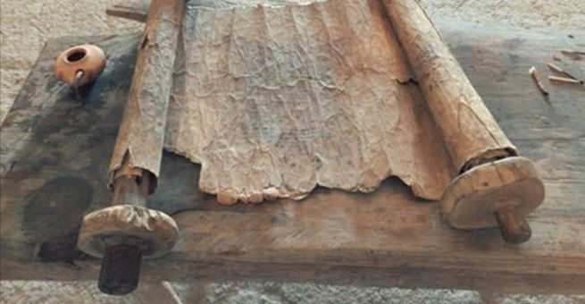
Papyrus

Slide 5
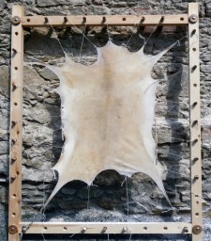
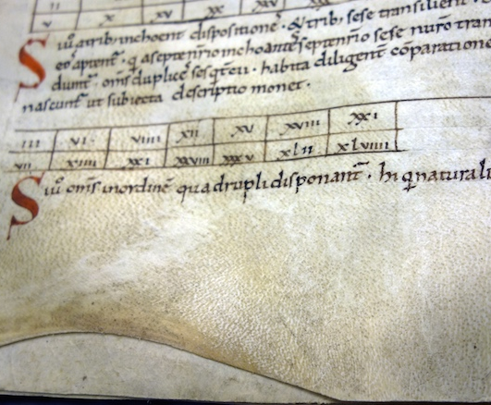
Parchment

Slide 6
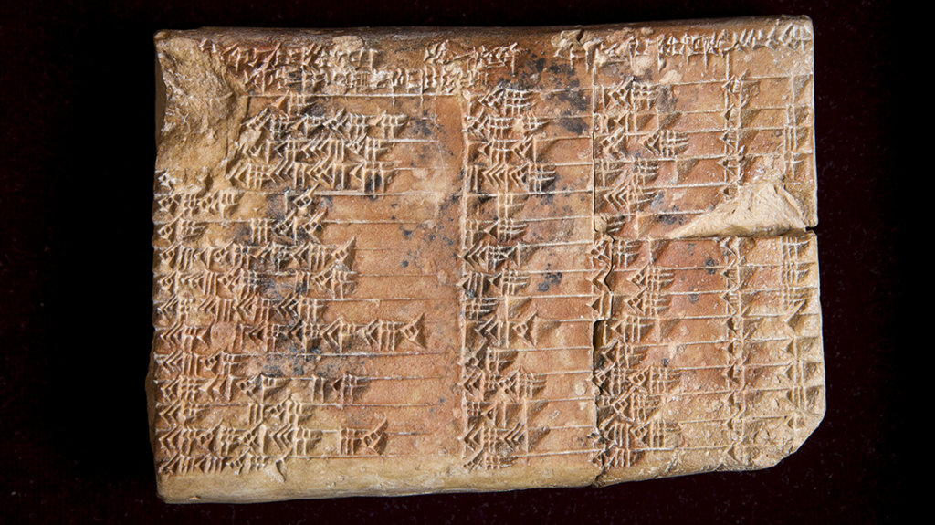
Tablets

Slide 7
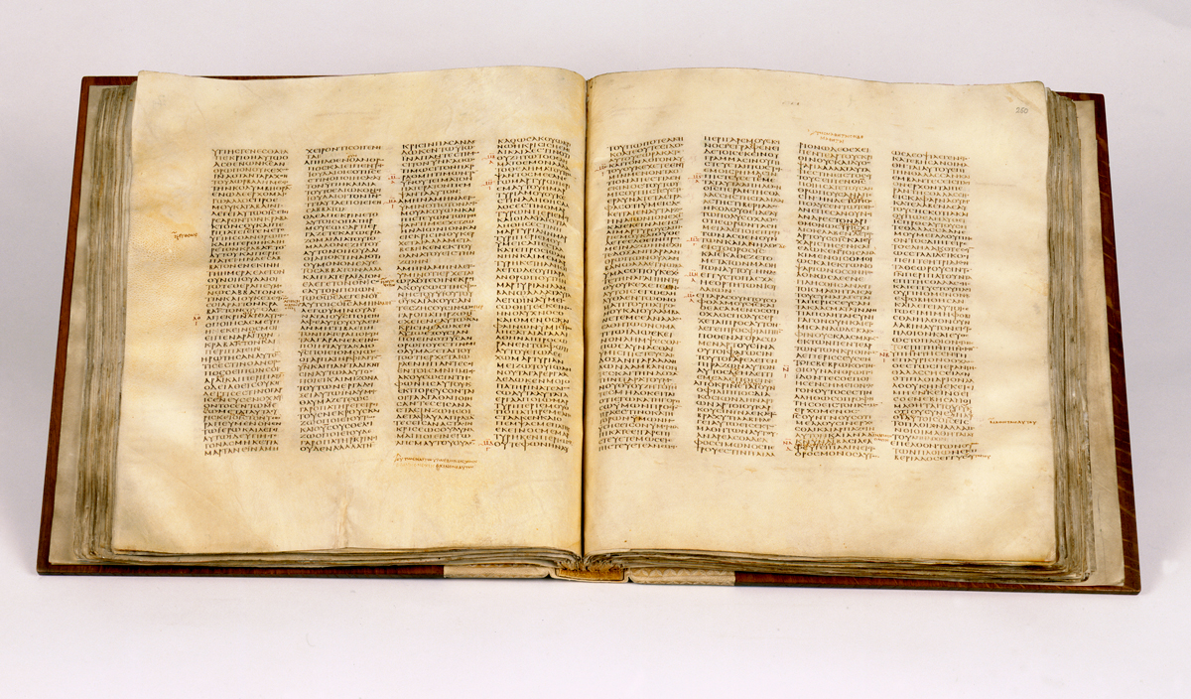
Codex

Slide 8
Manuscripts Reliably preserved?
Do we have the original text in our Bibles?
How do we know whether or not a manuscript is an accurate copy of the original?

Slide 9
Manuscripts
Important factors
How many?
Are they from many different areas geographically?
How close in age is the manuscript to the original writing?

Slide 10
Manuscripts
How many do we have?
We have over 5000 Greek manuscripts of the New Testament. (more than any other text in history)
Next closest in number: Homer’s Iliad with 650.

Slide 11
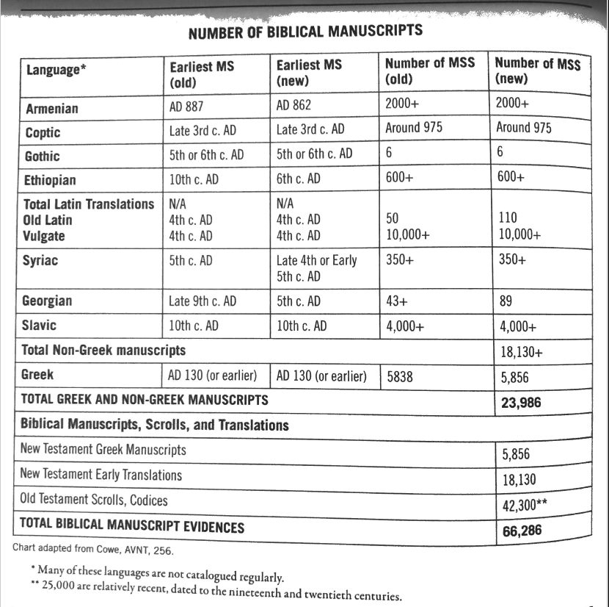

Slide 12
P52

Slide 13
Early Manuscripts
P52 – a papyrus fragment from the gospel of John – dated A.D. 100-150
So far, it is the oldest piece of the New Testament ever found.

Slide 14
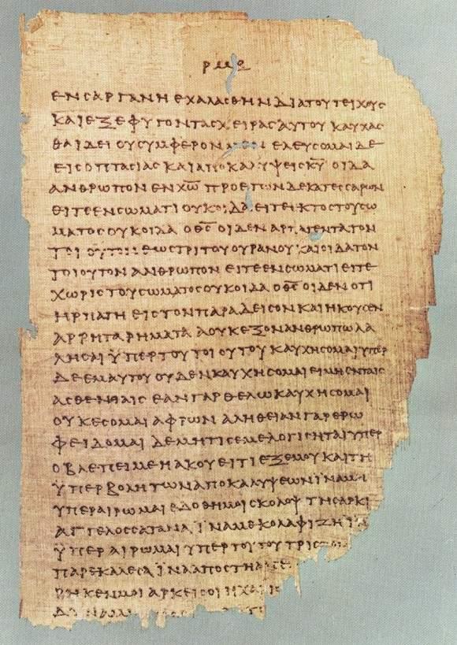
Chester Beatty Papyri
2 Corinthians 11:33-12:9

Slide 15
Early Manuscripts
Chester Beatty Biblical Papyri
#1: portions of the four gospels and Acts – 3rd century
#2: portions of 8 letters of Paul and Hebrews – AD 200
#3: large portion of Revelation – 3rd century

Slide 16
Early Manuscripts
Martin Bodmer Papyri
2/3 of the gospel of John
AD 200
Codex Sanaiticus – complete New Testament – AD 350
Codex Vaticanus – almost complete New Testament – AD 350

Slide 17
Manuscripts
What conclusion can we draw from the evidence?
But what about all of the discrepancies between manuscripts?
The scriptures have been handed down without change.

Slide 18
Manuscript Variants
Fact: There are tens of thousands variants in the New Testament manuscripts.
Sounds like a big number

Slide 19
Explanation of Manuscript Variants
Spelling
If a single word is misspelled in two thousand manuscripts, that’s counted as two thousand variants.
Switching of word order
Omission of a word
Slip of the pen
None of these variants have any bearing on the formation of doctrine.
(They’re minor variations)

Slide 20
Manuscripts
In light of this information, we can conclude:
The scriptures have been handed down without change in meaning.

Slide 21
Question
There is a popular theory that Christianity has been manufactured and that the books of our New Testament were chosen by a council in Nicaea (AD 325) arbitrarily by bishops.
Manuscript evidence shows the truth which is that the New Testament canon is a natural outworking of the early church. The books were collectively accepted as inspired writings by the first generations of Christians and passed down through the centuries.
How did we get the canon?

Slide 22
To put it simply:
God gave the books their divine authority – not people.

Slide 23
What goes in the Canon?
What is/was the criteria used for determining what is inspired by God?
1. Was the book written by a prophet of God or put together with the guidance of a phophet/apostle?
2. Was the writer confirmed by the acts of God? (i.e. miracles)
3. Did the message tell the truth? (Truth cannot contradict itself)
4. Was it generally accepted by God’s people, especially those living when the book was written? (they knew the writer)

Slide 24
New Testament Canon
Evidence of natural outworking
Letters of Polycarp (AD 115), Clement (AD 200), and others
refer to Old and New Testament books with the phrase, “as it is said in these scriptures.”
Iranaeus (AD 180) (20 books listed)
His writings attest the canonical recognition of the four gospels, Acts, Romans, 1 & 2 Corinthians, Galatians, Ephesians, Philippians, Colossians, 1 & 2 Thessalonians, 1 & 2 Timothy, Titus, 1 Peter, 1 John, and Revelation.

Slide 25
New Testament Canon
Evidence of natural outworking
Muratorian Fragment (2nd cent.)
Matthew, Mark, Luke, John, Acts, Paul’s epistles, Jude, 1 & 2 John, 2 different revelations (of John and Peter)
Some did not want Peter’s revelation to be read in the church assembly.

Slide 26
New Testament Canon
Evidence of natural outworking
Justin Martyr (AD 100-165)
“And on the day called Sunday, all who live in the cities or in the country gather together in one place, and the memoirs of the apostles or the writings of the apostles are read, as long as time permits; then, when the reader has ceased, the president verbally instructs, and exhorts the imitation of these good things.”

Slide 27
New Testament Canon
Evidence of natural outworking
Origen in Homiliae Josuam 7.1 (c. 249)
Lists Matthew, Mark, Luke, and John, two epistles of Peter, James, Jude, John’s epistles, Revelation, Acts, and the fourteen epistles of Paul (including Hebrews).

Slide 28
New Testament Canon
Evidence of natural outworking
Athanasius of Alexandria (AD 367) listed New Testaments books identically to what we currently have in the N.T.
Jerome and Augustine
shortly after Athanasius, these two men followed suit also defining the New Testament canon of 27 books.

Slide 29
New Testament Canon
Evidence of natural outworking
Synod of Hippo (AD 393)
This council listed the 27 books of the New Testament, but we can see that it did not confer on them any authority which they did not already possess. It was merely a confirmation of their previously establish canonicity.
Since that time, there has been no serious questioning of the accepted 27 books of the New Testament.

