Slide 1
Christian Evidences
Summer 2018
July 8: Inspiration of the Scriptures

Slide 2
Purposes of this study
To strengthen our own faith through the examination of evidence.
To equip ourselves with the tools needed to defend our faith.

Slide 3
Foundations of Faith
God, personal, eternal, all-powerful, created the world and sustains it.
Jesus of Nazareth lived the life written in the four gospels, died, and rose from the dead.
The Bible is the true, infallible, unchanged, inspired word of God.
3 classes
3 classes
3-4 classes

Slide 4
Belief and Trust
The Bible is the true, inspired, unchanged word of God.
Evidence
Evidence
Belief
Evidence
I am accountable for learning and living what it teaches.
Trust

Slide 5
Do we have the same Bible that was written?
How many manuscripts do we have?
How closely are they dated to the originals?
How much consistency exists between them?
How was the canon decided on?
Are there other books?

Slide 6
Is the Bible inspired? (from God)
Does it claim to be a message from God?
Is there internal evidence of its inspiration?
Unity/cohesion
Agreement with history/science
Fulfilled prophecy

Slide 7
Does the Bible claim to be God’s word?
2500 references in Scripture to God as source.
Deuteronomy 31
“Thus says the Lord…”
2 Samuel 23/Acts 4:25
Luke 24
1 Timothy 5:17
1 Thessalonians 2:13
2 Peter 3:16

Slide 8
Internal evidence of inspiration?
40 authors, writing over 1500 year time span.
In various locations, from different backgrounds.
Written in 3 languages, in a variety of styles/genres.
Unity and Cohesion
(Ps. 119:160)
Yet there is a unity of theme and doctrine.

Slide 9
Internal evidence of inspiration?
Agreement with History
”Tel-Dan Steele”, 870 BC* Reference to “House of David”

Slide 10
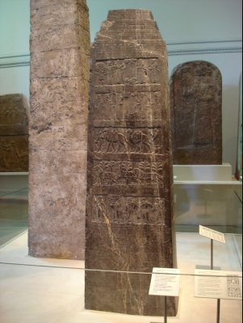
Internal evidence of inspiration?
Agreement with History
”Black Obelisk of Shalmaneser” Depicts Jehu, King of Israel bringing tribute to Damascus

Slide 11
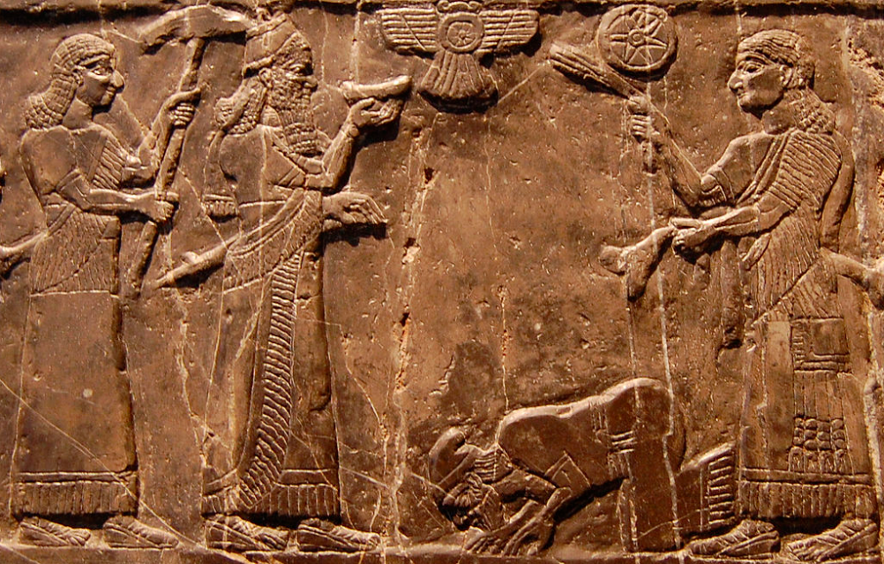
Internal evidence of inspiration?
Agreement with History
”Black Obelisk of Shalmaneser” Depicts Jehu, King of Israel bringing tribute to Damascus

Slide 12
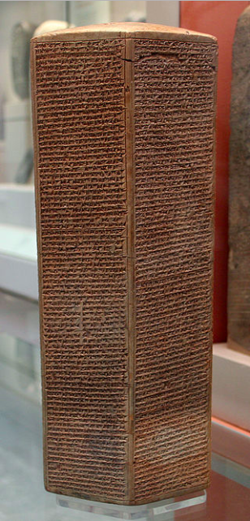
Internal evidence of inspiration?
Agreement with History
”Sennacherib’s Annals” (~700 BC) boasts of Assyrian siege of Jerusalem

Slide 13
Internal evidence of inspiration?
Some legitimate points to be made about science in the Bible.
i.e. quarantined lepers
But be careful with the “scientific foreknowledge” argument.
Isaiah 11:12 says flat earth?
Job 38:35 predicting telephones?
Agreement with Science
The Bible is not a science textbook, and we shouldn’t try to use it as one.

Slide 14
Christian Evidences
Summer 2018
Next: Fulfilled Prophecies?

Slide 15
Internal evidence of inspiration?
How does the Bible defend it’s own claim of inspiration?
Deuteronomy 18:20-21
Isaiah 41:21-23
Fulfilled Prophecies
The Bible makes clear that the ability to declare what will happen before it happens provides a stamp of divine approval.

Slide 16
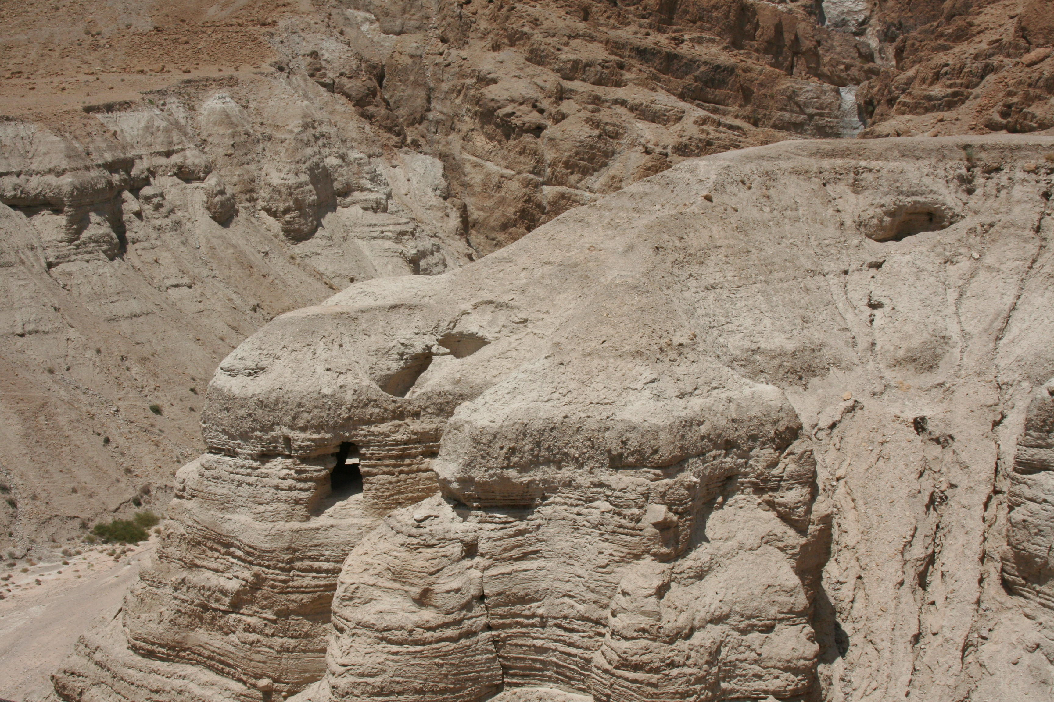

Slide 17
Internal evidence of inspiration?
Importance of the Dead Sea Scrolls found at Qumran
Discovered in 1947
Complete set of the Hebrew Bible (except the book of Esther)
Most scrolls and fragments date to Hellenistic period (300 BC)
Manuscripts 1000 years older than any previously found
Fulfilled Prophecies
We have all the OT prophecies about Christ preserved from before His birth.

