Slide 1
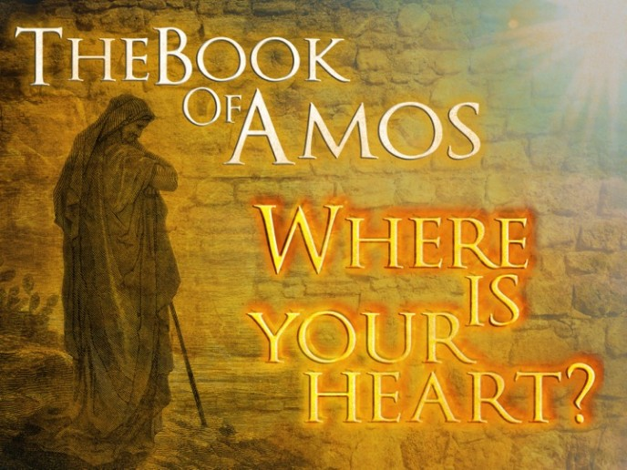
Hosea and Amos God’s Warning to His People

Slide 2
What is a prophet?
Prophet in Hebrew = navi (pl nevi’im)“One who is called” or “one who announces”
Exodus 4:16
The prophet is a link between the people and God.
Deuteronomy 18:14-22
I will put my words in their mouth
Their responsibility is to know and announce God’s will in the immediate situation in a way that the original audience can understand and respond to.
Their job is to bring people back to obedience to the Torah, and failing that, to specify the punishment for their disobedience.
Example: Exodus 7:1-2

Slide 3
Hosea 1:1
Date: 760-720 B.C.
Prophesied To: Israel (Northern Kingdom)
Purpose:
To Demonstrate God's Loving Relationship With His People
To Call Israel To Repentance
Contemporaries: Amos, Isaiah, Micah Historical Parallel: 2 Kings 13-17

Slide 4
Amos 1:1
Date: 765-755 B.C.
Prophesied To: Israel (Northern Kingdom)
Purpose:
God’s Judgement on Israel
The sin of Israel are great
Contemporaries:
After: Obadiah, Joel, and Jonah
Before: Hosea, Micah, and Isaiah

Slide 5
What Happened?
II Kings 14:23-24 & I Kings 13:33
King Amaziah did evil in the eyes of the Lord
Appointed Priest from all sorts of people
II Chronicles 27:1-2
Jotham did what was right, but the people continued in their corrupt practices

Slide 6
How do we prevent what happened to Israel?
A Foundation Built on God
Schedule regular times for communicating with God:
Ephesians 6:18
James 5:16
Schedule regular times to study:
Acts 17:11

Slide 7
How do we prevent what happened to Israel?
A Foundation Built on God
A daily offering of our lives
Your Time Eph. 5:15-16
Your Money Matthew 6:19
Your thoughts Phil. 1:4-8
Your supreme Love Matt. 22:37-38
Your whole heart Deut. 26:16
Dealing with sin in your everyday life
Put aside Sin Romans 6:6-7

Slide 8
Hosea 1:1
The word of the Lord
A Claim of Authority parallel to other prophets
Jeremiah 1:2
Jonah 1:1
Ezekiel, Joel, Micah, Zephaniah, Haggai, Zechariah, and Malachi

Slide 9
Hosea 1:2-9
Question 1: Consider the following possible listed below and be prepared to take one of the positions (or one of your own) and explain why:
The story of Hosea and Gomer is purely allegorical (symbolic)
Hosea married a women already in whoredom and with children
Hosea married a women of Israel whom God knew would eventually be unfaithful
Question 2: What were the name of Gomer’s children and what did they mean

Slide 10
Hosea's Children
Hosea & Gomer
Son: Jezreel
Daughter: Lo-Ruhamah
Son: Lo-Ammi
No Mercy
Not My People
I Will Avenge The Bloodshed Of Jezreel On The House Of Jehu
I Will No Longer Have Mercy On The House Of Israel
You Are Not My People And I Will Not Be Your God

Slide 11
Hosea 1:2-9
Question 3: Read II Kings 10:1-3, 7-11, 18, 29-31 Who is Jehu
What was the significance of Jezreel:
King Ahab’s 70 son’s heads were placed in heaps at the gate of Jezreel (2Kings 10:1-11)
Ahab’s Queen Jezebel met her death and her body was eaten by dogs (2 Kings 9:30-35)
Phony trial of Naboth (I Kings 21:1-23

Slide 12
Hosea 1:10-2:1
Question 4: Read I Peter 2:10 and Romans 9:26. Be prepared to explain the fulfillment of Hosea 1:10-2:1
Galatians 3:26-29

Slide 13
Hosea 2:2-7
Lord could not have a covenant relationship with Israel under the sinful conditions that existed
Israel had played the harlot by chasing after idolatrous lovers
God would strip her of all that He had given her
Question 6: Compare the attitude of God toward Israel in vs. 2-7 to the circumstance of Hosea?

Slide 14
Hosea 2:8-13
Question7: What was the irony of Israel serving Baal according to vs. 8-13?
Vs. 8-13 Read from the Bible
God will bring Judgement against Israel and put her to shame before her lovers
Israel had forgotten God had given her abundance
Israel gave credit to her new lovers as the source of her blessing and used her wealth on Baal worship.
Question 5: Who is speaking in this section (vs. 13)?

Slide 15
Hosea 2:14-17
God would not forget Israel though she had forgotten him
This demonstration of love and mercy beyond merit would cause her to call Him “Ishi” (my husband) rather than “Baali” (my master). Once more the right relationship would be established.
Question 8: What would Israel learn to call God?
Instead of what name?

Slide 16
Hosea 2:18-20
Refers to the Messianic age
The description of this covenant is a figure of speech (taming of wild beasts and causing war to cease) which the prophets often used to describe the peace and security which shall prevail when the animal spirit of man is brought under subjection to the Spirit of God.
Isaiah 35: 8-10
Question 9 Under the new covenant the people would be betrothed to God in?

Slide 17
Hosea 2:21-23
The name Jezreel which means God sows is interwoven through this section.
God’s people would be sown unto Him as before they had been scattered from Him.
Question 10: Vs. 21-23 refer to the Christian age when God draws His people together. Not how the promises here are exactly the opposite meaning of the names of Gomer’s children. List these promises.

Slide 18
Hosea 3
Although Gomer is an adulteress, Hosea still loved her- Just like God still loves us when we sin and wants us to return to him.
Until she proved herself faithful Hosea had no conjugal relations with her. This symbolized Israel’s captivity. After Gods Chastening she returned.
Clearing talking about the time of Christ
Acts 2:29-36

Slide 19
How do we overcome us depending on us
Don’t Depend on You Proverbs 3:5
Cry out to God Proverbs 3:6
Run from Evil 2 Timothy 2:22
Put God First in Your Life Proverbs 3:9-10
Check Yourself by God’s Word Jeremiah 17:9
Rest in God’s Love Proverbs 3:12

