Slide 1
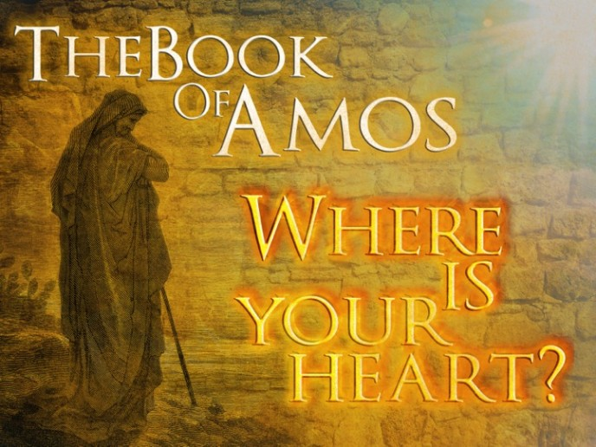
Hosea and Amos God’s Warning to His People

Slide 2
Chapter 14
Question 10: Why would Israel need to take words (vs. 2)?
Question 11: How is the restoration pictured?
Question 12: What will be the attitude of Ephraim in that day?
Question 13: Why is vs. 9 such an appropriate closing to the book?

Slide 3
Lessons Learned
God’s way is the only right way, and we walk or fall, according to the manner we obey.
2 John 9
Isaiah 55:8-9
Jeremiah 10:23

Slide 4
Review the Book of Hosea
Hosea was a living example of the lesson intended for Israel.
The tender loving God was offering one last chance for restoration to Israel which had committed spiritual adultery
The righteousness of God is portrayed in Hosea. Although doom of wicked nation of Israel is announced, Hosea often speaks of the loving-kindness of the Lord.
God loved His people, but Israel had sown to the wind and deserved to reap the whirlwind.

Slide 5
Amos- Means Burden-Bearer
Date: 765-755 B.C.
Prophesied To: Israel (Northern Kingdom)
Purpose:
God’s Judgement on Israel
The sin of Israel are great
Contemporaries:
After: Obadiah, Joel, and Jonah
Before: Hosea, Micah, and Isaiah

Slide 6
Amos
The message is primarily to Israel, but the opening words include a condemnation of the neighboring heathen nations.
The central theme of the book is woe to the Israelite nation and the neighboring heathen nations.

Slide 7
Amos 1:1-2:3
Question 1: Review lesson one and be prepared to discuss:
Israel was at the zenith of power economically and politically. Business was booming, and the material prosperity of the age led to a spirit of self-sufficiency and smug complacency.
2 Kings 14:25
2 Chronicles 26: 9-10

Slide 8
Amos 1:1-2:3
The background of Amos:
Native of Tekoa, a small village which is twelve miles south of Jerusalem and six miles south of Bethlehem
Almost was a herdsman of sheep and a grower of sycamore figs.

Slide 9
Questions 2-8
Question 2: Before condemning Israel, Amos addresses six foreign people. What were the nations and how did each condemnation begin?
Damascus (the capital of Syria, Question 3- located about 135 miles northeast of Jerusalem) - 1:1-5 For three sins of Damascus even four, I will not turn back my wrath. Because she threshed Gilead with sledges having iron teeth.
I will send fire on the house of Hazael

Slide 10
Questions 2-8
Questions 4: Read II Kings 8:7-15; 13:3, 22-25 to learn of Hazael and Ben-Hadad. List some details.
Ben-Hadad was king before Hazael and he was sick. Elisha prophesied he would recover, but Hazael would become king. Hazael killed Ben-Hadad
2 Kings 8:12
2 Kings 13:3
2 Kings 13:22
I will break down the gate of Damascus

Slide 11
Questions 2-8
Gaza (a chief city of Philistia) - 1:6-8 For three sins of Gaza, even for four, I will not turn back my wrath.
Question 5: Locate Gaza on a map. What was the specific sin noted of Gaza?
Because she took captive whole communities and sold them to Edom.
I will send fire upon the walls of Gaza
I will destroy the king of Ashdod
I will turn my hand against Ekron

Slide 12
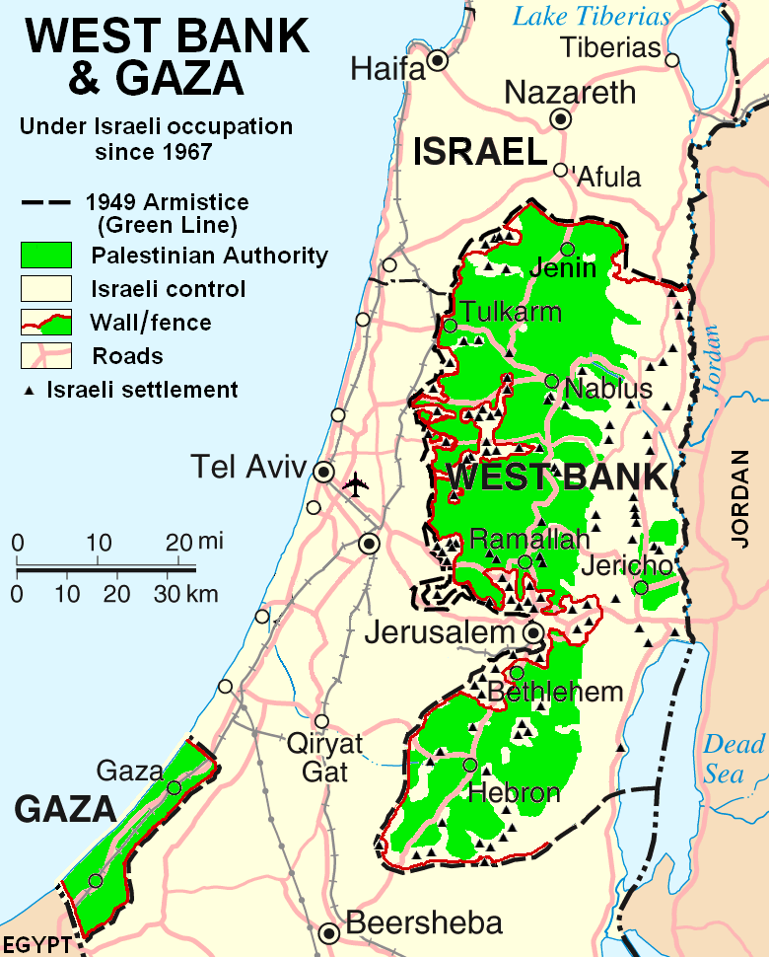
Questions 2-8

Slide 13
Questions 2-8
Tyre (the capital of Phoenicia) – 1:9-10
Question 6 Tyre is the next nation condemned. Read Ezekiel 26:1-14 for a more complete prophecy of its destruction. Summarize Tyre’s destruction.
I will send fire upon the wall of Tyre (Hosea 1:9-10)
Ezekiel 26:1-14
Vs. 4-5; Vs. 7; Vs. 11-12

Slide 14
Questions 2-8
Fate of three related people 1:11-2:3
Question 7 What was the origin of the?
Question 8 What was the specific sin mentioned of each of these people?
Edom- 1:11-12 (Descendants of Esau) for three sins of Edom, even for four, I will not turn back my wrath. Because he pursued his brother with a sword.
I will send fire upon the wall of Teman
Ammon- 1:13-15 (Related to the Israelites through Lot) for three sins of Ammon even for four, I will not turn back my wrath. Because he ripped open the pregnant women of Gilead.
Genesis 19: 36-38

Slide 15
Questions 2-8
Moab- 2:1-3 (Related to the Israelites through Lot) For three sins of Moab, even for four, I will not turn back my wrath, Because he burned as if to lime, the bones of Edom’s king
I will send fire upon Moab
Moab will go down in great tumult
I will destroy her rulers

Slide 16
Questions 2-8
Question 9: Only two verses are devoted to Judah whereas several are devoted to discuss Israel, perhaps an indication of the emphasis of the book. How was the sin of Judah different from the sins of the previous six people?
Question 10: List the sins of Israel?
Question 11: List the blessings God has given Israel?
Vs. 11 Is this not true, people of Israel? Declares the Lord

Slide 17
Lessons Learned
Question 12: What would be unable to save Israel (vs. 14-16)?
Amos 2:4 this is what the Lord says: “For three sins of Judah, even for four, I will not turn back my wrath. Because they have rejected the law of the Lord and have not kept his decrees.
Luke 6:47-49
Proverbs 14:12 There is a way that seems right to a man, but in the end it leads to death.

Slide 18
Hosea and Amos God’s Warning to His People Lesson 9

Slide 19
Review the Book of Hosea
Hosea was a living example of the lesson intended for Israel.
The tender loving God was offering one last chance for restoration to Israel which had committed spiritual adultery
The righteousness of God is portrayed in Hosea. Although doom of wicked nation of Israel is announced, Hosea often speaks of the loving-kindness of the Lord.
God loved His people, but Israel had sown to the wind and deserved to reap the whirlwind.

Slide 20
Amos- Means Burden-Bearer
Date: 765-755 B.C.
Prophesied To: Israel (Northern Kingdom)
Purpose:
God’s Judgement on Israel
The sin of Israel are great
Contemporaries:
After: Obadiah, Joel, and Jonah
Before: Hosea, Micah, and Isaiah

Slide 21
Review: Amos 1-2
Judgement is coming against both heathen and covenant Nations
Damascus
Gaza
Tyre
Edom
Ammon
Moab
Judah
Israel

Slide 22
Amos Begins
Amos began his prophesying by listing heathen people that God intended to punish. Now that his attention is focused on Israel, he begins to explain the purpose of a prophet; it is to warn the people. Amos explains that God had tried many methods to awaken Israel, but all had failed. He concludes this section by encouraging Israel to prepare to meet its God.

Slide 23
Amos 3:1-8
Note that Amos establishes early he is speaking the word of God, not his own.
Question 2: Describe the special relationship Israel had with God?
Question 3: Read vs. 3-6 carefully. These are points of common sense, but what is the lesson that Amos is teaching?
Point out at least two lessons using vs. 7-8

Slide 24
Amos: 3:9-15
Question 4: Ashdod was a city of the Philistines. Why might God call upon Ashdod and Egypt to look upon Samaria?
Question 5: What would the adversary of vs. 11 do?
Question 6: In what manner would Israel be rescued?

Slide 25
Amos 4:1-5
Question 7: What is a kine (KJV)?
Where was Bashan?
What would be the fate of the kine of Bashan
Question 8: What is the irony of sins being multiplied at Bethel and Gilgal?
Question 9: Read Col. 2:20-23. Consider how this passage applies the Israelites described in vs. 5.

Slide 26
Amos 4:6-12
Question 10: What does it mean to give clean teeth?
Question 11: How had God used rain to punish Israel?
Question 12: What was done to the crops of Israel?
To the horses and young men?
To the cities?
Question 13: How does Amos describe the God Israel is to prepare to meet?

Slide 27
Lessons Learned
Prosperity often leads to a false sense of security:
I Timothy 6:17-19
Luke 12:15-21 Read from the Bible
Isaiah 56:11

Slide 28
Hosea and Amos God’s Warning to His People Lesson 9

Slide 29
Review the Book of Hosea
Hosea was a living example of the lesson intended for Israel.
The tender loving God was offering one last chance for restoration to Israel which had committed spiritual adultery
The righteousness of God is portrayed in Hosea. Although doom of wicked nation of Israel is announced, Hosea often speaks of the loving-kindness of the Lord.
God loved His people, but Israel had sown to the wind and deserved to reap the whirlwind.

Slide 30
Amos- Means Burden-Bearer
Date: 765-755 B.C.
Prophesied To: Israel (Northern Kingdom)
Purpose:
God’s Judgement on Israel
The sin of Israel are great
Contemporaries:
After: Obadiah, Joel, and Jonah
Before: Hosea, Micah, and Isaiah

Slide 31
Review: Amos 1-2
Judgement is coming against both heathen and covenant Nations
Damascus
Gaza
Tyre
Edom
Ammon
Moab
Judah
Israel

Slide 32
Review: Amos 3-4
Chapter 3
Their main concern was a selfish desire to be pampered.
Luxury may characterize them now, but the day is coming when they will be torn away as helpless fish taken by hooks.
Chapter 4
Since the people liked the idolatrous form of worship offered in Bethel and Gilgal, they must have thought God was pleased too.
God gave them several signs they were not going in the right direction- Famine, Drought, Blasting, Mildew, Locusts, Pestilence, and overthrown cities.

Slide 33
Introduction: Amos 5-6
Amos begins to issue a lamentation for Israel. A lamentation is an expression of grief in a time of death; the death of Israel was near. He pleads with them to accept their only hope, to seek God and live. Two groups are specifically rebuked; those that desire the day of Jehovah (5:18) and those that are at ease in Zion (6:1).

Slide 34
Amos 5:1-13
Question1: In your words, what does it mean to seek God and live?
Question 2: What are Pleiades and Orion?
Be prepared to explain each phrase in vs. 8-9
Question 3: Why would a prudent man keep silent?
Was Amos prudent?

Slide 35
Amos 5:14-20
Question 4: According to vs. 14-15, what are the negative and positive aspects of serving God?
Question 5: How does vs. 9 explain the mistake of the man who desires the day of Jehovah?

Slide 36
Amos 5:21-27
Question 6: Since God had asked for burnt offering, meal offering, etc., why was he so upset with them?
Question 7: How does God feel toward the music of Israel?
Quesiton8: Verse 24 is one of the most eloquent in all of the Bible. Be prepared to discuss.

Slide 37
Amos 6:1-7
Question 9: What is the point in vs. 2 of discussing the borders of other peoples?
Question 10: List the characteristics of those at ease in Zion.

Slide 38
Amos 6:8-14
The Sovereign Lord has sworn by himself-
There is no greater name in which the Lord can take an oath. By this oath God declares that the verdict is final
Genesis 22:16 and said, “I swear by myself, declares the Lord, that because you have done this and have not withheld your son, your only son.
Hebrews 6:13 When God made his promise to Abraham since there was no one greater for him to swear by, he swore by himself
Question 11: How serve would be the destruction of Israel (vs. 9-10)?
Question 12: What is the meaning of vs. 12?

Slide 39
Lessons Learned
When one rejects the love of the truth the time may come when he will seek it but cannot find truth:
2 Thessalonians 2:10-12- and in every sort of evil that deceives those who are perishing. They perish because they refused to love the truth and so be saved. For this reason God sends them a powerful delusion so that they will believe the lie and so that all will be condemned who have not believed the truth but have delighted in wickedness.
Acts 13:45-46

