Slide 1
Lesson 3 – 1st Timothy Chapter 1
Goals:
Understand Paul’s reason for writing to Timothy
Understand Paul’s relationship with Timothy
Objectives:
List the reason Paul needed Timothy to stay in Ephesus.
List the purpose of Paul’s charge to Timothy
And the 3 components of that purpose.

Slide 2
Textual Study of 1 Timothy Chapter 1
[1Ti 1:1-7 NKJV] 1 Paul, an apostle of Jesus Christ, by the commandment of God our Savior and the Lord Jesus Christ, our hope, 2 To Timothy, a true son in the faith: Grace, mercy, [and] peace from God our Father and Jesus Christ our Lord. 3 As I urged you when I went into Macedonia--remain in Ephesus that you may charge some that they teach no other doctrine, 4 nor give heed to fables and endless genealogies, which cause disputes rather than godly edification which is in faith. 5 Now the purpose of the commandment is love from a pure heart, [from] a good conscience, and [from] sincere faith, 6 from which some, having strayed, have turned aside to idle talk, 7 desiring to be teachers of the law, understanding neither what they say nor the things which they affirm.

Slide 3
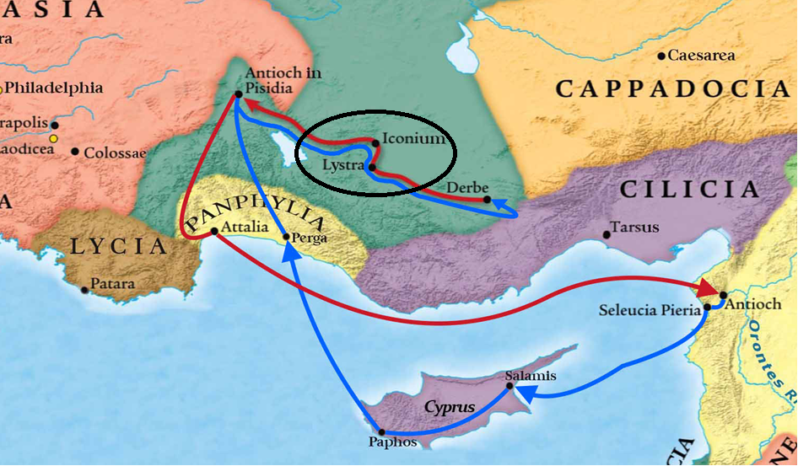
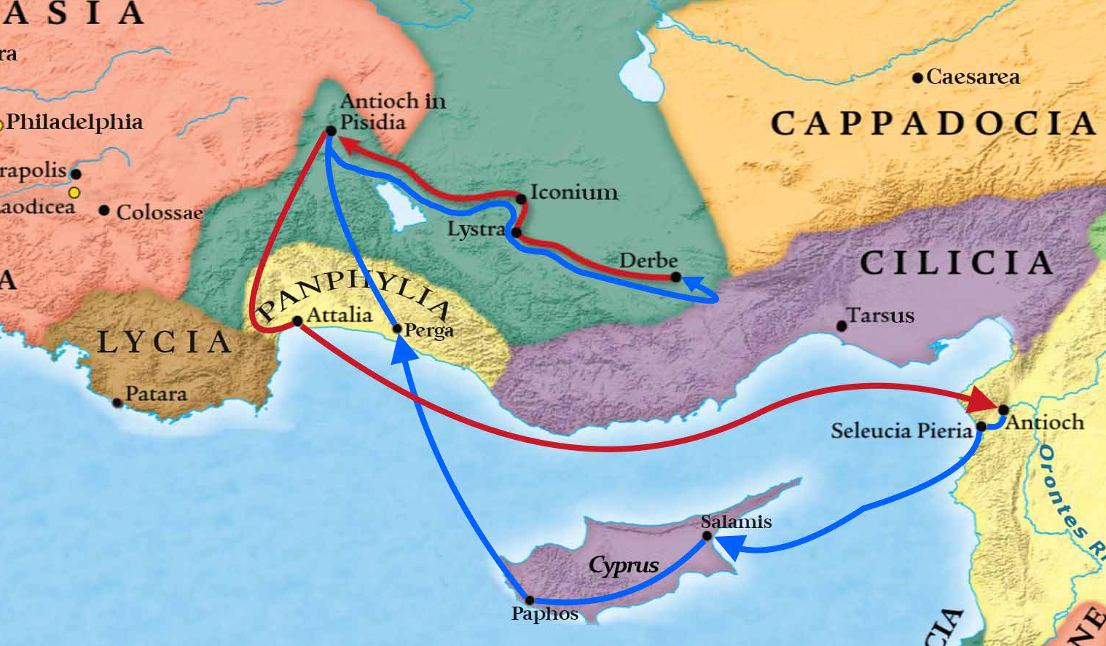

Slide 4
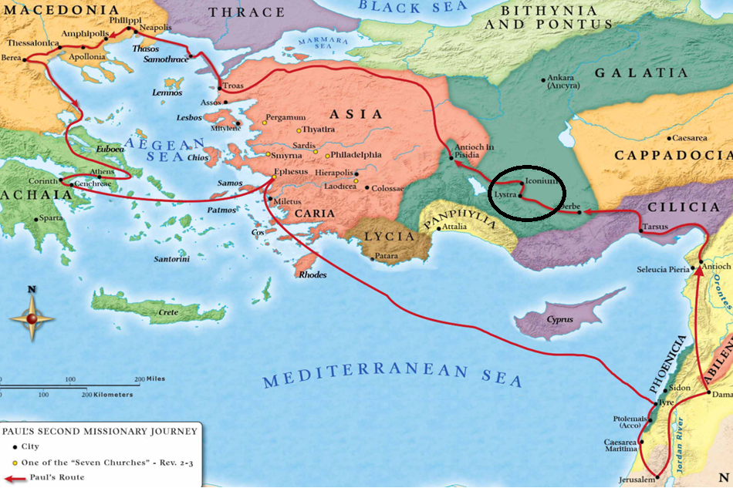
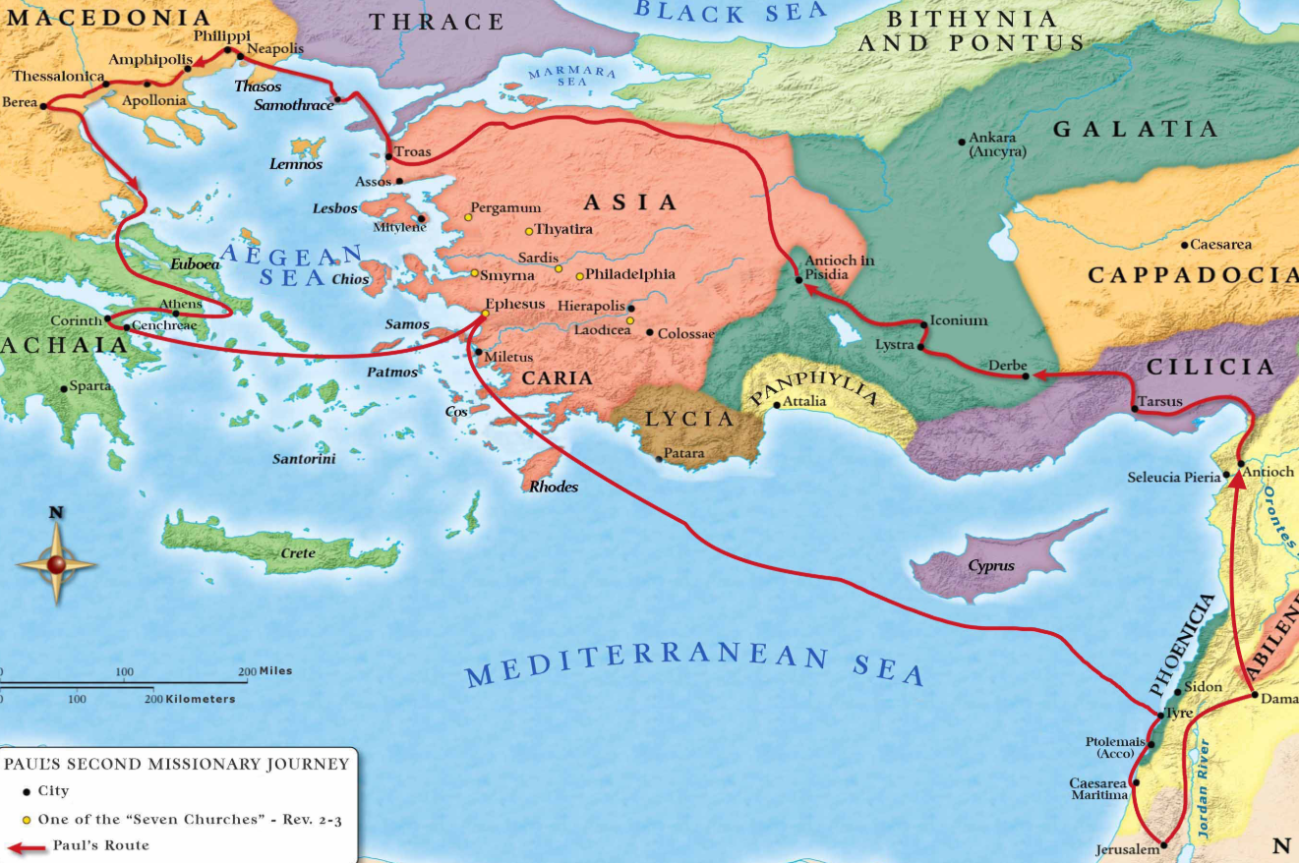

Slide 5
[Act 16:1-3 NKJV] 1 Then he came to Derbe and Lystra. And behold, a certain disciple was there, named Timothy, [the] son of a certain Jewish woman who believed, but his father [was] Greek. 2 He was well spoken of by the brethren who were at Lystra and Iconium. 3 Paul wanted to have him go on with him. And he took [him] and circumcised him because of the Jews who were in that region, for they all knew that his father was Greek.

Slide 6
[2Ti 1:5 NKJV] 5 when I call to remembrance the genuine faith that is in you, which dwelt first in your grandmother Lois and your mother Eunice, and I am persuaded is in you also.
[2Ti 3:14-15 NKJV] 14 But you must continue in the things which you have learned and been assured of, knowing from whom you have learned [them], 15 and that from childhood you have known the Holy Scriptures, which are able to make you wise for salvation through faith which is in Christ Jesus.

Slide 7
Textual Study of 1 Timothy Chapter 1
[1Ti 1:1-7 NKJV] 1 Paul, an apostle of Jesus Christ, by the commandment of God our Savior and the Lord Jesus Christ, our hope, 2 To Timothy, a true son in the faith: Grace, mercy, [and] peace from God our Father and Jesus Christ our Lord. 3 As I urged you when I went into Macedonia--remain in Ephesus that you may charge some that they teach no other doctrine, 4 nor give heed to fables and endless genealogies, which cause disputes rather than godly edification which is in faith. 5 Now the purpose of the commandment is love from a pure heart, [from] a good conscience, and [from] sincere faith, 6 from which some, having strayed, have turned aside to idle talk, 7 desiring to be teachers of the law, understanding neither what they say nor the things which they affirm.

Slide 8
Lesson to us all about the importance of influence in our lives.
Parents/Grandparents
Older Men/Women of the congregation
Younger Men/Women of the church
[2Ti 3:10-11 NKJV] 10 But you have carefully followed my doctrine, manner of life, purpose, faith, longsuffering, love, perseverance, 11 persecutions, afflictions, which happened to me at Antioch, at Iconium, at Lystra--what persecutions I endured. And out of [them] all the Lord delivered me.

Slide 9
Textual Study of 1 Timothy Chapter 1
[1Ti 1:1-7 NKJV] 1 Paul, an apostle of Jesus Christ, by the commandment of God our Savior and the Lord Jesus Christ, our hope, 2 To Timothy, a true son in the faith: Grace, mercy, [and] peace from God our Father and Jesus Christ our Lord. 3 As I urged you when I went into Macedonia--remain in Ephesus that you may charge some that they teach no other doctrine, 4 nor give heed to fables and endless genealogies, which cause disputes rather than godly edification which is in faith. 5 Now the purpose of the commandment is love from a pure heart, [from] a good conscience, and [from] sincere faith, 6 from which some, having strayed, have turned aside to idle talk, 7 desiring to be teachers of the law, understanding neither what they say nor the things which they affirm.

Slide 10
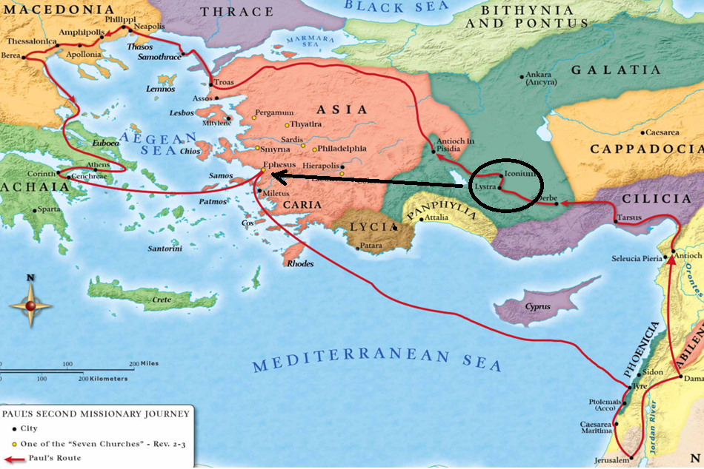

Slide 11
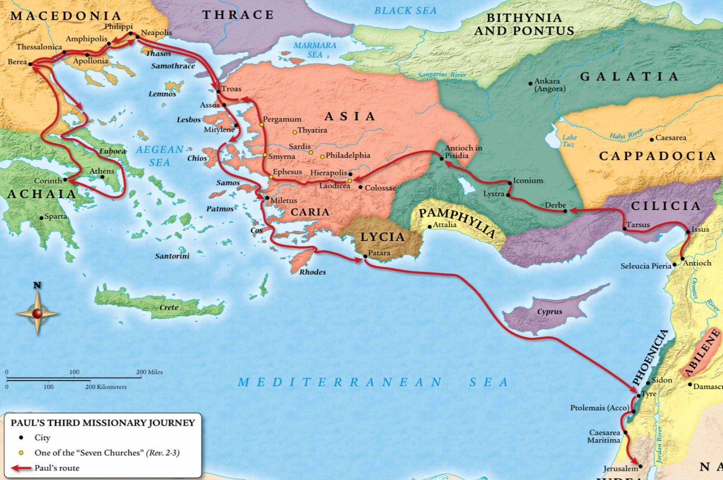
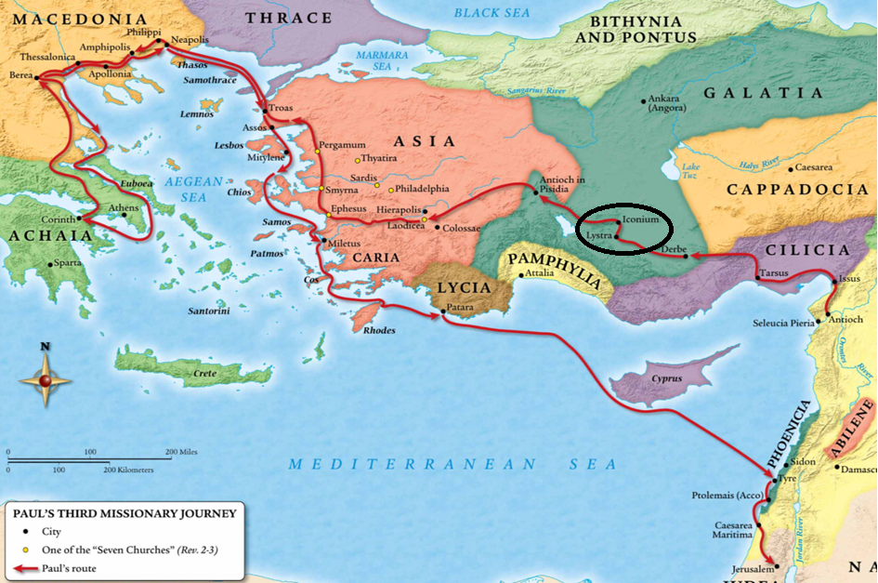
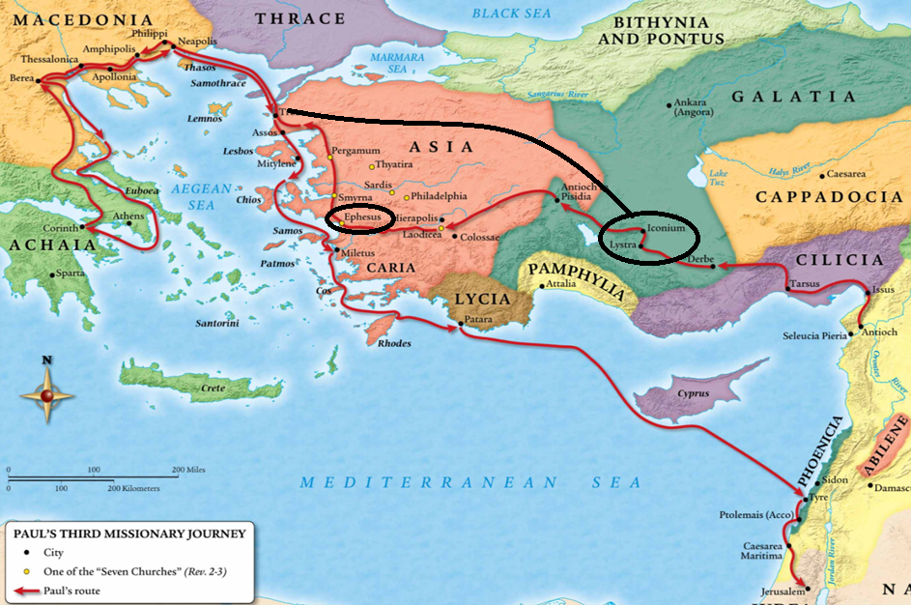

Slide 12
Textual Study of 1 Timothy Chapter 1
[1Ti 1:1-7 NKJV] 1 Paul, an apostle of Jesus Christ, by the commandment of God our Savior and the Lord Jesus Christ, our hope, 2 To Timothy, a true son in the faith: Grace, mercy, [and] peace from God our Father and Jesus Christ our Lord. 3 As I urged you when I went into Macedonia--remain in Ephesus that you may charge some that they teach no other doctrine, 4 nor give heed to fables and endless genealogies, which cause disputes rather than godly edification which is in faith. 5 Now the purpose of the commandment is love from a pure heart, [from] a good conscience, and [from] sincere faith, 6 from which some, having strayed, have turned aside to idle talk, 7 desiring to be teachers of the law, understanding neither what they say nor the things which they affirm.

Slide 13
[Heb 10:22-23 NKJV] 22 let us draw near with a true heart in full assurance of faith, having our hearts sprinkled from an evil conscience and our bodies washed with pure water. 23 Let us hold fast the confession of [our] hope without wavering, for He who promised [is] faithful.

Slide 14
Textual Study of 1 Timothy Chapter 1
[1Ti 1:1-7 NKJV] 1 Paul, an apostle of Jesus Christ, by the commandment of God our Savior and the Lord Jesus Christ, our hope, 2 To Timothy, a true son in the faith: Grace, mercy, [and] peace from God our Father and Jesus Christ our Lord. 3 As I urged you when I went into Macedonia--remain in Ephesus that you may charge some that they teach no other doctrine, 4 nor give heed to fables and endless genealogies, which cause disputes rather than godly edification which is in faith. 5 Now the purpose of the commandment is love from a pure heart, [from] a good conscience, and [from] sincere faith, 6 from which some, having strayed, have turned aside to idle talk, 7 desiring to be teachers of the law, understanding neither what they say nor the things which they affirm.

Slide 15
8 But we know that the law [is] good if one uses it lawfully, 9 knowing this: that the law is not made for a righteous person, but for [the] lawless and insubordinate, for [the] ungodly and for sinners, for [the] unholy and profane, for murderers of fathers and murderers of mothers, for manslayers, 10 for fornicators, for sodomites, for kidnappers, for liars, for perjurers, and if there is any other thing that is contrary to sound doctrine, 11 according to the glorious gospel of the blessed God which was committed to my trust.

Slide 16
12 And I thank Christ Jesus our Lord who has enabled me, because He counted me faithful, putting [me] into the ministry, 13 although I was formerly a blasphemer, a persecutor, and an insolent man; but I obtained mercy because I did [it] ignorantly in unbelief. 14 And the grace of our Lord was exceedingly abundant, with faith and love which are in Christ Jesus. 15 This [is] a faithful saying and worthy of all acceptance, that Christ Jesus came into the world to save sinners, of whom I am chief. 16 However, for this reason I obtained mercy, that in me first Jesus Christ might show all longsuffering, as a pattern to those who are going to believe on Him for everlasting life. 17 Now to the King eternal, immortal, invisible, to God who alone is wise, [be] honor and glory forever and ever. Amen.

Slide 17
18 This charge I commit to you, son Timothy, according to the prophecies previously made concerning you, that by them you may wage the good warfare, 19 having faith and a good conscience, which some having rejected, concerning the faith have suffered shipwreck, 20 of whom are Hymenaeus and Alexander, whom I delivered to Satan that they may learn not to blaspheme.

